Slide 1


Federal Bureau of Investigation
Biohazard Division
www.fbi.gov
INTERNAL DEPARTMENT USE ONLY – NOT TO BE DISTRIBUTED
From: Agent Robert Hode
To: Assistant Director Skinner
Subject: Updated briefing for Case Number #BD1347
Upon receipt of new information a secondary review of this case was ordered. Our findings are outlined below.
Summary:
For roughly 100 years scientists have claimed that the medieval Black Death was a case of Bubonic Plague. This was “proven” by comparing the medieval accounts to modern outbreaks of the Plague. Since Bubonic Plague is caused by fleas on rats it has been assumed that the Black Death was caused by the same factor. You will find this stated as fact in most modern sources.
However, recent evidence has led some to question that theory. The truth is we simply cannot state with 100% certainty what caused the Black Death.
The Theories:
It is still very possible that the Black Death was Bubonic Plague spread by rats. However, if that is not the case we do have some other options to investigate. The doctors of the Medieval period believed the disease was caused by a “miasma” which is, in modern language, bad air. They didn’t understand the concept of germs at the time but this may give us a clue. The most common explanation of the time, however, was that the disease was a punishment from God. Though this may sound ridiculous we have certainly seen stranger things and the evidence is there to support the theory.
Threat Level: Very High
Determining the cause of this disease is very important. If the Black Death was not Bubonic Plague we need to find out. We need to be ready to act if this disease returns. There are many reasons why this may not be Black Death so take this investigation very seriously. We do not want to cause a panic in the people so this investigation should remain classified.

Slide 2
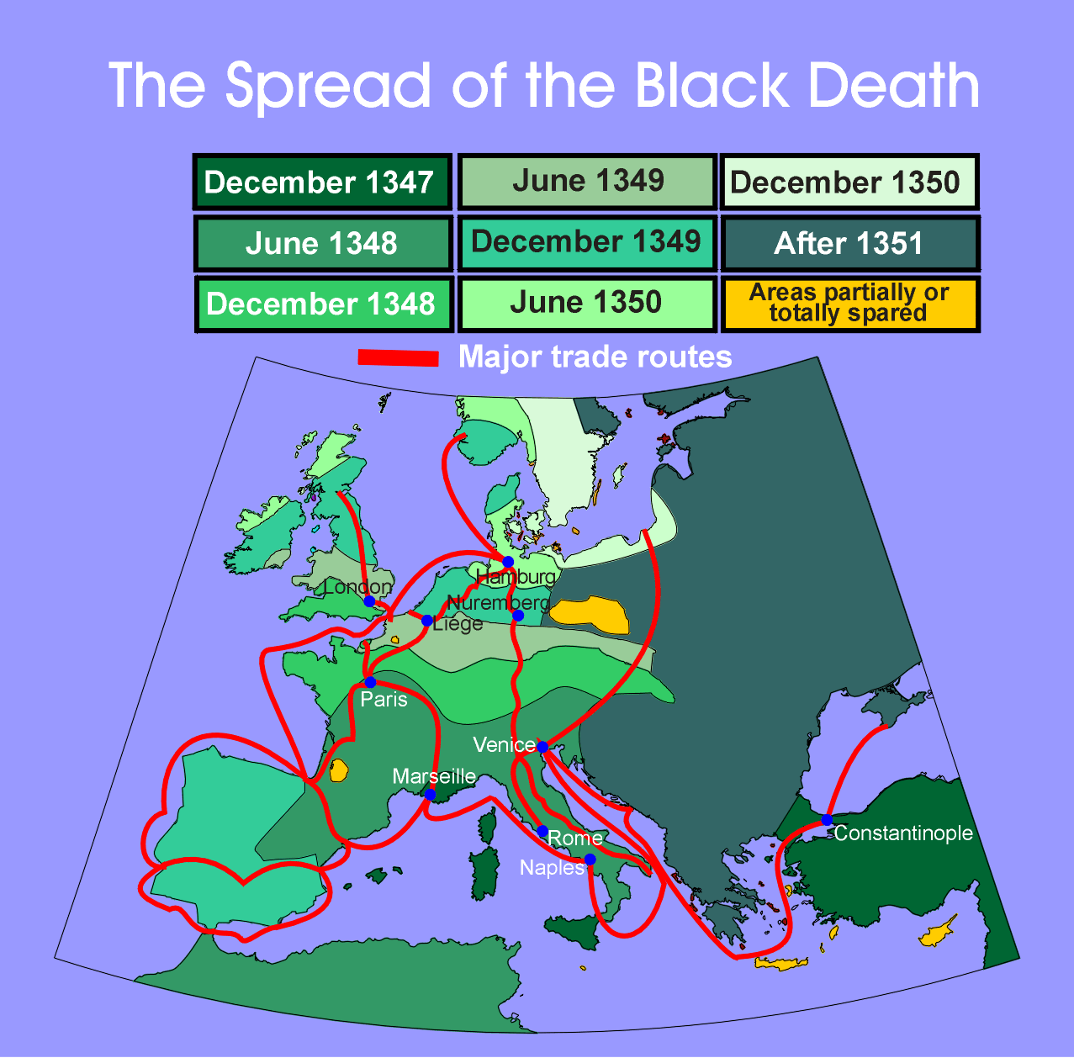
Genoa
Messina
The Black Death was first reported in Messina, Italy, on the island of Sicily, in October, 1347, and then moved through Europe. Below are the likely dates of the arrival of the Black Death in a variety of cities:
Genoa, Italy - January, 1348
Venice, Italy - February, 1348
Marseilles, France - February, 1348
Paris, France - June, 1348
Liege, Belgium - June, 1349
London, England - July, 1349
Hamburg, Germany - June 1350

Slide 3
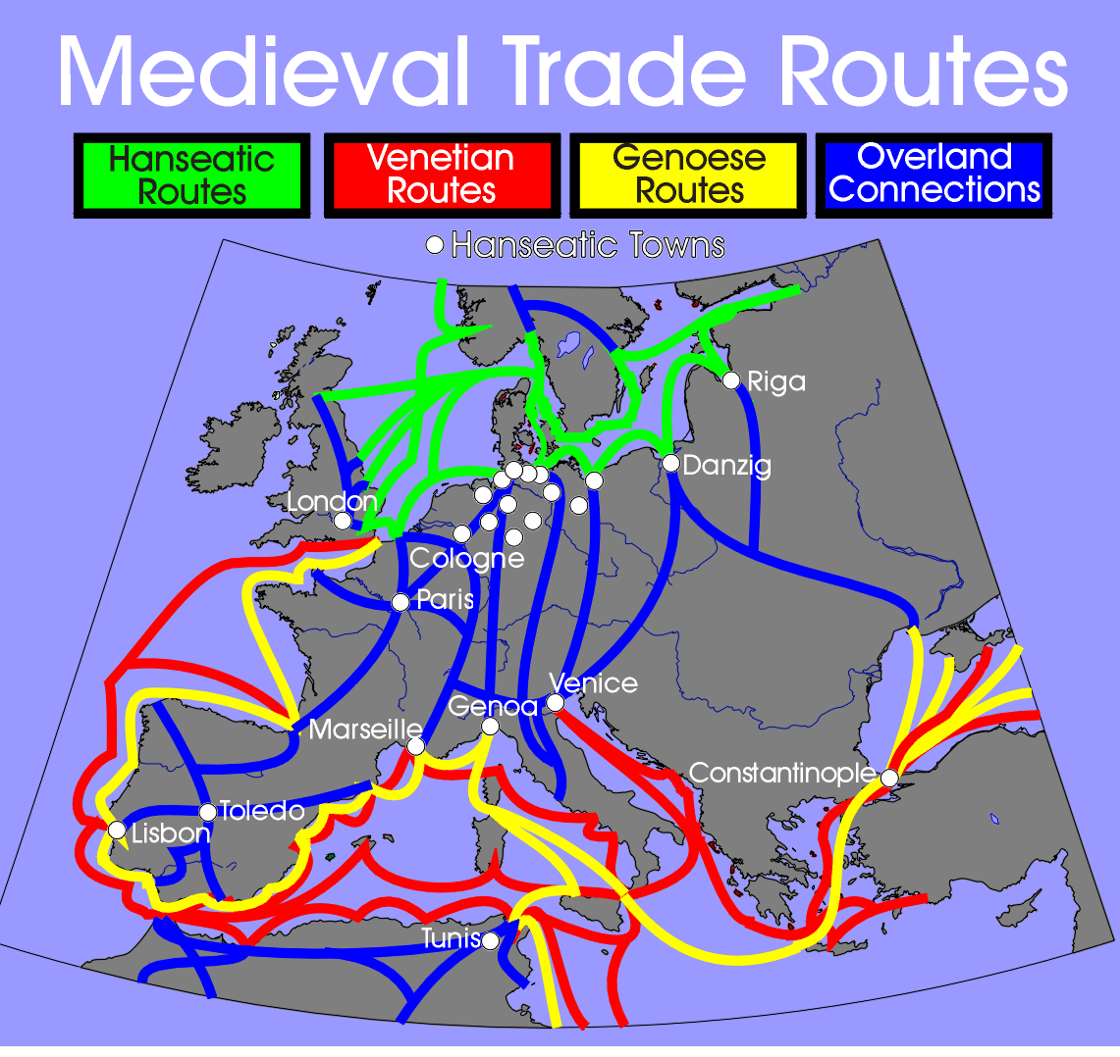

Slide 4
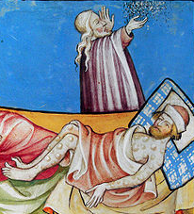
Description of the Medieval Black Death
Those infected felt themselves penetrated by a pain throughout their whole bodies and, so to say, undermined. Then there developed on the thighs or upper arms a boil about the size of a lentil which the people called "burn boil". This infected the whole body, and penetrated it so that the patient violently vomited blood.
Then there developed gland boils on the groin, the thighs, the arms, or on the neck. At first these were of the size of a hazel nut, and developed accompanied by violent shivering fits, which soon rendered those attacked so weak that they could not stand up, but were forced to lie in their beds consumed by violent fever. Soon the boils grew to the size of a walnut, then to that of a hen's egg or a goose's egg, and they were exceedingly painful, and irritated the body, causing the sufferer to vomit blood. The sickness lasted three days, and on the fourth, at the latest, the patient succumbed.
Michael Platiensis (1357)

Slide 5
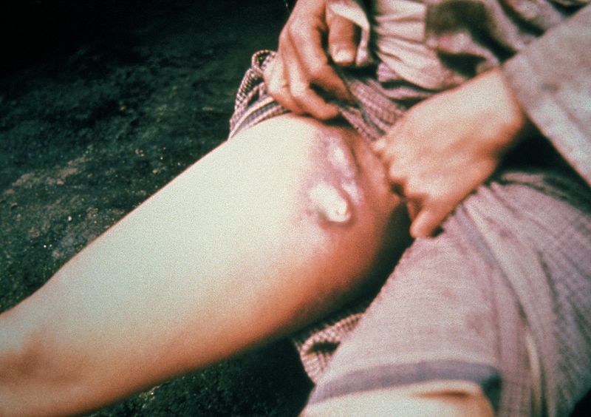
Description of Modern Bubonic Plague
Bubonic plague symptoms appear suddenly, usually 2–5 days after exposure to the bacteria. Symptoms include:
Chills
General ill feeling
High fever
Muscle Cramps
Seizures
Smooth, painful lymph gland swelling called a bubo, commonly found in the groin, but may occur in the armpits or neck, most often at the site of the initial infection (bite or scratch)
Pain may occur in the area before the swelling appears
Skin color changes to a pink hue in some extreme cases
Bleeding out of the ear will begin after 12 hours of infection
Other symptoms may include heavy breathing, continuous blood vomiting, aching limbs, coughing, and extreme pain. The pain is usually caused by the decaying or decomposing of the skin while the person is still alive. Additional symptoms include extreme fatigue, lenticulae (black dots scattered throughout the body), delirium and coma.

Slide 6
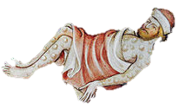
Office of the Medical Examiner
14 Abbey Road
London, England
REPORT OF INVESTIGATION BY THE MEDICAL EXAMINER
NAME: John Shoemaker SEX: male AGE: 23
x
sudden
CAUSE OF DEATH:
(mark one only)
violent
disease
suspicious, unusual or unnatural
Investigating Agency: FBI (Biohazard Division)
Figure 1 shows a sketch of the deceased shortly after death. He first developed red boils on the thighs or upper arms a about the size of a bean. Eventually this infected the whole body, and penetrated it so that the patient violently vomited blood. This vomiting of blood continued without intermission for three days.
He also developed larger gland boils on the thighs, the arms, and on the neck. At first these were of the size of a hazel nut, and developed accompanied by violent shivering fits. Soon the boils grew to the size of a walnut, then to that of a hen's egg . The sickness lasted three days, and on the fourth, at the latest, he succumbed and died.
It is unknown what disease caused this.
Figure 1
PROBABLE CAUSE OF DEATH MANNER OF DEATH
x
suicide
Multiple organ failure as a result of disease
natural
homicide
x
unknown
accident
I hereby declare that after receiving notice of the death described above I took possession of the body and made inquiries regarding the cause of death in accordance with Section 28-654038.
Date: ______________ Signature: ___________________
Notes:
Option: Use this autopsy with 2 short descriptions of Bubonic and Ebola for students to compare.

Slide 7
Description of Ebola Virus
Illness is characterized by the rapid onset of fever, malaise, muscle pain, headache, and the inflammation of the pharynx. Six days following vomiting and bloody diarrhea, individuals may develop maculopapular rash with bleeding at needle sites and bodily orifices
A maculopapular rash is a type of rash characterized by a flat, red area on the skin that is covered with small confluent bumps. The term "maculopapular" is a compound: macules are small, flat discolored spots on the surface of the skin; and papules are small, raised bumps. It is also described as erythematous, or red.

Slide 8
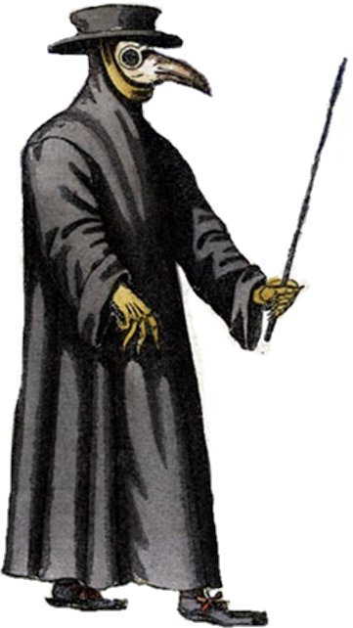
The hat was likely just a way to identify a person as a doctor.
As may be seen
on picture here,
in Rome the doctors
do appear. When to
their patients they
are called, in places
by the plague appalled.
The staff was used to keep infected people at a distance.
Their hats and cloaks
of fashion new, are
made of oilcloth, dark
of hue. Their caps with
glasses are designed,
their bills with antidotes
all lined, that foulsome
air may do no harm, nor
cause the doctor man
alarm. The staff in hand
must serve to show their
noble trade wherever they go.
As may be seen on picture here,
  In Rome the doctors do appear,
  When to their patients they are called,
  In places by the plague appalled,
  Their hats and cloaks, of fashion new,
  Are made of oilcloth, dark of hue,
  Their caps with glasses are designed,
  Their bills with antidotes all lined,
  That foulsome air may do no harm,
  Nor cause the doctor man alarm,
  The staff in hand must serve to show
  Their noble trade where'er they go.
  -Renaissance Poem
The doctors wore thick coverings over their hands and bodies. Their cloaks were coated with wax on the inside to help seal out the disease. It seems to have helped. Few doctors appear to have gotten sick.

Slide 9

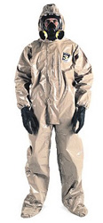

“Plague Doctors” stuffed their masks with herbs and flowers to keep out the bad smells that many doctors believed was causing the disease. The glass eye coverings helped to seal out the smell. It is interesting that though doctors of the time didn’t really know about germs these techniques are not very different from modern biological safety techniques.
Another indication of bad smells being thought to cause the disease is the children’s rhyme shown here. Many believe this rhyme references the Black Death and recommends carrying around posies (flowers) to keep out bad smells.
A ring, a ring of roses,
A pocket full of posies-
Ashes, Ashes we all fall down.

Slide 10

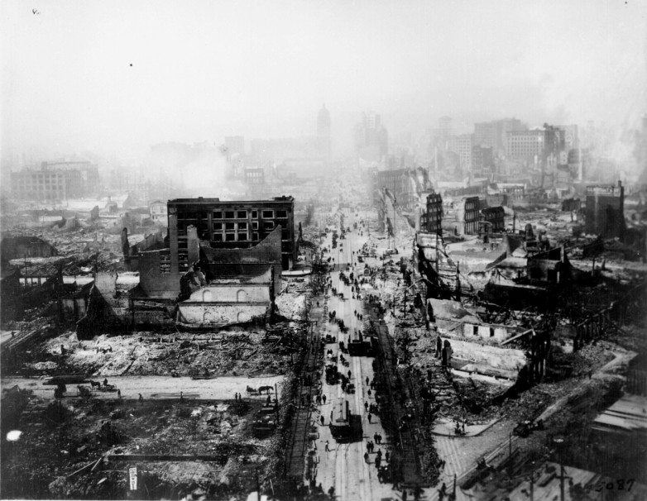
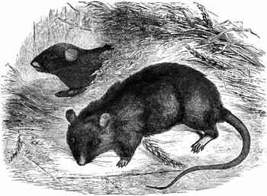
New Take on an Old Disease
Vol. CLII, No. 71
April 17, 2004
and as a result some in today’s modern scientific community are questioning the true cause of the Medieval Black Death.
Other Plagues in History
“The Third Pandemic”
The third major Bubonic Plague breakout in history occurred in the 1850s and, once again, originated in Asia. It spread, ultimately, to India, Russia, Hawaii and San Francisco. It lasted roughly fifty years.
It was during this outbreak that scientists first came to believe that the Plague was spread by rats. Just before the Plague was seen in humans there was a massive die-off of millions of rats.
San Francisco – 1906
The largest Plague scare in US history was part of this pandemic. Following the massive earthquake in 1906 rats were driven out of the sewers and into the streets of San Francisco.
A massive extermination effort (over 10 million rats were killed) prevented the disease from spreading to many humans. This helped prove rats were the cause of this particular Plague.
India - 1994
The latest worldwide outbreak was in India in 1994. Like the other Plagues recorded there was first a massive die-off of rats in the streets.
Once again actions like extermination helped to stop the spread and prove once and for all that the fleas on rats were both the carrier, and transmitter, of the Bubonic Plague.
But what if the Medieval Black Death wasn’t actually the Bubonic Plague? Medieval texts
San Francisco, 1906
The black rat (Rattus Rattus)
35
36

Slide 11


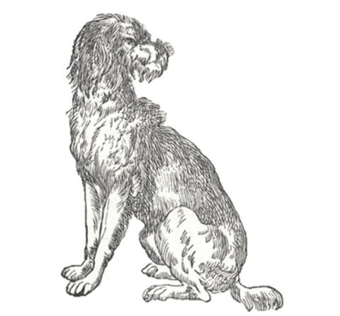
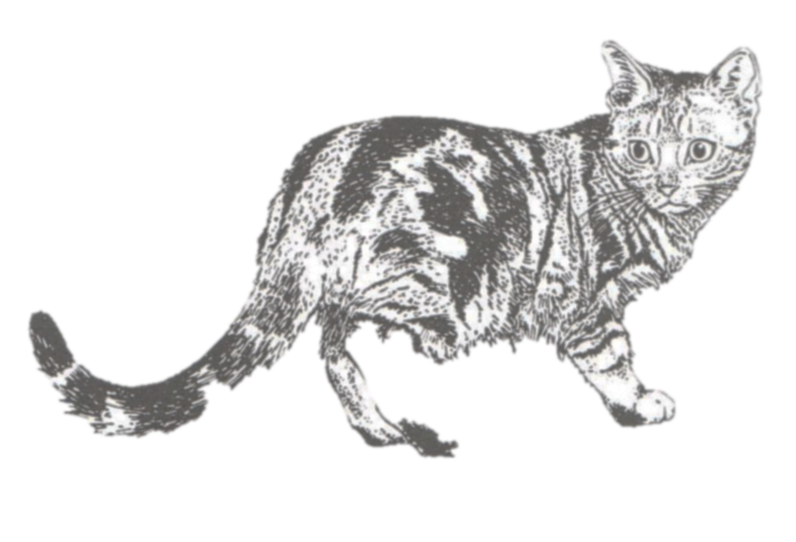
NOTICE OF EXTERMINATION
On this Monday the Fourteenth of July in the Year of Our Lord 1349 be it proclaimed that all house pets will be exterminated.
It has been decided that animals are carriers of the pestilence. These animals live in our homes causing the problem to be even worse. This action is needed to keep us safe.
Notes:
Why would they do this if cats kill rats?

Slide 12
Dearest Mother,
I am so glad to finally write to you and that these horrible days are now behind us. We have lost so many of our brothers from the monastery and I weep for little Maria and Phillip. I thank God that you have survived the pestilence. Many are saying that it will be back soon but I know it is now gone.
God has sent us this pestilence. Our people had become too corrupt and greedy. There has even been evil within the church. We failed God in the Crusades. He commanded us to regain the Holy Land and we did not. Our weak faith has brought this on us.
I know many say it was caused by the miasma, the bad odors, but that cannot be. If that were true then where has the pestilence gone now? The stench of death still hangs in the air. Why are no more getting sick? Simple. God, who brought this disease, has seen to forgive us and has now taken it away.
Many have asked me why God would allow monks like me to die. They do not see the true miracle. Our Pope has not shown even a hint of sickness even as those around him did. God protected him. There is no other way to explain the perfect health of God’s representative than to understand that this was from God.
We must learn to serve God always. His love has taken this pestilence away. We must work to make sure it never returns.
Sincerely,
John Smythe

Slide 13
Exhibit B:
Disease Descriptions
Exhibit C:
Historical Plagues
Exhibit D:
The Miasma
Exhibit E:
Letter from a Monk

Slide 14
Exhibit F:
Black Death Map
Exhibit G:
Extermination

