Slide 1
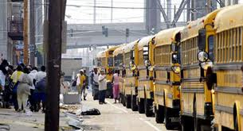
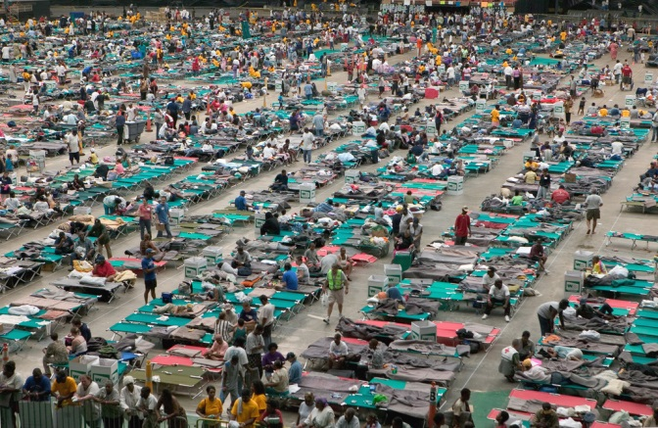
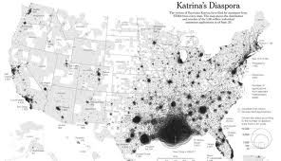
Warm Up
How did Hurricane Katrina affect Texas?
Houston, TX
Hurricane Katrina relocation map.

Slide 2
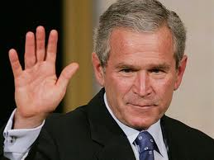
George W. Bush Continued
2001-2009
(Republican)

Slide 3
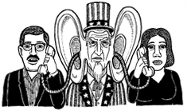
USA PATRIOT Act (Uniting and Strengthening America by Providing Appropriate Tools Required to Intercept and Obstruct Terrorism) – purpose of the Act is to deter and punish terrorist acts in the United States and around the world, to enhance law enforcement investigatory tools, and other purposes. Some Americans feel that this Act is unconstitutional and gives the executive branch the right to spy on its citizens without a warrant.

Slide 4
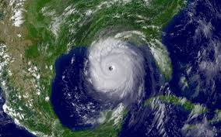
Hurricane Katrina - was the deadliest and most destructive Atlantic hurricane of the 2005 Atlantic hurricane season at a Category 5. It was the costliest natural disaster, as well as one of the five deadliest hurricanes, in the history of the United States. Among recorded Atlantic hurricanes, it was the sixth strongest overall. At least 1,833 people died in the hurricane and subsequent floods, making it the deadliest U.S. hurricane since the 1928; total property damage was estimated at $81 billion (2005 USD), nearly triple the damage brought by Hurricane Andrew in 1992. The most devastating impact was on the city of New Orleans.

Slide 5
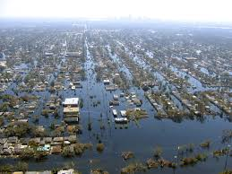
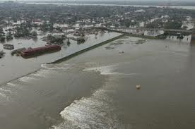
Impact of Physical and Human Geographic Factors of Hurricane Katrina
Levee failure in New Orleans after Hurricane Katrina
  Human factors – engineering failure of the levees (levees were build to hold back ocean water from the areas of the city that were below sea level.
  Physical factors – the wind and storm surge of the hurricane hit at high tide

Slide 6

No Child Left Behind Act of 2001 (NCLB) - is a United States Act of Congress that is a reauthorization of the Elementary and Secondary Education Act, which included Title I, the government's flagship aid program for disadvantaged students. NCLB supports standards-based education reform based on the premise that setting high standards and establishing measurable goals can improve individual outcomes in education. The Act requires states to develop assessments in basic skills. To receive federal school funding, States must give these assessments to all students at select grade levels. The Act does not assert a national achievement standard. Each individual state develops its own standards. NCLB expanded the federal role in public education through annual testing, annual academic progress, report cards, teacher qualifications, and funding changes. The bill passed in the U.S. Congress with bipartisan support.

Slide 7
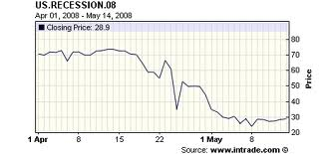
The Great Recession - also referred to as the global recession of 2009, is an ongoing marked global economic decline that began in December 2007 and took a particularly sharp downward turn in September 2008. The initial phase of the economic crisis started. The bursting of the U.S. housing bubble, which peaked in 2006, caused the values of securities tied to U.S. real estate pricing to plummet, damaging financial institutions globally and creating an interbank credit crisis.

Slide 8

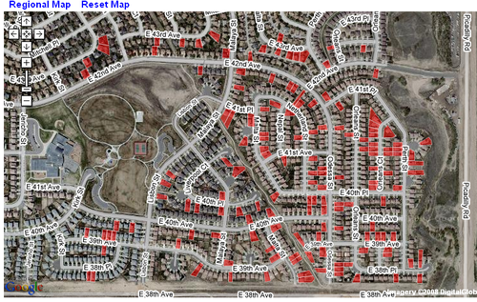
Basically, banks had been allowed to make fault loans to people buying houses. The values of the home loans were so high that the banks cut new homeowners a deal to get a house at low cost with the stipulation that after several years there would be a balloon in their payments. People could not make those high payments so many people foreclosed on their homes and the value of all homes in their neighborhood began to drop.

Slide 9
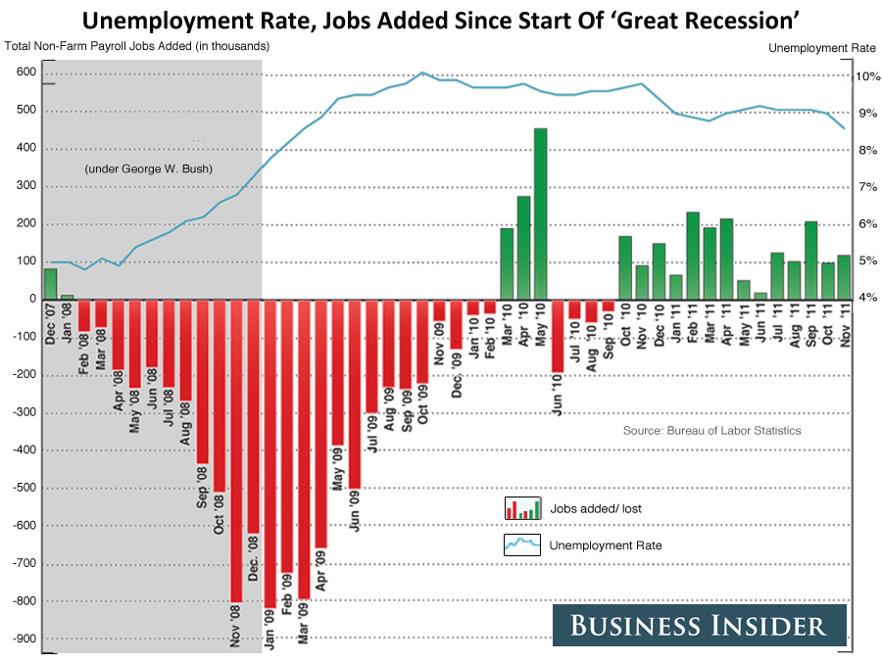
Americans purchasing power lowered and unemployment became high. It began as a national recession in United States in December 2007 and then the recession took place at the global level. The exact start and end-point for the recession at the national level, however greatly varied from country to country, and some countries did not experience any recession at all.
The Decline: The Geography of a Recession
http://abcnews.go.com/Business/fullpage?id=9549471

Slide 10
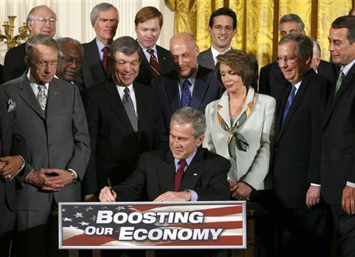
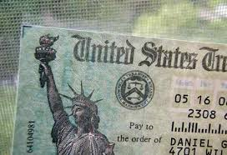
The American Recovery and Reinvestment Act of 2008 (Economic Stimulus Package) - enacted February 13, 2008 was an Act of Congress providing for several kinds of economic stimuli intended to boost the United States economy in 2008 to help economic conditions. It was signed into law on February 13, 2008 by President Bush with the support of both Democratic and Republican lawmakers. The law provides for tax rebates to low- and middle-income U.S. taxpayers, tax incentives to stimulate business investment, and an increase in the limits imposed on mortgages eligible for purchase by government-sponsored enterprises (e.g., Fannie Mae and Freddie Mac). The total cost of this bill was projected at $152 billion for 2008.

Slide 11
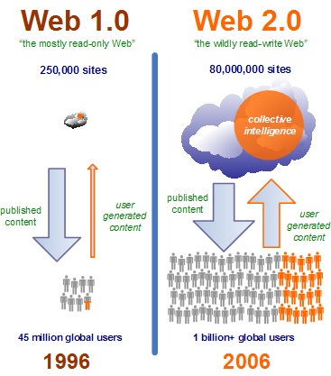
Social Media Becomes Popular
Web 2.0 describes web sites that use technology beyond the static pages of earlier web sites. The term was coined in 1999 by Darcy DiNucci and was popularized by Tim O'Reilly at the O'Reilly Media Web 2.0 conference in late 2004. A Web 2.0 site may allow users to interact and collaborate with each other in a social media dialogue as creators of user-generated content in a virtual community, in contrast to websites where people are limited to the passive viewing of content. Examples of Web 2.0 include social networking sites, blogs, wikis, video sharing sites, hosted services, and web applications.

Slide 12
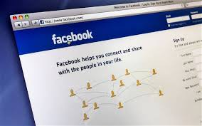
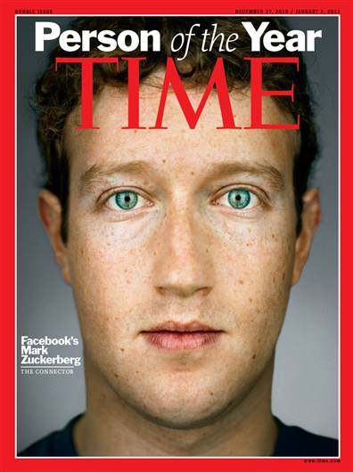
Facebook is an online social networking service. Facebook was founded in February 2004 by Mark Zuckerberg with his college roommates and fellow Harvard University students Eduardo Saverin, Andrew McCollum, Dustin Moskovitz and Chris Hughes. Facebook is the leading social networking site based on monthly unique visitors, having overtaken main competitor MySpace in April 2008. By 2005, the use of Facebook had already become so ubiquitous that the generic verb "facebooking" had come into use to describe the process of browsing others' profiles or updating one's own. It has become an interregnal part of relationships online.

Slide 13

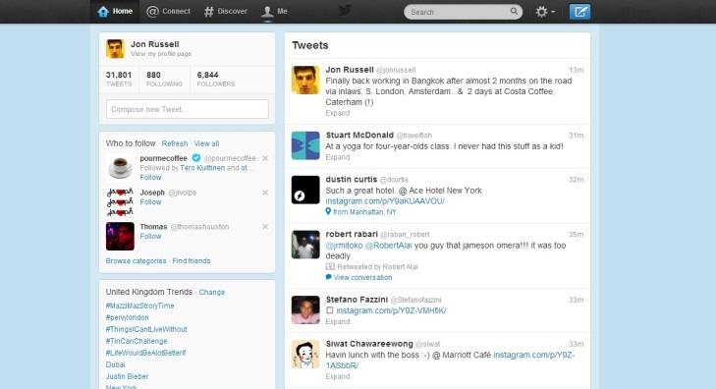
Twitter is an online social networking and microblogging service that enables users to send and read "tweets", which are text messages limited to 140 characters. Registered users can read and post tweets but unregistered users can only read them. Users access Twitter through the website interface, SMS, or mobile device app.
Twitter was created in March 2006 by Jack Dorsey, Evan Williams, Biz Stone and Noah Glass and by July 2006, the site was launched. The service rapidly gained worldwide popularity, with 500 million registered users in 2012, who posted 340 million tweets per day. The service also handled 1.6 billion search queries per day. Twitter is now one of the ten most visited websites, and has been described as "the SMS of the Internet."

