Slide 1
(top left side) Opener:
What would happen if you spent more money than you actually had?

Slide 2
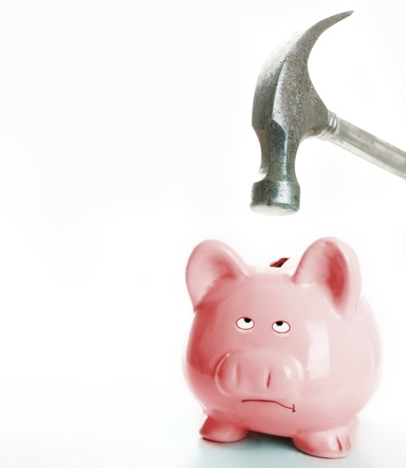


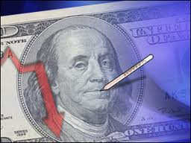
The Nation’s Sick Economy
The Great Depression Begins
U.S. History
Mrs. Janiak

Slide 3
(left side) Video Notes:
Describe the optimism (positive attitude) of the late 1920s.

Slide 4
#1 Problems in Industry
Some industries:
  lost business to foreign competition and new American technologies
  Some suffered from declining consumer purchases at the end of the 1920s (less cars and items bought)
  Coal industry declined because of the development of new energy sources
  New housing declined= affecting all businesses dependent on house construction

Slide 5
# 2 Problems in Agriculture
Demand for farm products fell after WWI (less production needed)
Many farmers couldn’t pay off their debts and lost their farms= some rural banks had to close
Congress tried to pass federal price supports for farm products but President Coolidge vetoed them

Slide 6
# 3 Problems with Consumer Spending
Buying on credit was easily available->businesses encouraged Americans to pile up large consumer debt
American consumers faced:
    Rising prices on products
    Stagnant wages
    High levels of debt
  = Americans decreased their purchasing

Slide 7
# 4 Uneven Distribution of Wealth Among Americans
Nearly half of U.S. families earned less than the minimum amount needed for a decent standard of living
The rich got richer
=most consumers didn’t have enough money to buy the goods produced in American factories

Slide 8
# 5 Stock Market Problems
Investors= any American who could afford to invest in stocks and bonds in the stock market
speculated= bought stocks and bonds in hopes of a quick profit, ignored the risks
  Buying on margin= paying a small % of a stock’s price as a down payment and borrowing the rest (never paid the full price).
When the market crashed- many investors lost their life savings.

Slide 9
Highlight the main terms/ notes
Answer the focus question (located above the agenda on the whiteboard wing)

