Slide 1
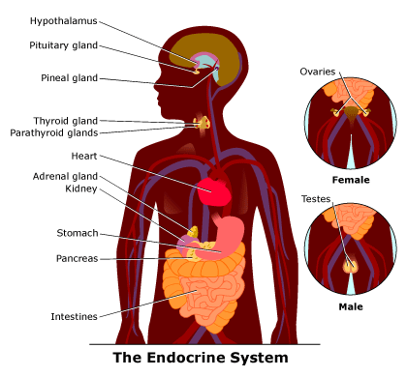
Endocrine System
Core 6.5.7 – 6.5.12

Slide 2
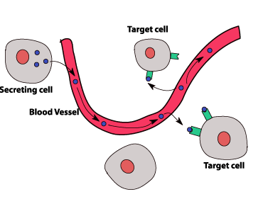
Introduction:
Animal hormones are usually secreted by and transported through the
Overall function of the endocrine system:

Slide 3
6.5.8 State that homeostasis involves maintaining the internal environment between limits, including blood pH, carbon dioxide concentration, body temperature and water balance.
Homeostasis
maintaining a “steady state”
Maintenance of

Slide 4
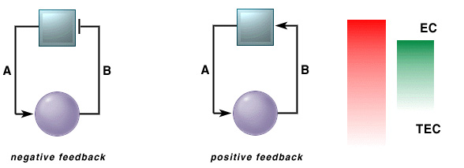
6.5.9 Explain that homeostasis involves monitoring levels of variables and correcting changes in levels by negative feedback mechanisms.
Usually achieved by – a change in the level of an internal factor causes effectors to restore the internal environment to its original level ( )
Ex. An increase in body temperature causes the body to lose more heat and vice versa

Slide 5
6.5.8 State that homeostasis involves maintaining the internal environment between limits, including blood pH, carbon dioxide concentration, body temperature and water balance.
Occasionally is used, such as in childbirth – oxytocin is released, contractions occur, stimulate more release of oxytocin and therefore more contractions ( )

Slide 6
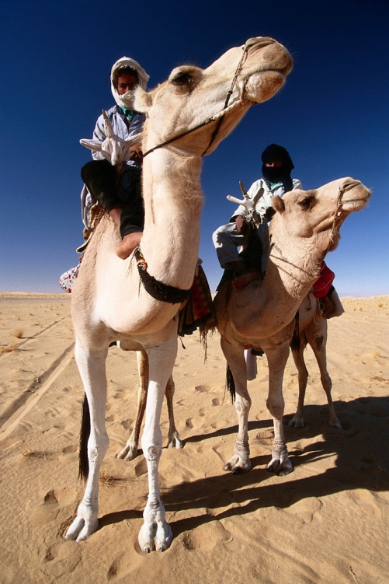
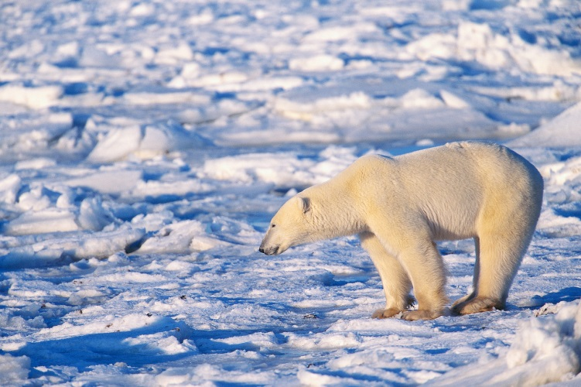
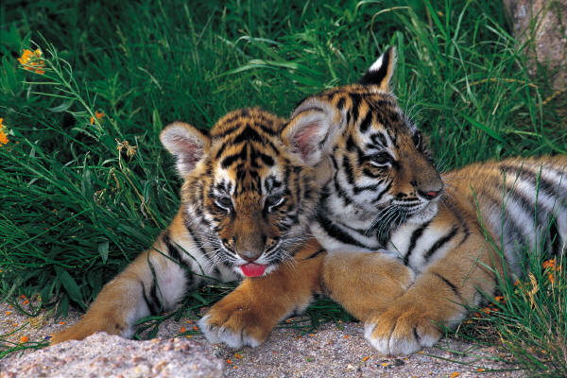
Ability of mammals to maintain a stable internal environment makes them
Ex. Maintenance of internal body temperature

Slide 7
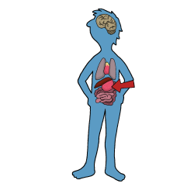
6.5.7 State that the endocrine system consists of glands that release hormones that are transported in the blood.
Mammals have two types of glands:
glands have

Slide 8
6.5.7 State that the endocrine system consists of glands that release hormones that are transported in the blood.
glands

Slide 9
Controls ; connects nervous & endocrine system
Makes hormones that
Makes
Makes
Makes
Makes
Controls ; makes

Slide 10
6.5.11 Explain the control of blood glucose concentration, including the roles of glucagon, insulin and α and β cells in the pancreatic islets.
Control of Blood Glucose Concentrations
Glucose is transported in solution in the
Maintenance of glucose at steady levels is vital
Normal blood glucose concentration is about cm³ of blood
Two interactive hormones control blood glucose concentrations (both are produced by the pancreas)
Insulin –
Glucagon –

Slide 11
6.5.11 Explain the control of blood glucose concentration, including the roles of glucagon, insulin and α and β cells in the pancreatic islets.
Insulin
Small protein consisting of
Secreted by special cells called
When blood glucose concentrations rise above the set point, more insulin is secreted by the pancreas which results in:
An increase in the
An increase in the (instead of other substrate such as fat)
An increase in the
An increase in the

Slide 12
6.5.11 Explain the control of blood glucose concentration, including the roles of glucagon, insulin and α and β cells in the pancreatic islets.
Glucagon
Secreted by the in the islets of Langerhans
When blood glucose concentrations fall below set point, the alpha cells secrete glucagon
Glucagon activates
Also increases the

Slide 13
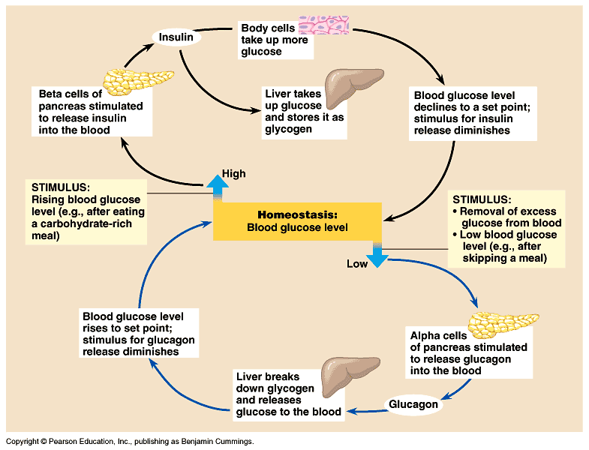

Slide 14
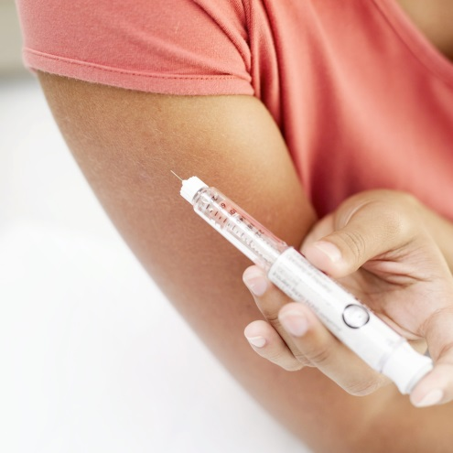
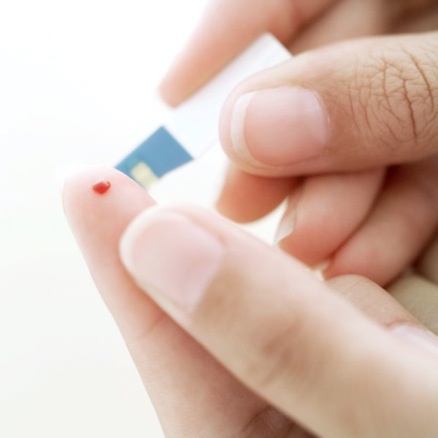
6.5.12 Distinguish between type I and type II diabetes.
Diabetes is a disease in which the body fails to regulate blood glucose levels
Type I
Sometimes called
Results from a
The body’s own immune system destroys the β cells
Symptoms include
Must be treated by

Slide 15
6.5.12 Distinguish between type I and type II diabetes.
Type II
Sometimes called
More common in people although many younger people are starting to be affected
Caused by
There is also a genetic link – this type of diabetes tends to run in families
This type of diabetes is usually treated by a
Both types of diabetes can lead to

Slide 16
6.5.10 Explain the control of body temperature, including the roles of the hypothalamus, sweat glands, sweat arterioles and shivering.
Temperature Control ( )
Humans are considered (maintain a constant body temperature and are endotherms – )
Body temperature is usually around ° C –
Body needs to maintain temperature regardless of changes in environmental temperature

Slide 17
6.5.10 Explain the control of body temperature, including the roles of the hypothalamus, sweat glands, sweat arterioles and shivering.
Heat is lost to the environment by:
Conduction:
Radiation:
Convection:

Slide 18
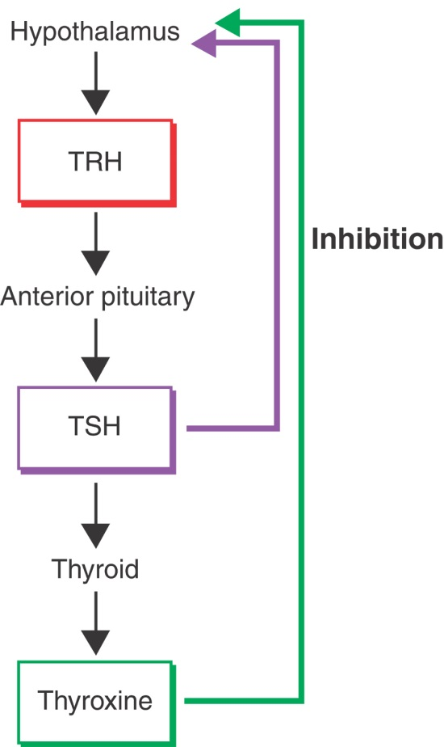
6.5.10 Explain the control of body temperature, including the roles of the hypothalamus, sweat glands, sweat arterioles and shivering.
Heat regulation in humans involves coordination between nervous and hormonal systems:
(nerve cells belonging to nervous system) under skin sense the
Thermoreceptors send nerve messages to (link between nervous and endocrine systems)
Hypothalamus releases (thyroid releasing hormone) that travels to which then releases (thyroid stimulating hormone) that travels to causing it to release the hormone,

Slide 19
6.5.10 Explain the control of body temperature, including the roles of the hypothalamus, sweat glands, sweat arterioles and shivering.
Thyroxine – in hot weather, less thyroxine is released and less heat is generated
Hypothalamus also sends nerve messages to in order to produce other responses such as
Heat regulation involves : as temperature goes up, hypothalamus produces less TRH, pituitary releases less TSH, thyroid releases less thyroxine and metabolism reduces resulting in less heat produced

Slide 20
6.5.10 Explain the control of body temperature, including the roles of the hypothalamus, sweat glands, sweat arterioles and shivering.
Body temperature responses in cold weather:
Thermoreceptors under skin sense decrease in temperature and send messages to hypothalamus in brain
Hypothalamus also has thermoreceptors to sense temperature of blood
Hypothalamus sends messages to different parts of the body to cause the following changes:
Vasoconstriction of blood vessels under the skin –
Metabolic rate
Involuntary
Body hairs

Slide 21
6.5.10 Explain the control of body temperature, including the roles of the hypothalamus, sweat glands, sweat arterioles and shivering.
Body temperature responses to hot weather:
Thermoreceptors under skin send messages to hypothalamus in brain and causes the following responses:
Vasodilation
Sweating increases –
Metabolic rate
Body hairs

