Slide 1
North Korean Propaganda against the U.S. during the Korean War
Photos frohttp://dpmachenry.tripod.com/propwar.htmm
And San Diego MCRD Museuem

Slide 2
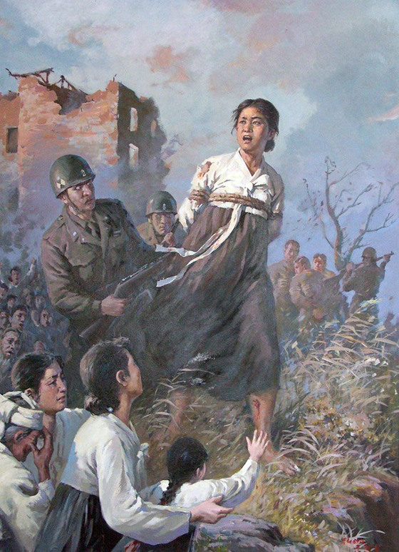

Slide 3
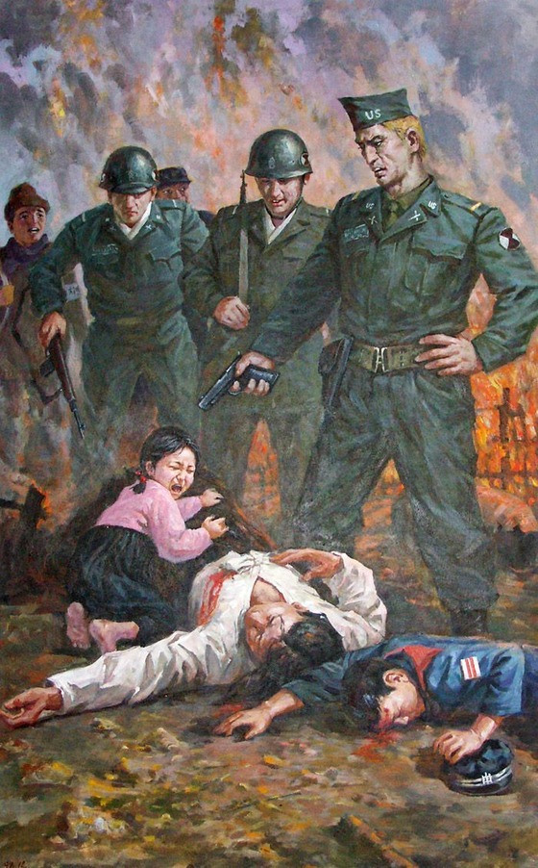

Slide 4
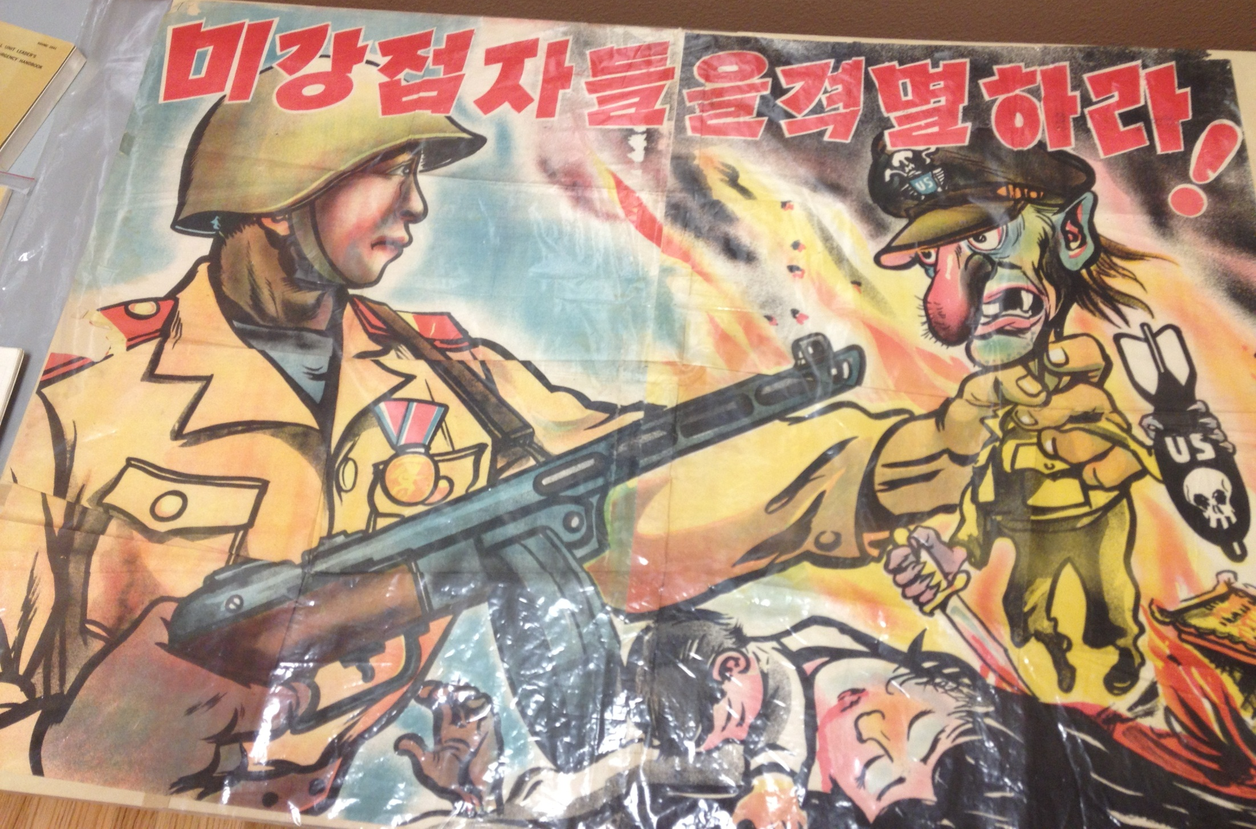

Slide 5
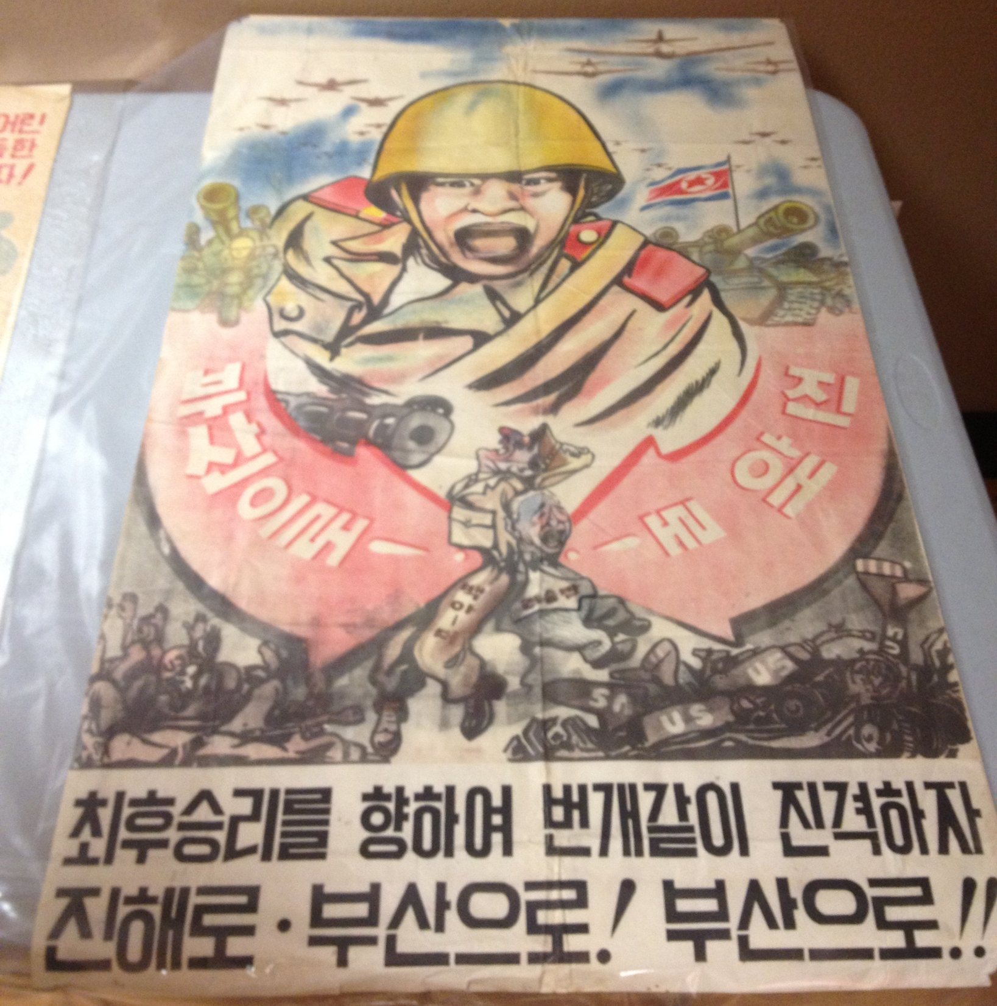

Slide 6
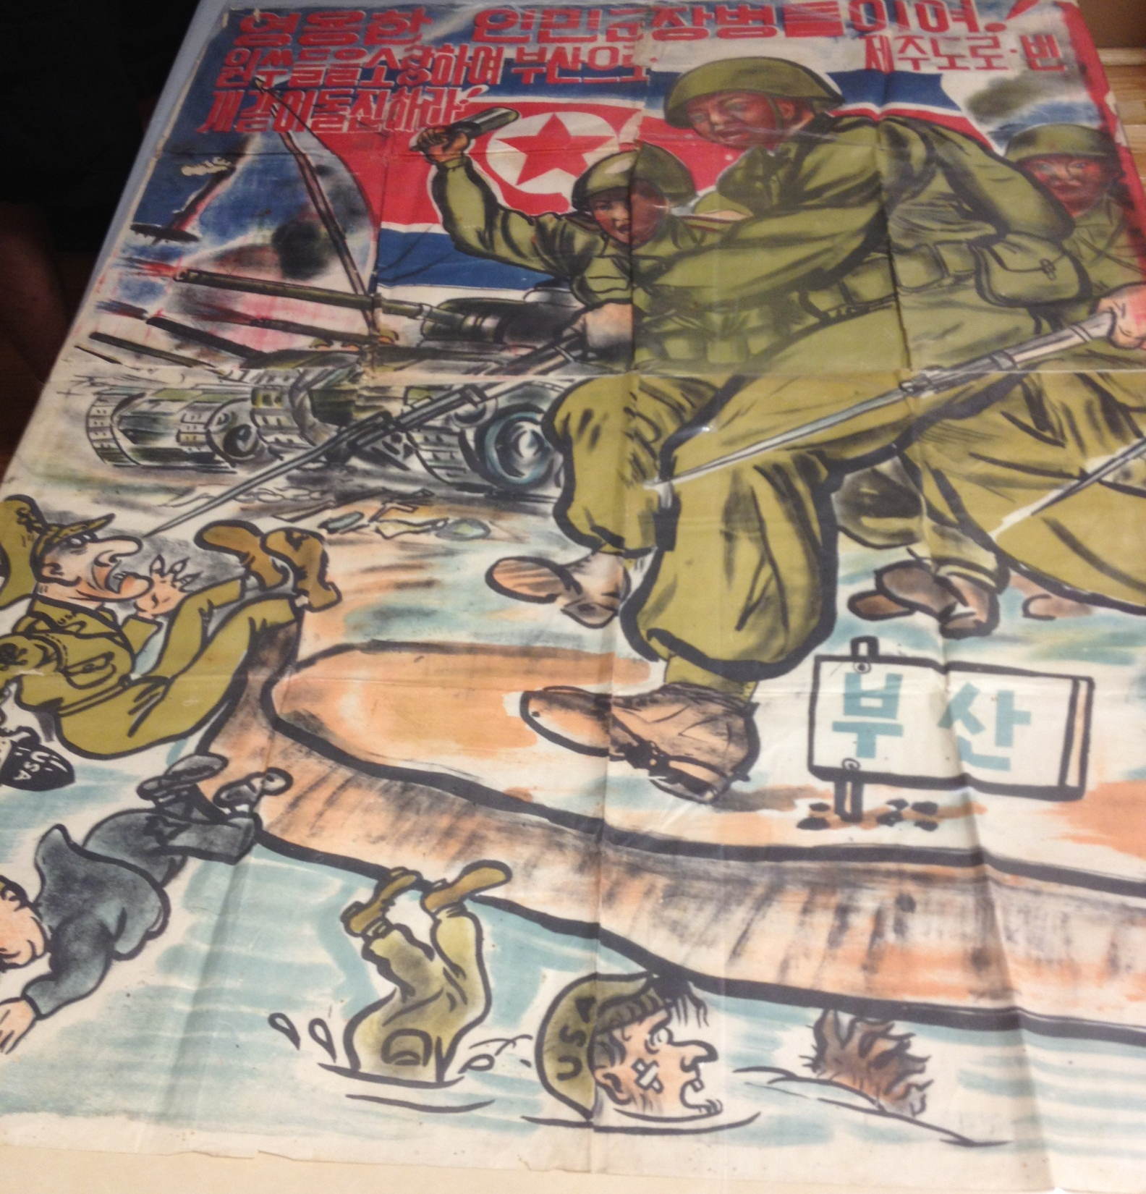

Slide 7
