Slide 1
Warm-up #2
Are samurai or knights better warriors? Why? Write a few sentences to support your opinion.

Slide 2
Geography of Europe
Physical Geography
Essential Question: How does the regional climate of Europe differ?

Slide 3
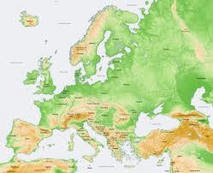
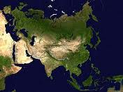
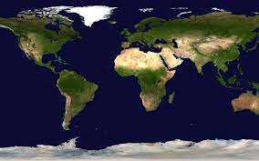
Europe
Europe is one of the 7 continents
However, it is actually the westernmost peninsula of the Eurasian landmass
Its Eastern Border is traditionally the Ural Mountains in Russia

Slide 4
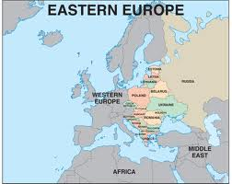
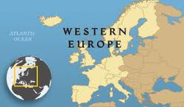
Regions
Europe is traditionally divided between Eastern and Western Europe
The East is dominated by the Russian Steppe, the Carpathian Mountains and the Balkans
The West is made up of Scandinavia, the British Isles, the Iberian & Italian Peninsulas, The Alps and The Lowlands

Slide 5
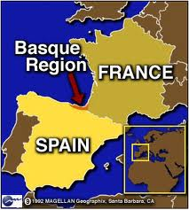
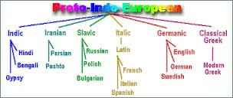
People
The first Europeans were related to the Basques who now live in NW Spain and SW France.
The indigenous people of Europe, with few exceptions, can be traced back to a common language known as Proto-Indo-European.
Europe was populated in waves from East to West with the earliest arrivers being pushed towards the Atlantic Ocean.

Slide 6
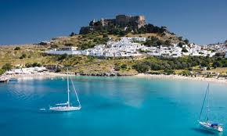
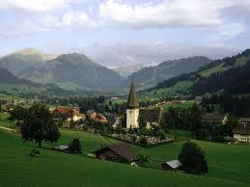
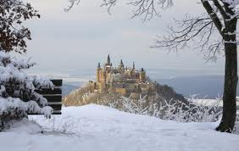
Climate
Southern Europe falls in a Mediterranean climate zone. That’s the same as Southern California!
Western and some of Central Europe tends to be wetter and has a temperate forest climate.
Eastern and Northern Europe are dryer and colder. It’s a tundra/tiaga climate zone.

Slide 7

While watching this video, add to your notes.

Slide 8
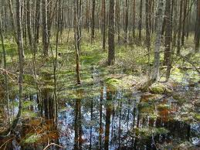
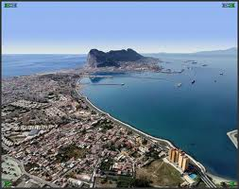
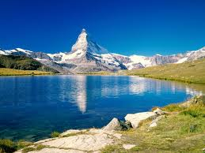
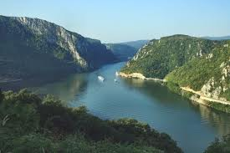
Physical Map of Europe
Please use the colors listed in the instructions.
You can use the maps in the textbook, or the Atlases on the classroom bookshelf
You MIGHT have to look for some of these landforms on multiple maps.

Slide 9
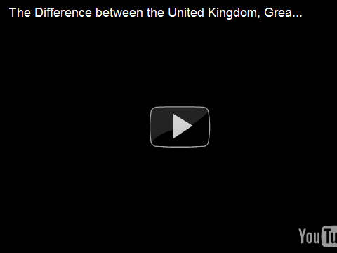
England, Britain, United Kingdom, Huh?

Slide 10
Quiz Time
Get out the piece of paper you did your warm up on.
Write down the # of the question and then the letter of the answer!
You have 1 minute per slide, I will not wait for you if you fall behind.
When you are finished get out your agenda and wait quietly until everyone is finished

Slide 11
Question #1
What is the name of the landmass that Europe is a part of?
  North Africa
  Asiarupe
  Eurasia
  Austrasia

Slide 12
Question #2
How is Europe traditionally divided?
  North/South
  East/West
  Upper/Lower
  Walnut/Diamond Bar

Slide 13
Question #3
Which Mountain Ranges are located in Europe?
  Alps, Urals, Carpathians
  Rockies, Sierra-Nevada, Appalachians
  Himalayas, Caucasus, Andes
  Lonely, Magic, SAC

Slide 14
Question #4
Which Region of Europe is most like Southern California in climate?
  British Isles
  Baltic Sea
  Paris, France
  Sicily

Slide 15
Question #5
Which of the following countries is part of Great Britain?
  Ireland
  Canada
  Wales
  British Columbia

