Slide 1
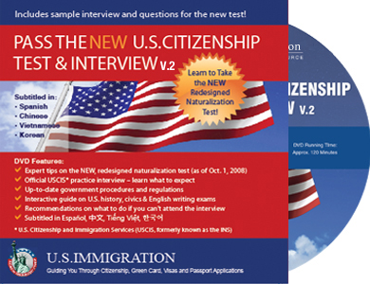
Warm Up
Take the Immigration Quiz that people seeking citizenship have to take and see how many questions you can get correct.
Answers on following slides:

Slide 2
Could You Pass the New Citizenship Test?
Constitution
We the People
Bill of Rights
Ted Cruz or John Cornyn
Market Economy, Free Market Economy or Capitalist Economy
6. Any one of the following:
  ▪ Congress
▪ legislative
▪ President
▪ executive
▪ the courts
▪ judicial
7. 9
8. Joe Biden
9. 21 years old

Slide 3
10. Any two of the following:
▪ Secretary of Agriculture
▪ Secretary of Commerce
▪ Secretary of Defense
▪ Secretary of Education
▪ Secretary of Energy
▪ Secretary of Health and Human Services
▪ Secretary of Homeland Security
▪ Secretary of Housing and Urban Development
▪ Secretary of the Interior
▪ Secretary of Labor
▪ Secretary of State
▪ Secretary of Transportation
▪ Secretary of the Treasury
▪ Secretary of Veterans Affairs
▪ Attorney General
▪ Vice President
11. Any one of these:
▪ freedom
▪ political liberty
▪ religious freedom
▪ economic opportunity
▪ practice their religion
▪ escape persecution
12. American Indians or Native Americans
13. Thomas Jefferson
14. July 4, 1776

Slide 4
15. Any 3 of these:
New Hampshire
Massachusetts
Rhode Island
Connecticut
New York
New Jersey
Pennsylvania
Delaware
Maryland
Virginia
North Carolina
South Carolina
Georgia
16. fought for women’s rights or fought for civil rights
17. any one of these:
War of 1812
Mexican-American War
Civil War
Spanish-American War
18.fought for civil rights or worked for equality for all Americans
19. Franklin D. Roosevelt
20. Communism

Slide 5
21. Any one of the following:
▪ Cherokee
▪ Navajo
▪ Sioux
▪ Chippewa
▪ Choctaw
▪ Pueblo
▪ Apache
▪ Iroquois
▪ Creek
▪ Blackfeet
▪ Seminole
▪ Cheyenne
▪ Arawak
▪ Shawnee
▪ Mohegan
▪ Huron
▪ Oneida
▪ Lakota
▪ Crow
▪ Teton
▪ Hopi
▪ Inuit
22. One of these: Missouri (River) or Mississippi (River)
23. Atlantic Ocean
24. Any one of these:
Puerto Rico
U.S. Virgin Islands
American Samoa
Northern Mariana Islands
Guam

Slide 6
25. Any one of these:
▪ Maine
▪ New Hampshire
▪ Vermont
▪ New York
▪ Pennsylvania
▪ Ohio
▪ Michigan
▪ Minnesota
▪ North Dakota
▪ Montana
▪ Idaho
▪ Washington
▪ Alaska
26. Any one of these:
▪ California
▪ Arizona
▪ New Mexico
▪ Texas
27. New York City or New York Harbor or Liberty Island
28. because there were 13 original colonies
29. because there are 50 states and one star for each state
30. Any one of the following:
▪ New Year’s Day
▪ Martin Luther King, Jr. Day
▪ Presidents’ Day
▪ Memorial Day
▪ Independence Day
▪ Labor Day
▪ Columbus Day
▪ Veterans Day
▪ Thanksgiving
▪ Christmas

Slide 7
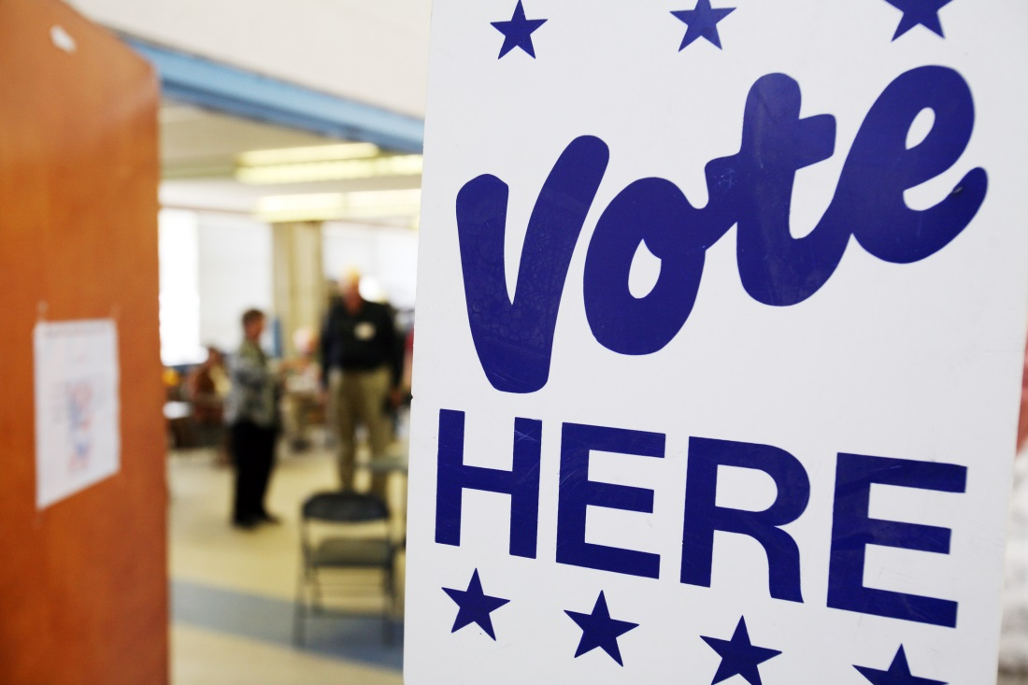
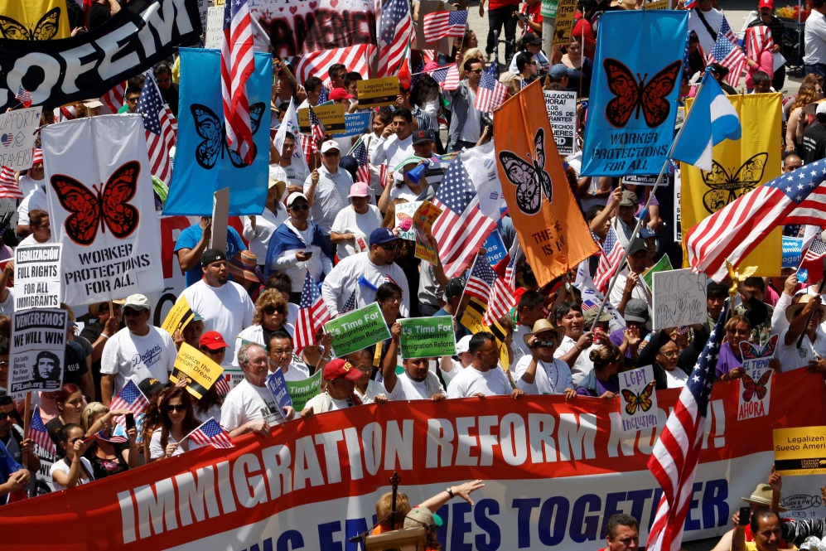
Organizations, Immigration and Elections

Slide 8
PROS AND CONS OF U.S. PARTICIPATION IN INTERNATIONAL ORGANIZATIONS AND TREATIES
Pros
  Influence international policy
  Protect American interest
  Protect American security
  Assist other countries
Cons
  Potential loss of American sovereignty
  Potential loss of American security

Slide 9
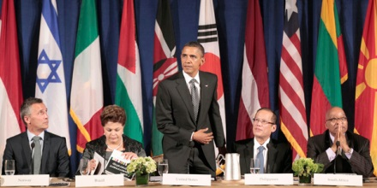
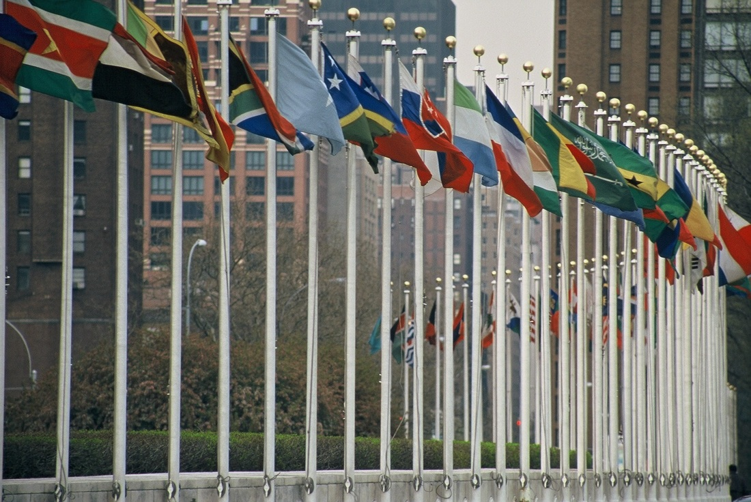
The end goal for a state’s participation in international relations is to attain a favorable outcome for their country. This is seen either in favoring or opposing different treaties or joining various organizations. Many representatives feel like participation in these global organizations undermine the U.S. sovereignty through the use of these treaties.

Slide 10
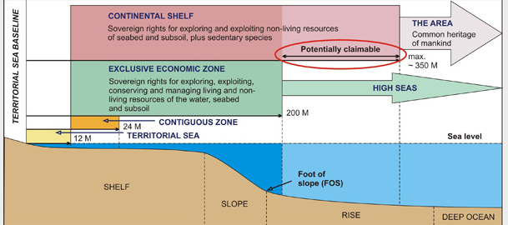
Current examples include:
  UN Convention on the Law of the SEA – opposed by President Reagan and numerous lawmakers because it gives power to a UN commission that has limited accountability; would impede U.S. sovereign security efforts and open the U.S. to numerous legal cases.

Slide 11
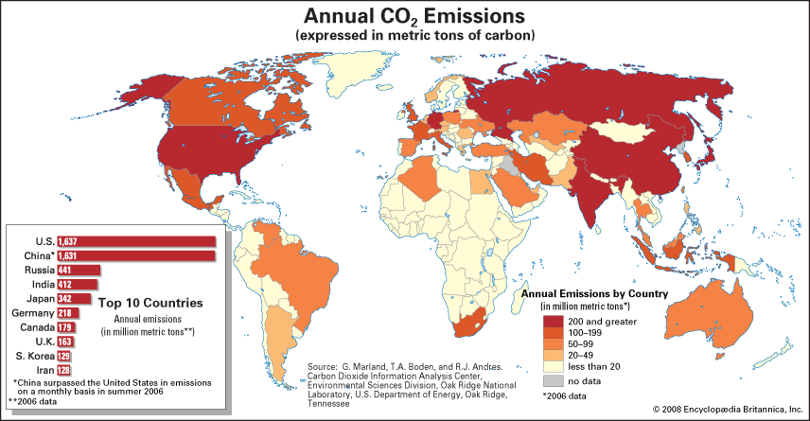
  Kyoto Protocol – opposed by President George W. Bush and numerous lawmakers because it imposed drastic cuts in pollution, which would have cost the U.S. government billions of dollars and loss of millions of jobs

Slide 12
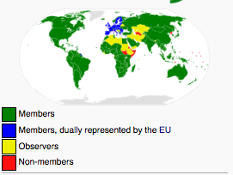
  World Trade Organization – It is easier and more profitable to businesses for U.S. commerce to have few trade barriers.

Slide 13
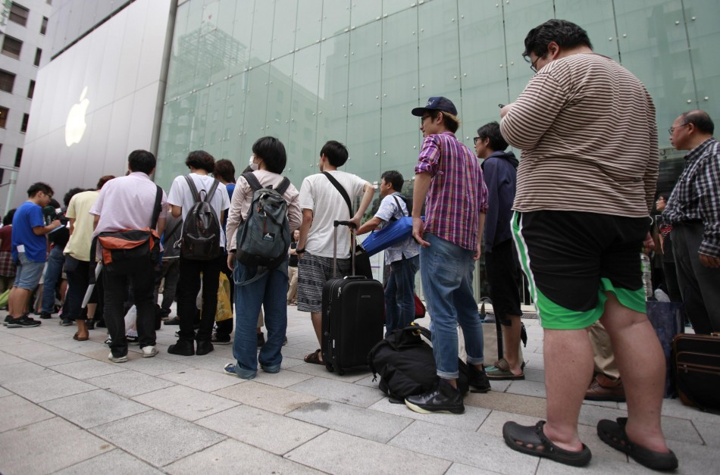

Impact of international events, multinational corporations, government policies, and individuals on the 21st century economy
Increased globalism has caused a swiftly changing economy. With increased investments, quantity, quality, and reduced price of goods, the average American’s standard of living has increased.
Japanese waiting outside the Apple Store for the Iphone 5.
South Korea Fashion Week just like New York Fashion Week

Slide 14
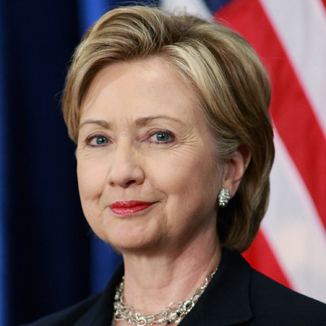
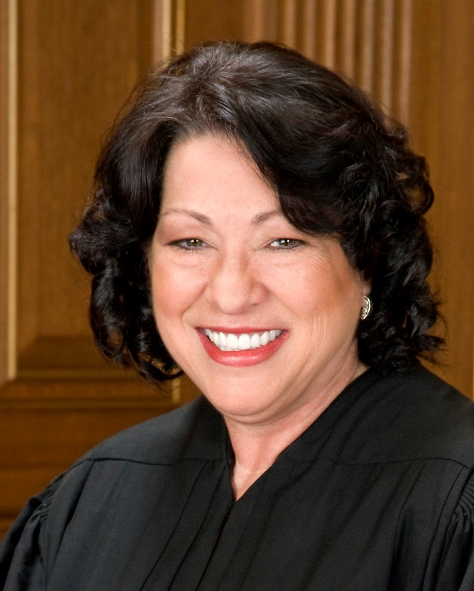
Contributions of Significant Political and Social Leaders
Political leaders
  Barack Obama - 2008 election of first black president
  Hillary Clinton – former First Lady, senator from New York State, Secretary of State
  Sonia Sotomayor – first Hispanic to serve on the Supreme Court, nominated by President Obama

Slide 15
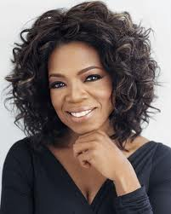
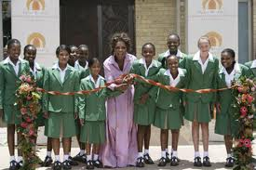
Economic
  Oprah Winfrey – supervising producer and host of the top-rated, award-winning The Oprah Winfrey Show for two decades. She is a global media leader and philanthropist.

Slide 16
Significant social and political advocacy organizations, leaders and issues across the political spectrum
Social and political advocacy organizations, leaders, and issues across the political spectrum that are currently significant (local, state, nation)
Take a moment to look through the list of the different organizations.

Slide 17
Many celebrities have gotten involved in philanthropic activities to bring awareness to global concerns:
Take a moment to look through the list of the different celebrities and the causes they support.

Slide 18
Causes and Effects of Changing Demographic Patterns Resulting from Legal and Illegal Immigration to the United States
Causes
  Push Factors (reasons people leave a place): unemployment, crime, political instability, etc.
  Pull Factors (reasons people move to a place): employment, improved quality of life, education, etc.

Slide 19
Causes and Effects of Changing Demographic Patterns Resulting from Legal and Illegal Immigration to the United States
Effects
  Large influxes of immigrants cause rapid growth in cities
  Housing; overcrowding
  Multiculturalism
  Strain on federal and state budgets
Take a moment to look at the table of our immigration trends. What do you notice?

Slide 20
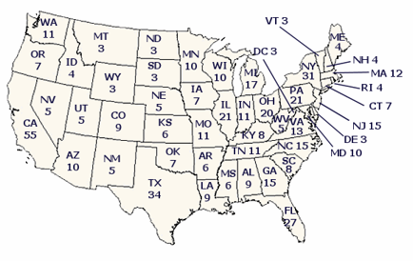
How does the Electoral College Work?

Slide 21
Presidential Elections
Impact of Third Parties on Presidential Elections
Third parties can greatly impact presidential elections. They provide the populace an additional candidate on the ballot that represents another American viewpoint, idea, and call for change from the status quo. In a close election, this person has the ability to upset the balance of power in the current system.
Take a moment to look at the table of data from the presidential elections from 1988 to the present. Think about the impact of third parties are the different elections.

