Slide 1
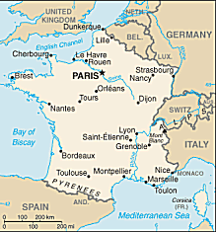

Slide 2
Map
Water: Atlantic Ocean North Sea Mediterranean Sea English Channel
Countries: FRANCE IRELAND ENGLAND SPAIN, PORTUGAL, DENMARK, SCOTLAND
Kingdoms: Aquitaine Brittany Normandy
Anjou Vexin
Cities: Bordeaux Portiers Paris St. Denis London Salisbury Canterbury

Slide 3
Map Rubric
Your Name and Class period
ALL Points labeled (See the slide before this one)
Capitalize names of places
Spelling
OUTLINE
Color. No white.
Water= blue
NEATNESS!!!!!

Slide 4
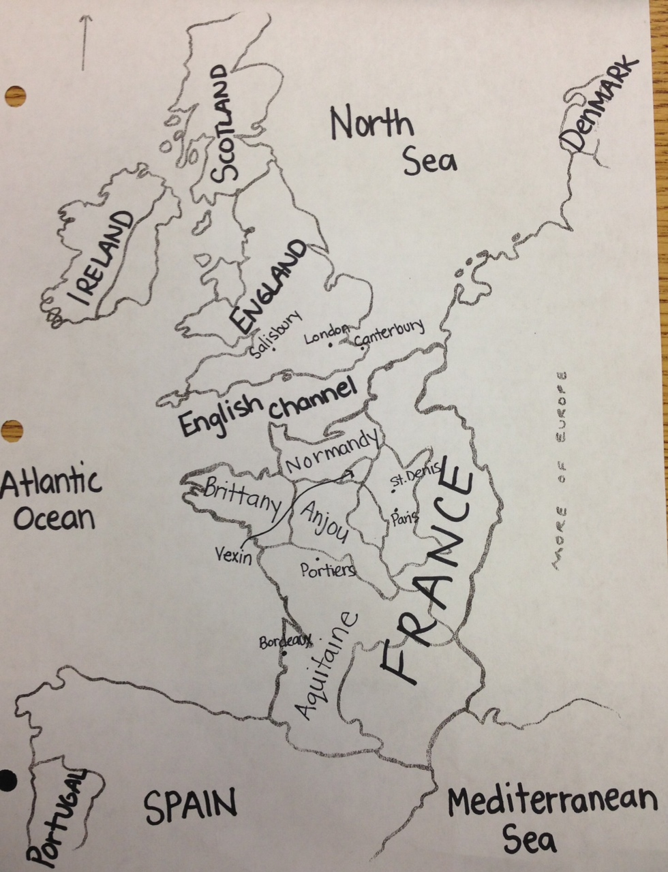
Cities: Bordeaux Portiers Paris St. Denis London Salisbury Canterbury Kingdoms: Aquitaine Brittany Normandy Anjou Vexin
Water:
Atlantic Ocean
North Sea Mediterranean Sea
English Channel
Countries:
FRANCE
IRELAND
ENGLAND
SPAIN
PORTUGAL
DENMARK
SCOTLAND

