Slide 1
Happy New Year!
Opener: Answer on the slip of paper-
Write down everything that you think you know about World War I (who, where, when, what, why…)

Slide 2
Tuesday January 4, 2011
MEMORY RECALL!
Opener: put your name on the paper, answer-
What are the 4 M.A.I.N. causes of World War I?

Slide 3
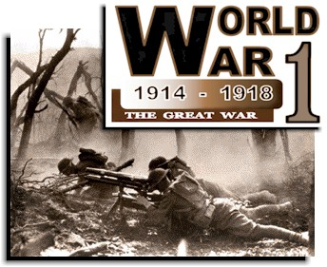
THE GREAT WAR
U.S. History

Slide 4
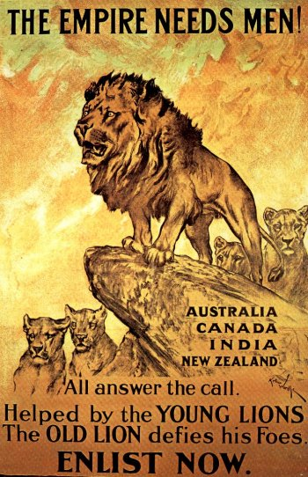
FOUR M.A.I.N. LONG-TERM CAUSES OF THE WAR
1. Militarism
2. Alliance System
3. Imperialist Rivalries
4. Nationalism

Slide 5
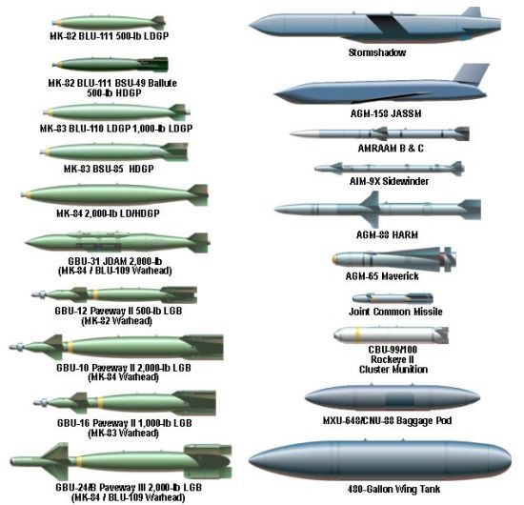
1. Militarism
Militarism – glorifying military power and keeping an army prepared for war.
An arms race developed between industrialized European nations- the Germans and the British were competing against each other for the greatest navy
Governments turned to military leaders for advice on peace and war

Slide 6
Militarism Competition
Game
-Each country is given a stack of paper. Countries have thirty seconds to construct as many bombs as possible with whole sheets of paper. The country with the most bombs at the end of the minute wins.

Slide 7

2. Alliance System
System of agreements between countries in which each would agree to defend the other in the case of foreign attack.

Slide 8
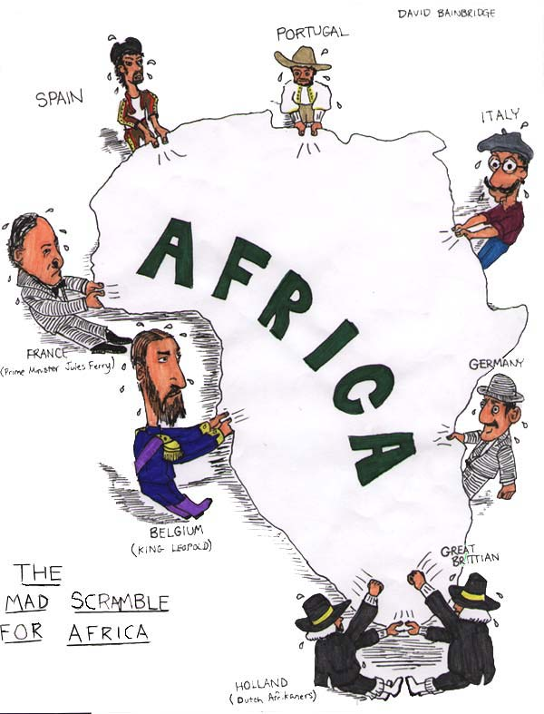
3. Imperialist Rivalries
Competition between imperialist countries to gain colonies throughout the world. These rivalries built up resentment between European powers. (Remember the Scramble for Africa)

Slide 9

4. Nationalism
Feeling pride in and devotion to one’s country or people. This becomes the basis for the idea that people should be ruled by people of the same ethnicity or religion. (Remember India and Pakistan)

Slide 10
Proclaim your Nationalism
Each member of the countries proclaims their love for their country
“__________ is the greatest country ever.”

Slide 11
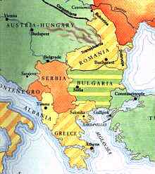
Event #1: Murder of the Archduke Franz Ferdinand
Serbians that live within the Austrian-Hungarian empire want to become part of Serbia
Archduke Franz Ferdinand (Heir to the throne of Austria-Hungary) is assassinated while visiting the city of Sarajevo by a group of Serbian Nationalists known as the ‘Black Hand’

Slide 12
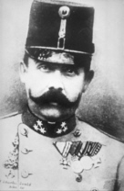
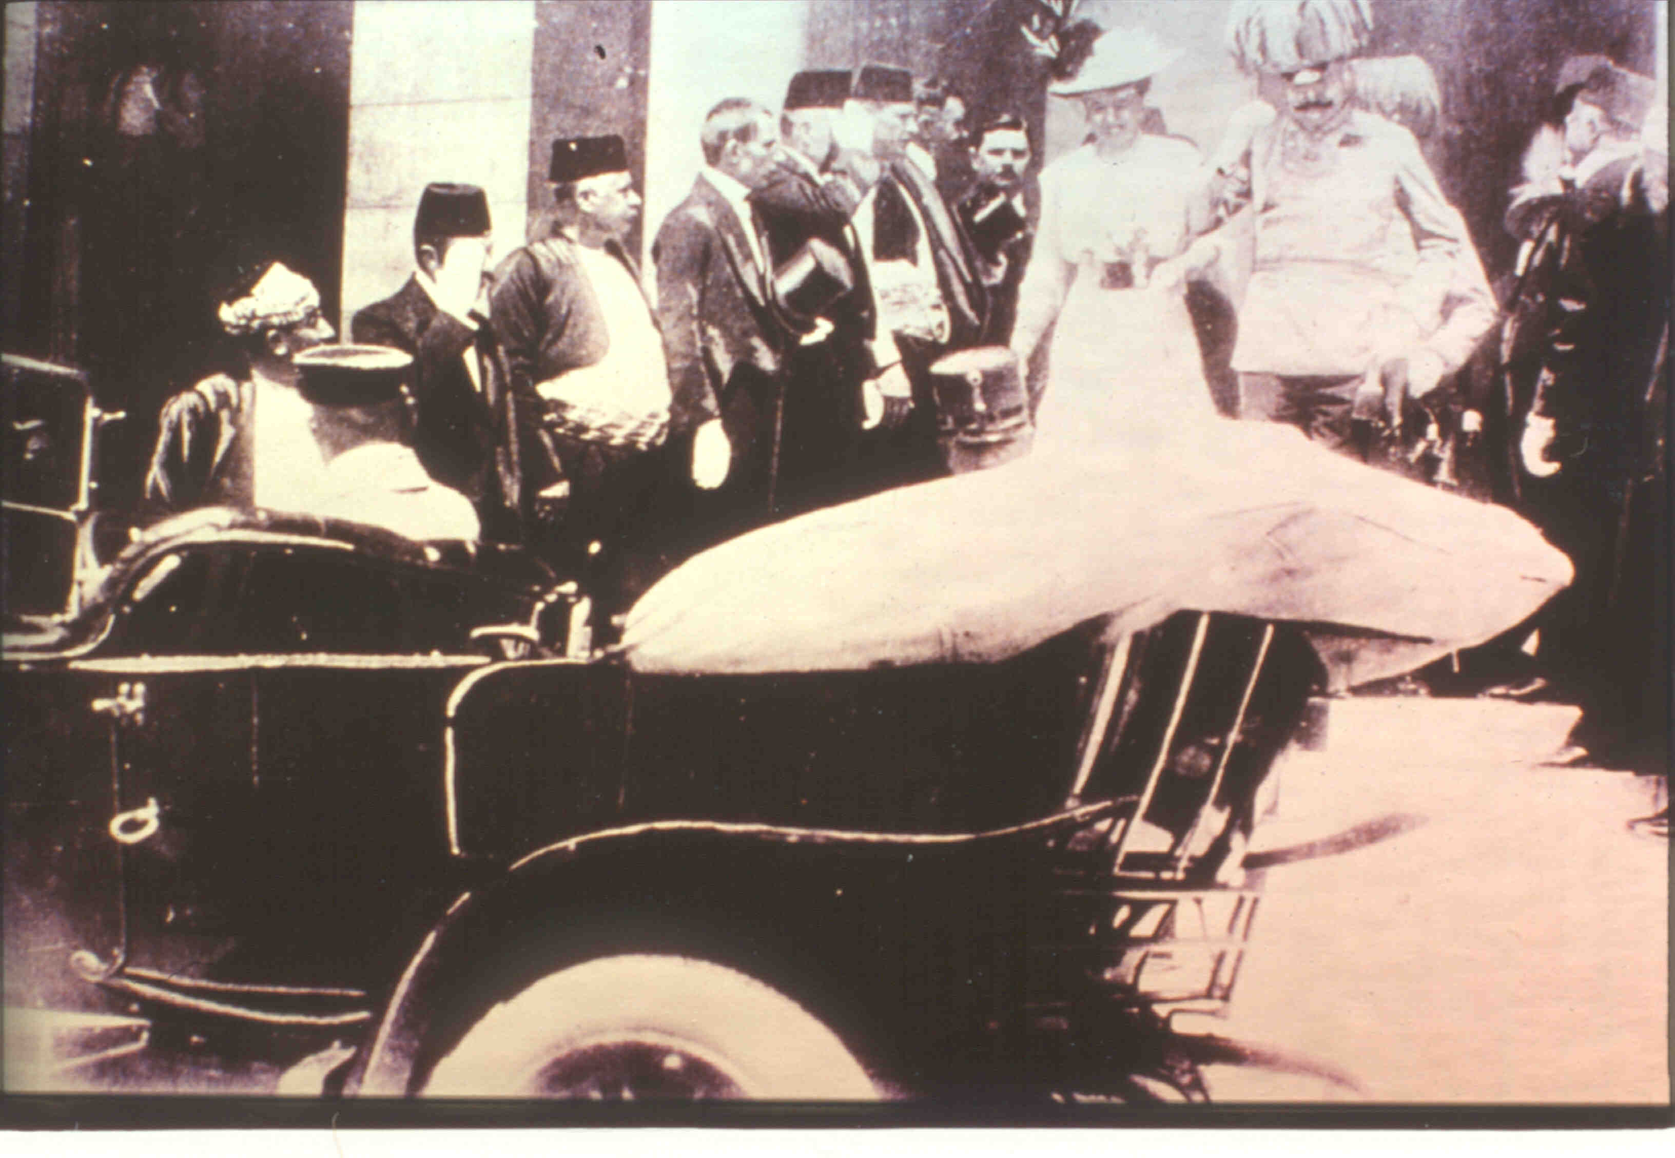
THE ARCHDUKE

Slide 13
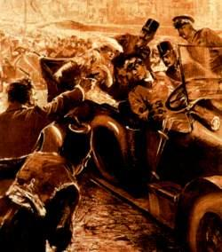

Slide 14
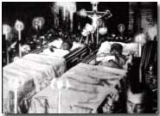
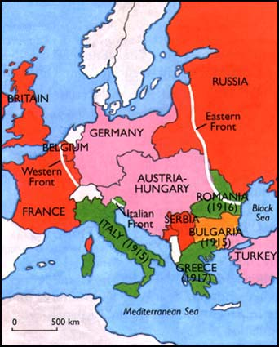
Event #2: Austria’s Ultimatum to Serbia
Austria believes the assassination was a conspiracy by the Serbian government
They send an Ultimatum (set of demands) to Serbia to allow their military to enter Serbia to conduct a full investigation

Slide 15
Event #2: Actions
Austria-Hungary gives the ultimatum to Serbia
Serbia Refuses the ultimatum
Austria-Hungary (Central Powers) and Serbia (Allied Powers) move to war
Serbia calls out to Russia for help
Russia moves to war (Allied Powers)

Slide 16
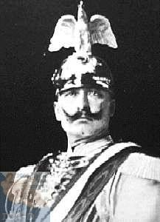
Event #3: Germany’s Blank Check
Germany offers Austria a blank check of support to back an invasion of Serbia
Germany tells France to not get involved in the conflict
Austria invades Serbia with German support
Russia mobilizes against Austria and Germany

Slide 17
Event #3: Actions
Germany gives ‘Blank Check” to Austria-Hungary
Germany (Central Powers) moves to war
Germany asks France to not get involved
France replies “Ouh Ouh We will not listen to you”

Slide 18
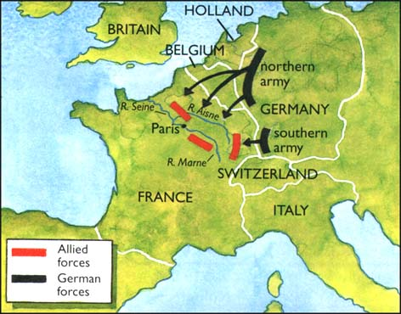
Event #4: The Schlieffen Plan
Germany trying to avoid a war on two fronts unleashes the Schlieffen Plan
Schlieffen Plan is the invasion of France thru the neutral country of Belgium
The goal is to knock France out of the war quickly on the Western Front then focus on defeating the Russians on the Eastern Front

Slide 19
Event #4: Actions
The German invasion of Belgium moves Belgium into war (Allied Powers)
France moves to war (Allied Powers)

Slide 20
Event #5: Alliance System Unravels
After Germany invades Belgium and France the Alliance system Unravels
Russia goes to war due to their alliance with Serbia
France goes to war due to their alliance with Russia
Britain goes to war due to their alliance with Belgium (France and Russia)
Italy goes to war due to its secret alliance with France
Ottoman Empire goes to war due to its alliance with Germany
The World is at War

Slide 21
Event #5: Actions
Britain moves to war (Allied Powers)
Italy moves to war (Central Powers)
Italy reads Secret Alliance Document
Italy moves to war (Allied powers)
Ottoman Empire moves to war (Central Powers)

Slide 22
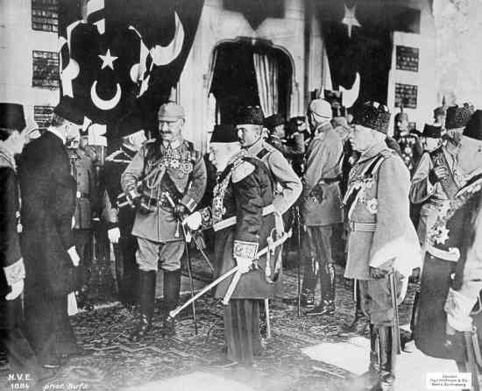
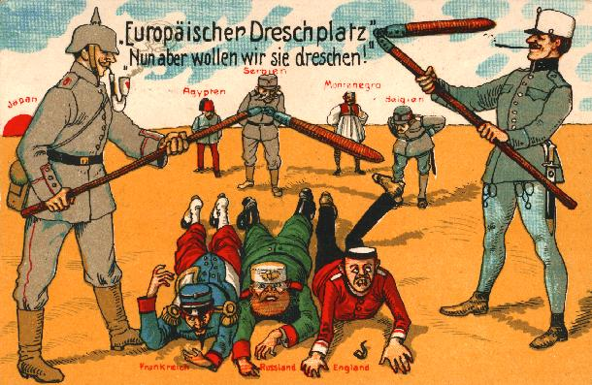
Triple Alliance
Germany
Austria-Hungary
Ottoman Empire (initially Italy)
Triple Entente
- France,
- Russia
- Great Britain

Slide 23
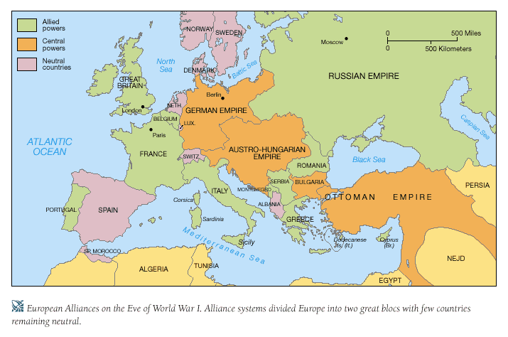

Slide 24
U.S. Makes an Entrance
United States enters the war for three major reasons
1. Sinking of the Lusitania – passenger liner torpedoed by German U-boats killing U.S. citizens
2. Zimmerman Telegram – Germany’s attempt to have Mexico invade the U.S. to prevent them from joining the war
3. Cultural Ties – Americas ties with Great Britain in terms of language, culture, and the belief in Democracy. U.S. wants to keep the world “safe for democracy”

Slide 25
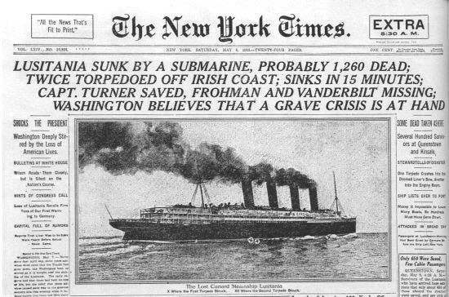

Slide 26
Assignment!
Write a news article (minimum ½ page) with a headline and details of the Lusitania sinking
Or
Draw a political cartoon of the Lusitania

Slide 27
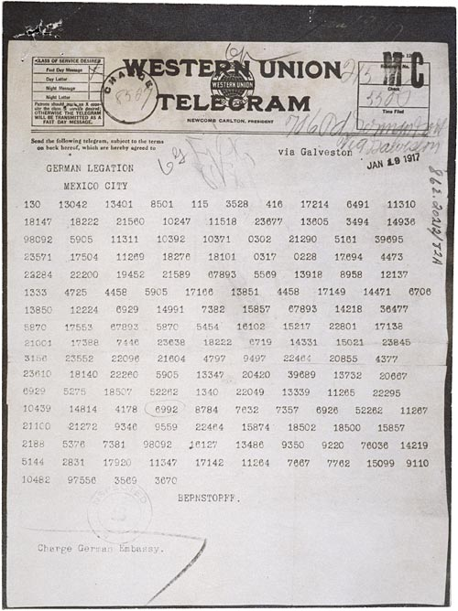
Zimmerman Telegram

Slide 28
Germany takes ‘Zimmerman Telegram’ to Mexico
Telegram is intercepted by the British
British give it to the Americans
Americans read the “Zimmerman Telegram”
U.S. joins the war (Allied Powers)
War!!!

Slide 29
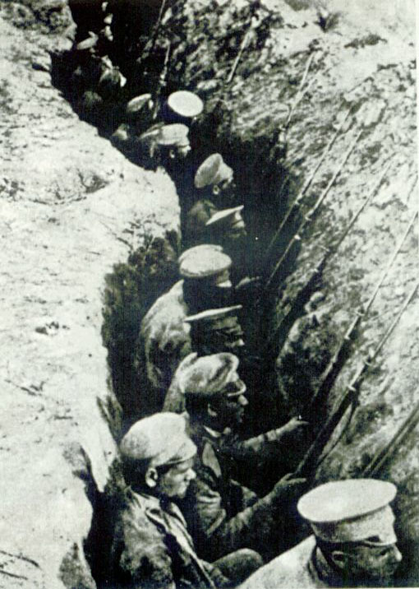
Event #6: Trench Warfare
Due to new technology such as mustard gas, planes and the machine gun produce stalemates along the front
Soldiers dig in and create the Trench system
Battles last for months over a few miles

Slide 30
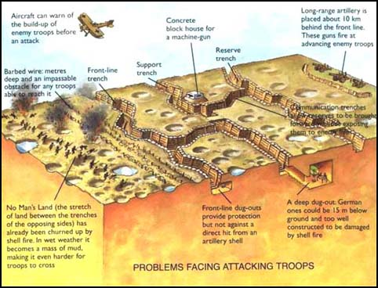

Slide 31
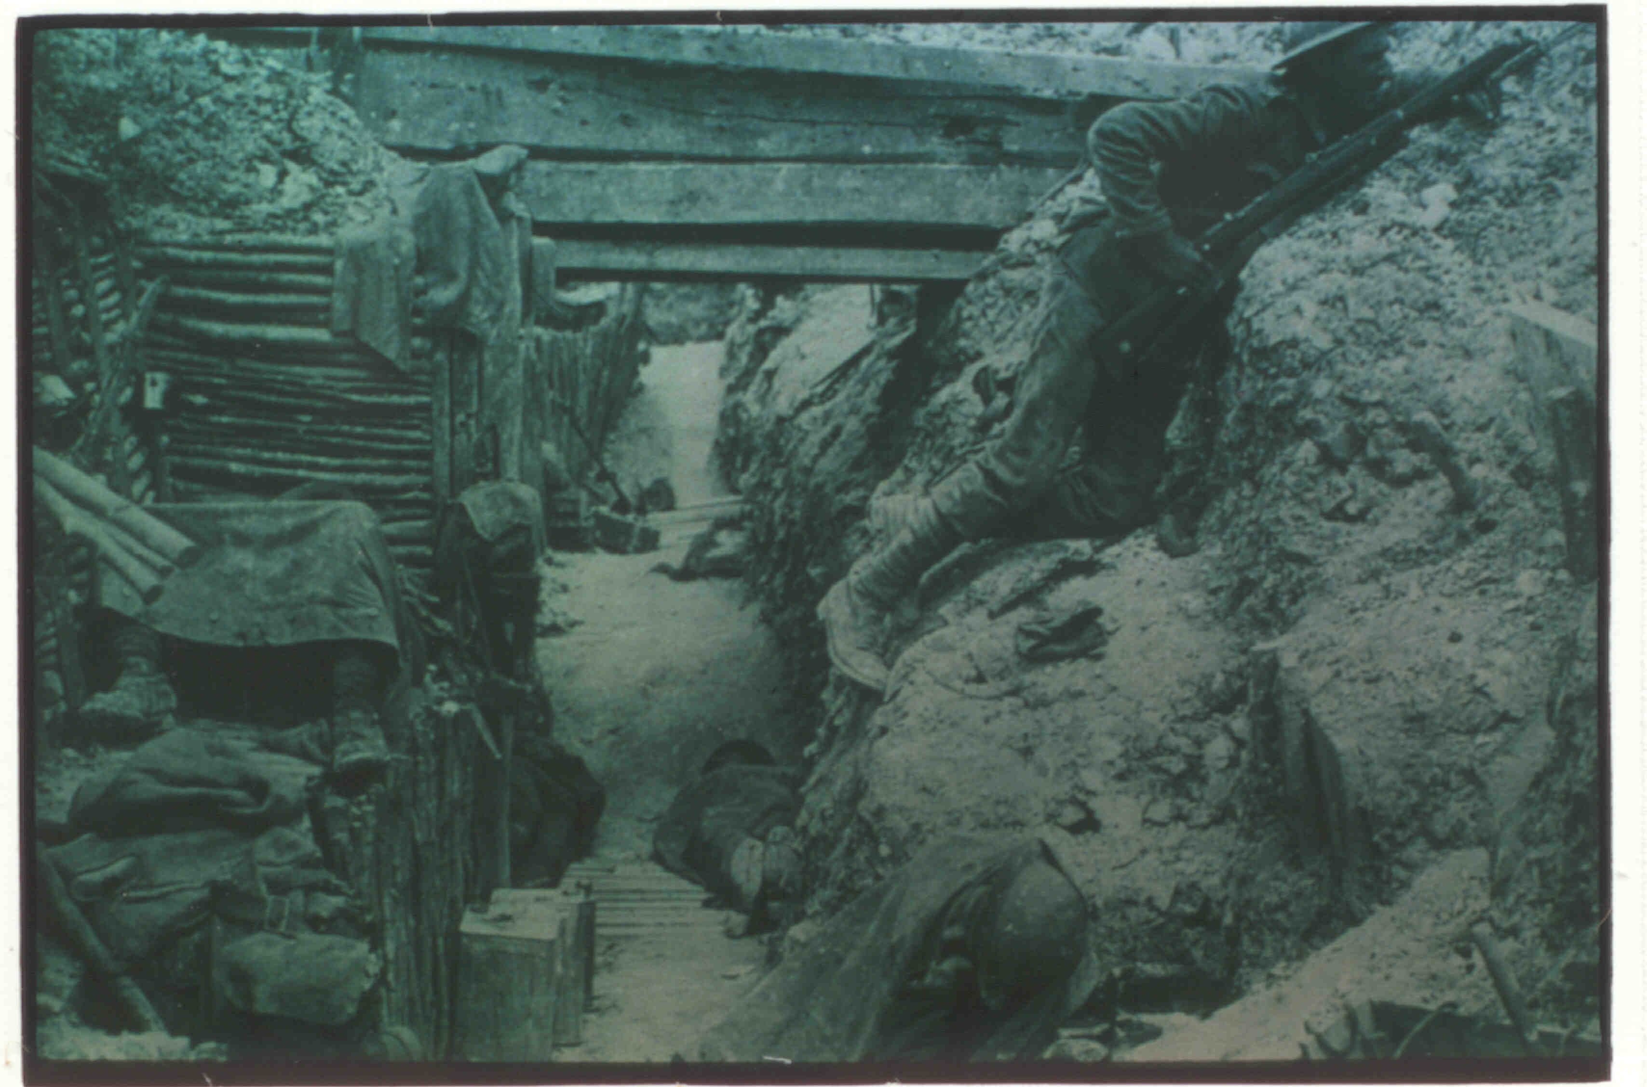

Slide 32
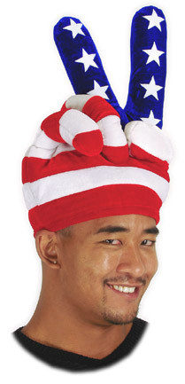
Event #10: Armistice (Peace)
With U.S. entry into the war, stalemates along the front end
U.S. quickly pushes Germany out of France
Germans, Austrians, and Ottomans in chaos within their countries
They agree to end the war
Armistice (end to war) occurs at 11 o’clock on 11/11/1918

Slide 33
Event #10: Action
Armistice is read to all countries
All countries come together and shake hands except Germany
Germany is forced to shake hands

Slide 34
Treaty of Versailles

