Slide 1
Populations
Ch. 24-2 Notes
EQ: What factors affect a population’s size

Slide 2
Characteristics of Populations
Three important characteristics of a population:
  Geographic distribution
  Population density
  Growth rate

Slide 3
Population Growth
Three factors can affect population size:
  The number of births
  The number of deaths
  The number of individuals that enter or leave the population

Slide 4
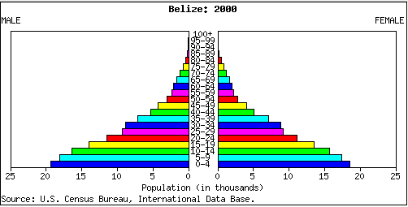
A fast growing population

Slide 5
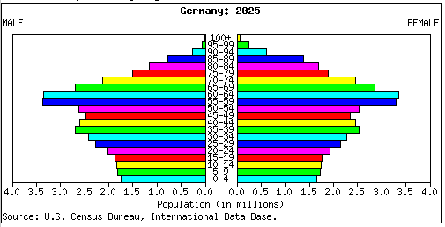
A Slow or Declining Population

Slide 6
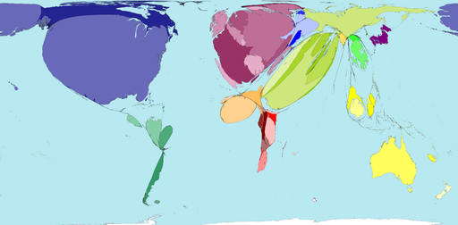
Immigration vs. Emigration
Immigration: the movement of individuals into an area
  Another factor that can cause a population to grow
Emigration: the movement of individuals out of an area
  Can cause a population to decrease in size

Slide 7
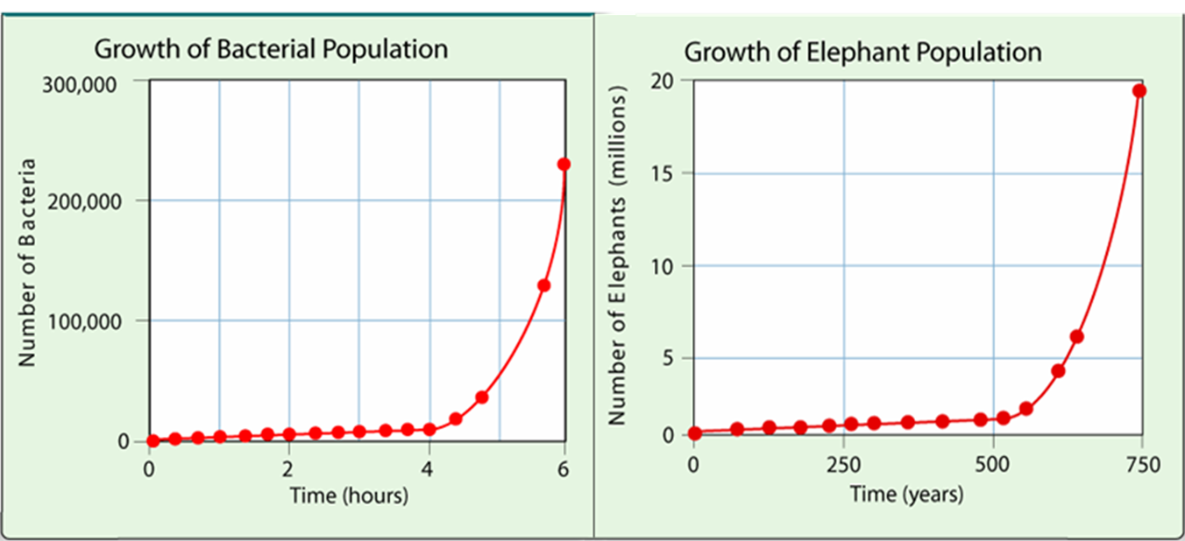
Exponential Growth
With ideal conditions with unlimited resources a population will grow expoentially.
  The population becomes larger and larger until it approaches an infinitely large size.

Slide 8
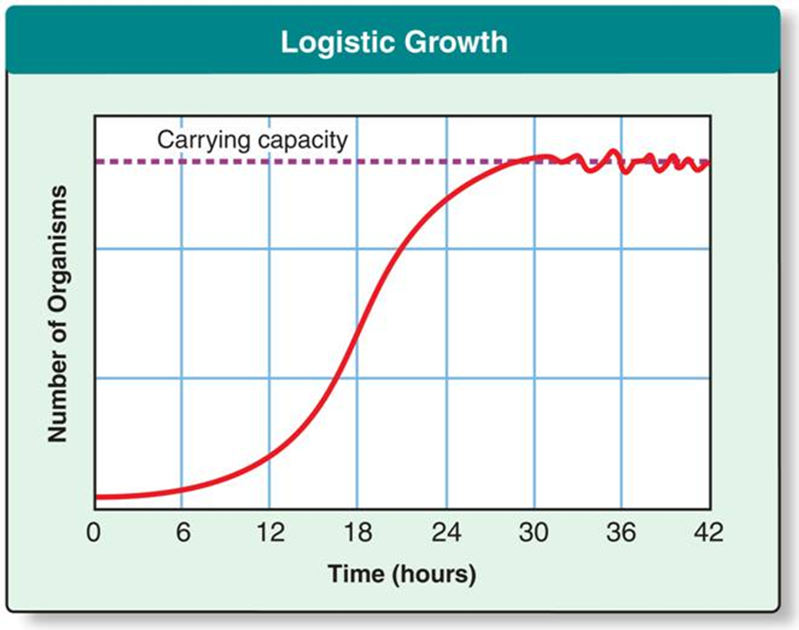
S-curve growth
As resources become less available, the growth of a population slows or stops

Slide 9
Review Question
What 2 charts show a rapidly growing population
  Pyramid/ S-curve
  Vase shape/ exponential curve
  Pyramid/ exponential curve
  Vase shape/ S-curve

Slide 10
Limiting Factors
The population can be reduced when there is an insufficient supply of a particular nutrient or resource
Limiting factor: a factor that causes population growth to decrease

Slide 11

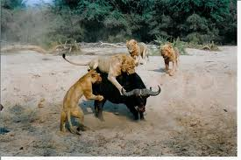
Examples of Limiting Factors
Biotic limiting factors include:
  Competition
  Predation
  Parasitism
  Disease
These factors are evident when a population gets really large and reaches a carrying capacity

Slide 12
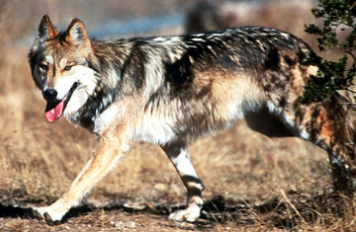
Biotic Limiting Factors
Competition: organisms compete for available resources (e.g. food, water, space, sunlight or other essentials)
  Can also occur between members of different species
Predation: regulation of a pop. by predation take place within a predator-prey relationship

Slide 13
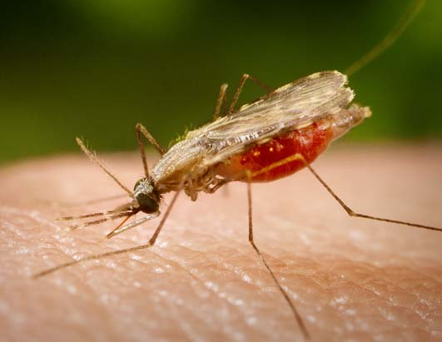
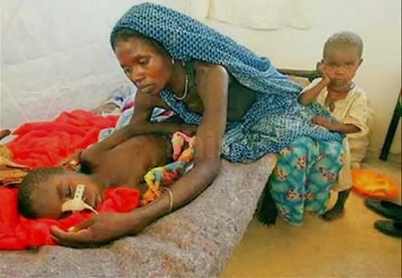
Biotic Limiting Factors
Parasitism and Disease
  A disease or parasite that is introduced into a population can reduce the population size
  (e.g. malaria)

Slide 14

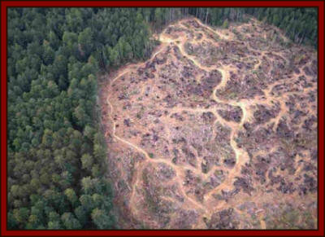
Abiotic Limiting Factors
Examples of abiotic limiting factors include
  Unusual weather
  Natural disasters
  Seasonal cycles
  Human activities : e.g. damming rivers and clear cutting forests

Slide 15
Review Questions
Which of the following would be a limiting factor affecting the panda population in China?
  Programs that educate people about endangered species
  Capture of some pandas for placement in zoos
  Laws protecting habitat destruction
  A disease that kills bamboo plants

Slide 16
Question 2
2. Biotic limiting factors operate most strongly when a population is
  Large and dense
  Large and sparse
  Small and sparse
  Small, but growing

