Slide 1
Do Now
Finish the chapter walk with your partner. ☺

Slide 2
Capitalism
What is it and where did it come from?

Slide 3

I. Background
Capitalism is an economic system in which investment in and ownership of the means of production, distribution, and exchange of wealth is made and maintained chiefly by private individuals or corporations.

Slide 4
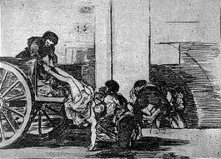
II. Roots of Capitalism
In the 14th century the Black Death and the Great Famine depopulated Europe.
This led to the collapse of the manor system due to serfs being able to rent or buy land from nobles who did not have enough people to work it.

Slide 5
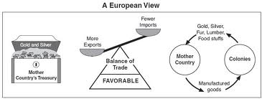
A. Mercantilism
Mercantilism stressed that a nation should export more then they import as a means of acquiring gold and other precious metals
Only materials not available at home should be imported
Zero sum…

Slide 6
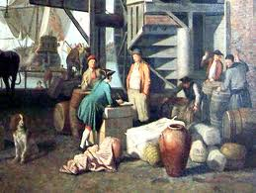
Wealth in Mercantilism
Under the mercantilist system, people believed that the wealth of the world was constant and the only way to gain wealth was to take it from another nation

Slide 7
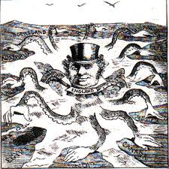
B. Colonialism
Mercantilism led to Colonialism, where nations sought out colonies that could supply them with materials that they could not get at home.
This led to the creation of trading companies who owned whole colonies like the Virginia Company or East India Company.

Slide 8

C. Industrial Capitalism and laissez-faire (hands off)
In the mid 1700’s, capitalism began to replace mercantilism as the main economic system in Western Europe and elsewhere
Laissez-faire means that the government does not interfere with the private economy

Slide 9
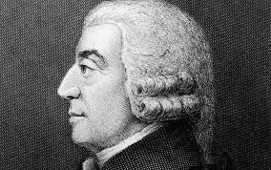
III. Adam Smith
In 1776 he wrote “The Wealth of Nations”
  Self-interst helps all (invisible hand).
  Division of labor
  Free markets (little government interference).
He believed that an “invisible hand” was always at work to promote the public good
Known as the father of modern economics

