Slide 1
Skin/Bone/Muscle Notes
Ch. 17
EQ: What does the skin do to maintain homeostasis and how does it provide protection from disease and other environmental factors?

Slide 2
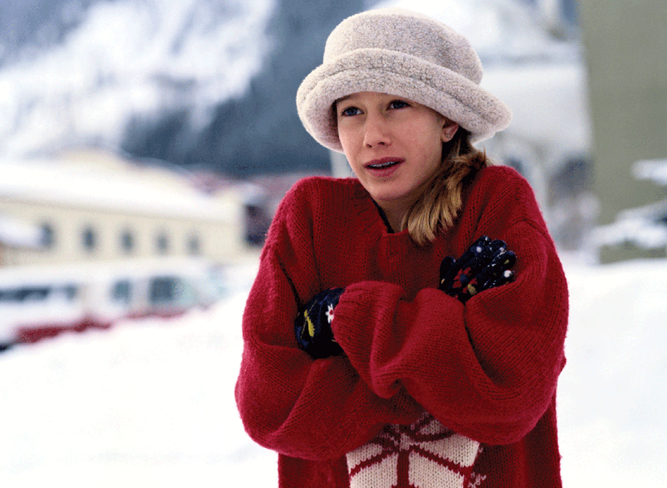
Homeostasis
Homeostasis is the regulation and maintenance of the internal environment of the human body.
e.g. – temperature, nutrient levels, CO₂ /O₂ levels

Slide 3
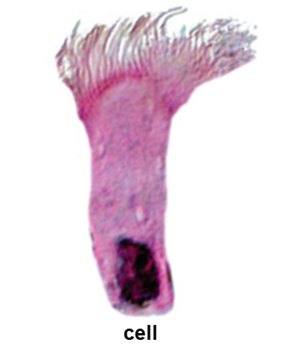
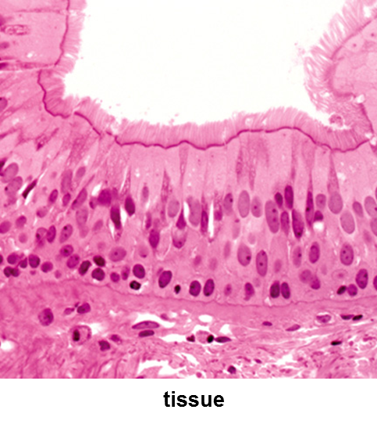
Levels of Organization
Cells, tissues, organs, organ systems, and whole organism
Tissues are groups of similar cells working together
Epithelial tissue
Connective tissue
Muscle tissue
Nervous tissue

Slide 4
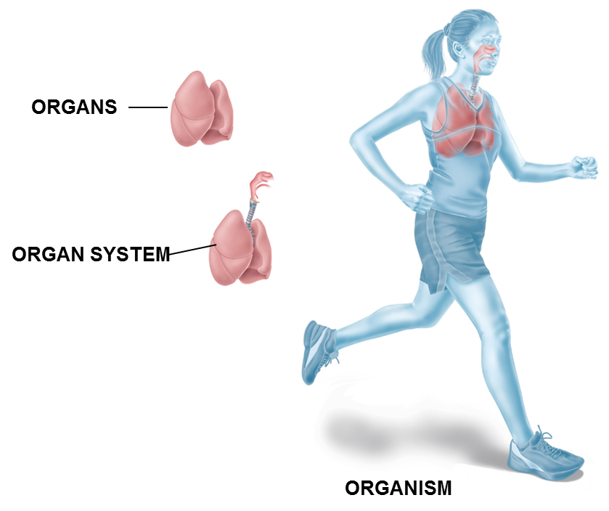
Levels of Organization
Organs are different tissues working together
Organ systems are two or more organs working together
Organism is all organ systems working together

Slide 5
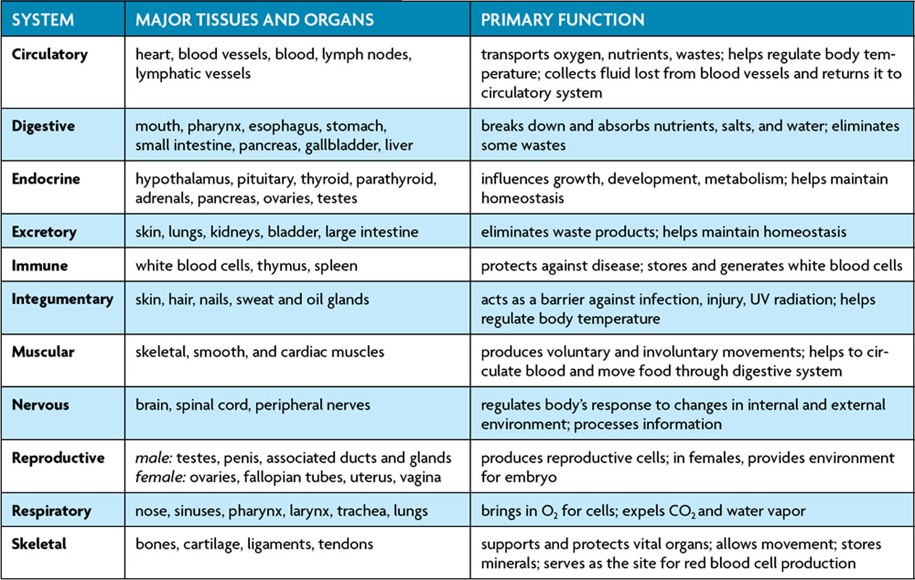
Organ Systems

Slide 6
Integumentary(Skin) System
Structure
Skin, hair, nails, sweat and oil glands
Function
Acts as a barrier against infection, injury, UV radiation; helps regulate body temperature
Shivers, sweating, goose-bumps

Slide 7
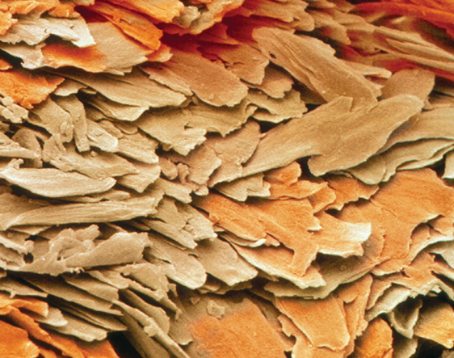
Integumentary System
Other important roles
Removes wastes and other substances through pores and glands
Water
Salts
Urea
There are 2 main layers of the skin
Epidermis
Outermost layer and contains keratin which makes cells waterproof and tough
Melanin is a dark pigment that absorbs UV rays

Slide 8
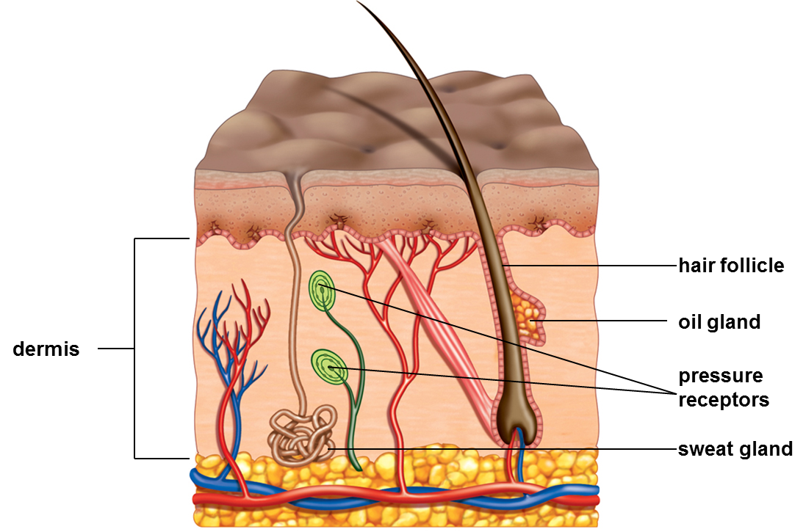
Integumentary System
Dermis – lower layer of skin and contains:
Sweat glands
Oil glands
Pressure receptors
Blood vessels
Hair follicles

Slide 9
Skeletal System
Structure
Bones, cartilage, ligaments, tendons
Function
Supports and protects vital organs, allows movement, stores minerals, serves as the site for red blood cell protection

Slide 10
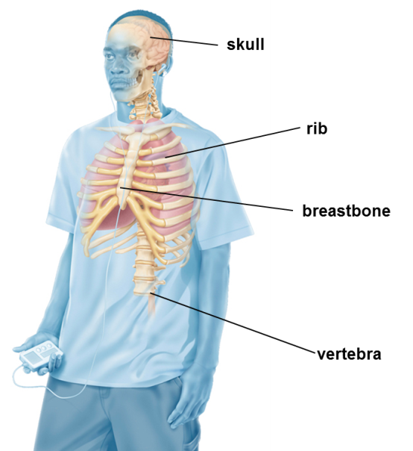
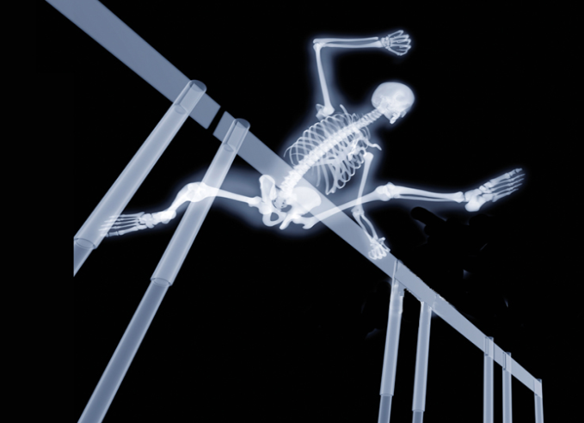
Skeletal System
The skeletal system is split up into 2 different categories:
Axial skeleton
Includes the skull, rib cage and spinal column
Appendicular skeleton
Includes shoulder blades, pelvis, legs, arms, feet and hands

Slide 11
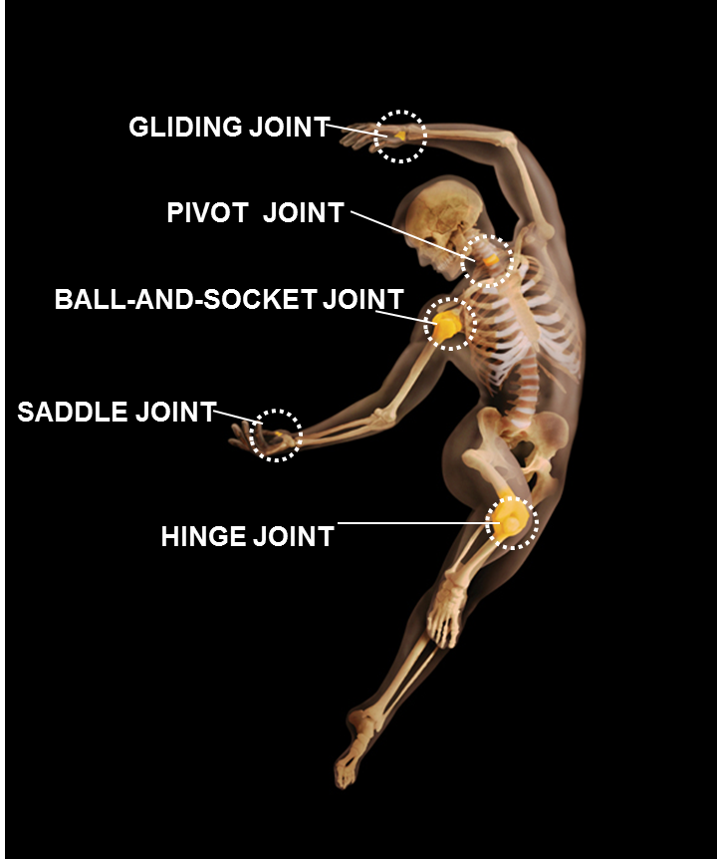
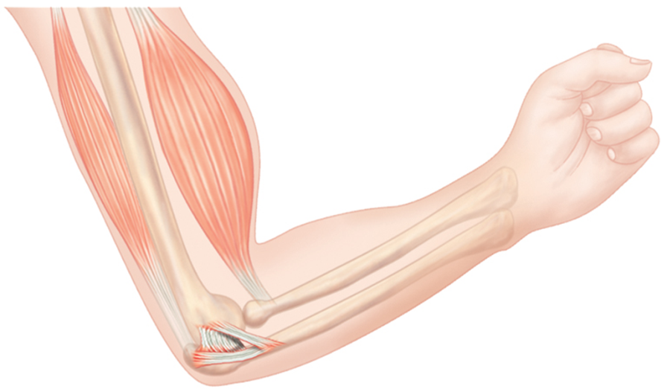
Joints and Ligaments
Joint: place were two bones meet
There are different types of joints and allow for different types of movement
Gliding
Pivot
Ball-and-socket
Saddle
Hinge
Ligaments are long bands of tissue that connect bones across a joint

Slide 12
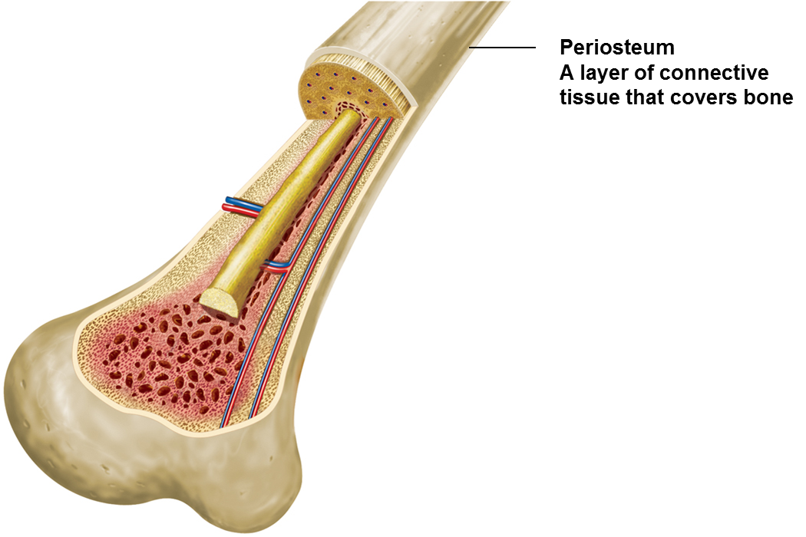
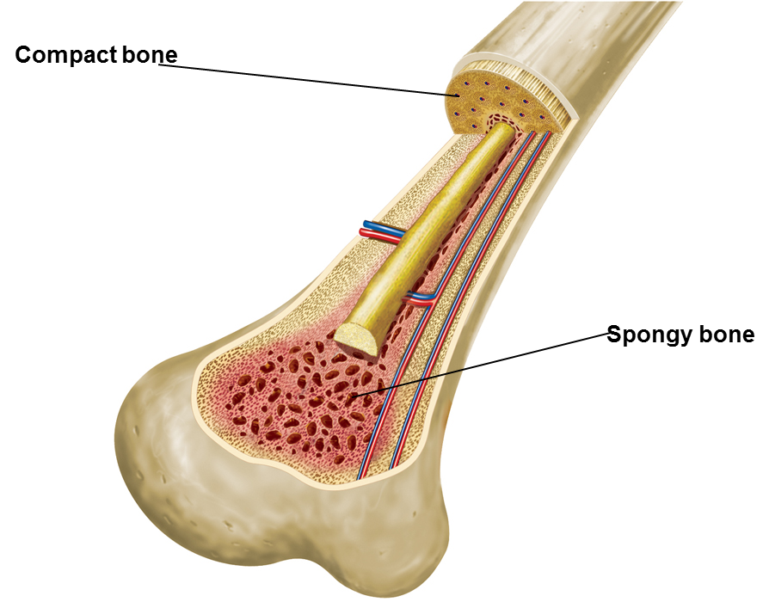
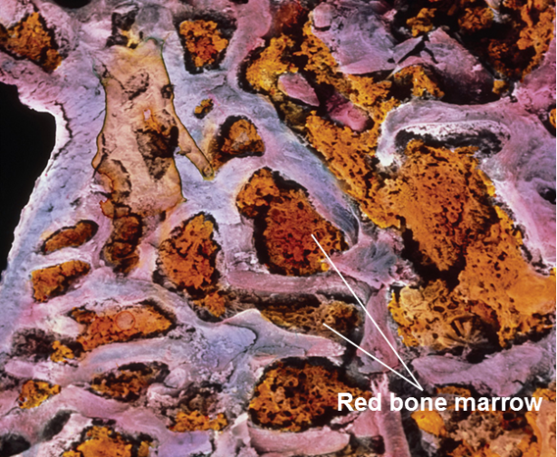
Bone Marrow
Bone is made up of different parts:
Periosteum
Compact bone
Spongy bone
Bone Marrow
In Red Bone Marrow red blood cells are produced
Yellow Bone Marrow is mostly made of fat

Slide 13
Muscular System
Structure:
Skeletal, smooth and cardiac muscle
Function:
Produces voluntary and involuntary movements, helps to circulate blood and move food through digestive system

Slide 14
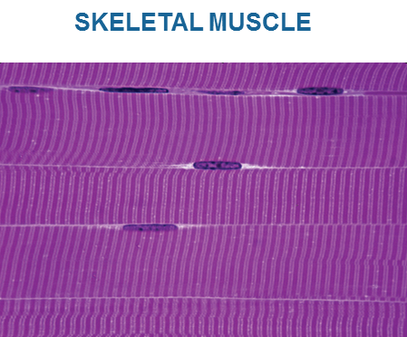
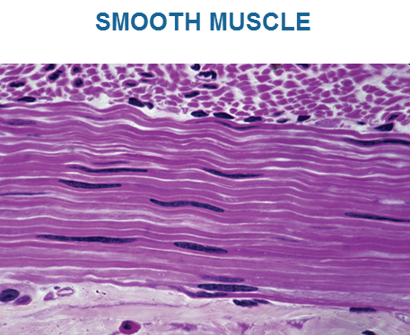
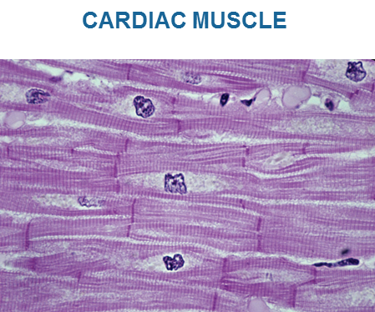
Muscular System
Three types of muscle tissue
Skeletal Muscle
Smooth muscle
Cardiac muscle

Slide 15
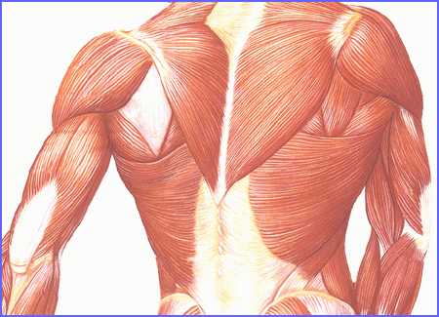
Skeletal Muscle
Attaches to the skeleton by tendons
Tendons connect muscle to bone
Skeletal muscles are mostly voluntary

Slide 16
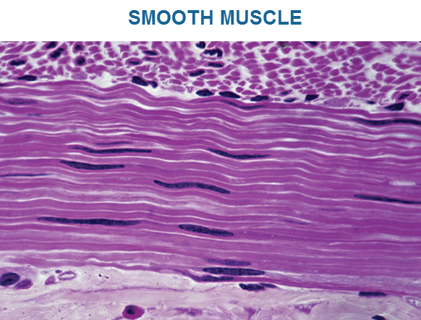
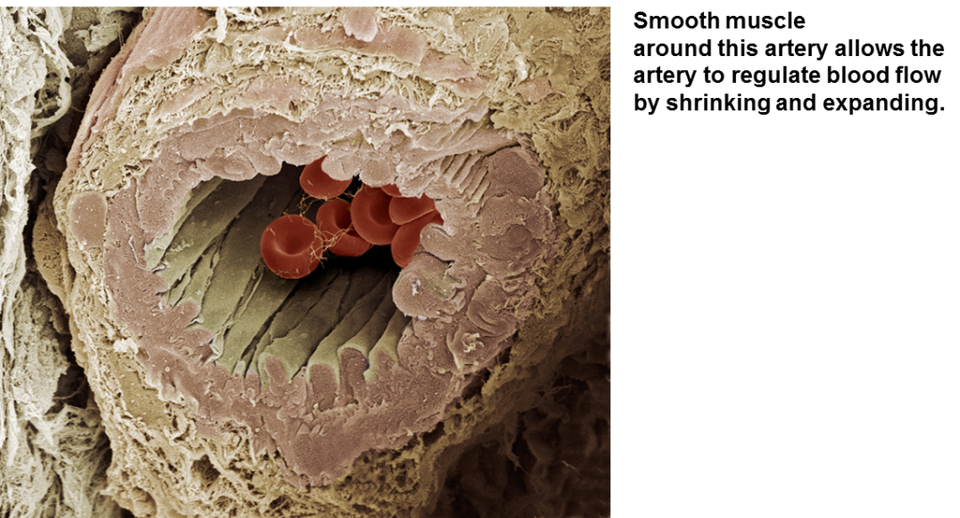
Smooth Muscle
Smooth muscle lines organs and is involuntary
Move food through digestive organs
Empty liquid from bladder
Control width of blood vessels

Slide 17
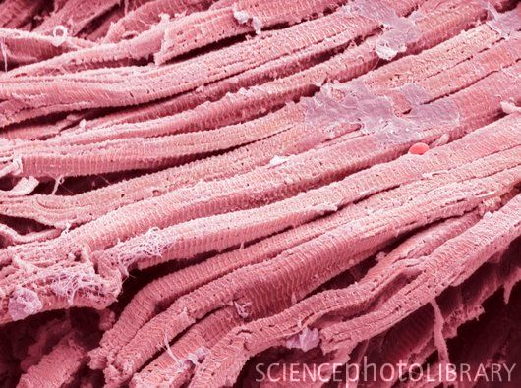
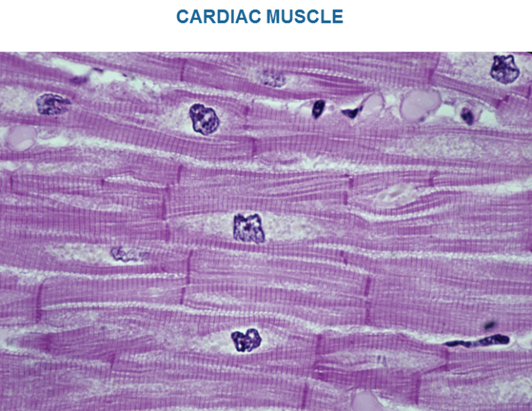
Cardiac Muscle
Cardiac muscle is found only in the heart
Pumps blood throughout body
Controlled by pacemaker
Contains more mitochondria than skeletal muscle cells

Slide 18
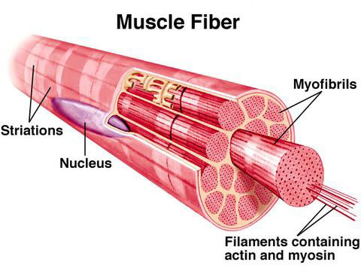
Muscle Contraction
The muscular system works with the nervous system to know when to contract and how many muscle fibers to fire.
Muscle Fibers
Made of myofibrils

Slide 19
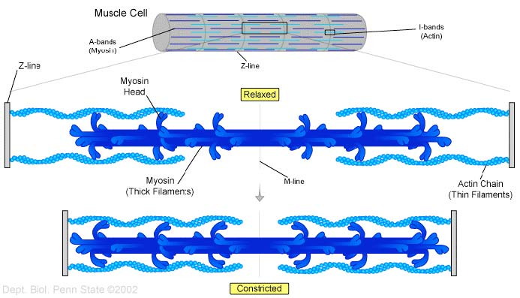
Muscular Contraction
Each myofibril is divided into sarcomeres
Sarcomeres contain filaments that cause contraction
Actin filaments are pulled during contraction
Myosin filaments pull actin during contraction

