Slide 1
Warm-up #6
Read page 59 of the Red book…
  How did the Enlightenment influence colonial society?

Slide 2
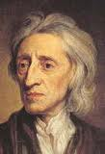
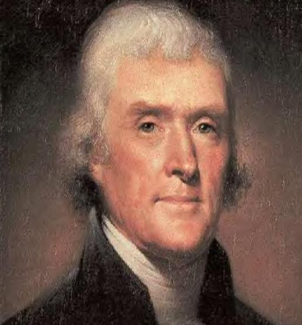
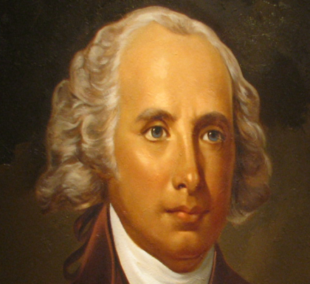
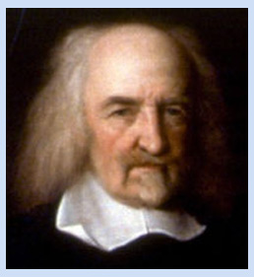
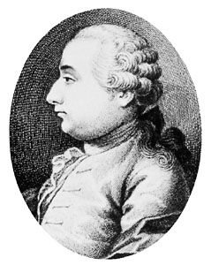
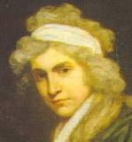
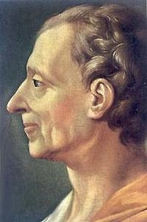
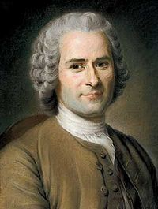

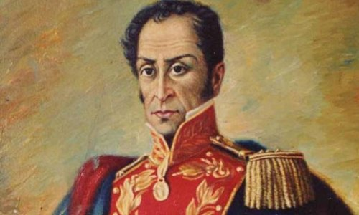
The enlightenmenTt

Slide 3

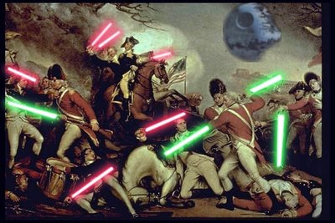
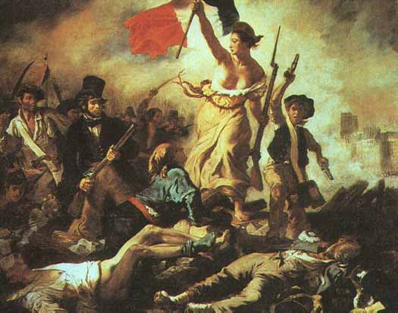
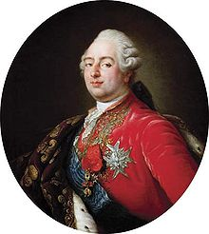
Who, what, AND WHERE?
Started in Paris, spread throughout Europe and American
Political thinkers at the heart of the movement.
  Their ideas inspired democratic revolutions in Europe, U.S., and Latin America.
    Reason→ people challenge the old ways of government absolutism
Louis XVI

Slide 4
Enlightenment Thought Card Sort
Using you prior knowledge and skills of inference match the name, philosophy, and quote or reach thinker.
No, you can’t use the book or any other resources (just your brains)!

Slide 5
Enlightenment X-Rays
Record what each thinker believed by their heart.
Record what the said by their mouths.
If you have extra time and space include how they influenced the USA somewhere by their hands or feet.

Slide 6
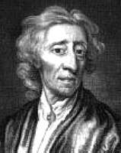

John Locke
English Philosopher
Beliefs:
  1. All men can reason
  2. Ppl. have natural rights to life, liberty, and ownership of property.
  3. Ppl. form govs. to protect those
  natural rights.
  4. If the gov. does not protect the natural rights, ppl. can form a new gov.
  5. Gov. gets it authority from the ppl. so it should do what the ppl. want.
His ideas used in the Declaration of Independence by Thomas Jefferson !

Slide 7
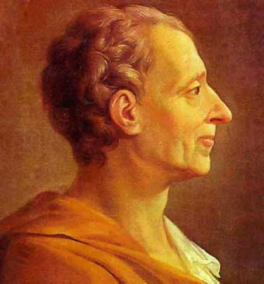

Charles-Louis Montesquieu
French Philosopher
Beliefs:
  1. Any person or group will try to increase their power
  2. Gov. kept under control through separation of powers.
  3. Governmental balance achieved with three branches of gov.→ checks and balances
Ideas used in the Constitution by James Madison

Slide 8
Jean-Jacques Rousseau
French Philosopher
Beliefs:
  1. Advocated direct democracy→ he advanced democracy
  2. A social contract exists between citizens and the gov.
    Unlike Hobbes, he believed people could live peacefully in a state of nature
  3. Gov. should respond to the people’s will—consent of the governed

Slide 9
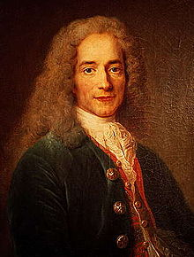
Voltaire
French writer, historian, and playwright.
Beliefs:
  1. Advocated for freedom of expression, freedom of religion, and separation of church and state.
  2. Arrested several times and eventually exiled for his criticism of the Church and government.

Slide 10
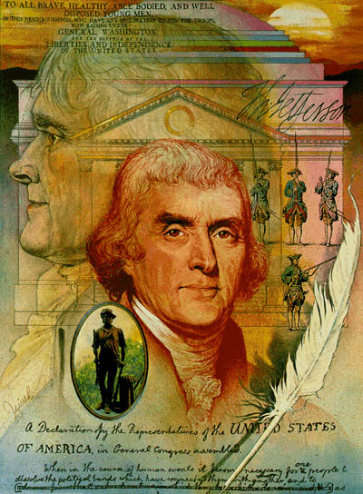
Thomas Jefferson
Beliefs: Influenced by Locke
  1. Rights received at birth (unalienable rights)
  2.Government in power because the ppl. put it there→gov. must do what the ppl. want.
Main author of the Declaration of Independence.
  His statement, “Life, liberty, and the pursuit of happiness” is similar to Locke’s idea.

Slide 11
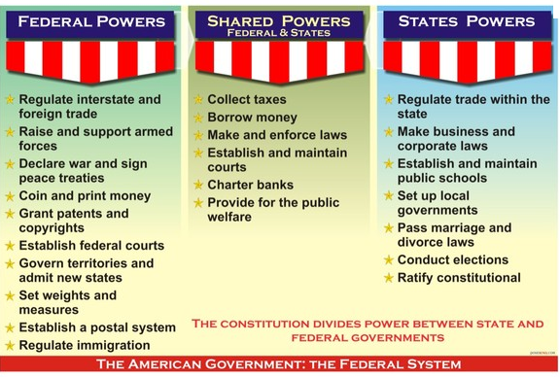
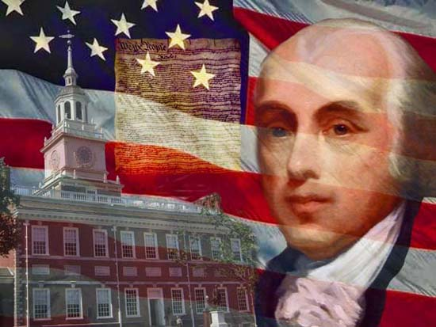



James Madison
Know as the “Father of the Constitution”
Created the Federal system
  Gov. power divided between a central gov. and local gov.
Came up with the idea for the Great Compromise→ bicameral Congress

