Slide 1
Annotating a Text
La Quinta World History
2013

Slide 2

Our goal with complex text is to slow you, the reader, down.

Slide 3

Annotation is a note of any form made while reading text.
“Reading with a pencil.”

Slide 4

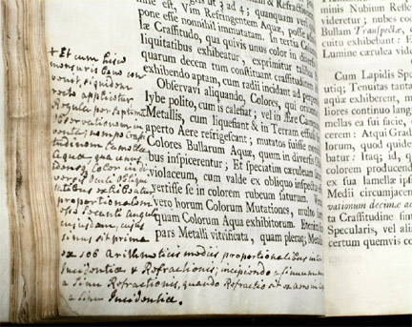
People have been annotating texts since there have been texts to annotate.

Slide 5
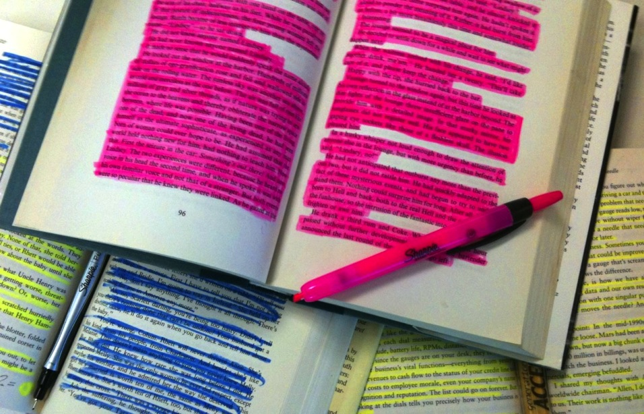
Annotation is not highlighting.

Slide 6

Annotation slows down you, the reader, in order to deepen understanding.

Slide 7
General Annotations
Underline for major points/Vertical lines in the margin for statements that are too long to be underlined
Star to emphasize the most important statements
Numerate arguments (numbers) in the margins to indicate sequence of points to develop an argument
Draw an arrow (↵) when you make a connection to something inside the text, or to an idea or experience outside the text. Briefly note your connections.
Mark EX when the author provides an example.

Slide 8
General Annotations
Page numbers in the margin to indicate other places the author makes the same point
Circles for key words or phrases
Questions (?) in the margin or at the top or bottom of the page that come to mind while reading
Exclamation mark (!) for things that surprise you, and briefly note what it was that caught your attention

Slide 9
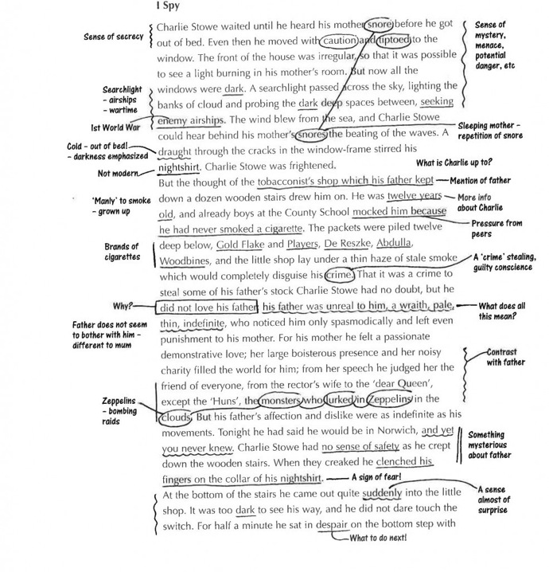
Modeled annotation in Seventh Grade

Slide 10
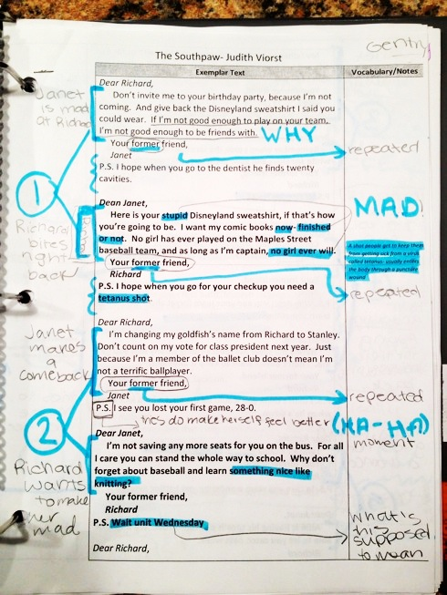
Student annotation in 6th grade
Student sample from Leigh McEwen, AEA 9, Iowa

Slide 11
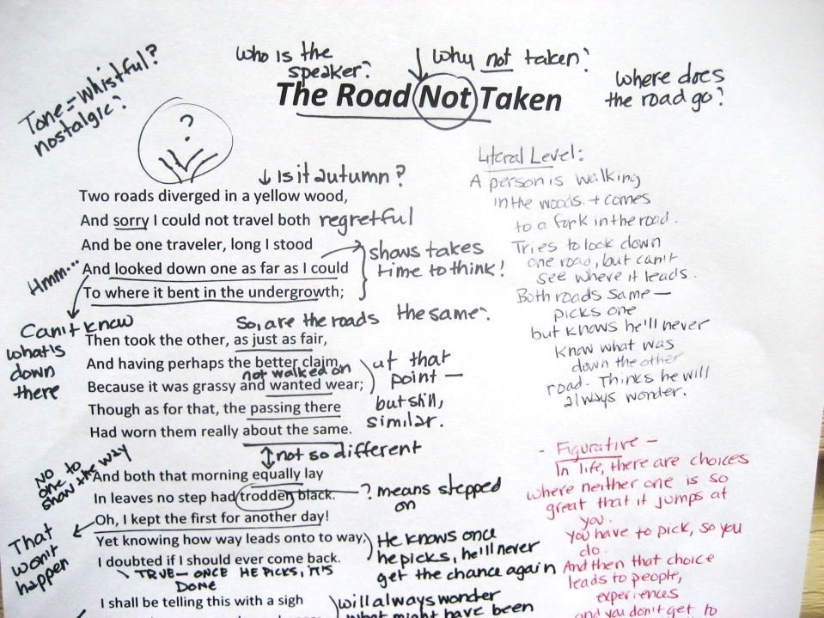
Modeling in 9th Grade English

Slide 12
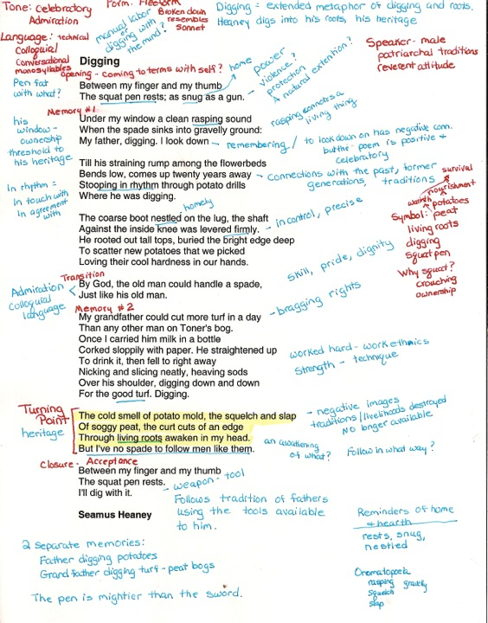
Student annotation in 11th grade English

Slide 13
After you annotate- what next?
After you annotate, transfer your margin notes into the “8 stages of flow-map chart”

Slide 14
How fellow writers talk?
1. Tell your fellow write what you liked best.
2. Retell the story or main ideas in your own words.
3. Ask questions about the parts you don’t understand.
4. Give your fellow writer your good ideas about making it even better.
5. Thank the writer for sharing his or her writing with you.

Slide 15
Sample: Applying Text to Speaking
Making a claim
    I think that_________, because ________________.
    Although I agree that ______________, I still think that _________.
    She says ______, and I agree, because _________.
Supporting/critiquing a claim
    Her idea that __________ is supported by _______________, ___________, and _______.
    For example, ________________ shows that ________________.
    They say that ___________ , but _______, _____, and ____ say differently.
Introducing and addressing a counterargument
    Of course, you might disagree and say that _________________.
    Some might say _________, but I would say that _____________.
    While it is true that __________, that does not always mean that _________.
Stating a conclusion or summing up an argument
    In conclusion, I believe ____________________.
    In sum: _____________ is shown by _____________ and ______________.
    For these reasons, _______________ should be ________________.

Slide 16

Develop Text-dependent Questions for Your Reading
Do the questions require the reader to return to the text?
Do the questions require the reader to use evidence to support his or her ideas or claims?
Do the questions move from text-explicit to text-implicit knowledge?
Are there questions that require the reader to analyze, evaluate, and create?
Table Leaders

