Slide 1
Ch. 5-1 Mendel Genetics and Heredity
EQ: How do scientist use Punnett squares to predict the genetics of an individual?

Slide 2
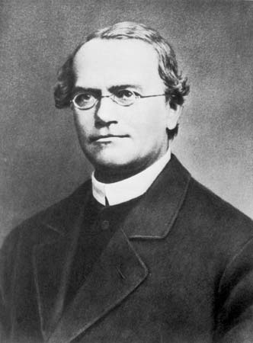
Gregor Mendel’s Peas
Genetics is the scientific study of heredity.
Gregor Mendel was an Austrian monk . His work was important to the understanding of heredity
Mendel carried out his work with ordinary peas.

Slide 3
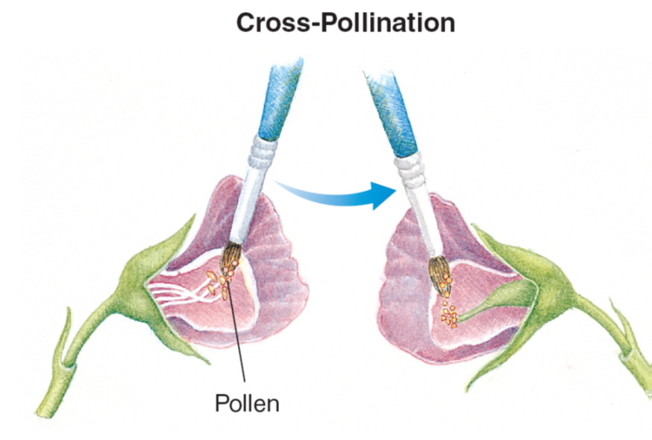
Gregor Mendel’s Peas
Cross-Pollination
Mendel was able to produce
seeds that had two different parents

Slide 4
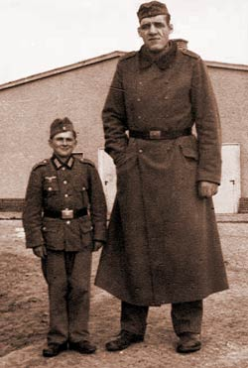
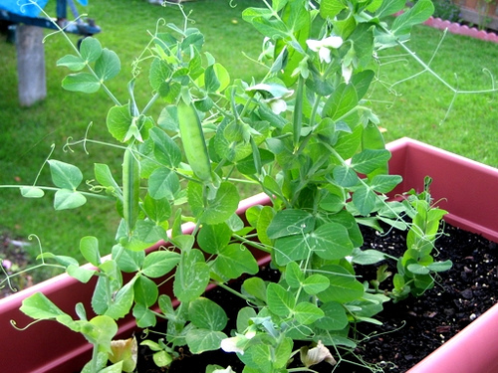
Genes and Dominance
A trait is a specific characteristic that varies form one individual to another
Mendel studied seven pea plant traits, each with two contrasting expressions.
Mendel studied the off-spring of parent plants that were cross-pollinated

Slide 5
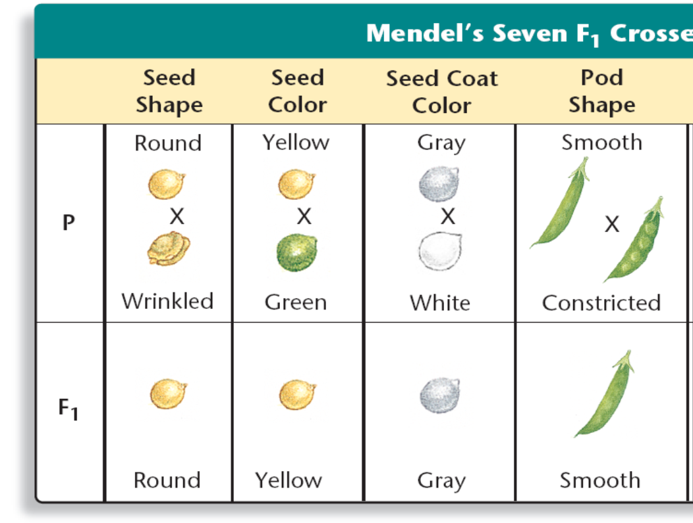
Genes and Dominance
The offspring (F₁) of crosses between parents (P) with different traits are called hybrids

Slide 6
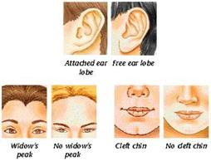
Mendel’s first conclusion
Was that biological inheritance is determined by factors that are passed from one generation to the next.
Today, scientists call the factors that determine traits genes

Slide 7
Mendel’s Conclusions
Each trait Mendel studied was controlled by one gene that occurred in two contrasting forms that produced different expressions
The different forms of a gene are called alleles
Mendel’s second conclusion is called the principle of dominance
The principle of dominance states that some alleles are dominant and others are recessive

Slide 8
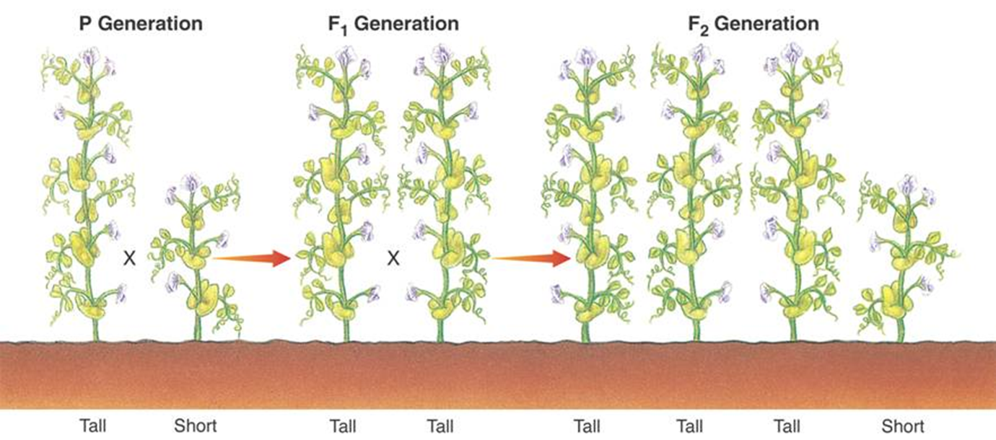
Segregation
Mendel crossed the F₁ generation with itself to produce the F₂ generation
The traits controlled by recessive alleles reappeared in one fourth of the F₂ plants.

Slide 9
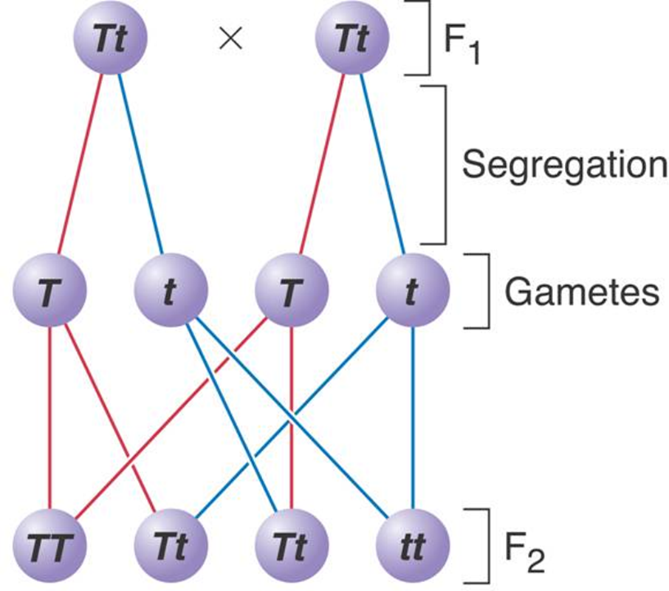
Segregation
The reappearance of the trait controlled by the recessive allele indicated that at some point the allele for shortness had been segregated from the allele for tallness

Slide 10
Question 1
The offspring of crosses between parents with different traits are called
Alleles
Hybrids
Gametes
Dominant

Slide 11
Question 2
If a particular form of a trait is always present when the allele controlling it is present, then the allele must be
Mixed
Recessive
Hybrid
Dominant

Slide 12

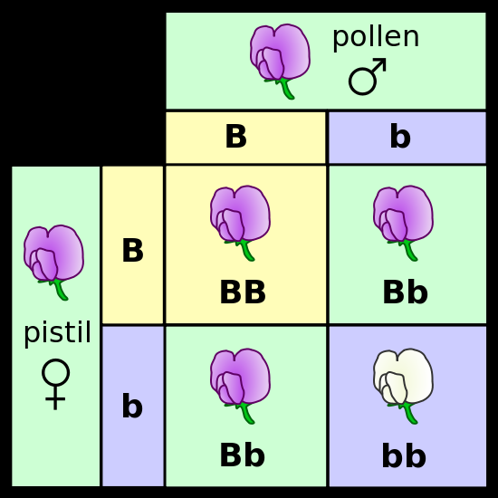
Genetics and Probability
The likelihood that an event will occur is called probability
The principle of probability can be used to predict the outcomes of genetic crosses

Slide 13
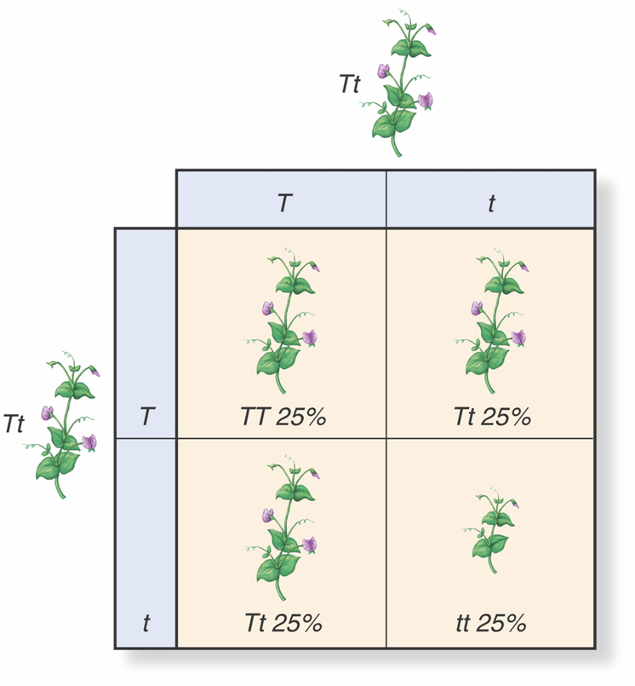
Punnett Squares
The possible gene combinations resulting from a genetic cross can be determined by using a Punnett Square
Capital letter represent the
dominant allele
Lowercase letter represents
the recessive allele

Slide 14
Punnett Squares
Organisms that have two identical alleles for a trait are called homozygous (TT or tt); considered to be true-breeding for a trait
Organisms that have two different alleles for a trait are called heterozygous (Tt); considered to be a hybrid for a trait

Slide 15
Punnett Squares
Phenotype: physical characteristic
Genotype: the genetic makeup
Punnett square to the right has only 2 phenotypes: Tall or Short
Genotypes: TT, Tt and tt

Slide 16
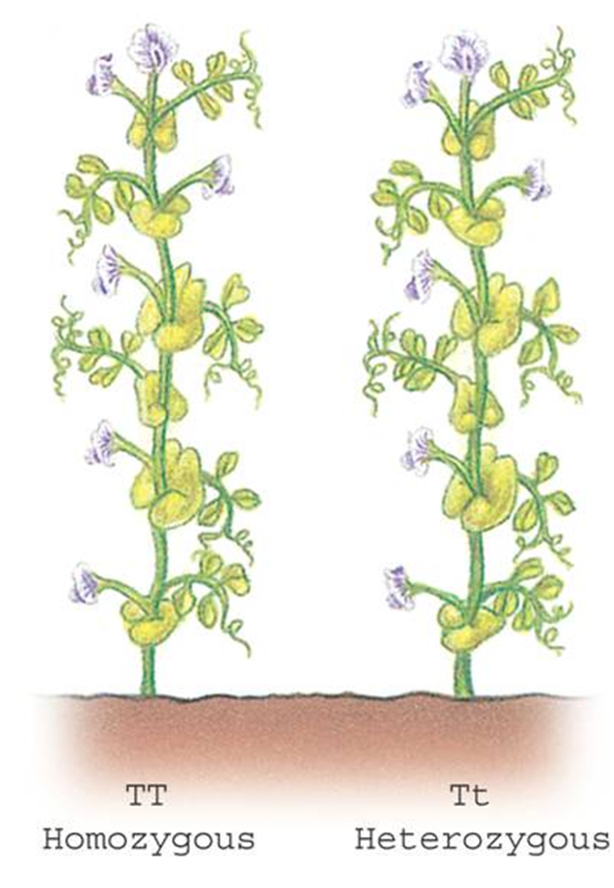
Punnett Squares
The plants have different genotypes (TT and Tt), but they have the same phenotype (tall)

Slide 17
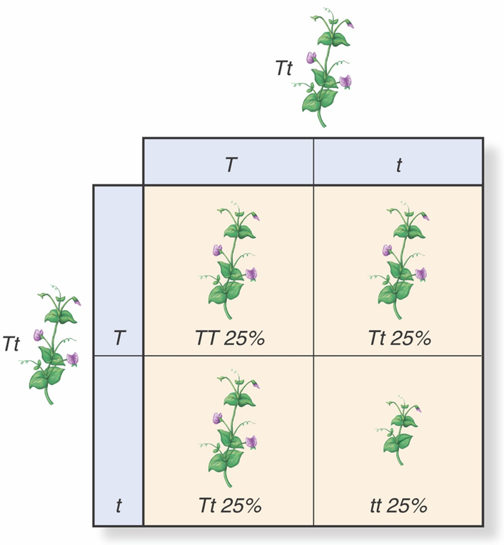
Probability and Segregation
¼ of the F₂ plants have two alleles for tallness (TT)
2/4 or half have allele for tall (T) and one for short (t)
¼ of the F₂ have two alleles for short (tt)

Slide 18
Question 3
Organisms that have two different alleles for a particular trait are said to be
Hybrid
Heterozygous
Homozygous
Recessive

Slide 19
Question 4
Two F₁ plants that are homozygous for shortness (tt) are crossed. What percentage of the offspring will be tall?
100%
50%
0%
25%

