Slide 1
How does a bill become a law?
Ms. Mendoza
PLHS
Government
12th Grade

Slide 2


Notes
On a blank piece of paper write the following information:
  Name
  Date
  Period
  Notes: How Does a Bill Become a Law?
  Warm up Question: What does the word “alien” make you think of?
I will tell you what to write down in your notes.
  Feel free to write additional notes (I WON’T STOP YOU!)
Green Light for Notes!
Notes:
Schoolhouse Rock Video!
http://www.youtube.com/watch?v=nlka6fTnDnI

Slide 3
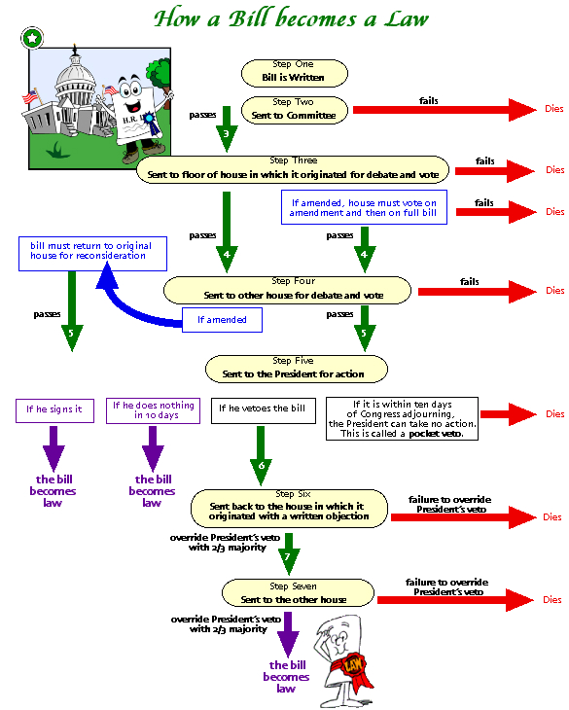
Notes:
*Focus on the “floor of house” section
Purpose of Congress= to make laws=legislative branch.
*Tell students to copy down the first 5 steps in their notes.

Slide 4
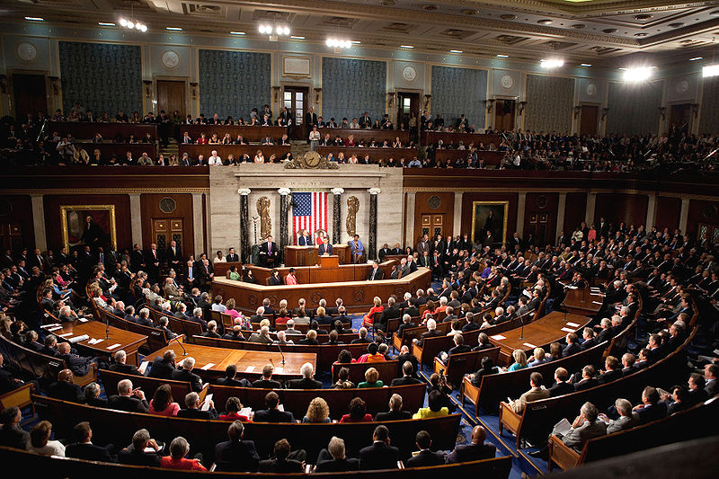
The House has 435 members, how does any work get done?!
Committees do most of the work in Congress
  Work = making bills to make them into laws
  Work is more efficient through committees
  Representatives have more influence in committees than House floor
Members of the House of Representatives focus on issues from constituents (people they represent)
Notes:
An example of this is how they wrote letters to their representatives, they (students) are constituents.
Tell students to copy down information about committees

Slide 5
H.R. 4437 Committee Handout
H.R. = House of Representatives
This bill has gone through STEP #1 of making a bill into a law, it has been written.
Now you will do STEP #2=Send the bill to committee
  As members of the committee you have to figure out what this bill is saying.
  Take notes on what the bill is trying to do
  PLEASE WRITE DOWN YOUR NAME, DATE, PERIOD.
  You have 4 minutes.
  If you finish early, begin to write down pros & cons of the bill in the margins or on the back.
Notes:
Sections of an actual bill about immigration
Information in brackets, I added in.
At the end of the individual work, Think. Pair. Share. (2 minutes)
Have 3 students share out for each of the boxes, show my answers on the doc cam for each one.

Slide 6
STEP #3: Floor of House-
For Debate & Vote
Groups of 5-6 people
  I will assign them
Your whole group needs ONE sheet of paper
  Write down all group member’s names, date, period.
  In two columns labeled “pros and cons” write down reasons you are for the bill and reasons you are against the bill.
  You have 4 minutes.
  Then your group will share.
  We will VOTE!
Notes:
When students are sharing, have them share out one pro and one con per group.
After the vote, tell students that this bill was passed in reality in the House of Representatives in 2005.
Sparked massive protests and lots of students walked out from the schools.
It was not passed by the Senate, so the bill died.
Review the steps on the chart in the powerpoint for how a bill becomes a law (refer to what we did in class that outlines the steps).

Slide 7
Exit Slip!
Turn over your “H.R. 4437” handout onto the blank side.
Answer these REQUIRED questions:
  Describe the five steps to make a bill into a law.
  What purpose do committees serve in Congress?
If you finish early answer these questions:
  Why are committees more important in the House than in the Senate?
  If you were a member of Congress what kind of bill would you write and what would it say?
Pass your completed handout/exit slip forward to the front of your row.
Homework: pg. 137 #4 & #5
Notes:
If some time is left, ask students to share out responses.
Ask one student to state first step, another student 2nd step etc.
Ask students to share out what bill they would make and what would it say?

