Slide 1

8th Grade Literary Terms

Slide 2

Cornell Notes
Use a different color for the name of the term, its definition and its example
Holes go on left side.
Name (first and last)
Period #
Date
Figurative Language
Essential Question: What are the literary devices that impact my understanding of a text?
What is a simile?
Definition: It is a comparison using the words like or as
Example: Her eyes shined like diamonds

Slide 3
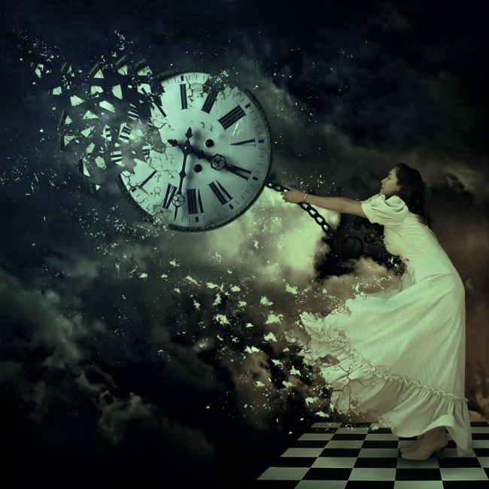
Figurative Language
A means of saying something other than in the literal meaning of the words. The writer uses other images, usually unusual ones, to make a
comparison
between unlike things
so that their similarities
present a different, but revealing way, of looking at the subject.

Slide 4
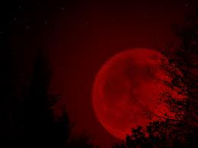
Simile
A comparison between two unlike things that uses the word “like” or “as.”
Example:
The moon appeared as a large drop of blood.
Jake was like Michael Jordan out there on the court tonight.

Slide 5
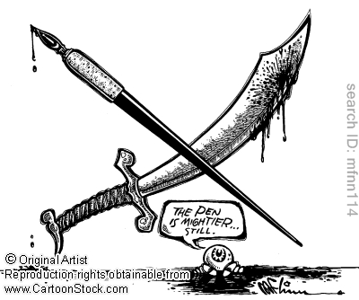
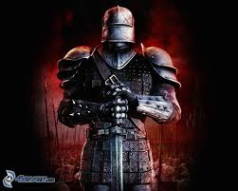
Analogy
A comparison between two things, typically on the basis of their structure and for the purpose of explanation or clarification.
Example: "Just like a sword is the weapon of a warrior, pen is the weapon of a writer."

Slide 6
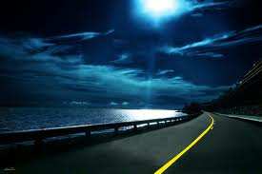
Metaphor
A comparison between
two things not usually
compared to each other.
Example:
The road was a ribbon of moonlight
Her hair, a spider web of tangles.

Slide 7
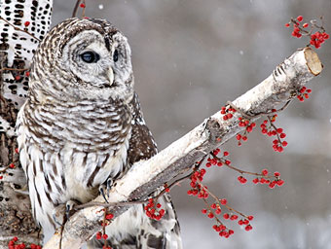
Symbol/Symbolism
Something on the surface level has one meaning, but which also has another meaning.
Example:
Light symbolizes knowledge.
An owl symbolizes wisdom.

Slide 8
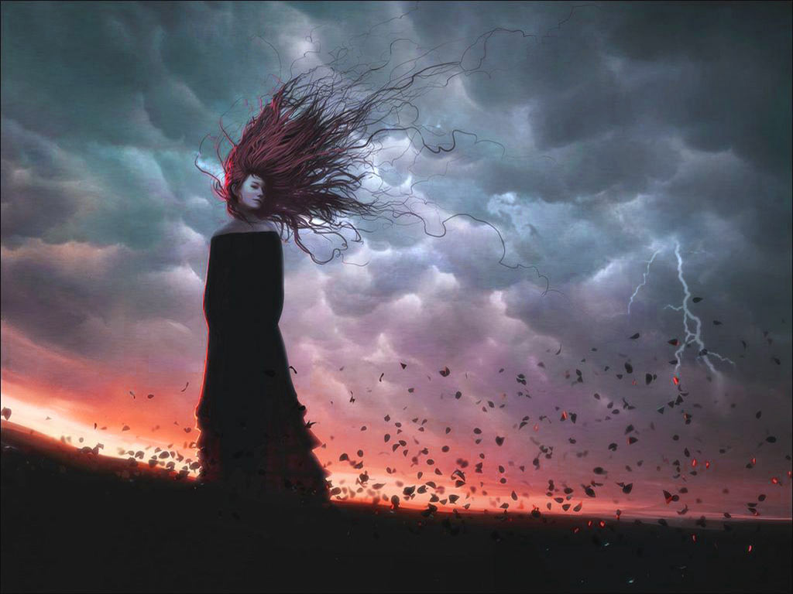
Personification
Using human characteristics to describe an inanimate object.
Example:
The wind gnawed at her dress.

Slide 9
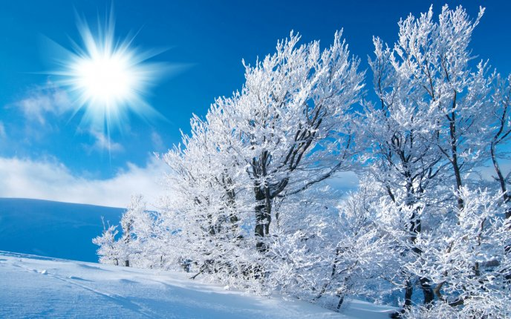
Imagery
Using words to describe
an image that appeal
to the five senses in
order to create a
mental picture.
Example: The snow-covered branches glistened as the bright sundrops sprinkled across their tips.

Slide 10
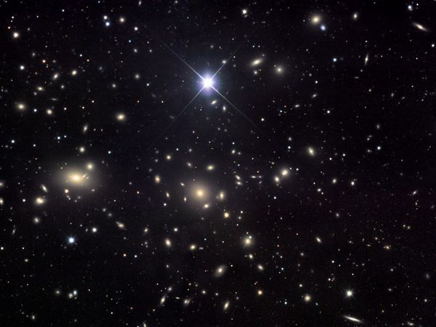
Irony
A contrast between expectation and reality.
There are three types of irony:
Situational irony: occurs when what happens is very different from what we expected would happen.
Verbal irony: a contrast between what is said or written and what is really happening (sarcasm).
Dramatic irony: when the audience or reader knows something a character does not know.

Slide 11
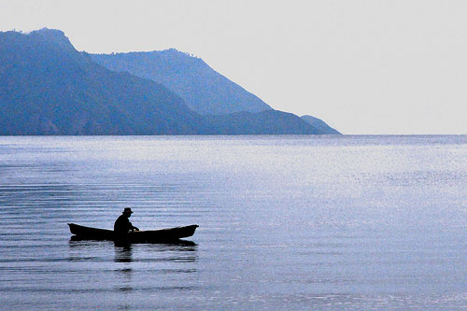
Situational Irony
“The Rime of the Ancient Mariner” by Coleridge:
Water, water, every where,
And all the boards did shrink ;
Water, water, every where,
Nor any drop to drink
In this example it is ironic that water is everywhere but none of it can be drunk

Slide 12
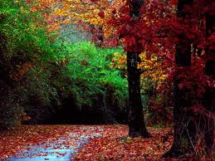
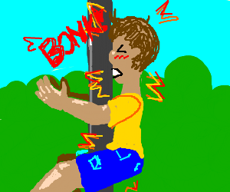
Verbal Irony
A group of friends are walking and one person walks into a tree. The group says, “Smooth move, man.”
This is verbal irony because they don’t really think the guy is a smooth walker.

Slide 13
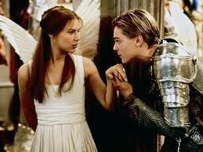
Dramatic Irony
Romeo and Juliet by William Shakespeare.
When Romeo finds Juliet in a drugged sleep, he assumes her to be dead and kills himself. Upon awakening to find her dead lover beside her, Juliet then kills herself.

Slide 14
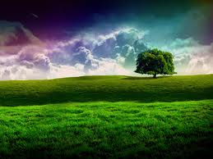
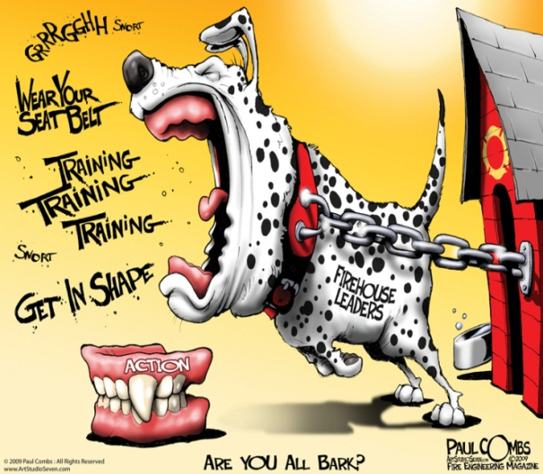
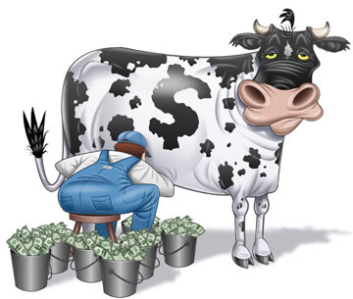
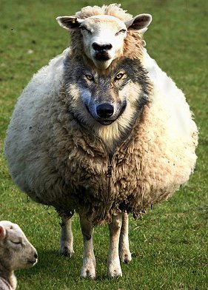
Idiom
An accepted phrase or expression having a meaning different from the literal.
Example:
All Bark and No Bite
Wolf in Sheep's Clothing
Cash Cow

Slide 15
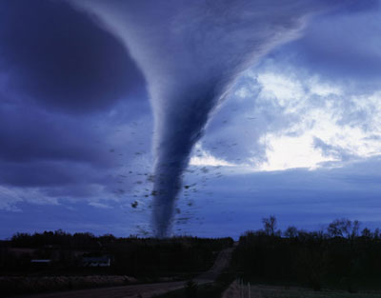
External Conflict
a character struggles against a person, a group, or a force of nature (earthquake, hurricane, a bear etc.)
.

Slide 16
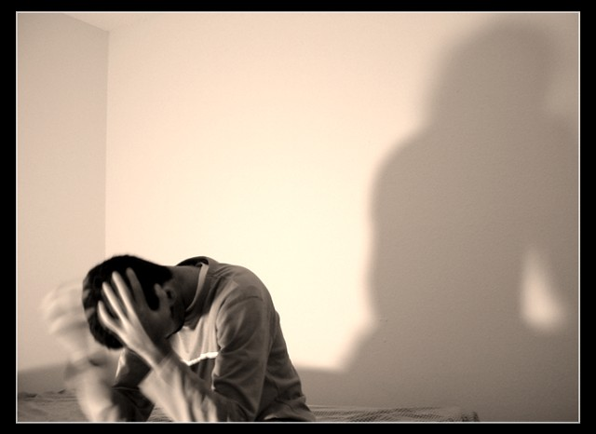
Internal Conflict
a struggle in one’s mind, like being shy or accepting the death of a loved one.

