Slide 1
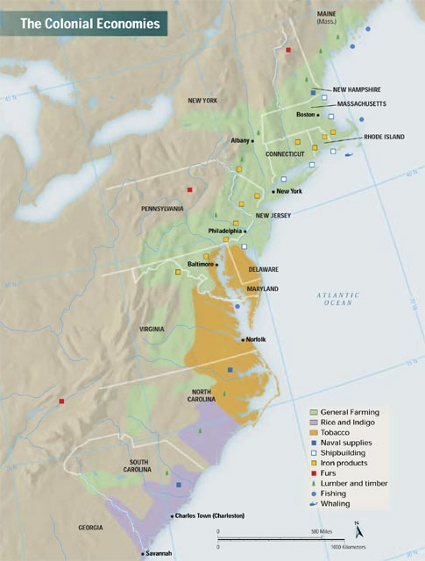
18th Century America (1700’s)
Objectives
  Understand the different ethnicities and diversity that existed in the colonies by identifying 5 different ethnicities
  The role and responsibility of government imagined by Enlightenment thinkers by defining Thomas Hobbes and John Locke beliefs on the role of government
  The impact of the 1st Great Awakening in popularizing and Americanizing Christianity

Slide 2

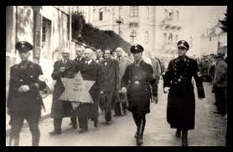
What is the purpose of Government?

Slide 3
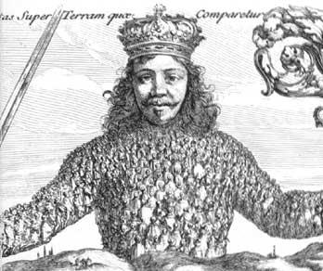
Enlightenment- flowering of new ideas in government and science
  Thomas Hobbes
    Social Contract- people give up their rights to a strong leader in return for safety
    *Where are there examples of the Social Contract in society today?
    *Does the Social Contract fit in American society?

Slide 4
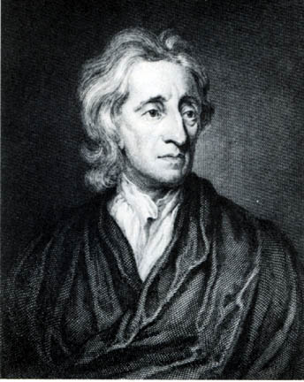
Enlightenment- flowering of new ideas in government and science
  John Locke
    Natural Rights
      Life, Liberty, and Property
      Purpose of Government is to Protect Natural Rights
      If Government does not protect our Natural Right, the People have a right to overthrow the government
How does our government reflect Lockes’s ideas today?

Slide 5
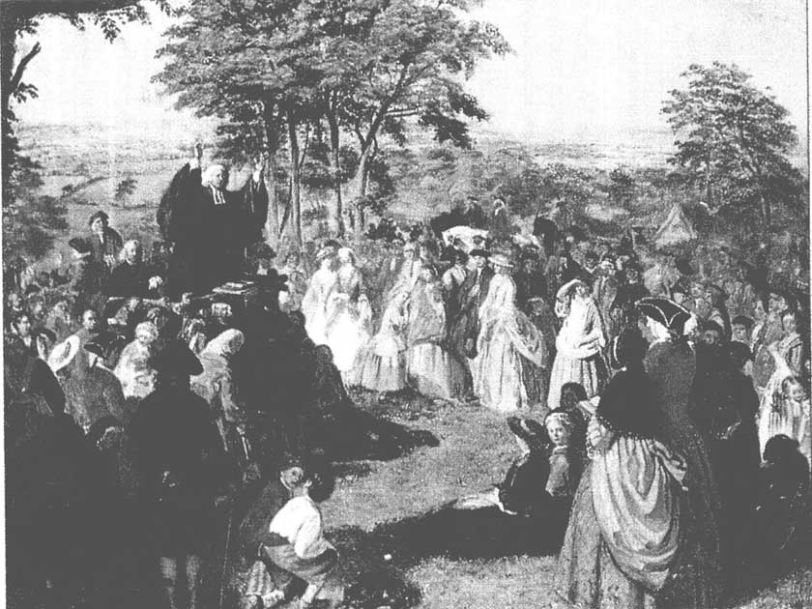
1st Great Awakening- flowering of religion
Evangelical Message- that everyone can find salvation if they accept Jesus
  Jonathan Edwards- popular preacher, gave exciting sermons, vivid depictions of hell for those who did not convert
    *How does the 1st Great Awakening Americanize Christianity?

