Slide 1

What is matter made up of?
All matter is made up of atoms.
An atom is the smallest unit of an element that still maintains the characteristics of that element.

Slide 2
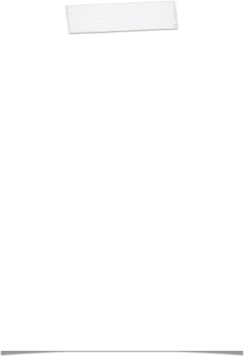

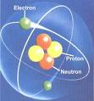
Structure of an atom
Atoms have a nucleus and an electron cloud.
Atoms are made up of 3 types of subatomic particles:
  Protons
  Neutrons
  Electrons
An Atom

Slide 3
Subatomic Particles
Protons have a positive charge (+1)
Neutrons have no charge
Electrons have a negative charge (-1)

Slide 4
Subatomic Particles
The number of protons (positive charges) will equal the number of electrons (negative charges) in an atom.
  This means the atom has no overall charge.

Slide 5
What is chemical bonding?
Chemical bonding refers to the attraction between atoms or molecules.
There are 3 types of chemical bonding.

Slide 6
Chemical Bonding
Chemical bonding is when atoms interact with other atoms to form molecules and compounds.
If atoms were not able to attract one another other, life could not exist.

Slide 7
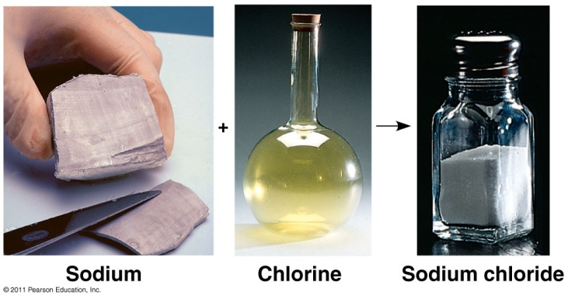
Element
“pure” substance
Can’t be broken down by ordinary means to another substance
Smallest unit= atom
Ex. hydrogen (H), nitrogen (N)
Compound
2 or more different elements combined in a fixed ratio
Ex. H₂O, CO₂
Smallest unit = Molecules- group of atoms bonded together

Slide 8
Remember...
It is important to remember that atoms are always trying to become stable.
They become stable by having a full outer electron orbital.

Slide 9
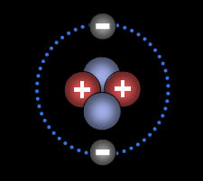
Electron Orbitals
Small atoms like hydrogen and helium have a single orbital that holds 2 electrons
Larger atoms can hold 8 electrons in their outer orbital. This is called an octet.
Helium has a
complete outer orbital

Slide 10
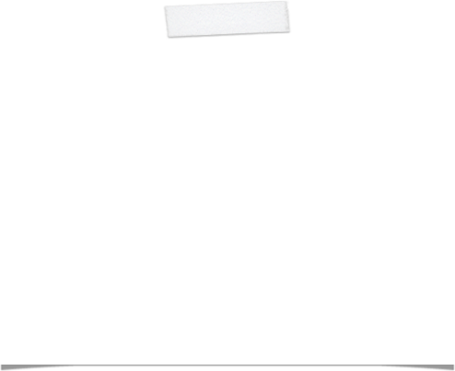


Orbitals
Draw neon in your notes:
Neon has a complete octet
(an outer orbital that can
hold eight electrons)

Slide 11
Misconceptions
Orbitals are typically depicted as rings surrounding the nucleus – but it would be more accurate to think about a cloud of e- with no set pattern or course.

Slide 12
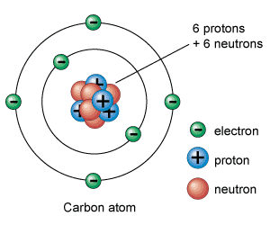
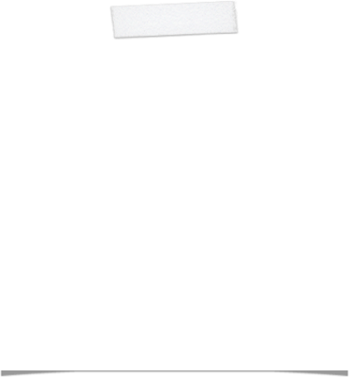
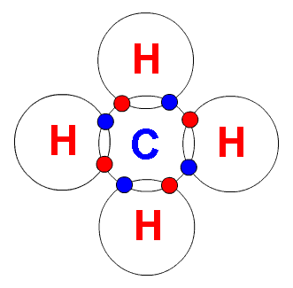
Carbon has 4 electrons
in its outer orbital
Carbon will form bonds and fill the octet.

Slide 13
3 Types of Bonding
Ionic bonding
Covalent Bonding
Hydrogen Bonding
Van der Waals interactions
    Each type of bonding is very specific.

Slide 14
Ionic Bonding
Ionic bonding occurs between charged particles. An ion is a charged particle.
Typically, atoms do not have a charge because the positive charge of the nucleus (protons) and the negative charge surrounding the nucleus (electrons) cancel each other out.
Atoms become charged when they gain or lose an electron.

Slide 15
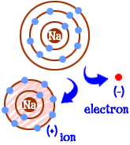
Ions
Sodium (Na) begins with:
11e- (-1 charge) = -11
11 protons (+1 charge) = +11
no overall charge
When sodium loses an electron it then has 10e-, but still has 11 protons. It will now have an overall positive charge.
A positively charged ion = cation

Slide 16
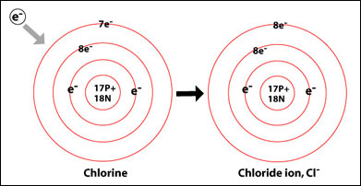
Ions
Chlorine begins with 17 protons and 17e-.
When chlorine gains an e-, it has one more e- than it has a proton in the nucleus
A negatively charged ion = anion

Slide 17
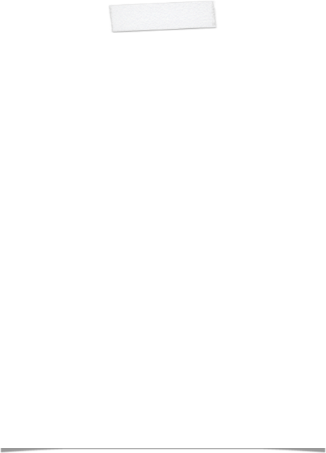
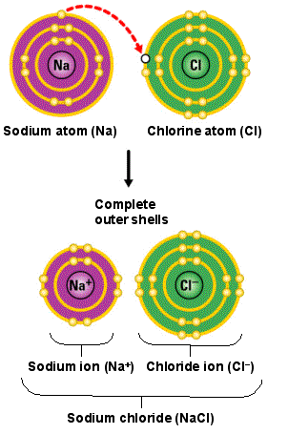
Ionic Bonding
In order to become stable, sodium will donate an electron to chlorine. This causes both particles to become charged (ions). The positively charged sodium ion and the negatively charged chloride ion are now attracted to each other.

Slide 18
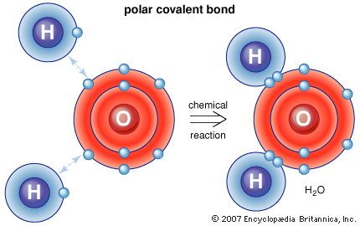
Covalent Bonding
Covalent bonding occurs when atoms share electrons in order to complete their octet.
The hydrogens atoms have a complete outer orbital (2 e-).
The oxygen atom has a complete outer orbital (8 e-).

Slide 19
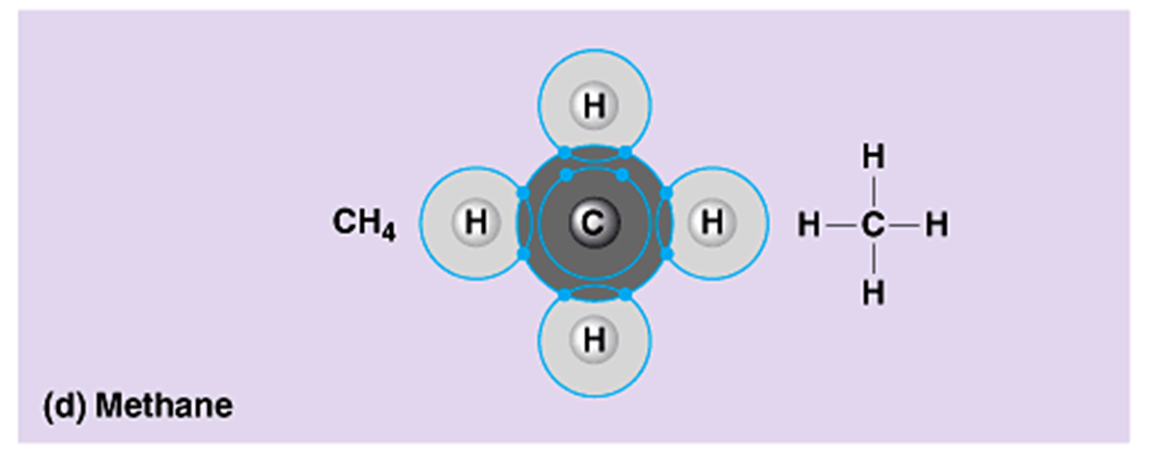
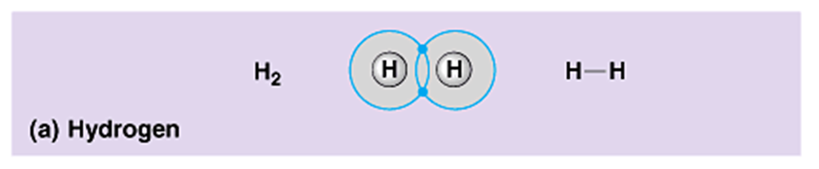
Covalent bonds

Slide 20
Electronegativity
Electrons spend more time with larger atoms
O-H
N-H
Uneven distribution of charge = polar
Slight negative charge for larger atoms ( O and N)

Slide 21
Polarity
Polar covalent bonds create regions of slight positive and negative charge in the molecule, want to interact with other charged substances
Non-polar covalent bonds do not have a significant difference in charge, don’t want to interact with other charged substances

Slide 22
Hydrogen Bonding
Certain molecules like water form weak bonds called hydrogen bonds.
Hydrogen bonds occur when molecules have partial electrical charges.
  The partial negative charge of the oxygen atom in water attracts the hydrogen atoms of other water molecules

Slide 23
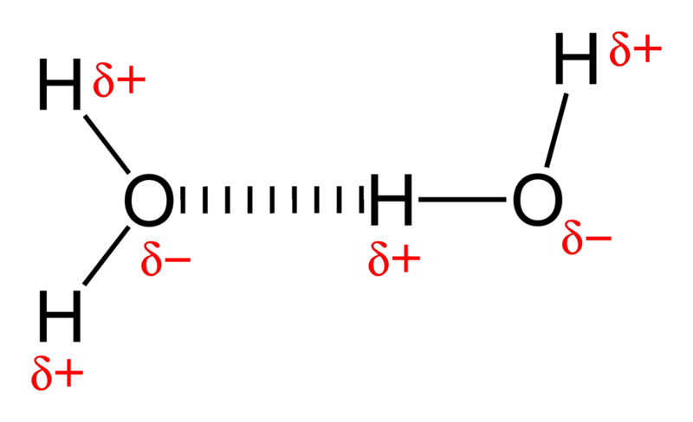
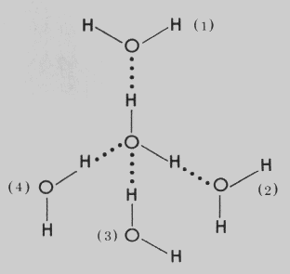
Hydrogen Bonding
Delta (δ+ or δ-) is used to indicate a slight charge

Slide 24
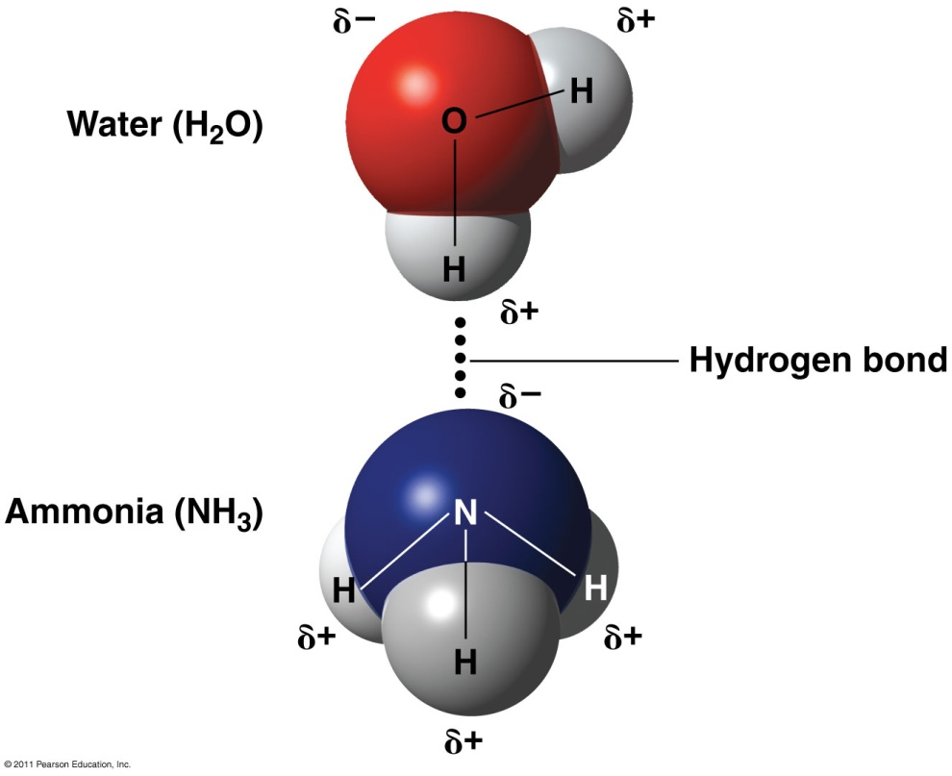

Slide 25
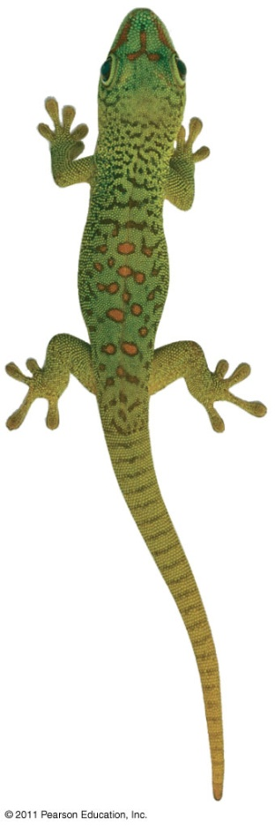
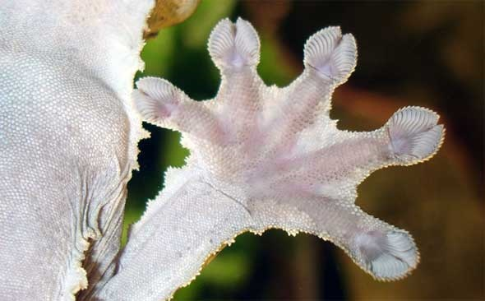
Van der Waals interaction
Weak attraction
slight, fleeting attractions between atoms and molecules close together
  Temporary uneven distribution of electrons orbiting the nucleus of atoms
  Eg. gecko toe hairs + wall surface

Slide 26
Quick review...
In an atom, the number of protons equal the number of what?
Indicate the type of bonding.
  Sharing of electrons
  Temporary imbalances in charge resulting in weak attraction
  Attraction between partial charges
  Attraction between charged particles

