Slide 1
Notes: Photosynthesis
EQ: What is the difference between the Light Reaction and the Dark Reaction. State the differences in terms of their Products and Reactants

Slide 2
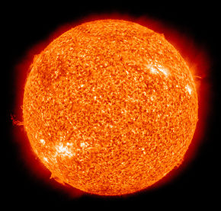
Energy and Life
Where do plants get the energy they need to produce food?
  Plants and some other types of organisms are able to use light energy from the sun to produce food.

Slide 3
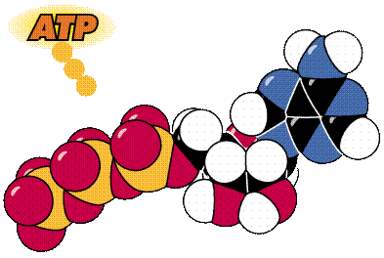
Chemical Energy and ATP
An important chemical compound that cells use to store and release energy is ATP
ATP is used by all types of cells as their basic energy source

Slide 4
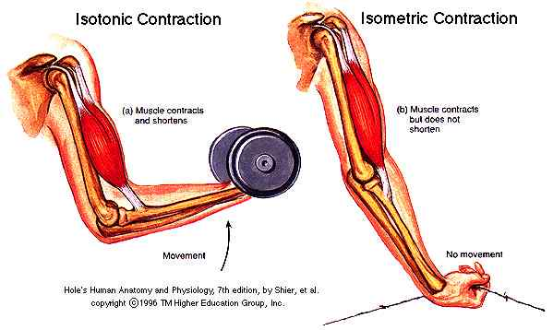
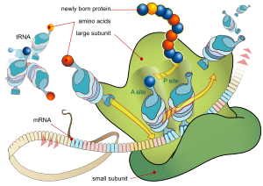
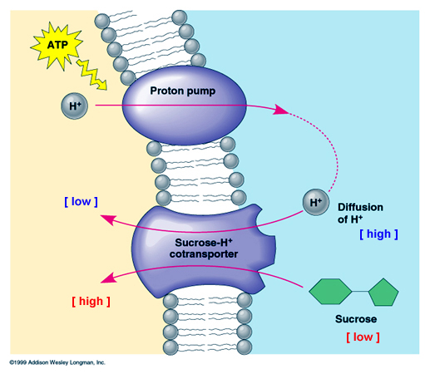
Role of ATP
The energy from ATP is used for many cellular activities, that include active transport, protein synthesis and muscle contraction

Slide 5
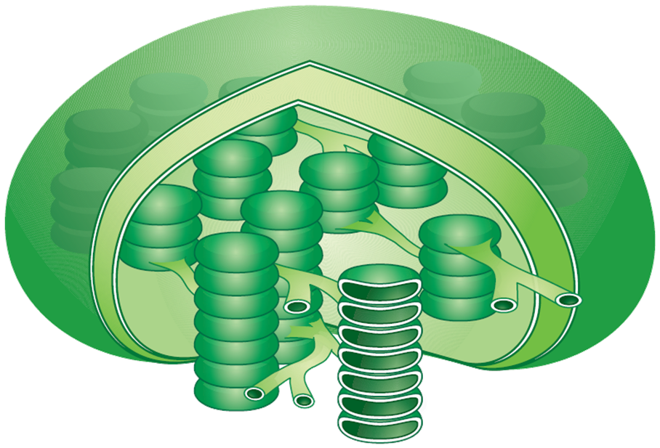
Inside a Chloroplast
In plants, photosynthesis takes place inside the chloroplast
Single
thylakoid
Chloroplast

Slide 6
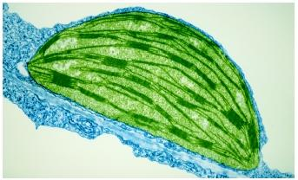
What is the role of light and chlorophyll in photosynthesis?
Plants gather the sun's energy with light-absorbing molecules called pigments.
      The main pigment in plants is chlorophyll.
Light is a form of energy, so any compound that absorbs light also absorbs energy from that light.

Slide 7
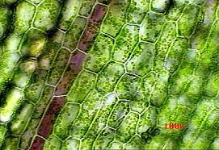
What is the role of light and chlorophyll in photosynthesis?
When chlorophyll absorbs light, much of the energy is transferred directly to electrons in the chlorophyll and excite them.
These excited electrons are what make photosynthesis work.

Slide 8
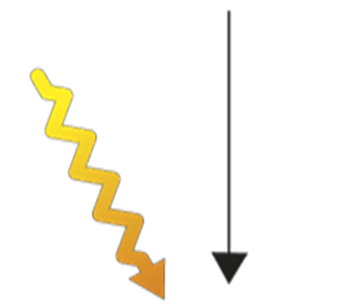
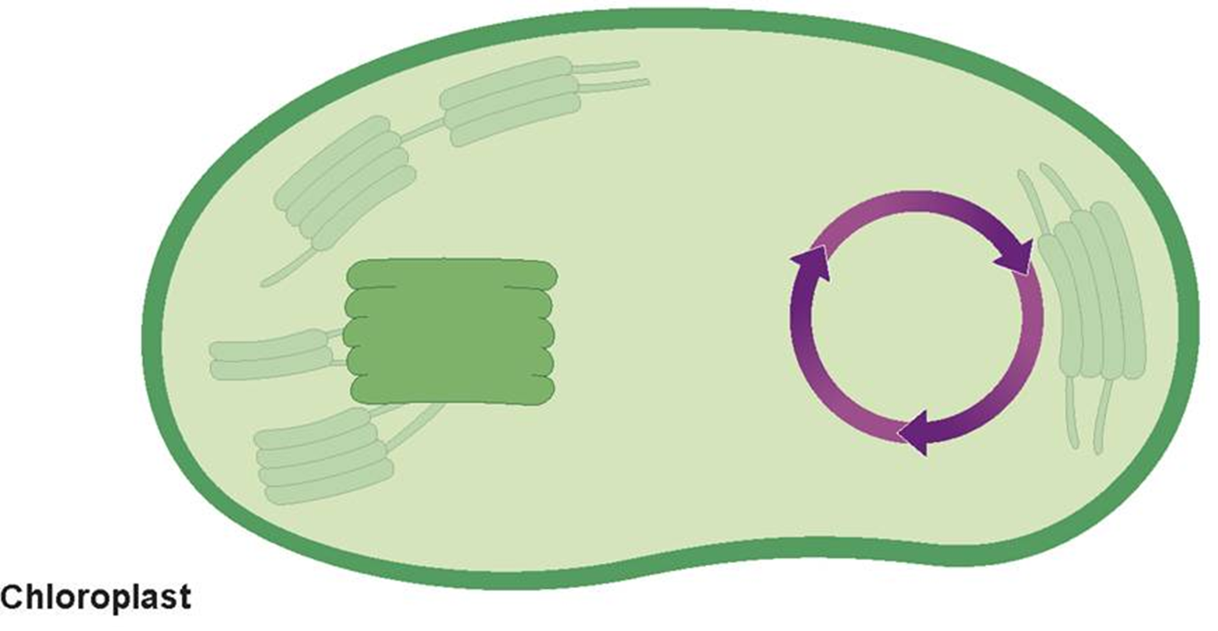





Inside a Chloroplast
(DRAW This Picture)
H₂O
CO₂
Light
ADP + P
Light- dependent reactions
Calvin cycle
O₂
Sugars

Slide 9
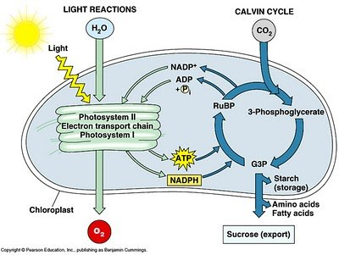
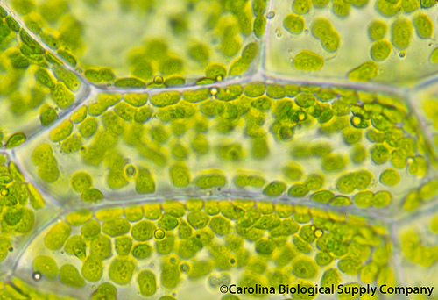
Light-Dependent Reaction
The Light Reaction requires light and water
The light-dependent reaction produce oxygen produce ATP for the Calvin Cycle to work

Slide 10


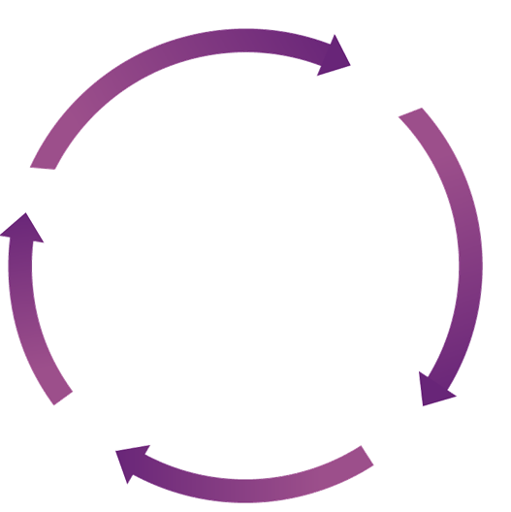

What is the Dark Reaction
(Calvin Cycle)
The dark reaction uses ATP from the light-dependent reaction and CO₂ to produce sugars.
This cycle is also called the light-independent reaction because it does not need light.
Carbon
Dioxide
Calvin Cycle
Sugars

Slide 11
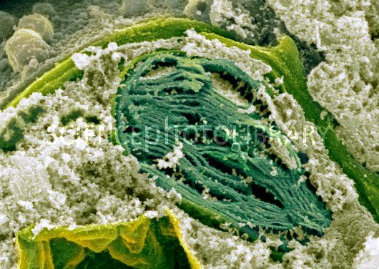
Light and Dark Reactions
The two sets of reactions work together
  The light-dependent reaction trap sunlight energy in chemical form as ATP
  The light-independent reactions (Dark Reaction/Calvin Cycle) use the ATP to produce sugars from carbon dioxide and water.

Slide 12
What is the overall equation for photosynthesis?
The equation for photosynthesis is:
6CO₂ + 6H₂O C₆H₁₂O₆ + 6O₂
Carbon Dioxide + Water Sugars + Oxygen

Slide 13
Question 1
The raw materials required for plants to carry out photosynthesis are
carbon dioxide and oxygen.
oxygen and sugars.
carbon dioxide and water.
oxygen and water.

Slide 14
Question 2
The principal pigment in plants is
chloroplast.
chlorophyll.
carotene.
carbohydrate.

Slide 15
Question 3
In plants, photosynthesis takes place inside the
thylakoids.
chloroplasts.
photosystems.
chlorophyll

Slide 16
Question 4
What is another name for the Calvin cycle?
light-dependent reactions
light-independent reactions
electron transport chain
photosynthesis

