Slide 1
Winslow Homer
Thomas Eakins
American Realism

Slide 2
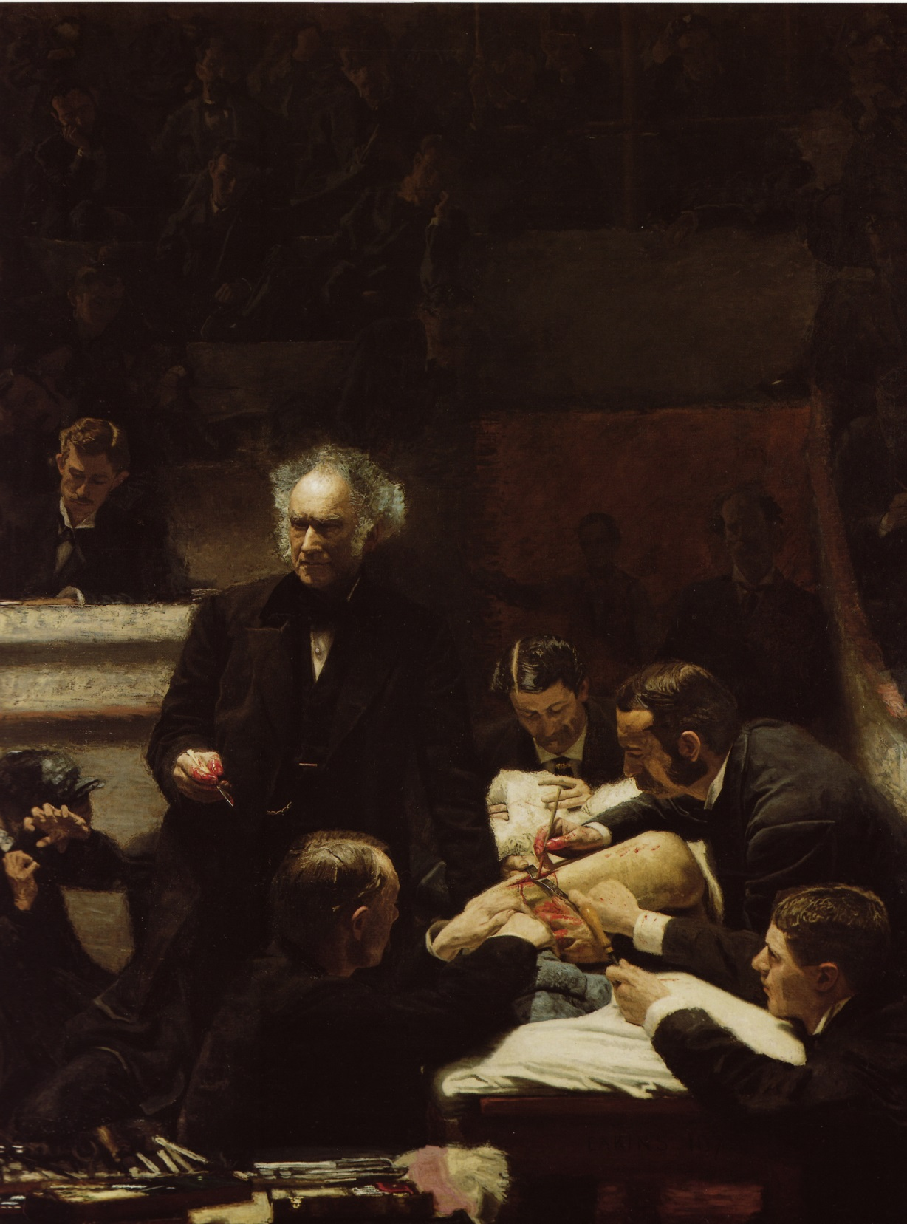
Thomas Eakins
The Gross Clinic
1875
This image was rejected and severely criticized. The jury refused to allow it to hang at the 1876 Philadelphia Centennial exhibition. Why?
What other works does this one remind you of?
Hint: what other image was criticized for being too shockingly realistic?
Hint: What do you notice about the way light is handled?
Stokstad writes that this image argues that “amid the darkness of ignorance and fear modern science shines the light of knowledge” (1048)

Slide 3
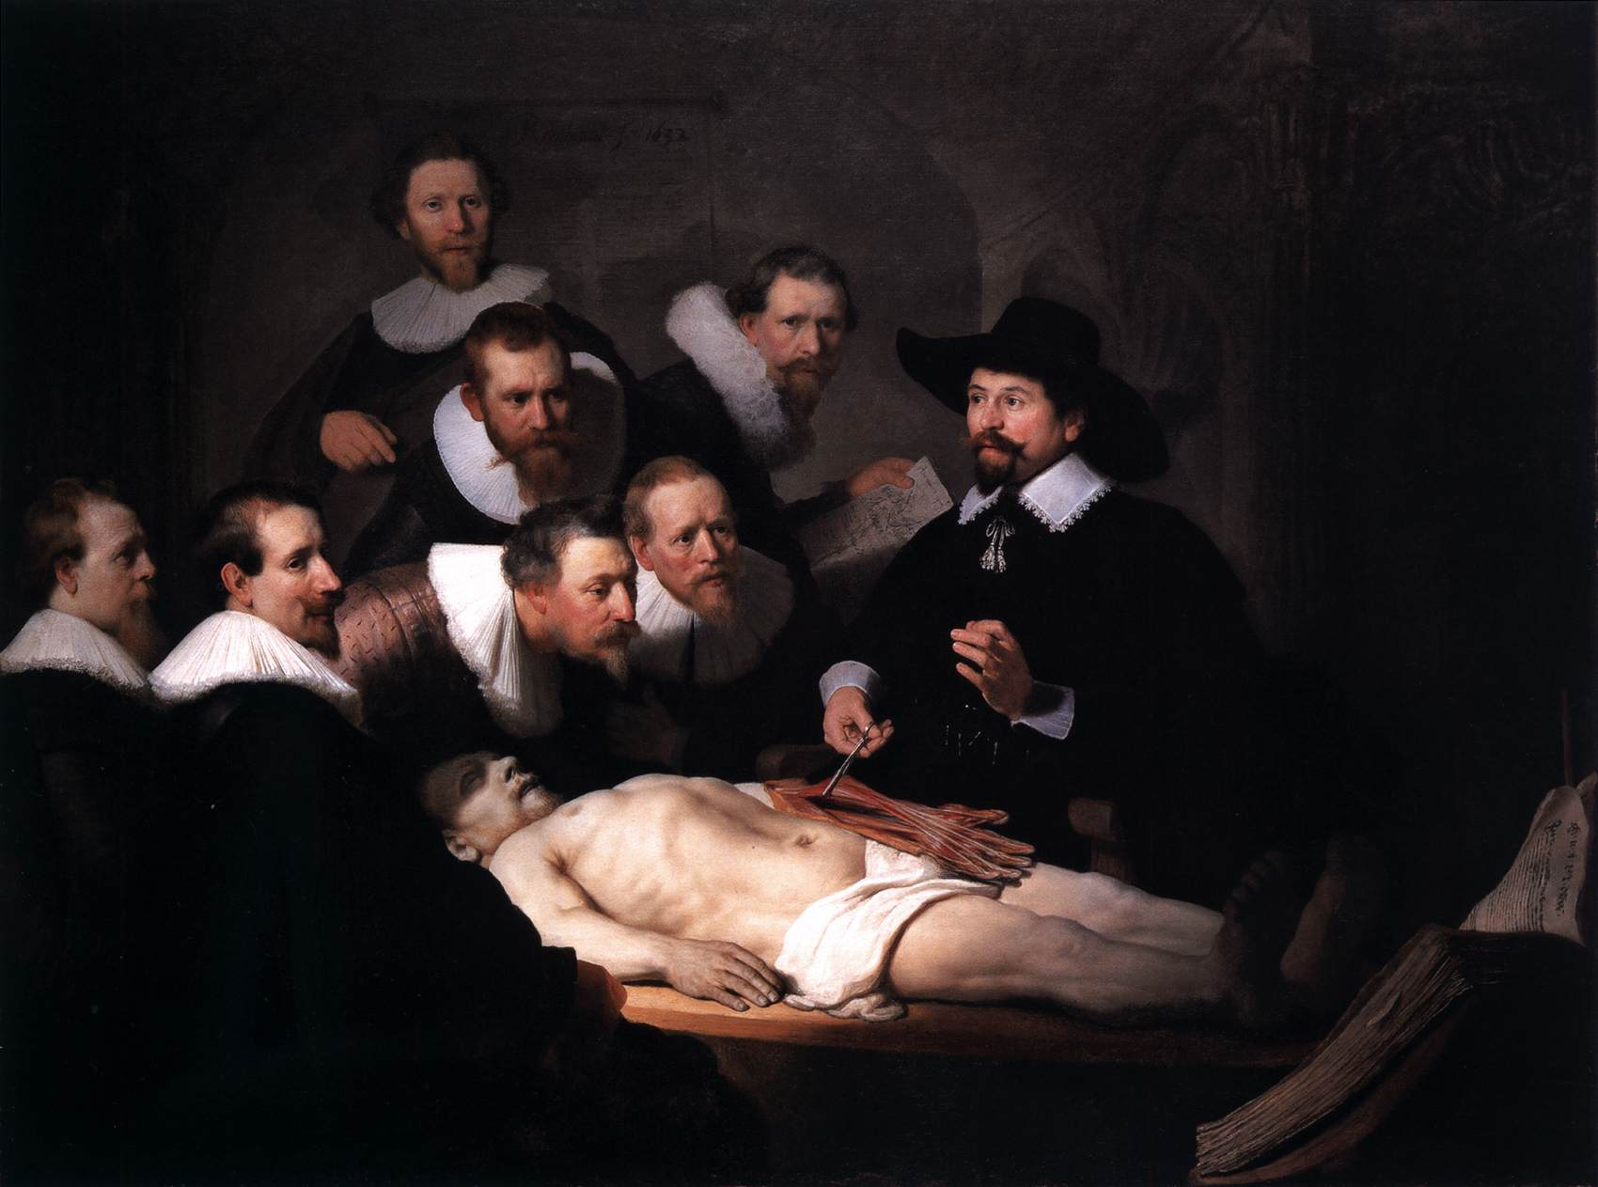

Slide 4
Rembrandt The Anatomy Lesson of Dr. Nicolaes Tulp 1632

Slide 5
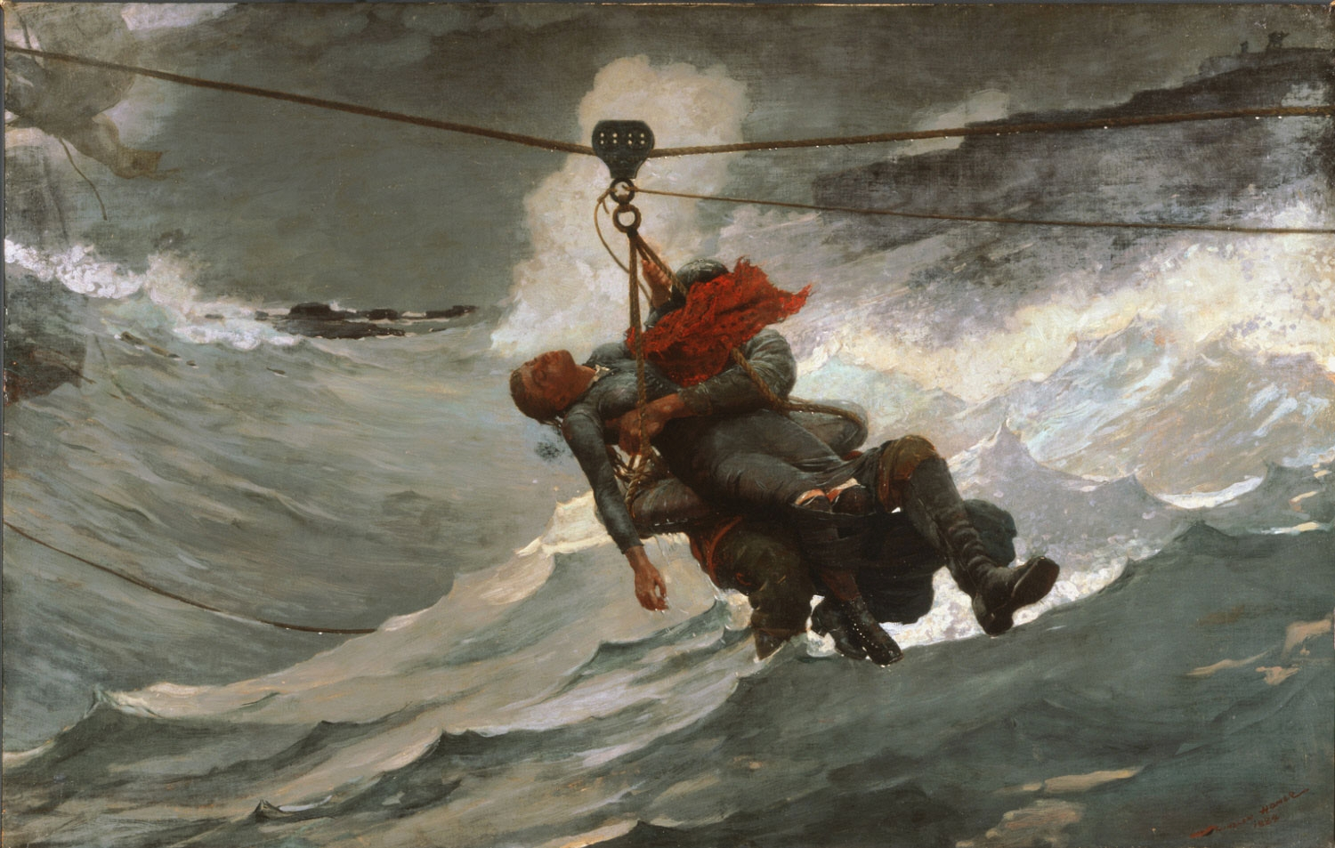
Winslow Homer Life Line 1884

Slide 6
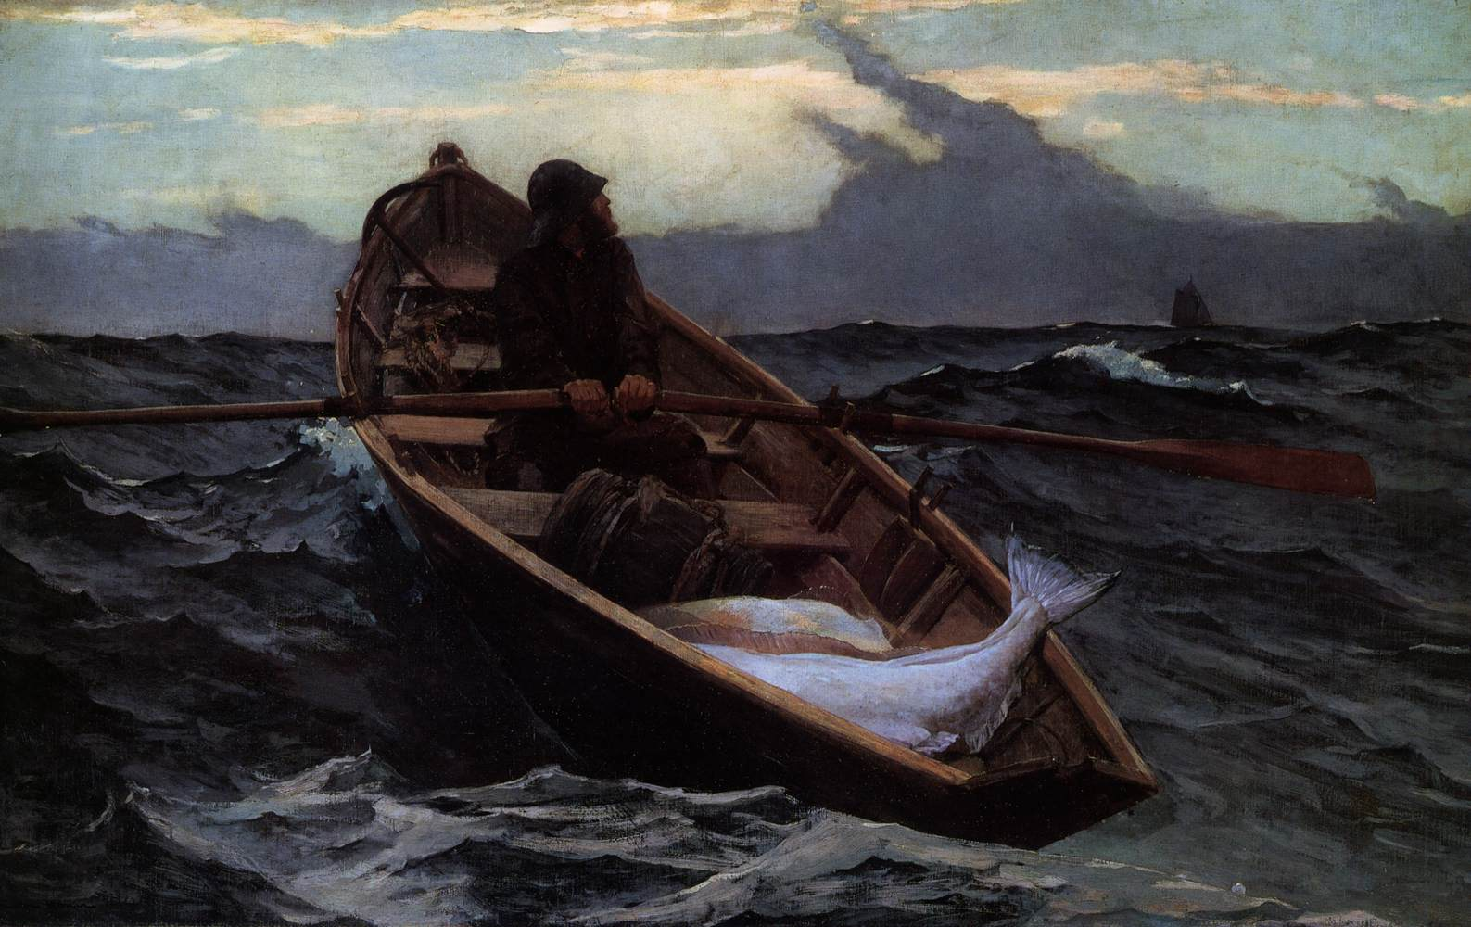
Winslow Homer Fog Warning 1885

Slide 7
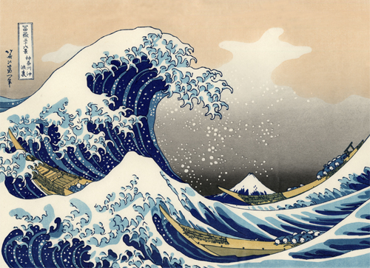
The Great Wave
Hokusai
Edo period, c.1831
polychrome woodblock print on paper

Slide 8
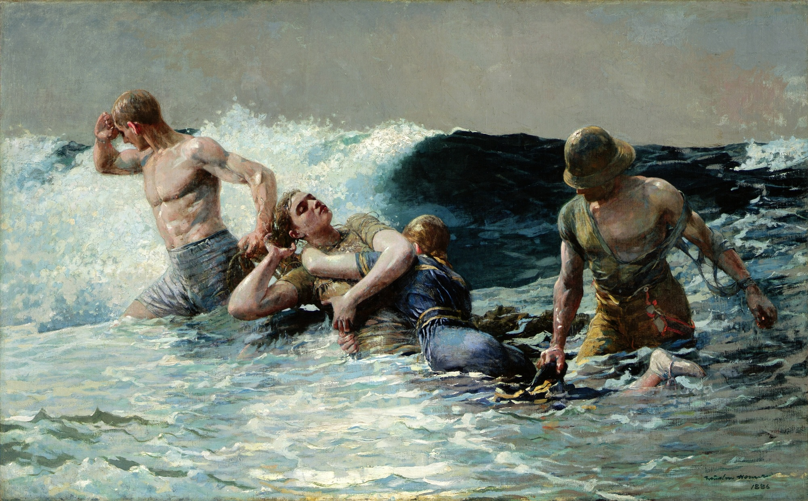
Winslow Homer Undertow 1886

