Slide 1
Critique of American Isolationism CA Std: 11.4.5 & 11.7.1 Objective: to examine anti-isolationism attitude in the U.S. (pre-WWII) through political cartoons.
Lesson created by Mrs. Janiak

Slide 2
Warm-Up: (answer each question)
How did many Americans feel about war, after World War I was over?
What do you know was happening in the U.S. after WWI from 1920-1940?
What does isolationism mean?
Who is Ted Geisel?

Slide 3
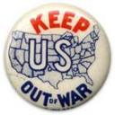
Isolationism
Many Americans felt focusing on problems and issues at home were easier and more important than international problems.
They felt American interests were different/ superior to European interests.
Spread democracy through example, not military
Most isolationists favored international trade and agreements
Isolationists want to stay out of wars-> strict neutrality
U.S. must remain a pillar of peace and sanity in a divided world

Slide 4
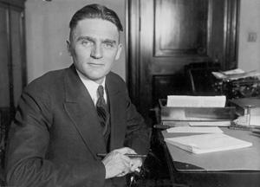
Nye Committee Hearings (1934-1936)
The Nye Committee investigated the charge that WW I was needless and the US entered so munitions owners could make big profits [“merchants of death.”]
A) The Committee did charge that bankers wanted war to protect their loans & arms manufacturers to make money.
B) Claimed that Wilson had provoked Germany by sailing in to warring nations’ waters.
= Committee hearings increased American suspicion of big business and increased feelings of isolationism.
= Resulted in Congress passing several Neutrality Acts.
Senator Gerald P. Nye [R-ND]

Slide 5
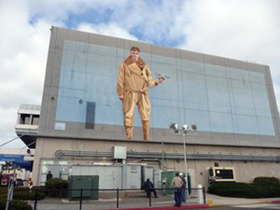
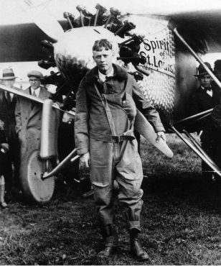
Famous Isolationists
Politicians and public figures were outspoken supporters
Charles A. Lindbergh: first man to fly solo across the Atlantic Ocean, widely respected hero.
While living abroad in Europe (1930s), he spent time meeting with German military leaders, including Hitler who he stated was “undoubtedly a great man” who “has done much for the German people”
Lindbergh traveled the U.S. promoting isolationism

Slide 6
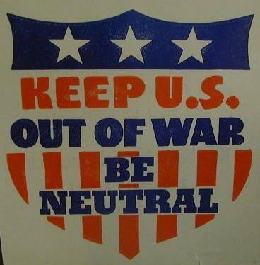
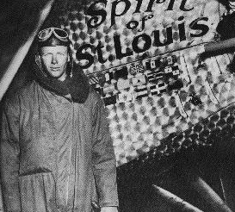
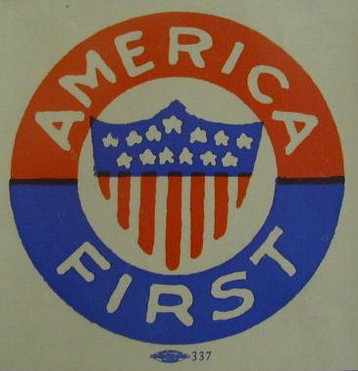
America First Committee
Formed in 1940 to keep the U.S. out of the war
Spokesmen- Senator Nye, Charles Lindbergh
Close to 800,000 members
Charles Lindbergh

Slide 7
Neutrality Acts: 1935, 1936, 1937
When the President acknowledged the existence of a foreign war, certain restrictions would automatically go into effect:
Prohibited sales of weapons to nations at war.
Prohibited loans and credits to nations at war.
Forbade Americans to travel on vessels of nations at war [in contrast to WW I- Remember the Lusitania].
Non-military goods must be purchased on a “cash-and-carry” basis → pay when goods are picked up.
Banned involvement in the Spanish Civil War.
This limited the options of the President in a crisis.
America in the 1930s declined to build up its forces!

Slide 8

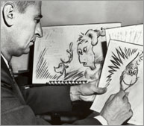
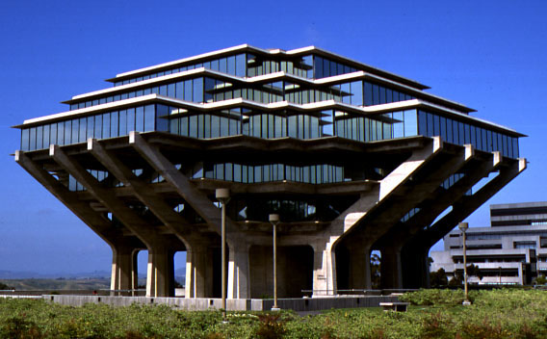
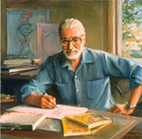
Theodor Geisel
Dr. Seuss was a not only a successful children's author, but also a successful political cartoonist, lampooning current events during World War II for a progressive newspaper. Viewed as mere entertainment or children’s “funnies,” modern cartoons and comics often don’t get enough respect. But from caricature to commentary, from long-running print serials like Matt Groening’s “The Simpsons,” political cartoons have rightly taken their place on the page and screen as valid outlets for expressing political thought, championing activism and affecting social change through creative use of visual art.

Slide 9
Political Cartoon Analysis
Literal: visuals and text
Interpretative: visuals and text
Applied: message and audience
Let’s practice!

Slide 10
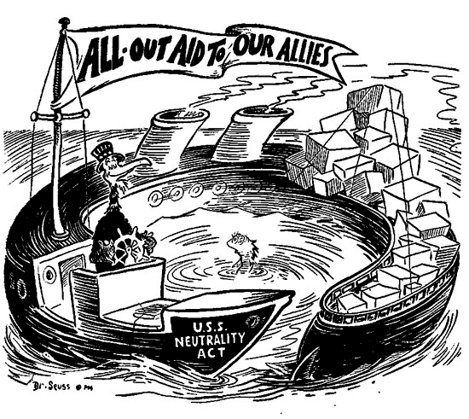
VERBAL PRACTICE CARTOON ANALYSIS- DO NOT WRITE ON YOUR ANALYSIS PAPER FOR THIS CARTOON ☺

Slide 11
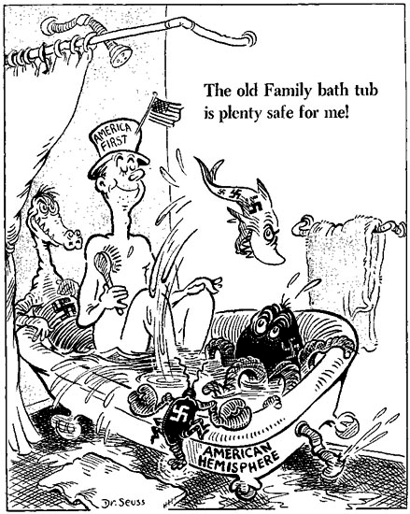

Slide 12
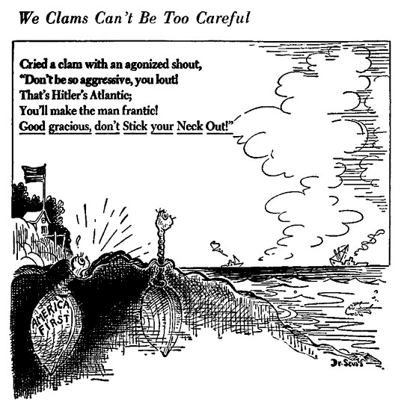

Slide 13
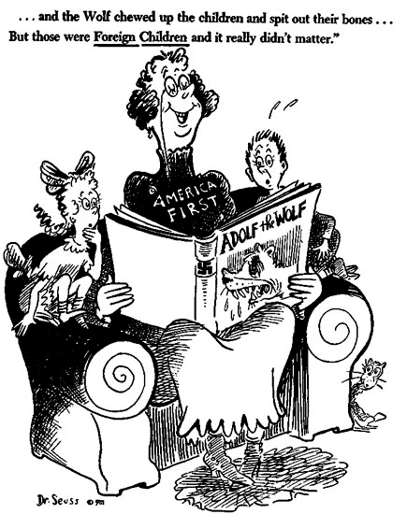

Slide 14
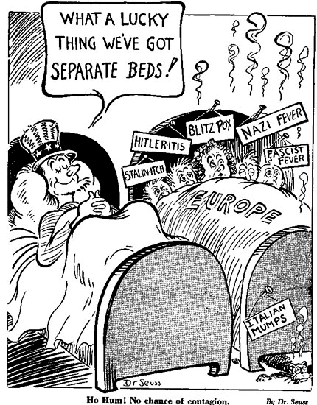

Slide 15
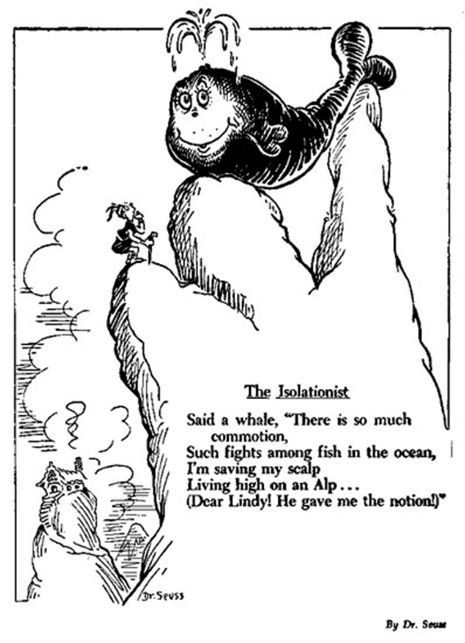

Slide 16
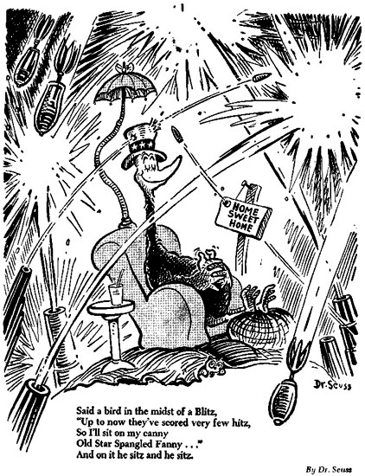

Slide 17
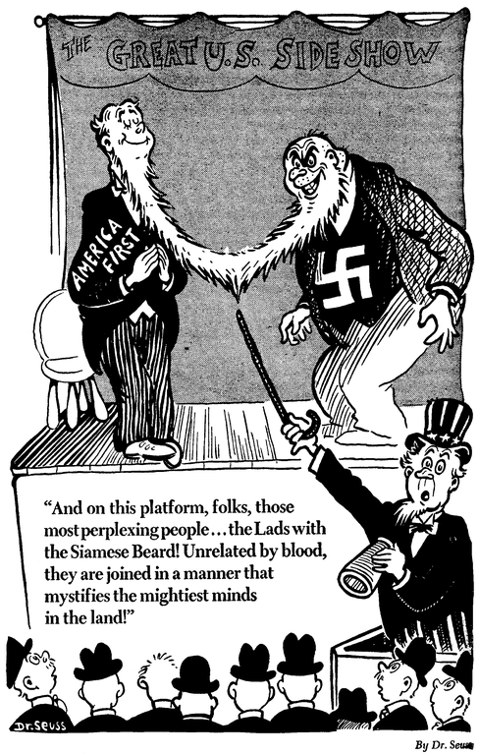

Slide 18
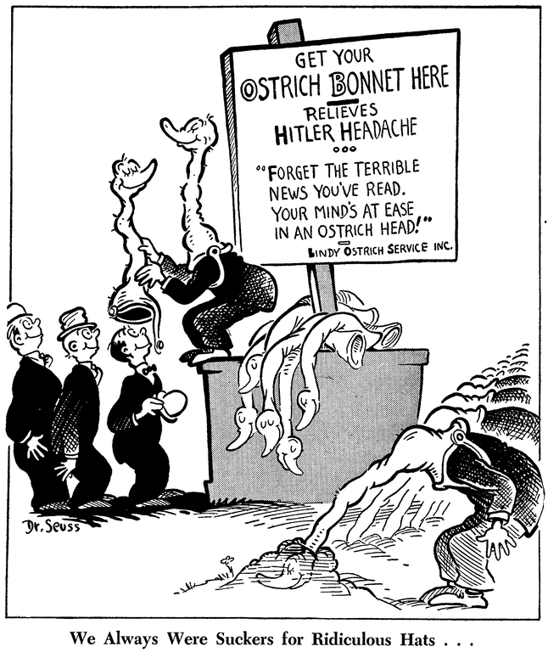

Slide 19
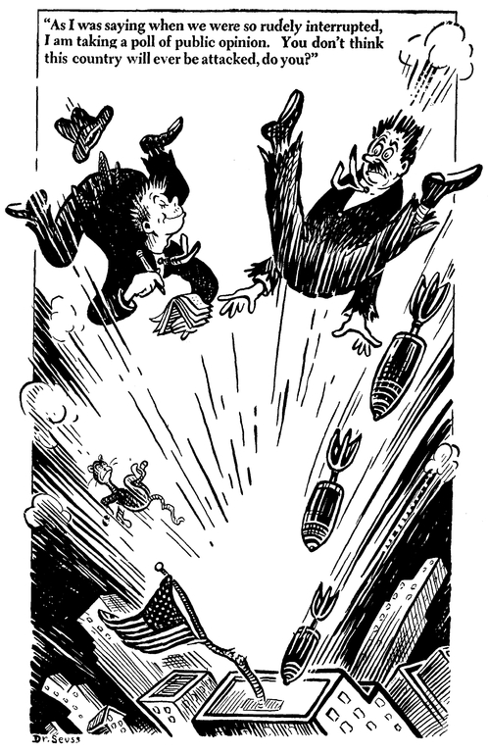

Slide 20
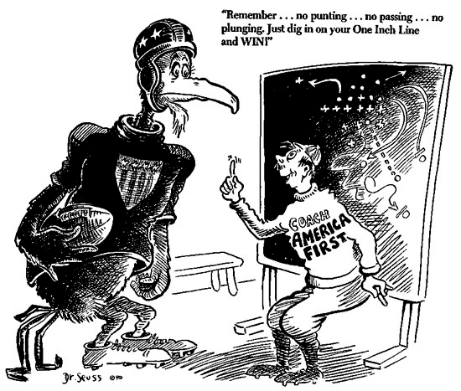

Slide 21
Wrap-Up:
How did Dr. Seuss's cartoons reflect his own political views?
How effective do you think Dr. Seuss's political cartoons are in communicating his viewpoints?
How important do you think the work of political cartoonists is in general? Do you think they still play an important role in shaping public opinion? Why or why not?

Slide 22
Thank you!

