Slide 1
Cell Division and Mitosis
EQ: What are the 4 stages in Mitosis and what happens during each stage?

Slide 2
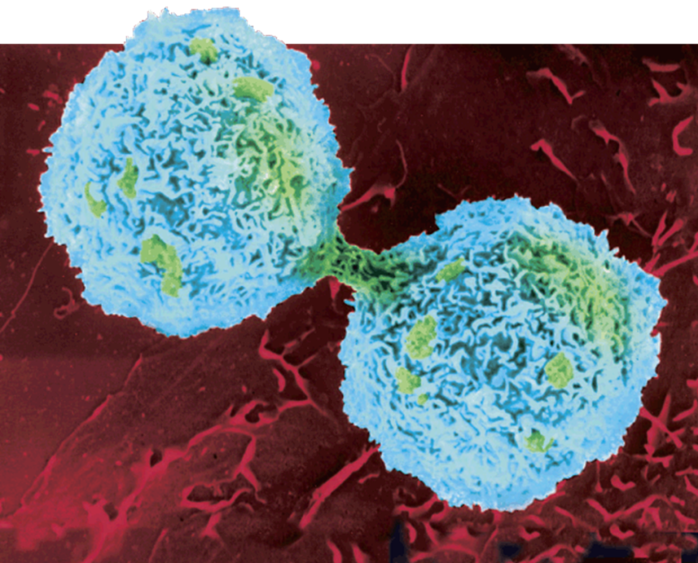
Cell Division
In eukaryotes, cell division happens in two stages.
1st stage: Mitosis – division of nucleus
2nd stage: Cytokinesis – division of the cell cytoplasm

Slide 3
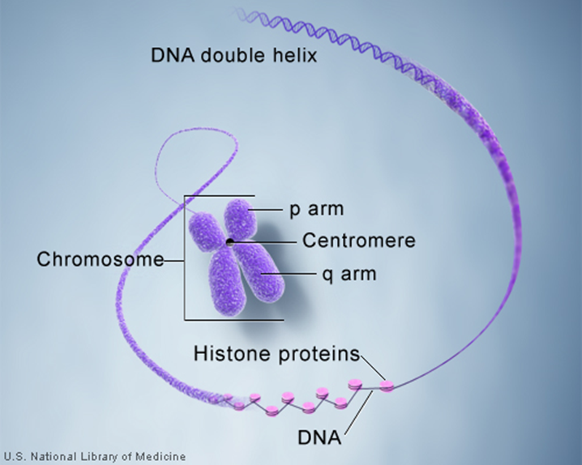
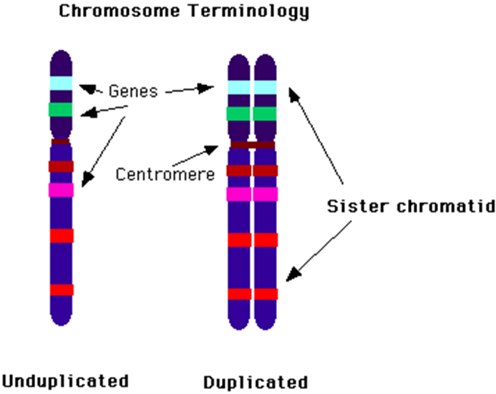
Chromosomes
Genetic information is passed from one generation to the next on chromosomes.
Before cell division, each chromosome is copied.

Slide 4
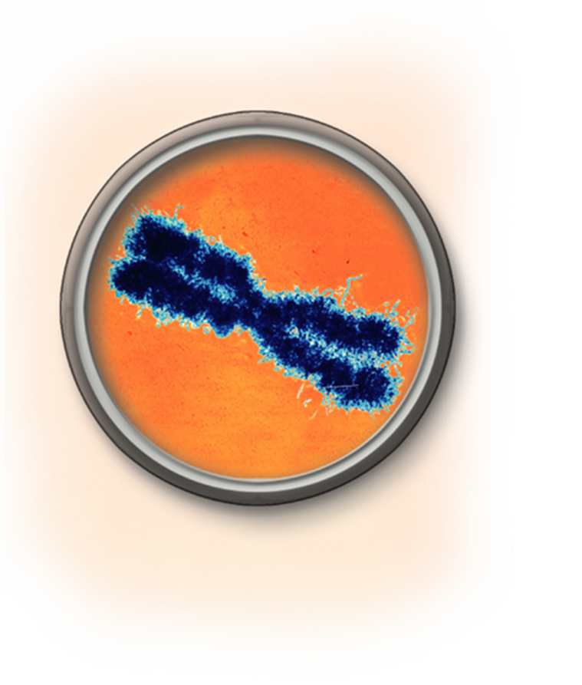


Chromosomes
Each chromosome consists of two identical “sister” chromatids.
Chromatids are attached by the centromere.
Sister Chromatids
Centromere

Slide 5
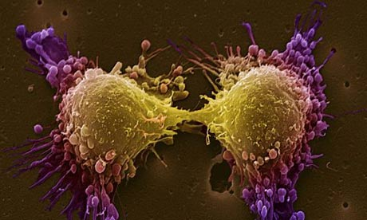
Cell Cycle
The cell cycle is the series of events that cells go through as they grow and divide.
During Interphase :
A cell grows
Cell replicates DNA to prepare for cell division

Slide 6
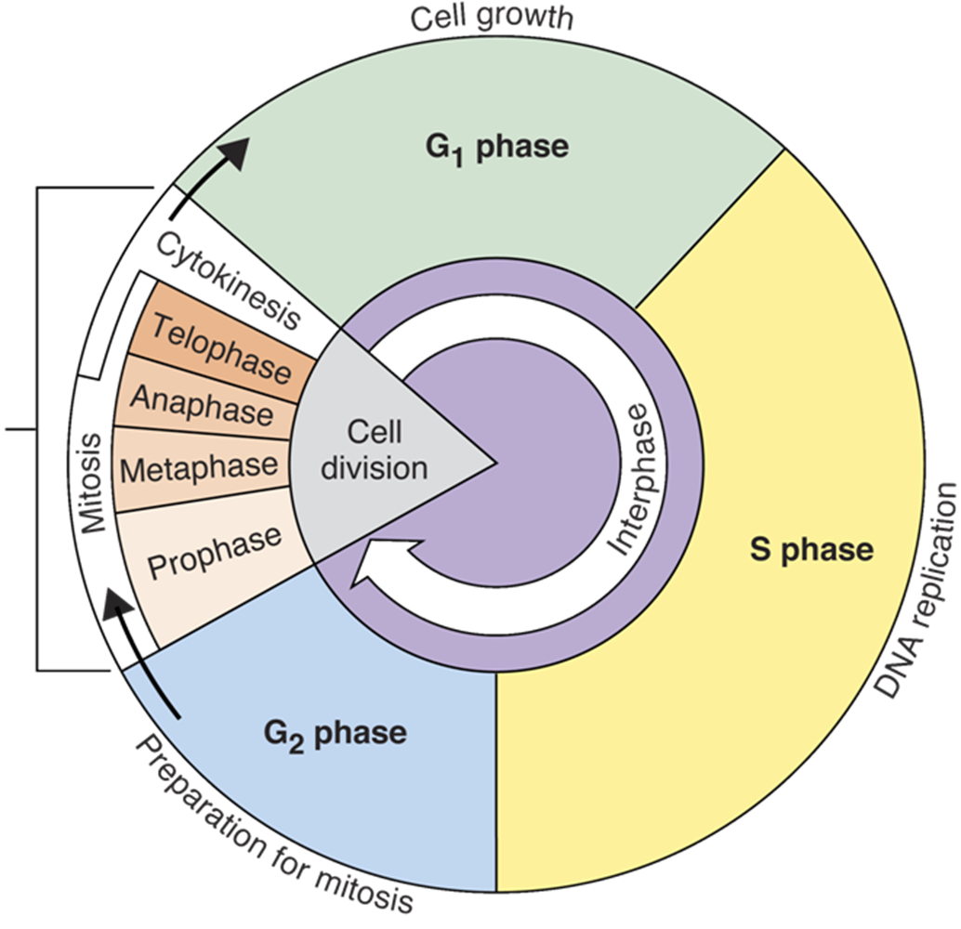

Slide 7
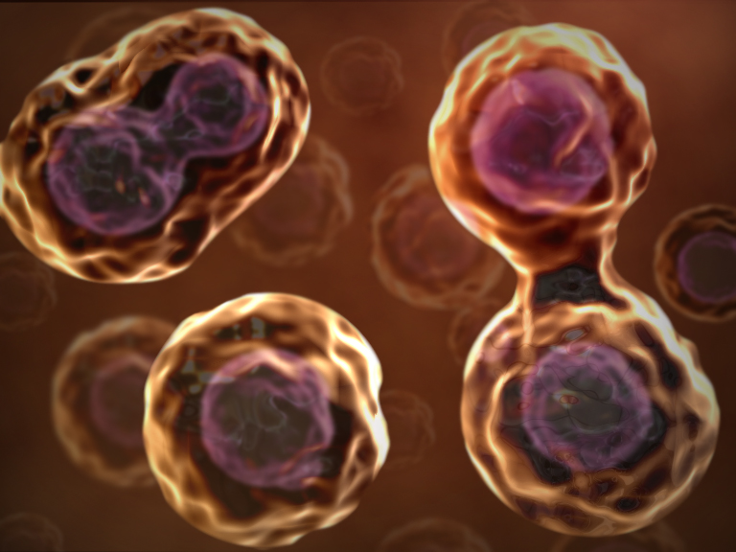
Mitosis
Biologist divide the events of mitosis into four phases:
(PMAT)
Prophase
Metaphase
Anaphase
Telophase

Slide 8
Question 1
The series of events that cells go through as they grow and divide is called
The cell cycle
Mitosis
Interphase
cytokinesis

Slide 9
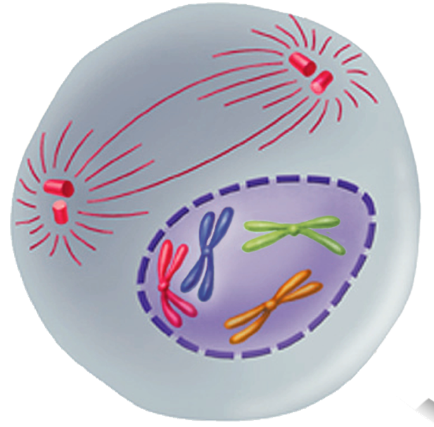

Prophase
Spindle
forming
Centrioles
Prophase is the first phase of mitosis.
The centrioles separate and take up positions on opposite side of the nucleus
Spindle fibers begin forming
Chromosomes form and nucleus begins to break down
Chromosomes
(paired chromatids

Slide 10
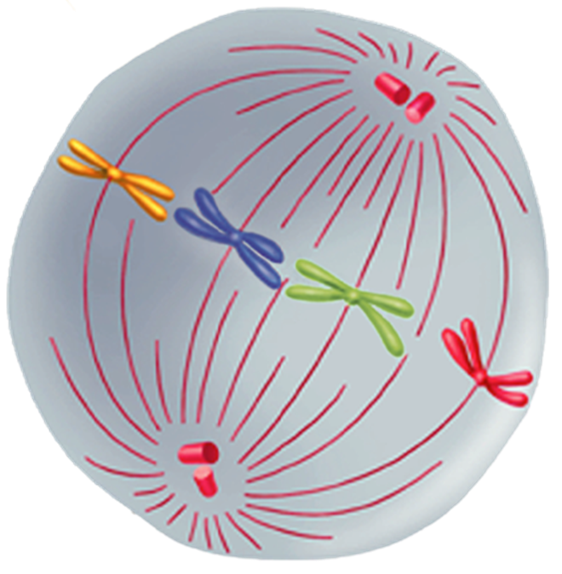
Metaphase
Centriole
The 2nd phase of mitosis
The chromosomes line up across the center of the cell.
Spindle fibers connect to the chromosome
Spindle

Slide 11
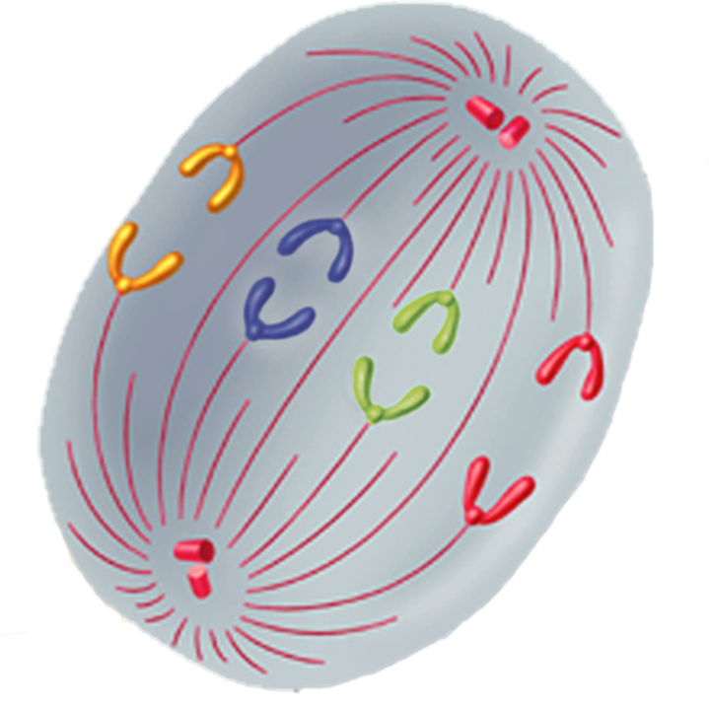
Anaphase
Individual
Chromosomes
Separate
Anaphase is the third phase of mitosis
Sister chromatids separate into individual chromosomes
The continue to move unit they have formed into 2 groups

Slide 12
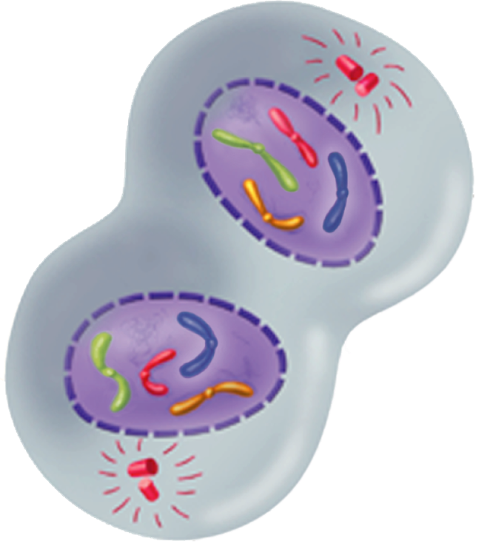
Telophase
Nucleus reforms
Telophase is the 4th and final phase of mitosis
Chromosomes gather at opposite ends of the cell and start to unwind.
A new nucleus forms around each group of chromosomes

Slide 13
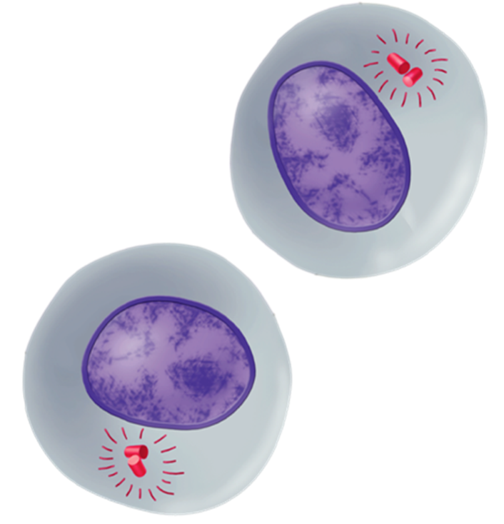
Cytokinesis
Not a part of mitosis
During cytokinesis, the cytoplasm pinches in half.
Each new cell now has an identical set of chromosomes

Slide 14
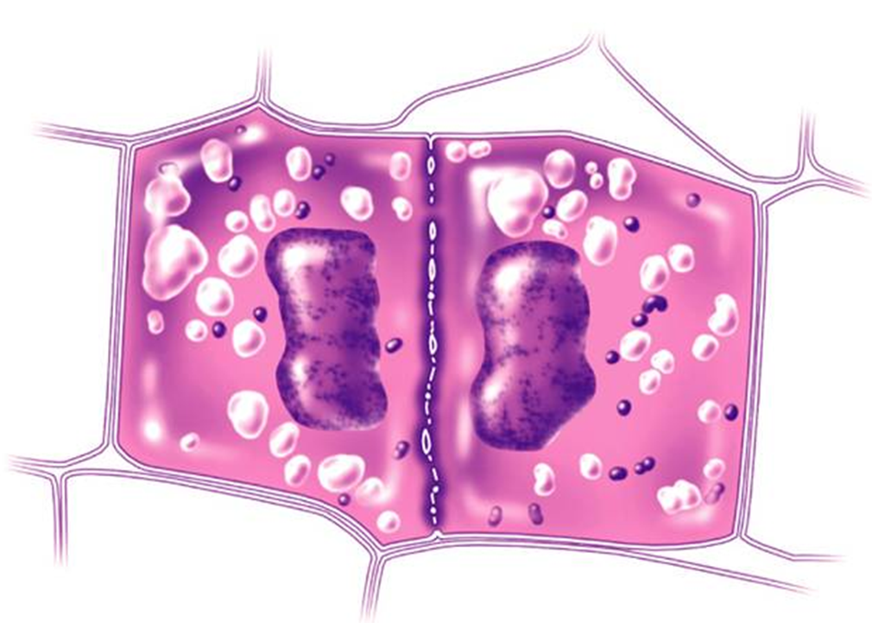
Cytokinesis
In plants, a cell plate forms in the middle of the 2 new nuclei
Cell wall
Cell plate

Slide 15
Question 2
The phase of mitosis during which the chromosomes line up at the center of the cell.
Prophase
Metaphase
Anaphase
Telophase

Slide 16
Question 3
During mitosis, “sister” chromatids separate from one another during
Prophase
Metaphase
Anaphase
Telophase

