Slide 1
Art of Ancient Greece

Slide 2
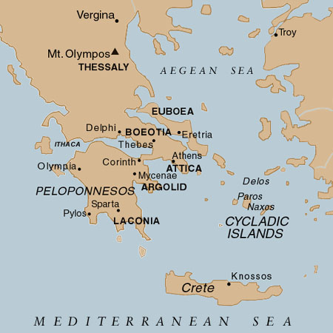

Slide 3
Major Periods
Geometric Period 900-700 BCE
Orientalizing Period 700-600 BCE
Archaic Period 600-480 BCE
Athens has a representative government; every community (deme) had its own assembly and magistrates

Slide 4
4. Classical Period
framed by the defeat of the Persians (479 BCE) and the death of Alexander the Great (323 BCE)
Early Classical 480-450 BCE
destruction of the Persian fleet in the Straits of Salamis, 479 BCE
5th Century Classical 450-400 BCE
Pericles rebuilds the Acropolis, he dies in 429 BCE
Sparta dominated the Peloponnese and much of the rest of mainland Greece;

Slide 5
  5th Century Classical 450-400 BCE (continued…)
Athens dominated the Aegean and became a wealthy and influential center of a maritime empire
the series of conflicts between Sparta and Athens became known as the
Peloponnesian Wars (641-445 BCE)
  4th Century Classical 400-330 BCE
Alexander the Great died in 323 BCE
at the age of 32
5. Hellenistic Period 320-21 BCE
Cleopatra died in 30 BCE

Slide 6
Terms and Stuff
city-state -- a polis
  an autonomous region having a city as its political, cultural, religious, and economic center
  for example: Athens, Sparta, Corinth or Thebes—remember Antigone
a stoa –colonnaded pavilion, open on three sides
stadium
sanctuaries
Mount Olympos
Sanctuary of Apollo, Delphi (the oracle of Delphi)

