Slide 1
Chapter 1
New World Beginnings
33,000 B.C – A.D. 1769

Slide 2
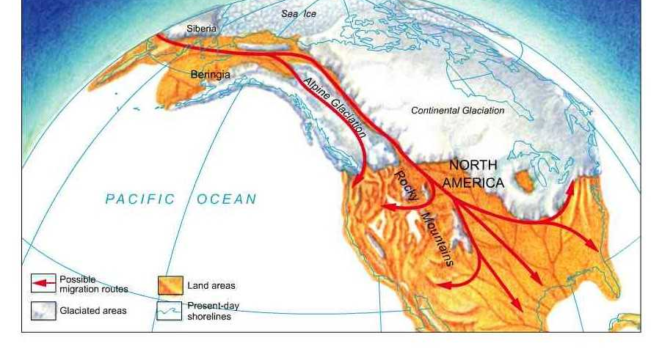
First “discoverers” of America
Matrilineal Culture Theme: Globalization, Demographic Changes
Three Sisters: Corn/Maize, Beans, Squash sustains high population
17 Million crossed strait to later become Aztecs, Incas, Mayans
Notes:
- came through Bering straight (land bridge between Siberia and Alaska)
- By 1492, 17 million people crossed the strait to later become the Aztecs, Incas, Mayans.
- “Three sisters”: corn/maize, beans, squash sustained high population densities
- Matrilinear culture
- NA had no desire to manipulate the land

Slide 3
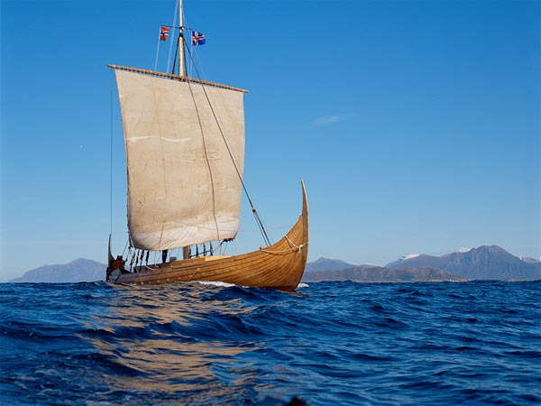
Other discoverers of America
Theme: Globalization, economic transformations
Norse seafarers from Scandinavia came upon current day Newfoundland. No one sponsored them. Asian Gene found.
Crusaders acquired a taste for exotic delights of Asia like spices (esp. sugar), silk, drugs perfumes. But the route was long and the product wasn’t cheap!
The Portuguese start exploring through Africa and begin slave trading hardcore.
Notes:
- Norse seafarers from Scandinavia came upon current day Newfoundland. No one sponsored them.
- Crusaders acquired a taste for exotic delights of Asia like spices (esp. sugar), silk, drugs perfumes. But the route was long and the product wasn’t cheap!
- The Portuguese start exploring through Africa and begin slave trading hardcore.

Slide 4
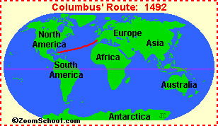
Columbus: A successful failure
Themes: Economic transformation, globalization, uses/abuses of power, Technology
Europeans want cheaper products from the East. Africa is established as a source of cheap slave labor for plantation agriculture. The Portuguese proved long ocean travel is possible.
Four Worlds: CC’s successful failure’s effect on Europe, Africa, and two Americas?

Slide 5
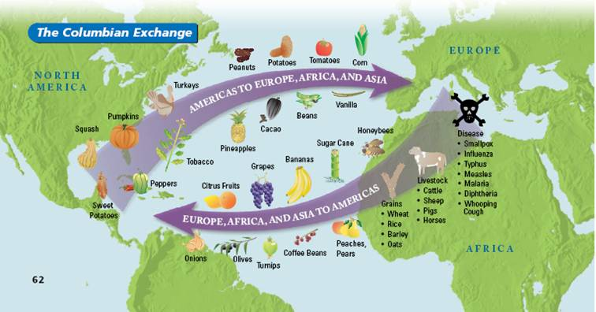
When Worlds Collide: Columbian Exchange
Exchange of “flora and fauna” Theme: globalization, demographic
Natives had tobacco, maize, beans, tomatoes, and potato.
Euros cattle, swine, and horses, seedlings of sugar cane which would grow well in the west indies. Seeds of kentucky bluegrass, dandelions, and daisies. Germs like smallpox, yellow fever, malaria;
Notes:
Natives died in droves due to white man maladies. After 100 years after CC, 90% died.
Imagine how life would be like today had this exchange of flora and fauna never happen. Talk with a partner

Slide 6
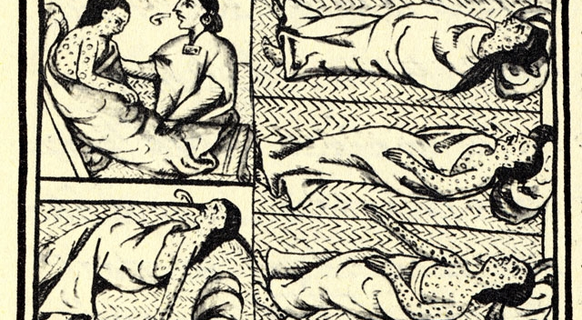
More than 90% of Natives dead after 100 years of European contact.
Theme: Culture, slavery, Religion,

Slide 7
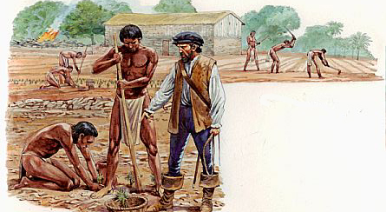
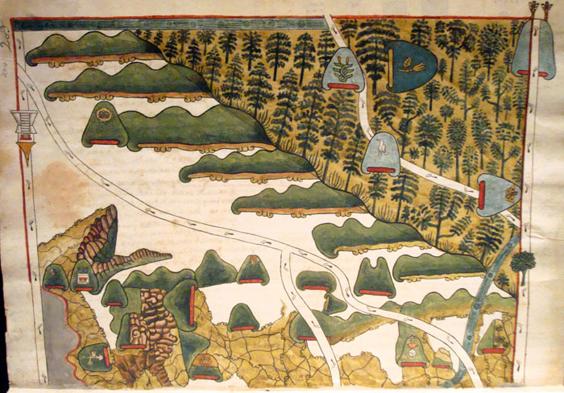
Encomienda System
Theme: Uses/Abuses of Power
Notes:
Spanish conquistadors, settlers, priests or colonial officials were given a repartimiento, or grant of land. These lands were often quite vast. The land included any native cities, towns, communities or families that lived there. The natives were supposed to provide tribute, in the form of gold or silver, crops and foodstuffs, animals such as pigs or llamas or anything else the land produced. The natives could also be made to work for a certain amount of time, say on a sugarcane plantation or in a mine. In return, the owner, or encomendero, was responsible for the well-being of his subjects and was to see to it that they were converted and educated about Christianity.

Slide 8
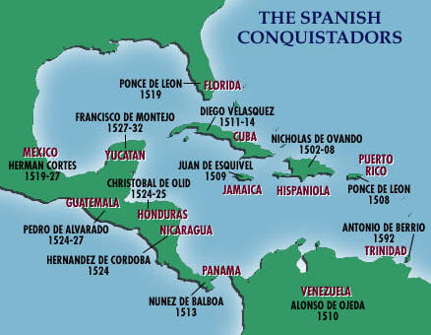
Spanish Conquistadores for gold and glory! – Ballooning Euro money supply is the fuel that started growth of capitalism
Theme: Economics
Notes:
Ferdinand Magellan – strait off tip of S. America to circumnavigate the world
Ponce De Leon – Florida, Killed by NA
Coronado – quest for golden cities in Arizona, Kansas, and New Mexico.
Hernando De Soto – discovered Mississippi river
Francisco Pizarro – crushed the Incas
Potosi – present day Bolivia- got Spain tons of Silver

Slide 9
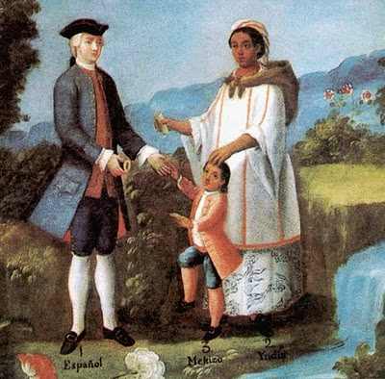
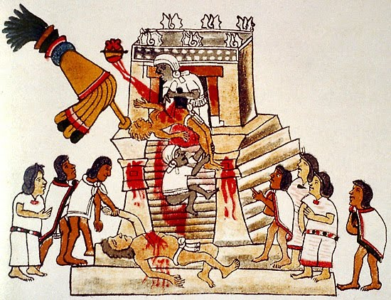
Conquest of Mexico
Theme: Uses/Abuses of Power, Identity
Hernan Cortez wanted gold from Montezuma
Cortez’ army won and also spread massive disease to the people. In 100 years, the population went from 20 million to 2 million
Mestizos – creation of a new race!
Dia De La Raza – birthday of a whole new race of people
Notes:
Hernando Cortes offered as a good justification for the conquest of Mexico. He said since the native people observed degrading and horrific customs, including human sacrifice, it was essential to conquer them and convert them to Christianity.

Slide 10
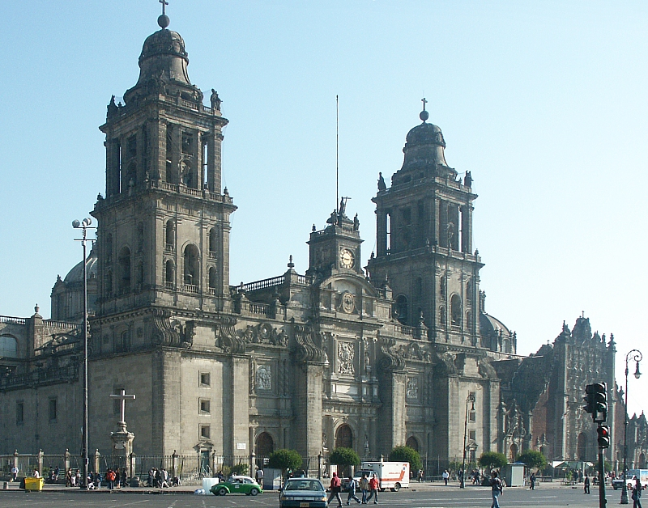
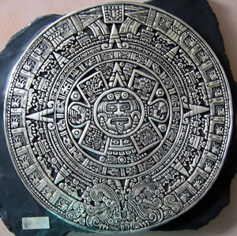
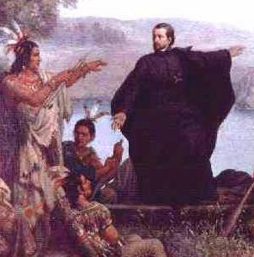
How the Spanish changed the Americas through conquest
Pope’s Rebellion – pueblo rebels destroyed churches and killed priests in New Mexico
Notes:
Silver towns of Peru and Mexico,
subjugation of NA,
majestic cathedrals everywhere,
printing press make books, scholars studied at universities 85 years before the Harvard opened in the colonies,
Christian religion,
Roman Catholic mission’s effort to convert Natives

