Slide 1
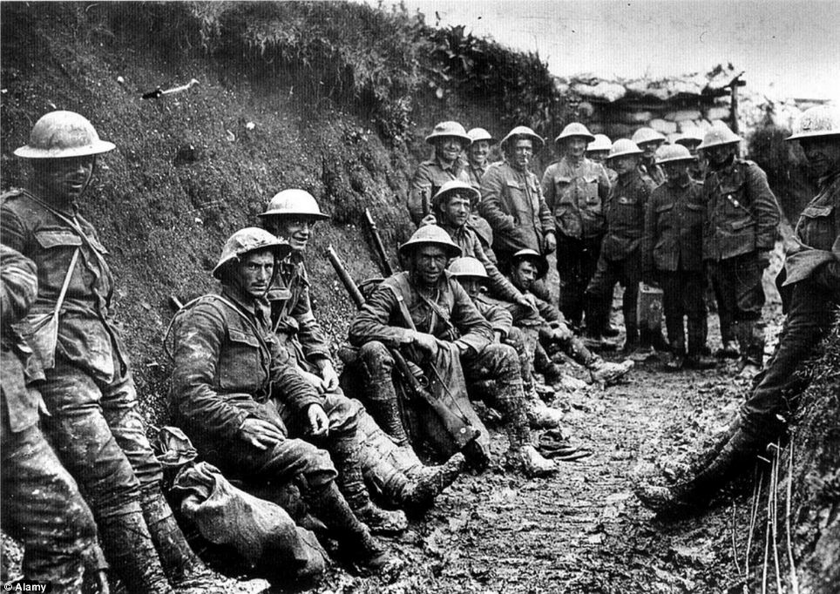
Post War Trauma
End of WWI
U.S. History
Mrs. Janiak

Slide 2
Opener: (left side)
What is Post Traumatic Stress Disorder?
Who can get PTSD?
What are the symptoms?

Slide 3
“Shell-shocked”
Shell Shock was a term used during the First World War to describe the psychological trauma suffered by men serving on the battlefronts.
The intensity of the essentially artillery battles often caused neurotic cracks to appear in otherwise mentally stable soldiers.
Symptoms varied widely in intensity, ranging from moderate panic attacks - which sometimes caused men to flee the battlefield: a crime which was invariably regarded as rank cowardice and which resulted in a court martial for desertion - to effective mental and physical paralysis.
Sent home to recover many shell shock victims recovered over time, whereas many others continued to feel its effects for years afterwards.
Treatment for shell shock was primitive at best and dangerous at worst; psychological theories governing its treatment developed only gradually. Reliable figures relating to the total number of shell shock sufferers are not available.

Slide 4
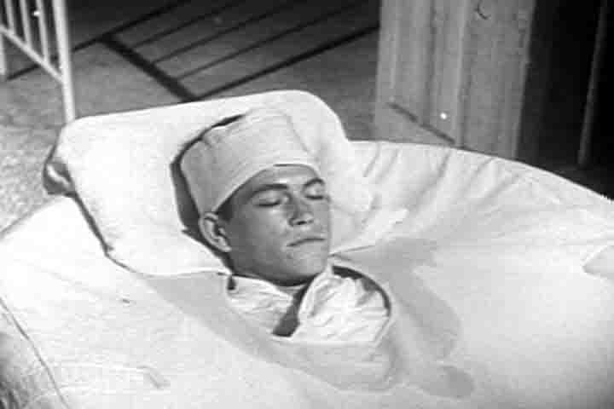
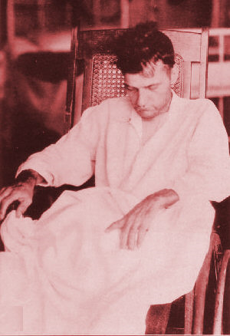

Slide 5
Public Disillusionment
A growing distrust of political leaders and government officials
Many citizens were angered that peacemakers had not expressed their ideals fervently enough, and people began to wonder why the war was fought at all.
A feeling of disillusionment spread across the world as people bitterly decided that their governments in no way knew how to serve the best interests of the people.
The loss of loved ones on the battlefield was especially disturbing, for in some parts of Western Europe, one of four young men had lost his life in battle. Altogether, the war killed 10 to 13 million people, with nearly a third of them civilians. The future certainly did not look bright for the families of those killed in the war, and a grim acceptance of reality replaced the optimistic dreams of those in decades past.

Slide 6

(Left side) Johnny Got His Gun
*An anti-war novel written in 1938 (published 1939) by American novelist and screenwriter Dalton Trumbo
What is the point that the author Dalton Trumbo is making about war? How does he feel about men going to war?
What is Trumbo’s attitude about the reasons countries go to war?

Slide 7
Left side- Metallica “One” song analysis
Song released on Justice for All album, Jan. 10, 1989
What lyrics from the song show a direct connection to the Johnny Got His Gun novel?
Who is the storyteller in the song?
What is Metallica’s overall message from the song in your opinion?

