Slide 1
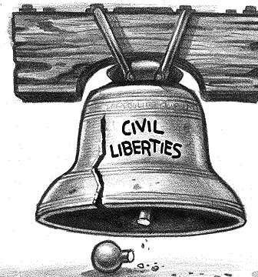
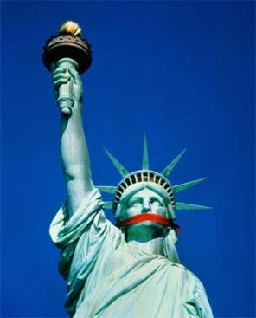
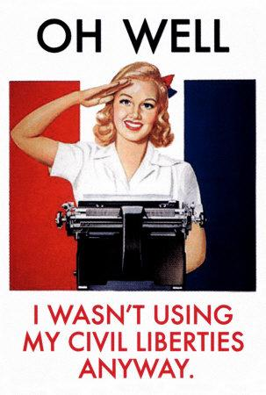
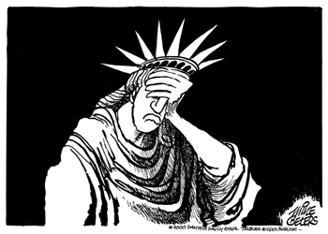
Civil Liberties
WWI: U.S. History
Mrs. Janiak

Slide 2
*Anti-Immigrant Hysteria:
Hysteria= fear, dislike, resentment, pity, sympathy, sorrow, superiority, disgusted, hate
-Who? German- Americans & Austrian-Hungarian Americans
-Why? Because Germany and Austria are enemies to the U.S. & Allies in the war
How? speaks German or had an accent, clothing, name, physical features
-What happened? Their loyalty was questioned, lost jobs, stopped teaching German, some were tar and feathered, some changed their names, German music was banned, German books were banned, lynched, flogged
Americans renamed: German Measles-> “Liberty Measles,” sauerkraut-> “Liberty Cabbage”

Slide 3
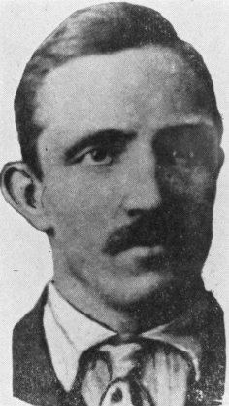
Examples:
Collinsville, Illinois: German born Robert Prager was lynched
A mob on April 4 captured Prager at his home, paraded him, made him kiss the flag — momentarily rescued and hustled off to jail by police and a mayor who tried to talk the mob out of its design — then shanghaied (take (someone) against his will) from his “protective” custody cell and taken to the outskirts of Collinsville for hanging on a tree.

Slide 4
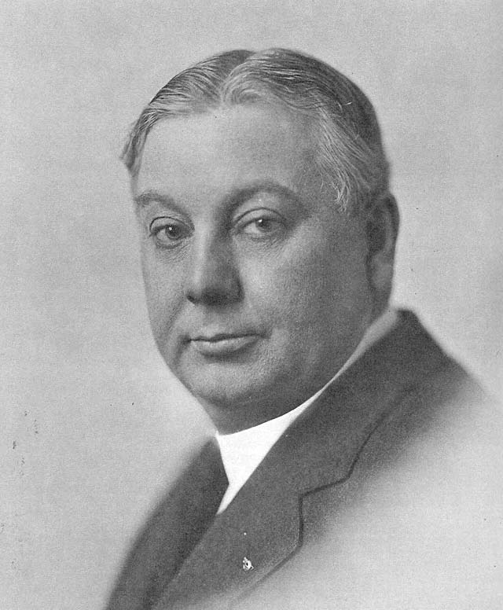
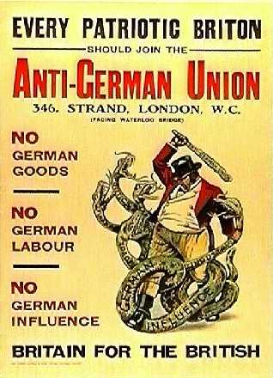
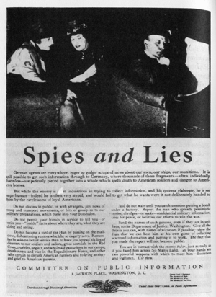
Iowa Governor William Hardy: proclaimed all conversations should be in English.
“God didn’t hear any prayers except in English.”

Slide 5
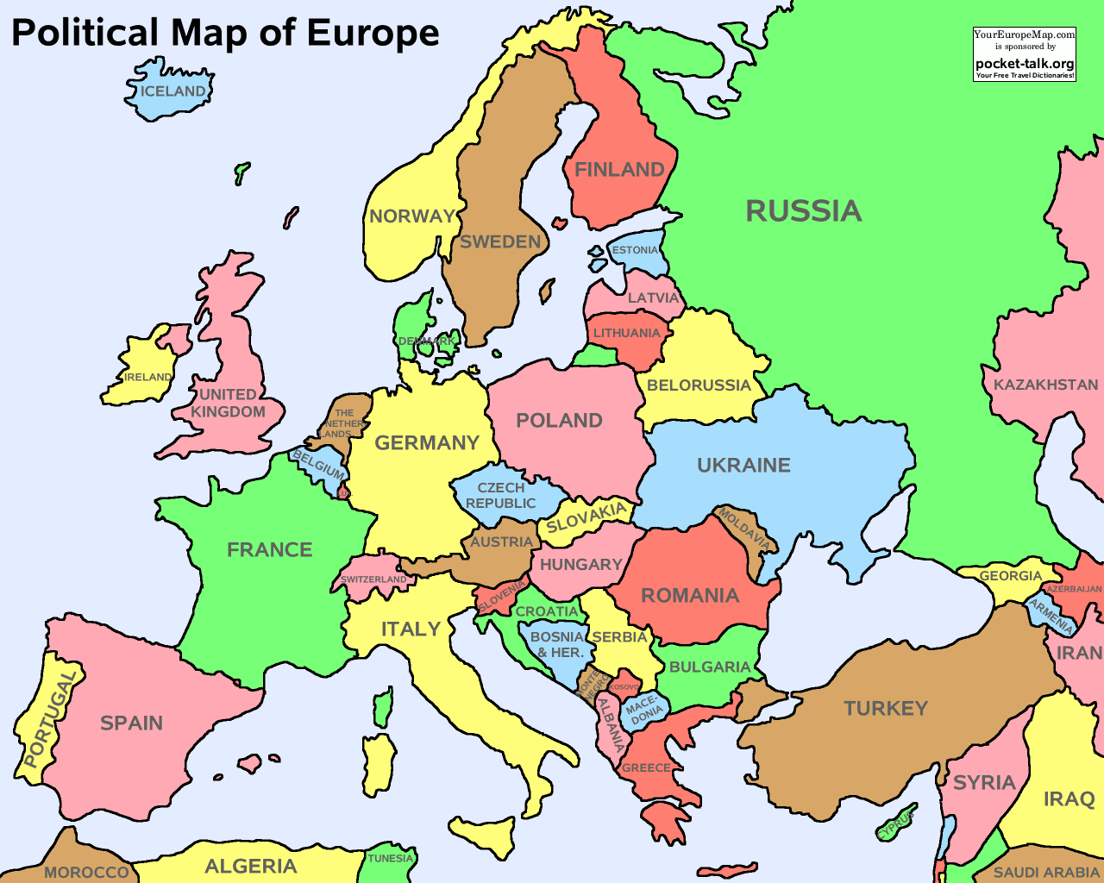
Dutch, Danish, Norwegian, Swedish, Czech and German speaking Americans were affected.

Slide 6
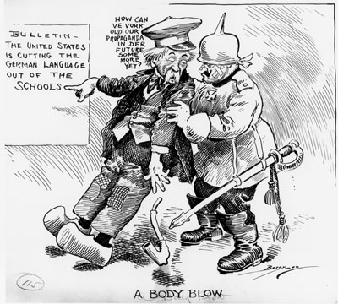
German speaking elderly- jailed for speaking German on the phone.
Lutheran pastor- jailed for speaking part of a funeral service in Swedish (dead soldier’s grandparents didn’t speak English)

Slide 7
Left side of your notebook activity!
Draw a small political cartoon depicting the anti-German attitude in the U.S. during WWI.

Slide 8
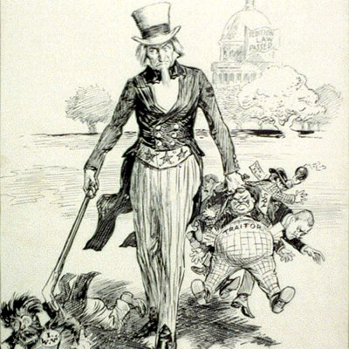
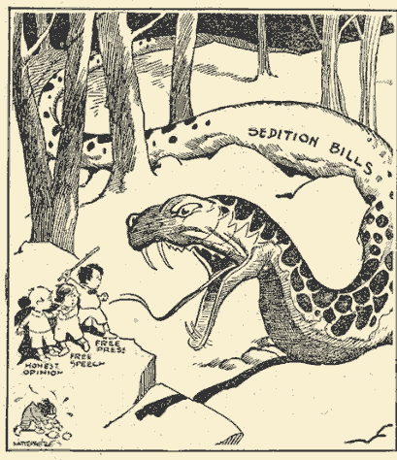
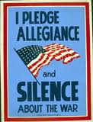
Espionage and Sedition Acts: Congress and President Wilson signed 1917 & 1918
If found guilty of being disloyal, Anti-American, interfering with the draft or sale of government bonds.
Penalty: up to $10,000 fine and/or sentenced to a max of 20 years in prison
=direct violation of the First Amendment in the Constitution (your freedom of….)
(Supreme Court claimed there was a “clear and present danger to freedom of speech and press during a war”).

Slide 9
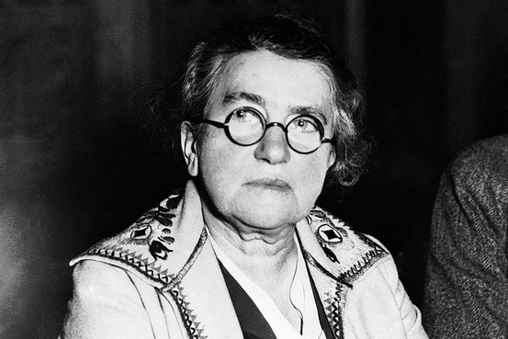
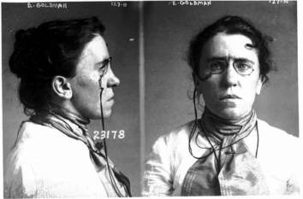
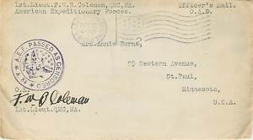
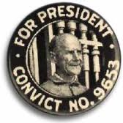
Examples:
Post Office censored mail, magazines were banned
Film director Goldstein was jailed, career ended with his Revolutionary War movie that showed the British (now the Allies) shooting at colonists
Socialists and labor leaders harassed-> Eugene Debs jailed for 10 years (spoke against the war)
Emma Goldman: an anarchist= doesn’t believe in a government, fined $10,000 and 2 yrs. of jail for speaking against the draft-> released from jail and deported to Russia

Slide 10
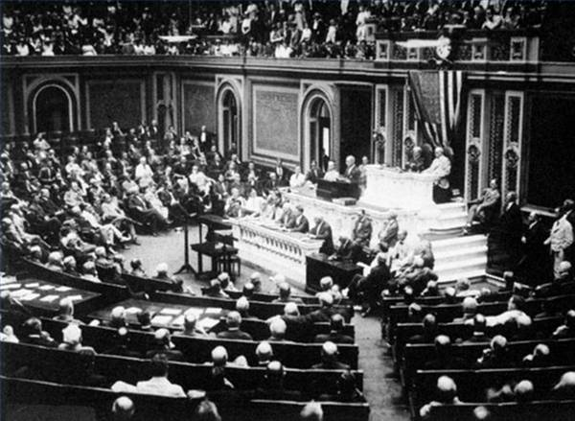
Wilson’s last day in office: Congress repealed the Acts

Slide 11
Left side of your notebook activity!
Draw another small political cartoon- this time depicting the Espionage and Sedition Acts as an irony.
Ironic: While our soldiers fought “to preserve democracy and freedom” our country at home had banned some of the most important freedoms (freedom of speech and press, right to assemble)

