Slide 1
Warm-up #7
John Calvin believed in Predestination, what does that term mean?
How did Henry VIII get his way in his dispute with the Pope?

Slide 2
The Counter-Reformation
Analyze the Church’s reaction to the reformation?

Slide 3
I. Background
Counter-Reformation aka Catholic Reformation.
  1500s-1600s
  The Catholic Church worked to strengthen itself and stop the spread of Protestantism in Europe.
Protestantism- a Christian way thinking which challenged the traditions and actions of the Church.

Slide 4
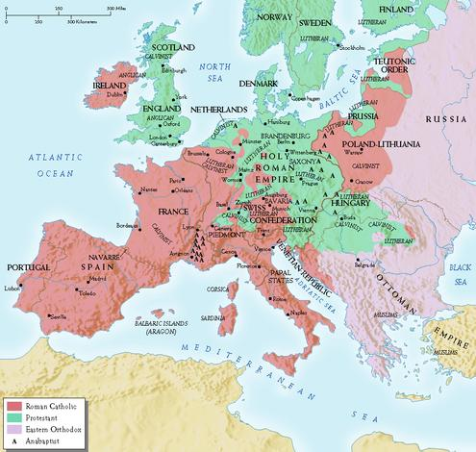
Protestant
Catholic

Slide 5
1500 A.D.
1560 A.D.
1600 A.D.
# of followers
Catholic
Protestant (Lutheran, Anglican, etc.)

Slide 6
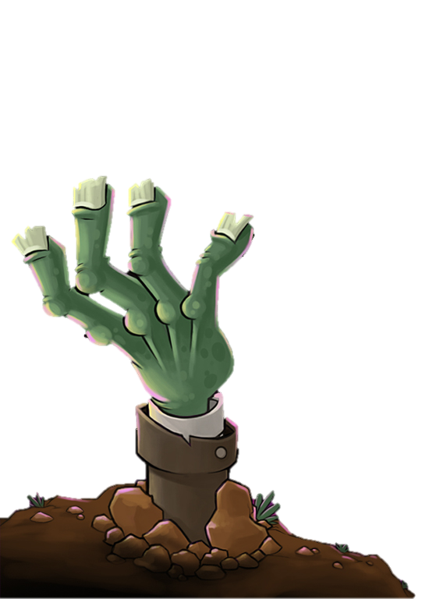
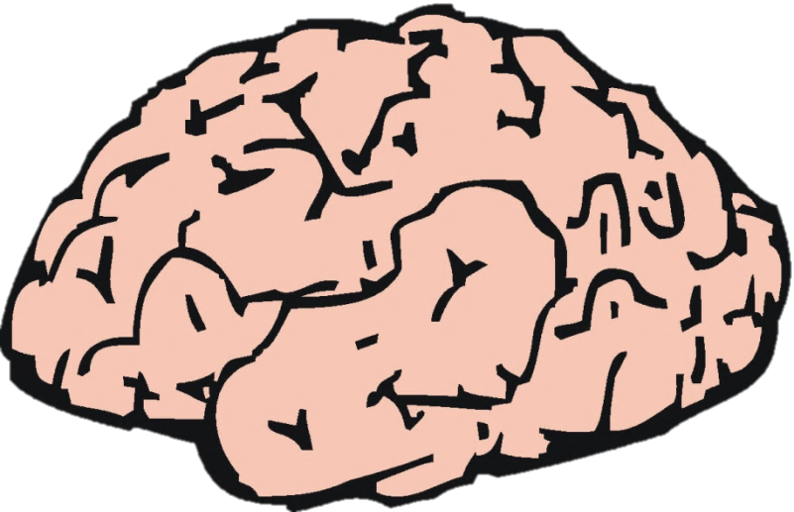


Brain
Snack
.
.
.
.

Slide 7
What were some differences between Catholics and Protestants?

Slide 8
Protestant
Catholic
-Jesus offers salvation but you must work to get it.
-Salvation is . the free gift of God, you cannot earn it.
-Jesus lived, was crucified and resurrected.
-Only God can forgive sins
-Popes can forgive sins.
-Communion and baptism are very important
-Regular church members help make decisions.
-Only clergy make decisions in the church.

Slide 9
Religious Orders
In reaction to the protestant reformation, the Church created new religious orders to win back support for the Catholic Church.
  Jesuits
    Founded by Ignatius of Loyola.
    It was a religious order created to serve the pope and the Church.
    Disciplined
    goal = to teach people about Catholic ideas and turn people back against Protestant ideas.
  Ursuline Order by Angela Merici. Taught girls.

Slide 10
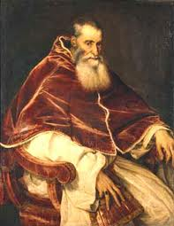
Council of Trent (1545)
Pope Paul III realized that the reformation could no longer be ignored.
Meet three times between 1545 and 1563.
He called a meeting of Roman Catholic officials to discuss issues with the Church

Slide 11
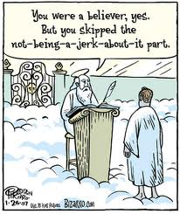
Issues
Corruption
  Indulgences
  Waste of church money (Leo X)
Incompetence of Church Officials
Issues raised by reformers
Faith versus Works

Slide 12
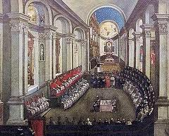
Resolutions
A system of training was to be put in place for priests.
New rules for clergy:
  Bishops had to live in the areas they oversaw.
Restated the importance of the clergy in interpreting the Bible.
All of the major doctrines (beliefs) were reaffirmed
Abuses were no longer tolerated, such as the selling of indulgences
Pope created religious courts to punish Protestants in Italy.
Pope banned some books (read = excommunicated).

Slide 13
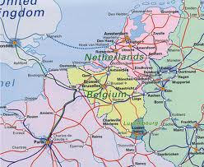
Other major consequences
A re-emphasis of religious order, particularly the Jesuits
Protestants were pushed North in the Netherlands, splitting off the Catholic Belgium in the South
Catholic missionaries increase greatly (Jesuits)
  Africa and Asia, and the Americas
  Francis Xavier – Asia mid 1500s brought Catholicism to Japan and India.
  Catholic missionaries baptized millions of people around the world.

Slide 14
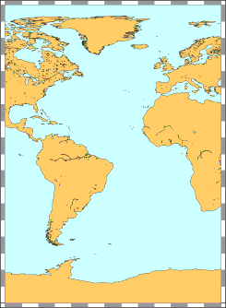
Protestant England settled in what is now the United States.
Catholic Spain and France settled in what is now Mexico and South America.
England
North America
Protestant
Draw this map in your notes!
Spain
Catholic
South America

Slide 15
Things to Remember
Problems in the church like selling indulgences led to the Reformation.
Martin Luther and others argued that God provided salvation, not the church.

Slide 16
3. France and Spain remained Catholic and spread Catholicism to Mexico and South America.
4. England and Germany became Protestant and spread Protestantism into what is now the USA.

