Slide 1
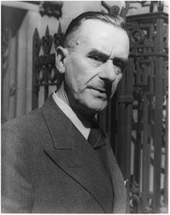
Thomas Mann
6 June 1875- 12 August 1955

Slide 2
Why He’s Famous
Known for his series of highly symbolic and ironic epic novels and novellas
Noted for their insight into the psychology of the artist and the intellectual
Modernized German and Biblical stories, as well as the ideas of Goethe, Nietzsche, and Schopenhauer

Slide 3
Important Moments
Mann was awarded the Nobel Prize in Literature in 1929, principally in recognition of his popular achievement with the epic Buddenbrooks
Author of "The Magic Mountain“
The start of his writing career was with a short story ‘Little Mr. Friedemann’

Slide 4
His Writings
His writing style can be described as formal, filled with humor, irony and satire
His writings are deep and meaningful
Thomas Mann was one of the most renowned and greatest writers of the twentieth century
His writings are commended not only in Germany but all over the world

Slide 5
Life
Born in 1875 in Lubeck, Germany
He was the son of a senator and merchant
Had 6 children
Wanted a career in journalism
Attended the Ludwig Maximillians University of Munich
First worked for South German Fire Insurance Company from 1894-1895
Settled in the U.S in 1938 after having lived in France and Switzerland

Slide 6
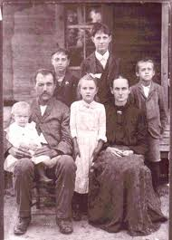
Family
Thomas Mann and his 6 children

Slide 7
Quote
‘‘Des Schriftstellers Freude ist der Gedanke, der Emotion wird, die Emotion, die ganz ein Gedanke werden kann.”
“The writer’s joy is the thought that can become emotion, the emotion that can wholly become a thought.”

