Slide 1
Properties of Matter

Slide 2
What is matter?
Anything that has mass and takes up space

Slide 3
Common States of Matter
atoms and molecules are constantly moving, and we measure the energy of these movements as the temperature of the substance. The more energy a substance has, the more molecular movement there will be, and the higher the perceived temperature will be
amount of energy that atoms and molecules have (and thus the amount of movement) influences their interaction with each other

Slide 4
Solids
Solids are formed when the attractive forces between individual molecules are greater than the energy causing them to move apart. Individual molecules are locked in position near each other, and cannot move past one another. The atoms or molecules of solids remain in motion. However, that motion is limited to vibrational energy

Slide 5
Liquids
Liquids are formed when the energy (usually in the form of heat) of a system is increased and the rigid structure of the solid state is broken down. In liquids, molecules can move past one another and bump into other molecules; however, they remain relatively close to each other like solids. Often in liquids, intermolecular forces pull molecules together and are quickly broken.

Slide 6
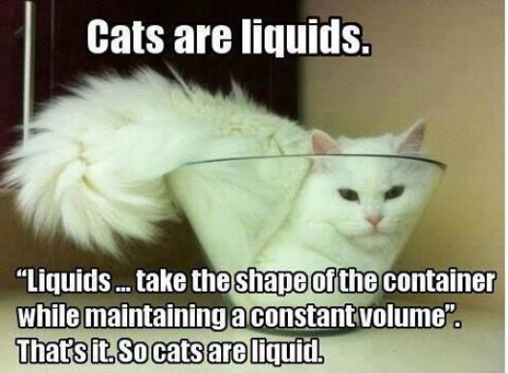

Slide 7
Gases
Gases are formed when the energy in the system exceeds all of the attractive forces between molecules. Thus gas molecules have little interaction with each other beyond occasionally bumping into one another. In the gas state, molecules move quickly and are free to move in any direction. As the temperature increases, the amount of movement of individual molecules increases. Gases expand to fill their containers.

Slide 8
Plasma*
Plasmas are hot, ionized gases. Plasmas are formed under conditions of extremely high energy, so high, in fact, that molecules are ripped apart and only free atoms exist. More astounding, plasmas have so much energy that the outer electrons are actually ripped off of individual atoms, thus forming a gas of highly energetic, charged ions.

Slide 9
Properties of Matter
Intensive Properties – a physical property that doesn’t depend on the size or amount of material (if you cut the substance in half, these properties wouldn’t change)
Temperature, density, hardness, reactivity are all intensive properties
Extensive Properties – depend on the amount of a material – such as mass, volume or weight

Slide 10
Physical Properties of Matter
Physical properties can be observed or measured without changing the composition of matter. Physical properties are used to observe and describe matter.
Physical properties include: appearance, texture, color, odor, melting point, boiling point, density, solubility, polarity, and many others.

Slide 11
Physical Changes
A physical change takes place without any changes in molecular composition. The same element or compound is present before and after the change. The same molecule is present through out the changes. Physical changes are related to physical properties since some measurements require that changes be made.
Boiling and melting are physical changes

Slide 12
Chemical Properties of Matter
Chemical properties of matter describes its "potential" to undergo some chemical change or reaction by virtue of its composition. What elements, electrons, and bonding are present to give the potential for chemical change.
For example hydrogen has the potential to ignite and explode given the right conditions. This is a chemical property.
Metals in general have they chemical property of reacting with an acid. Zinc reacts with hydrochloric acid to produce hydrogen gas. This is a chemical property.

Slide 13
Chemical Changes
A CHEMICAL CHANGE alters the composition of the original matter. Different elements or compounds are present at the end of the chemical change. The atoms in compounds are rearranged to make new and different compounds.
http://www.elmhurst.edu/~chm/vchembook/105Achemprop.html

Slide 14
Four Signs of Chemical Change
Color change
Release of a gas
Formation of a solid
Production of heat and/or light (be careful to differentiate between heat or light produced by the reaction vs heat or light that already exist – from flame, for example)
Making a mixture is not a chemical change

