Slide 1
Name:
Date:
Introduction to Stock Market
Warm Up
What do you know about the stock market?
What I know | What I want to know | What did I learn
1. | 1. | 1.
2. | 2. | 2.
3. | 3. | 3.
4. | 4. | 4.
5. | 5. | 5.
6. | 6. | 6.
7. | 7. | 7.
8. | 8. | 8.

Slide 2
Overview
The Stock Market
  Financial Markets
  Economic Benefits of Financial Markets
Stocks
  What is stock
  Does it work
  How is it priced
Different Exchanges
  NYSE
  NASDAQ
Conclusion

Slide 3
The Stock Market is a financial market
A Financial Market is a market in which financial assets (stocks=$) are TRADED.
The New York Stock Exchange (NYSE) and the NASDAQ are examples of Financial Markets.
Financial Markets exist to facilitate interaction or connect providers and users of capital.
Users of Capital
Governments
Companies like:
McDonalds
Home Depot
Google
Apple
Providers of Capital
Savers
Investors
You and I
Financial Markets
NYSE
NASDAQ
Financial Markets have been the real backbone of the growth western economies have experienced in the modern period.

Slide 4
Providers and Users Wants and Needs
Providers of Capital
Savers
Investors
You and I
Financial Markets
NYSE
NASDAQ
Users of Capital
Companies like:
McDonalds
Home Depot
Google
Apple
Want
To make $ on their $ - A RETURN
Need
$ to grow, purchase equipment, build factories, or pay employees
Choice
Centralization
Liquidity “Buy or Sell” at any time
Access to large numbers of investors
Ability to raise a lot of money
Real time pricing
The benefits of financial markets
to each group

Slide 5
Stock market versus Stock Exchange
The stock market is where shares/pieces of stocks, bonds, and futures are bought and sold (or traded). (Can be electronic.)
The stock exchange is the actual physical location or virtual location where stocks are listed and traded.
    New York Stock Exchange (NYSE)
    American Stock Exchange (now part of NASDAQ)
    NASDAQ—virtual exchange

Slide 6
Check for understanding #1
A financial market connects which two types of people? __________________________
Can you list one advantage a financial market provides for each of these people? ________________________________________________
A stock market can be either physical (based in a building) or______________?

Slide 7
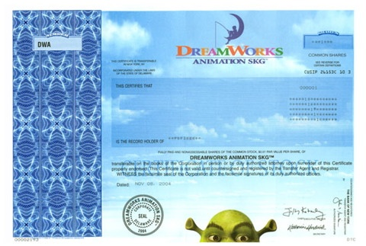
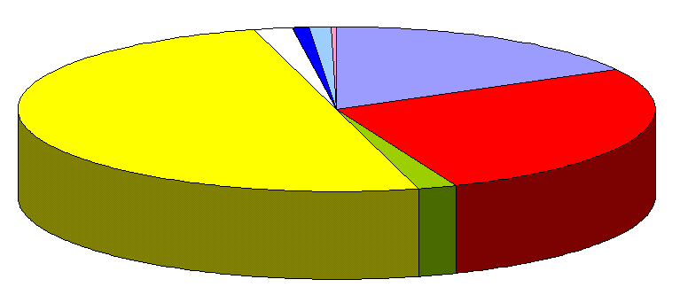
What is Stock?
It is a piece of EQUITY or ownership interest in a corporation.
All corporations have stock and it is divided into pieces called SHARES of Stock.
Think about a company’s stock as a pie.
All of the company’s stock is divided into pieces or parts called shares.
Example of a physical share(s) of stock for DreamWorks studios.

Slide 8
How does it work?
Company decides to SELL some pieces/shares of stock (a part of itself) to different investors in order to raise some money.
These shares are then LISTED on a specific stock exchange.
Brokers at the exchange work to connect the individuals who OWN shares of stock in a company with those who want to BUY those shares.
Once the SHARES are listed the company doesn’t get any more money when they are traded.
Potential Buyer
Sends payment to broker
F. Receives shares from Broker.
Broker
B. Finds seller and passes them the payment
E. Sends shares to Buyer
Seller
C. Takes payment
D. Passes shares of stock to Broker

Slide 9
How are “listed” shares priced
Publically traded shares/pieces of stock are LISTED on a specific stock exchange
Each share of stock in a company has a value called the PRICE.
Exchanges report the PRICE at which the LAST TRADE was made as the “Current Price” for a share of the company’s stock
Prices can VARY from moment to moment
  The price for a widely held or heavily traded Stocks like IBM or the Home Depot can change each second
Each stock when traded has two components
  The BID – The price for the share that the buyer is ready to pay
  The ASK – What the seller is willing to take for a share of stock
When the bid and ask prices match the broker fills the ORDER and a trade takes place. This determines the Stock’s Price.

Slide 10
Check for understanding #2
Stock represents a part of EQUITY in a company, what is another word for equity? __________________________
Stock is divided into pieces or parts, what do we call these? ________________________________________________
A Broker connects which TWO people?
_______________________________________________
How often does a stock’s price change?
________________________________________________

Slide 11

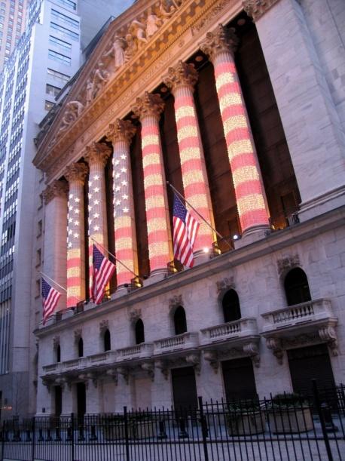




Different Exchanges – THE NYSE
The New York Stock Exchange is on Wall Street and is often called the big board
It is the largest stock exchange in the world by dollar value
In October 2008 the combined capitalization of all the NYSE companies was $10.1 Trillion
There are over 1000 companies listed on the NYSE and they are not all from the US

Slide 12
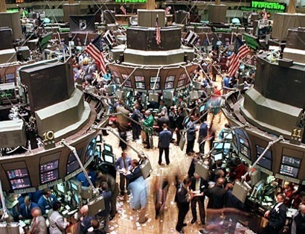
How the NYSE works
The NYSE is a physical exchange in a building with people making the trades
In 2008 an average of 1.28 billion shares trade hands each day it operates
70% of all of its trades take place in one room
NYSE brokers work with Specialists to trade specific stocks.
To be listed on the NYSE represents an older well established company, most of the NYSE stocks are the most widely held companies in the world.

Slide 13

Let see how trades at NYSE work

Slide 14
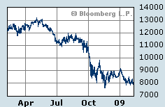
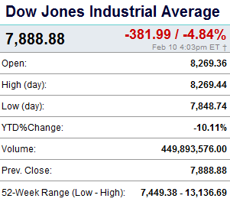
NYSE Performance
The Dow Jones Industrial Average is a price-weighted average of 30 blue-chip stocks that are generally the leaders in their industry.
It has been a widely followed indicator of the stock market since October 1, 1928.
The Dow Jones Industrial Average

Slide 15
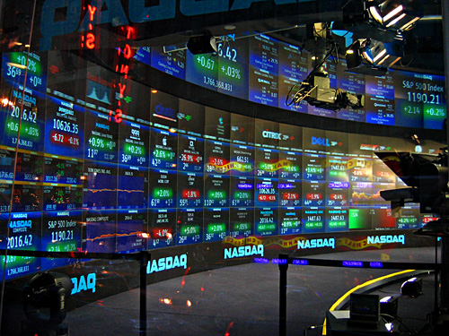




Another exchange – The NASDAQ
NASDAQ is a totally electronic exchange. All computer trading
It lists over 3,200 companies and trades approximately 2 billion shares a day.
Companies need “less” to list on the NASDAQ than the NYSE
  Lower Revenue
  Lower Assets
  Lower Capitalization
This is why there are more High Tech and Bio Tech companies on the NASDAQ than the NYSE

Slide 16

NASDAQ Movie

Slide 17
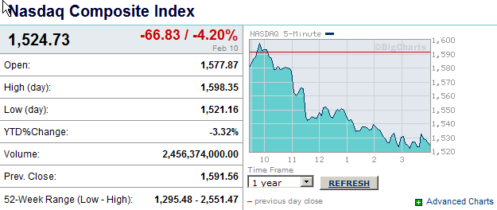
NASDAQ Performance
The Nasdaq Composite is a stock market index of all of the common stocks and similar assets listed on the NASDAQ stock market,
meaning that it has over 3,000 components.
It is highly followed in the U.S. as an indicator of the performance of stocks of technology companies and growth companies.
Since both U.S. and non-U.S. companies are listed on the NASDAQ stock market, the index is not an exclusively U.S. index.

Slide 18
NYSE versus NASDAQ
NYSE
Older Well Established Companies
More expensive to list
More difficult to list
Well established companies
Human based
IBM
Boeing
NASDAQ
High Growth Stocks
Cheaper to list
Less requirements to list
New emerging companies
  High Tech – Biotech
All computer based
Google
Microsoft

Slide 19
Check for understanding #3
A High Tech or Bio Tech company’s stock is more likely to be LISTED on which exchange? __________________________
An older, bigger or more established company’s stock is more likely to be listed on which exchange?__________________
If I want to know how the New York Stock Exchange performed on a given day; I should look at what?
_______________________________________________
If I want to know how the NASDAQ performed on a given day what should I look at what?
________________________________________________

Slide 20
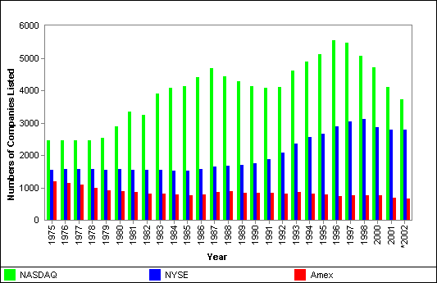
Conclusion
To be part of a stock exchange a stock must be listed
Once listed the company doesn’t make any more money from the stock
Companies choose which exchange they want the stock to be listed on
Companies can switch exchanges.

Slide 21
Name:
Date:
Introduction to Stock Market
Warm Up
What do you know about the stock market?
What I know | What I want to know | What did I learn
1. | 1. | 1.
2. | 2. | 2.
3. | 3. | 3.
4. | 4. | 4.
5. | 5. | 5.
6. | 6. | 6.
7. | 7. | 7.
8. | 8. | 8.

Slide 22
Stock Market Game
Each team is given $100,000
You may trade stocks listed on the NYSE or NASDAQ
Stocks must have a price over $5 a share
You must trade at least 100 shares of a company at a time
Each time you trade you will be charged a broker’s fee of 2%
The game will start next week

Slide 23
Ch. 11 Assessment pg 294
Key Terms page 294
#1-5 and # 9
Skills for Life page 295
#20-24

