Slide 1

HOT TOPICS

Slide 2
1. Sickle cell anemia, used as an example of a single base substitution mutation and as an example of transient polymorphism (GAG mutates to GTG, glutamic acid to valine)

Slide 3
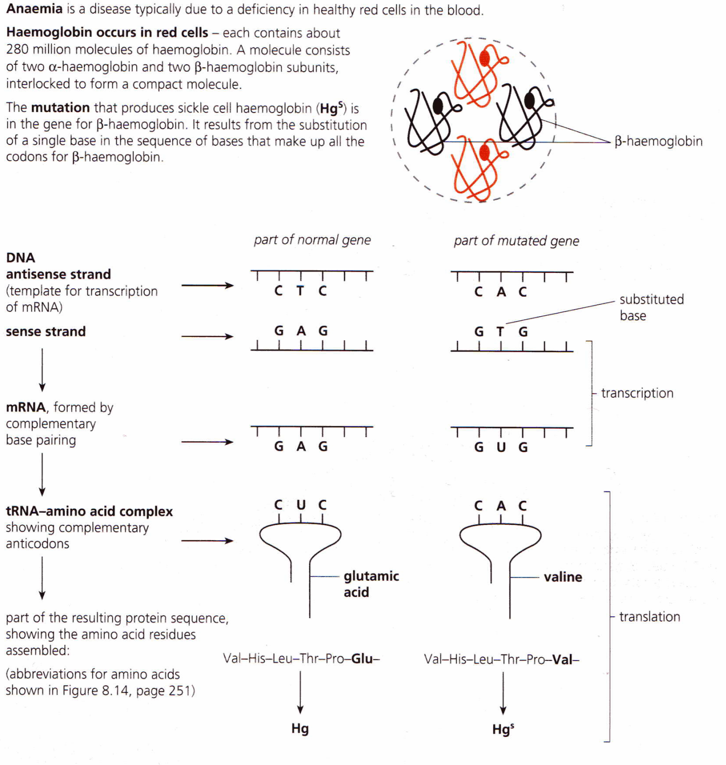
Sickle Cell Anemia is the result of a gene mutation called a base substitution
Hemoglobin is found in your red blood cells.
Each hemoglobin molecule is made up of 2 alpha chains (α-hemoglobin) and 2 beta chains (β-hemoglobin)
The mutation producing sickle cell hemoglobin is in the gene for β-hemoglobin.

Slide 5
2. Use of lactase in the production of lactose-free milk

Slide 6
What is lactase?
Lactase is an enzyme produced by the pancreas and the surface of the villi of the small intestine
Lactase hydrolyzes lactose (disaccharide in milk) into its constituent monosaccharides
What is lactose intolerance?
When a person cannot produce lactase, lactose enters large intestine where bacteria feed on lactose producing fatty acids and methane, causing diarrhea and flatulence.

Slide 7
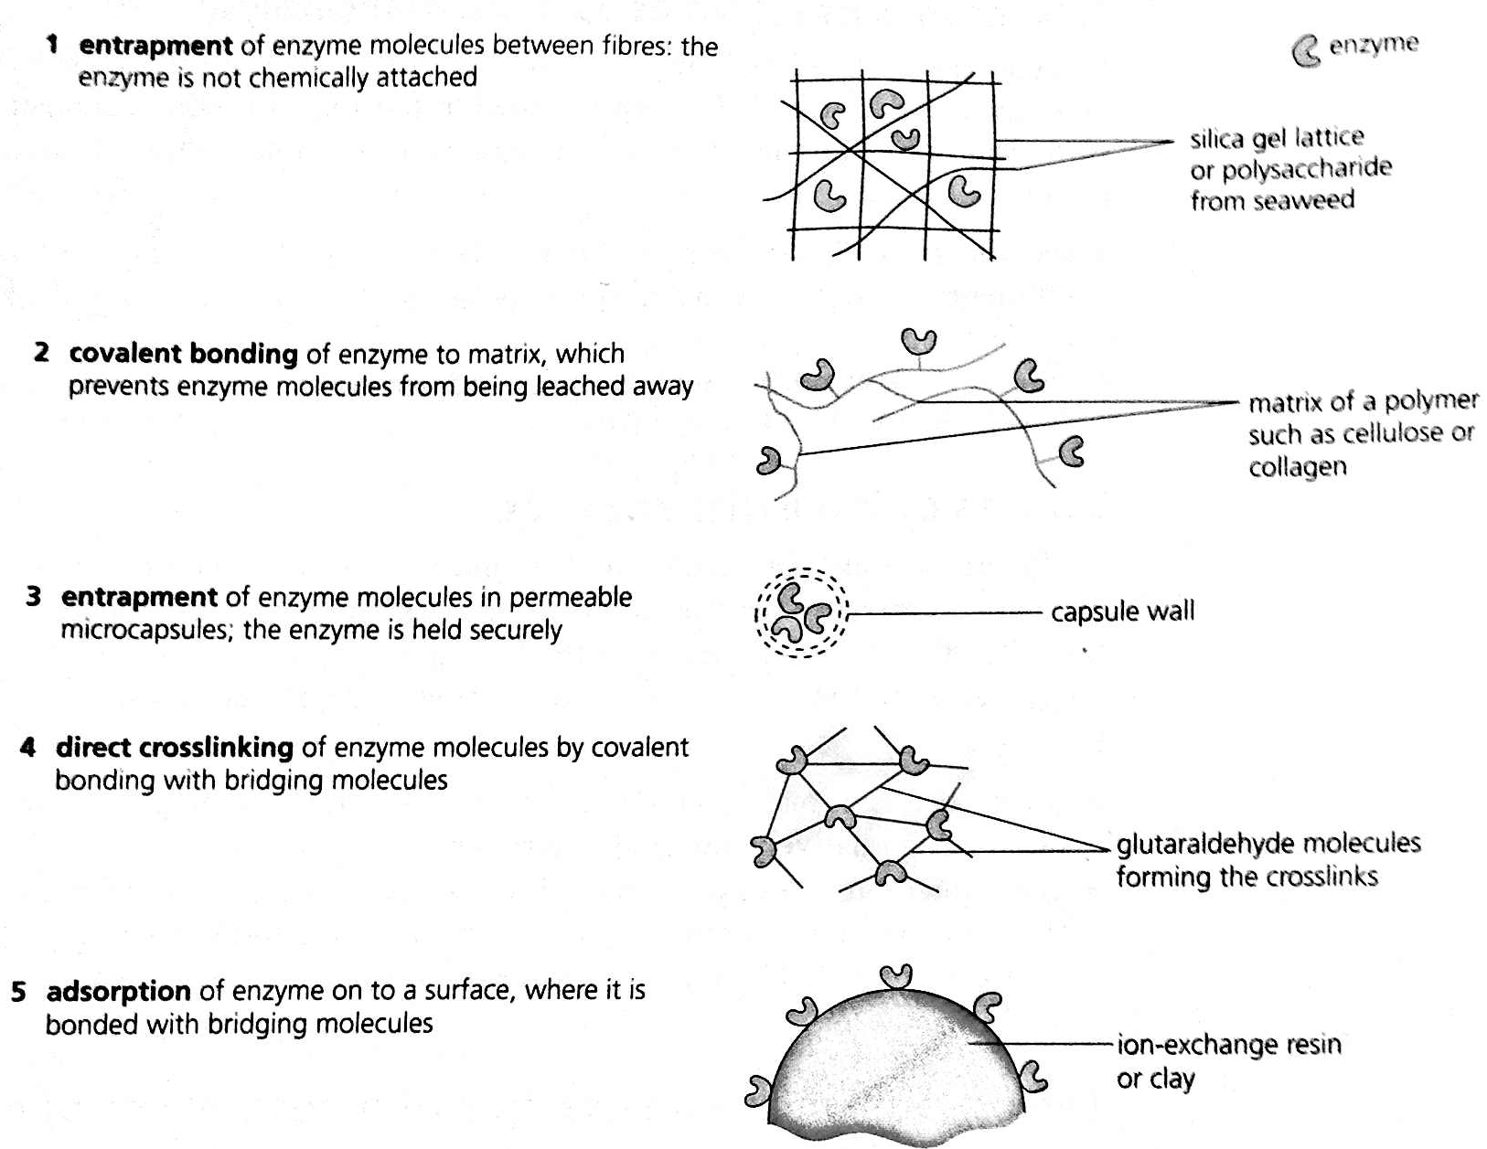
How is lactose-free milk created?
Enzyme is obtained from bacteria, purified and enclosed in capsules
Enzyme is immobolized in one of the following ways:

Slide 8
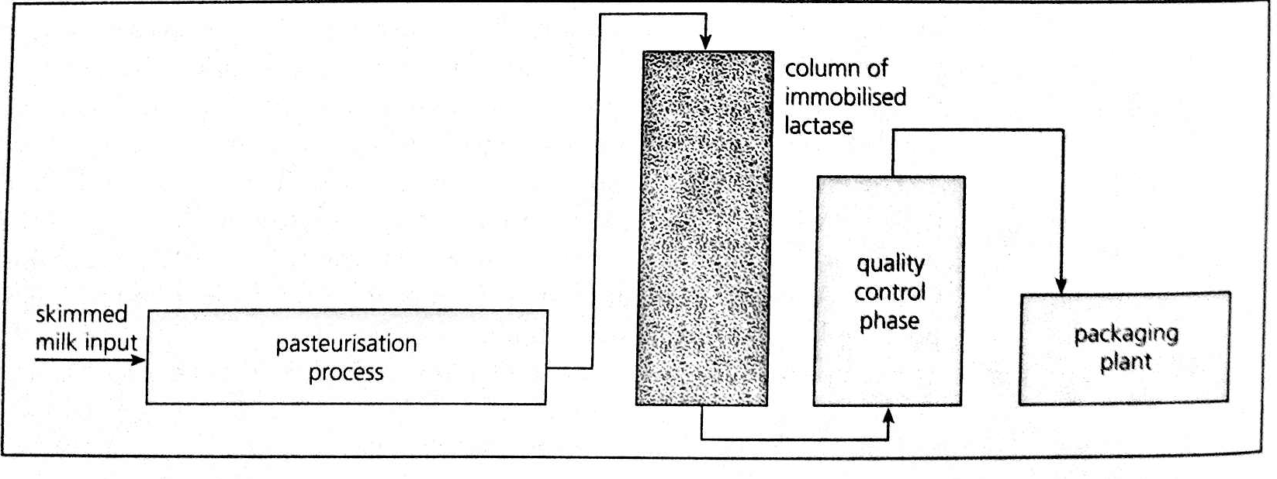
Milk is passed through a column containing immobilized lactase.
Overview:

Slide 9
3. Non-disjunction can lead to changes in chromosome number, Down Syndrome

Slide 10
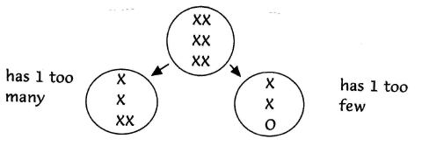
Nondisjunction – failure of the homologous partners to separate during meiosis – homologous pair moves together into the same cell
If this gamete gets fertilized it would lead to trisomy (3 chromosomes instead of 2)
Downs Syndrome – Trisomy 21

Slide 11
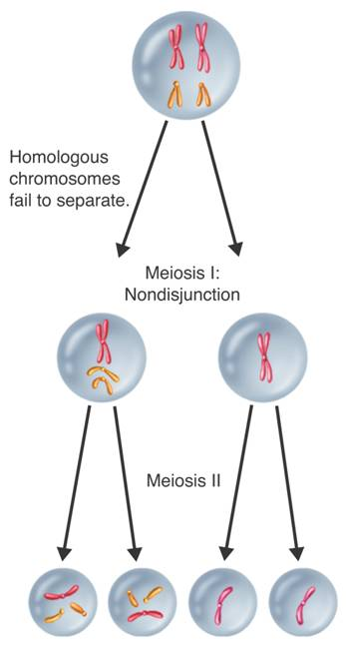
Extra chromosomes
Missing chromosomes

Slide 12
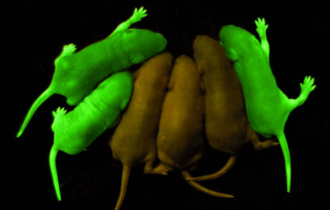
4. Universal nature of the genetic code, leads to gene transfer between organisms

Slide 13
What is meant by the “genetic code is universal” is that the codons in living organisms code for the same amino acids (with the exception of a few prokaryotes)
This means that if a gene is transferred from one organism to another, the resulting polypeptide synthesized would be the same
This allows us to genetically modify organisms, transforming them and making them transgenics
Ex. Spider goat, glow in the dark pig & mice, bacteria with human insulin gene

Slide 14
5. Differentiation of cells is from expressing some genes but not others

Slide 15
Multicellular organisms have cells that perform similar specialized functions, these cells make up a specific tissue type
Different types of tissues make up organs
How do the cells become specialized???

Slide 16
Each of your cells has a complete copy of your DNA
When the embryo is developing, the cells begin to differentiate
Differentiation occurs as a result of different genes being activated
By “activated” I mean those genes are being expressed (transcribed and translated – polypeptide made)
The position of the cell in the body along with environmental cues is what determines which genes are activated and which are not

Slide 17
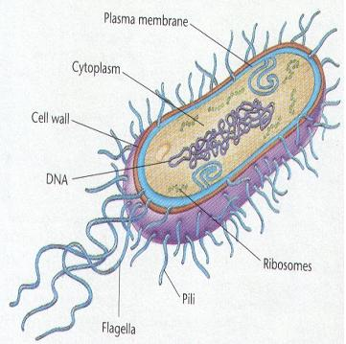
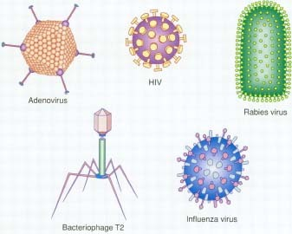
6. Antibiotic effectiveness against bacteria (but not viruses)
It’s alive!!!
Are they?????

Slide 18
Antibiotics work by blocking metabolic pathways in bacteria
Viruses are not living cells & have no metabolism of their own to be interfered with
Their reproduction relies on metabolic pathways of the host and they are not affected

