Slide 1
The Geography of Macbeth
Where has Ross just come from when he gives his report to the king?
Where is the Norwegian lord going to pay retribution?
Where are Macbeth and Banquo heading when they first appear in the play?
Where is Macbeth’s castle?

Slide 2
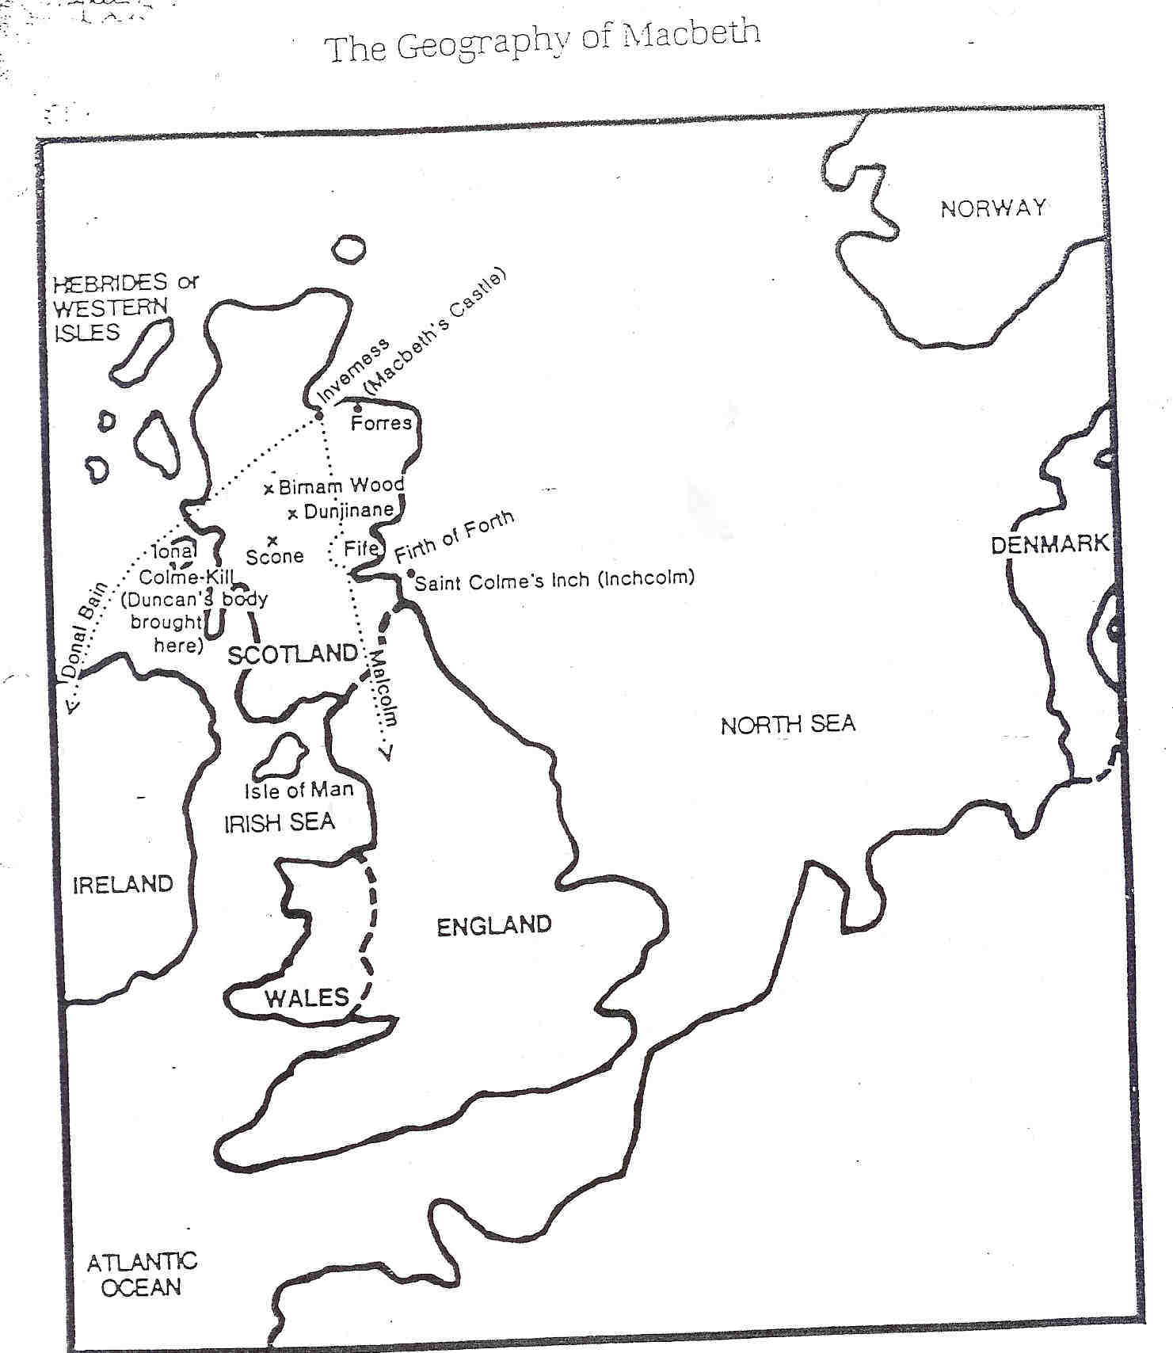
Macbeth and Banquo
are traveling here
Ross comes from here
Norwegian king disburses $10,00000

