Slide 1
Notes Ch.1-1
EQ: What is the goal of science?

Slide 2

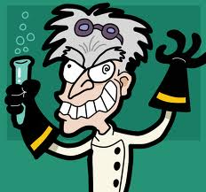
What is Science?
Science is often described as an organized way of studying things and finding answers to questions

Slide 3

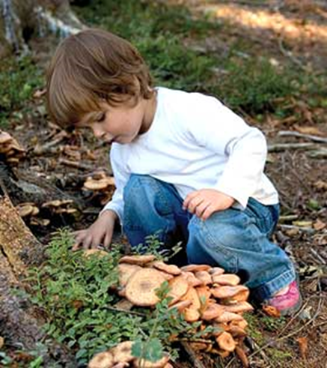
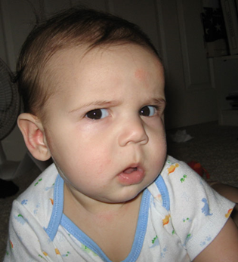
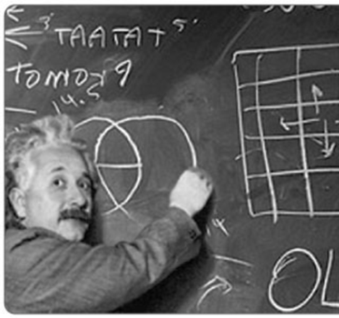
Goals of Science
Investigate and understand the natural world.
Explain events in the natural world
Use those explanations to make useful predictions.

Slide 4

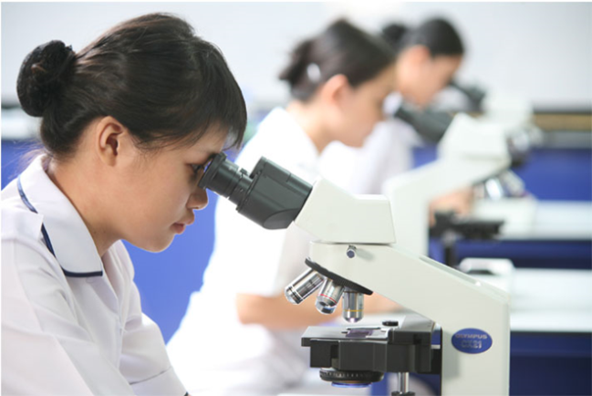
Thinking Like a Scientist
Scientific thinking begins with observation.
Observation is the process of gathering information about events or processes in a careful orderly way.
A hypothesis is a proposed scientific explanation for a set of observations
You can either confirm a hypothesis or rule it out.

Slide 5
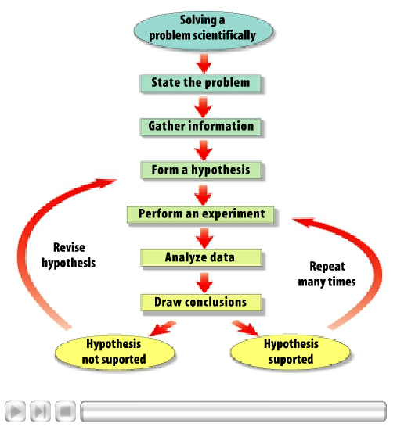
Scientific Method
In order to test a hypothesis you must perform experiments or gather new data.
In science this often takes the form of a series of procedures called the scientific method.

Slide 6
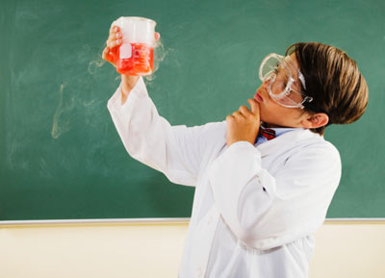
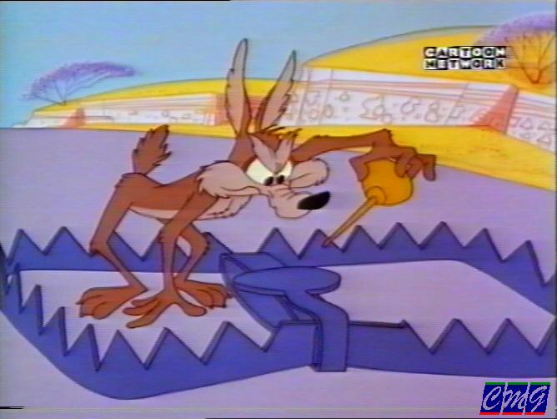
Controls and Variables
A control is the standard to which the outcome of a test is compared
A variable is something in an experiment that can change.
An experiment should have only one variable

Slide 7
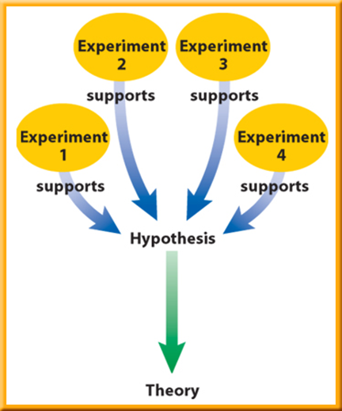
Theory v. Law
Scientist will report their findings of an experiment and can be used to propose a scientific theory.
A theory is an explanation based on scientific knowledge resulting from many observations and experiments.

Slide 8
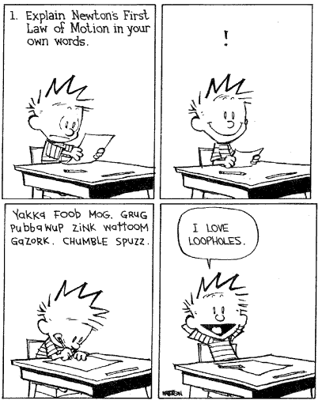
Theory v. Law
A scientific law is a statement about how things work in nature that seem to be true all the time
What is an example of a law?

Slide 9
Turn to page 11 in your book!
Look at the section Applying science.
Lets work through this together!

