Slide 1
Progressive Era
10/1-10/2 US History

Slide 2
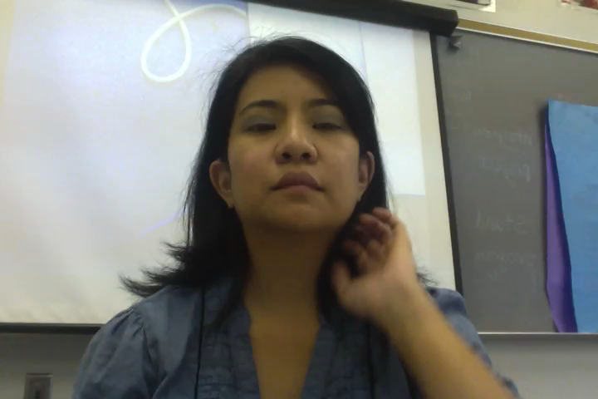
Vocabulary Words
CAPITALISM, MUCKRAKER, TRUST

Slide 3
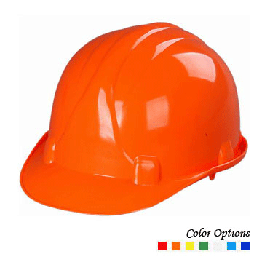
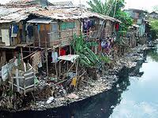
Problems during this time..
POVERTY-not having enough access to: food, water, sanitation (cleanliness), houses, health care, education and information (news).
UNSAFE WORKING CONDITIONS-working too much, not having the right clothes or equipment.

Slide 4
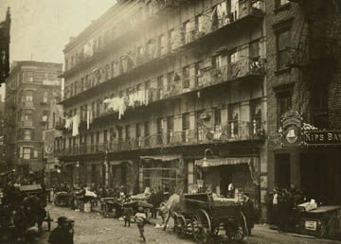
Why were there so many problems?
Progressives thought cities and businesses had grown too fast.
They decided that they had to make more laws to fix the problems.

Slide 5
Muckrakers
MUCK-means dirt
-They helped people learn about what the big businesses didn’t want them to know.
-They told people about how their food was dirty.
-They told people about how some businesses were ruining other businesses.

Slide 6
Corruption
Bribe-to take something from someone (money, car, something nice) to do something wrong.
Corrupt-ruined. A corrupt person is someone you can’t trust.
http://app.discoveryeducation.com/core:player/view/assetGuid/CD662F62-B3BC-4BF0-9593-5C4101D9E07E

Slide 7
What should I do now?
1. Make a video and e-mail it to me. Fingerspell and sign “capitalism, muckraker, trust”. Write down these words in your notes and what they mean.
2. Write down these questions in your notes and find the answers in the Powerpoint notes.
A. What is poverty?
B. What are some examples of unsafe working conditions?

Slide 8
More questions…
C. What did Progressives think caused the problems?
D. What did they decide to do to fix the problems?
E. What did muckrakers do?
F. What is a bribe?

Slide 9
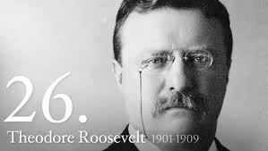
Theodore Roosevelt was the 26th President of the U.S. He supported many Progressive ideas.

Slide 10
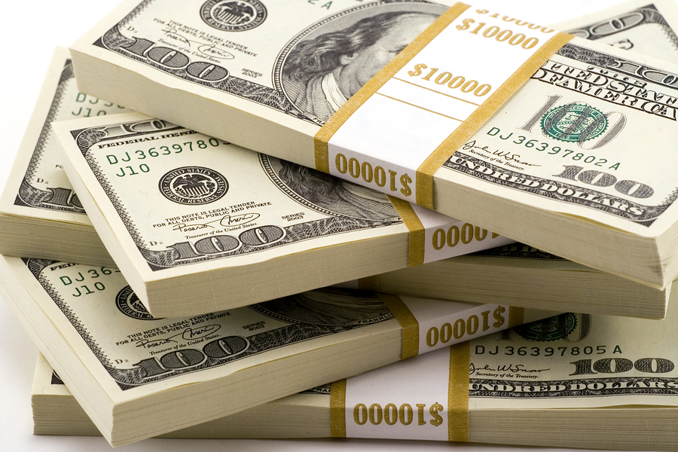
16th Amendment
This allowed the government to collect INCOME TAXES. Rich people paid more money than poor people.

Slide 11
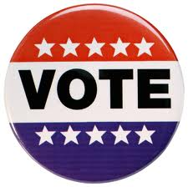
Women’s Suffrage
Women had to fight for the right to vote.
The Nineteenth (19th) Amendment gave women in the U.S. the right to vote.

Slide 12
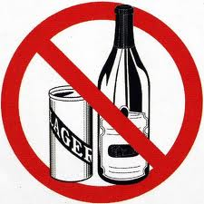
Prohibition-18th Amendment
Prohibit-means NOT ALLOWED.
In 1919, the 18th Amendment was passed, and people could not drink.

Slide 13
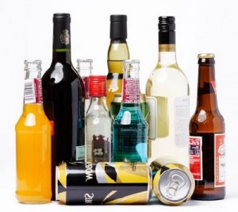
Gangs and Crime
Many people found secret ways to make, sell and move alcohol.
People made a lot of money illegally with alcohol.
In 1933, the 21st Amendment cancelled the 18th Amendment. You could drink now if you were over 21 years old.

Slide 14
Questions
What did the 18th Amendment not allow?
What amendment allowed women to vote?
Who was the 26th President of the United States?

