Slide 1
5.3.1 Outline how population size is affected by natality, immigration, mortality and emigration.
Population growth: determined by three factors:
Immigration – migration
Emigration – migration
(births – deaths) + (immigrants – emigrants) = change in population size

Slide 2
5.3.1 Outline how population size is affected by natality, immigration, mortality and emigration.
Ultimate size of a population results from a balance between opposing factors:
Biotic potential –
Environmental resistance –

Slide 3
5.3.1 Outline how population size is affected by natality, immigration, mortality and emigration.
Biotic Potential
Growth rate (r):
b - d = r
(birth rate) (death rate) (growth rate)
To determine number of individuals added to a population in a given time period, growth rate (r) is multiplied by original population size (N)
population growth = rN

Slide 4
5.3.1 Outline how population size is affected by natality, immigration, mortality and emigration.
Exponential growth:
Ex: bacteria under ideal lab conditions could produce enough bacteria to form a foot deep layer over the entire Earth starting with just one cell dividing every 20 min.

Slide 5
5.3.1 Outline how population size is affected by natality, immigration, mortality and emigration.
Biotic potential is influenced by:
Age at which the organism first reproduces
Frequency with which reproduction occurs
Average number of offspring produced each time
Length of organism’s reproductive life span
Death rate of individuals under ideal conditions
Biotic potential helps ensure that at least one offspring survives to bear it’s own young
In nature,

Slide 6
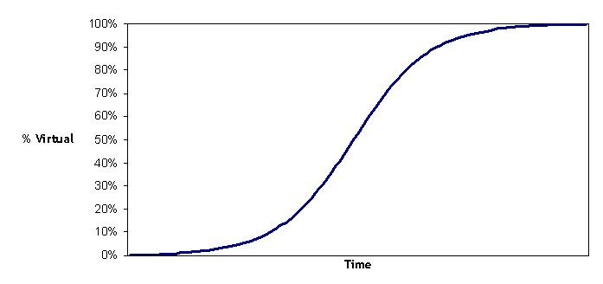
5.3.2 Draw and label a graph showeing a sigmoid (S-shaped) population growth curve.
Lag phase – period of
Exponential growth phase (logarithmic phase) – period of
Transitional phase (linear growth phase) –
Plateau phase (stationary phase) – (has reached
)

Slide 7
5.3.3 Explain the reasons for the exponential growth phase, the plateau phase and the transitional phase between these two phases.
Reason for:
Exponential growth phase:
Initially the population has
They have lots of food and therefore the energy needed to reproduce
The population size increases exponentially ( )

Slide 8
5.3.3 Explain the reasons for the exponential growth phase, the plateau phase and the transitional phase between these two phases.
Reason for:
Transitional phase:
As the
A
During this phase the natality rate still exceeds mortality; however,

Slide 9
5.3.3 Explain the reasons for the exponential growth phase, the plateau phase and the transitional phase between these two phases.
Reason for:
Plateau phase:
Mortality rate catches up with the natality rate and they are
Population size is maintained constant
No growth

Slide 10
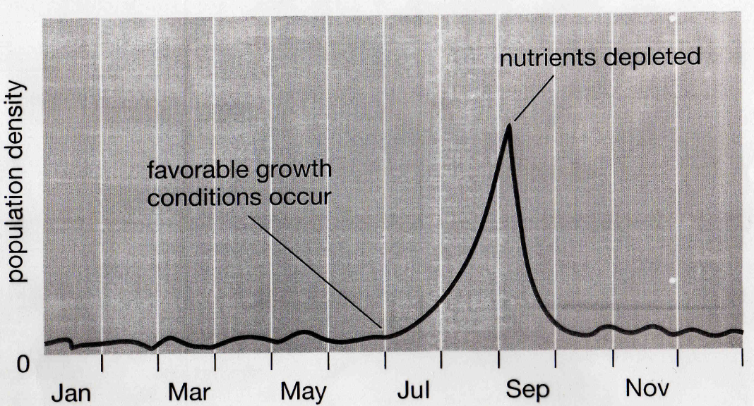
5.3.4 List three factors that set limits to population increase.
Regulation of Population Growth
Population size is limited by (such as available resources)
Boom-and-Bust cycles –
ex. Algae, insects – have seasonal cycles linked to rainfall, temperature, nutrient availability
Insects grow during spring and summer and die with the frost

Slide 11
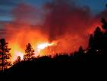
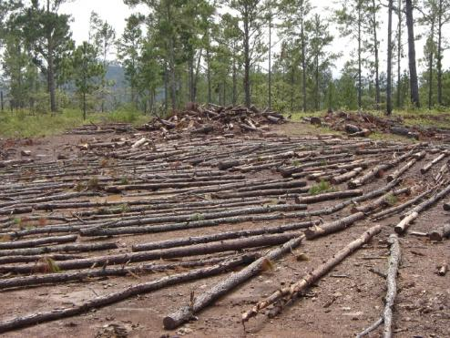
5.3.4 List three factors that set limits to population increase.
Limiting Factors – 2 major types:
Density independent –
Weather (causes boom and bust cycles), human activity (pesticides, pollution, habitat destruction), natural catastrophes (flood, fire, hurricane)

Slide 12
5.3.4 List three factors that set limits to population increase.
Density dependent –
Major limiting factor for long-lived species
Examples include:
predation and parasitism – control prey/host populations

Slide 13
5.3.4 List three factors that set limits to population increase.
Competition for limited resources
Intraspecific competition –
Interspecific competition –
Usually, if two species niches overlap too much, will lead to Competitive Exclusion
Overcrowding may lead to physiological and behavioral changes that increase emigration

Slide 14
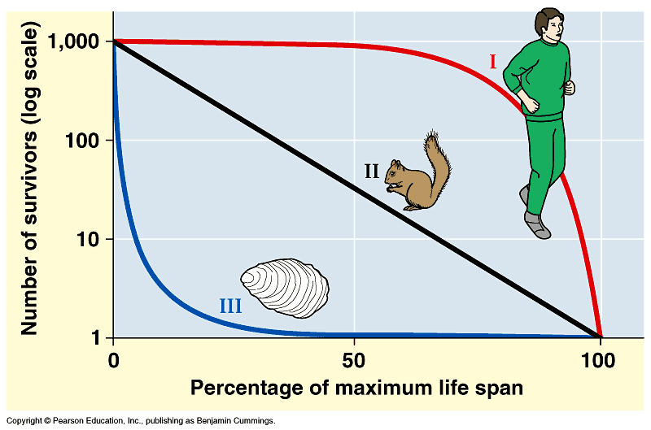
Mortality and Survivorship Curves
Populations show characteristics patterns of deaths or survivorship over time
Late Loss –
Red curve
Ex. Humans, large animals

Slide 15
Mortality and Survivorship Curves
2. Constant Loss –
Black line
Ex. annual plants, hydra, some invertebrates, some rodents

Slide 16
Mortality and Survivorship Curves
3. Early Loss – shows a , produce , death rate is , those that become adults have a
Blue curve
Ex. Most invertebrates, plants, many fish

Slide 17
Life History
Traits that affect an organism’s schedule of reproduction and death
K- selected populations (species or strategists) and r-selected populations (species or strategists) represent hypothetical models

Slide 18
r-selected populations
Usually
Tend to live in
Generally limited by
Produce
survivorship curve

Slide 19
K-selected populations
Usually have
Usually
Live in
Produce
Competition for
survivorship curve

