Slide 1
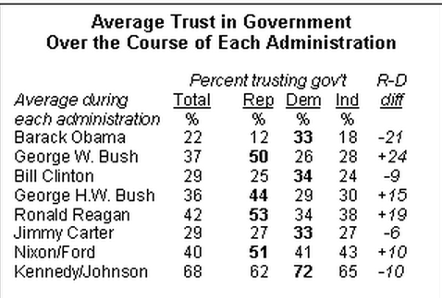
Warm Up
Look at the data above, list some observations about the average trust in government that Americans have over the course of each administration. Also, what can you tell about party politics in America? What do you think the word bi-partisan mean?

Slide 2
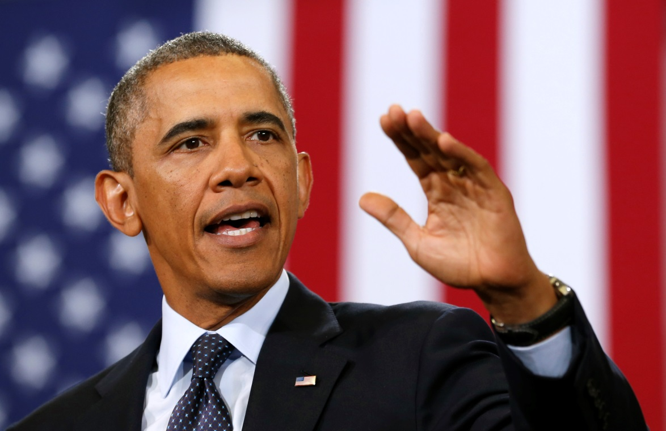
Barack Obama Continued

Slide 3
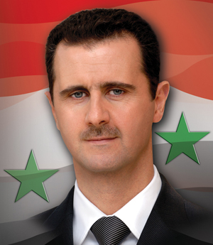
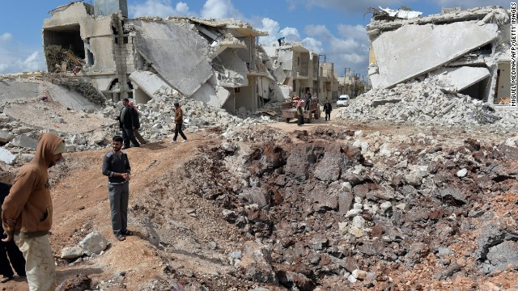
Potential War in Syria – The Syrian Civil War began on March 15 2011, when Syrian protesters demanded the resignation of President Bashar al-Assad whose family has help the presidency since 1971. Rebel groups began to form as the Syrian Army was deployed to stop the uprising. Many protesters have been arrest and tortured. Since then the UN, including the U.S. as well as Amnesty International has been supplying humanitarian aid to the Syrian citizen. The U.S. has supplied defensive, non-combat assistance to the rebels: night vision goggles, bullet proof vests, etc.

Slide 4
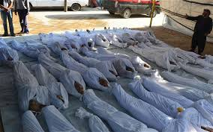
On 13 June, the United States announced that there is definitive proof that the Assad government has used limited amounts of chemical weapons on multiple occasions on rebel forces, killing 100 to 150 people.
On 5 August, another chemical attack by the Syrian army was reported by the opposition, who documented the injured with video footage. The activists claim up to 400 people were affected by the attack in Adra and Houma of the Damascus suburbs.

Slide 5
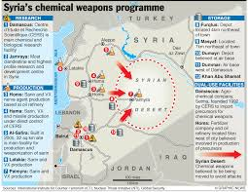
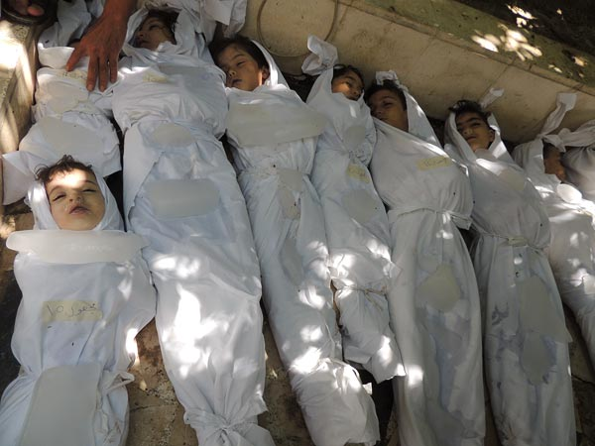
On 21 August, Syrian activists reported that Assad regime forces struck 4 regions with chemical weapons. At least 635 people were killed in a nerve gas attack. These chemical attacks were confirmed after a three-week investigation conducted by the UN, who also confirmed the main agent used in the chemical attacks was sarin gas.
The 1925 Geneva Protocol prohibits the use of chemical and biological weapons in warfare. The reason for restricting biological weapons is because of the unexpected outcome of their use.

Slide 6
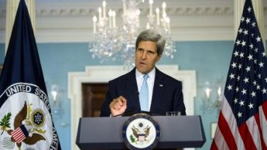
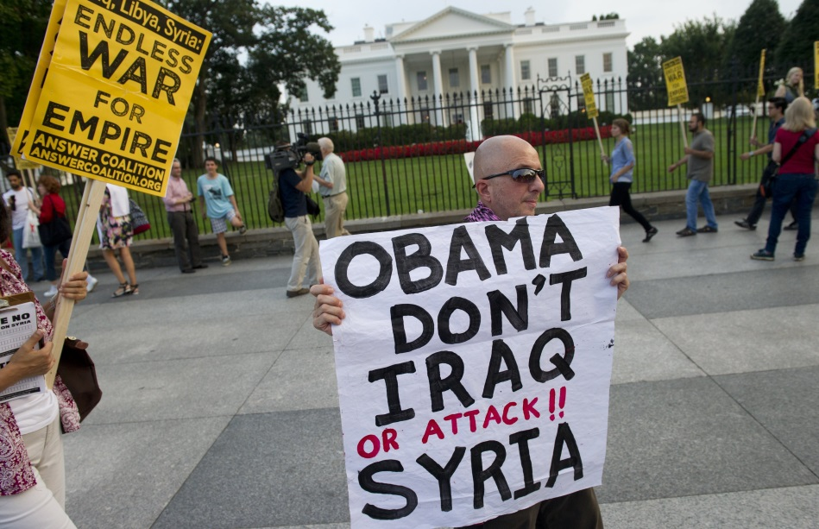
President Obama threatened U.S. military intervention regarding the use of chemical weapons. The mood in Congress was not supportive of this action as well as the U.S. allies. This opposition was in part due to the unpopular entrance into the War in Iraq. Congress, however, did not put this action to a vote. Before that would happen, Secretary of State John Kerry mentioned in a meeting in London that Syria could prevent war if they were willing to give up their chemical weapons to the international community.

Slide 7
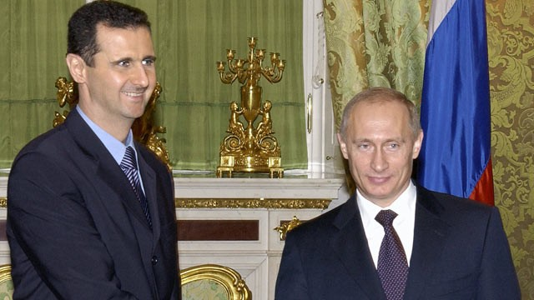
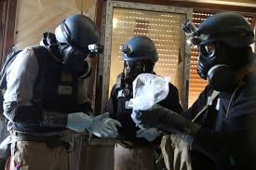
On September 9 Russia urged Syria to put its' chemical weapons stockpile under international control. The initiative was expressed in the wake of American threat of attacking Syria after the chemical attack of August 21. On September 14, US and Russia announced in Geneva that they reached a deal on how Assad should give up his chemical weapons.

Slide 8

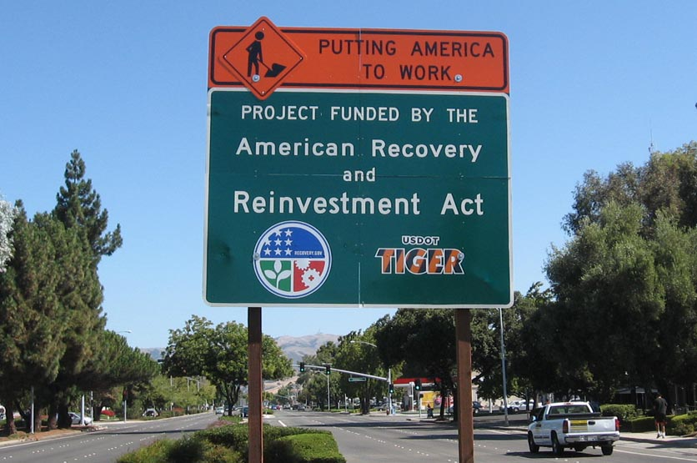
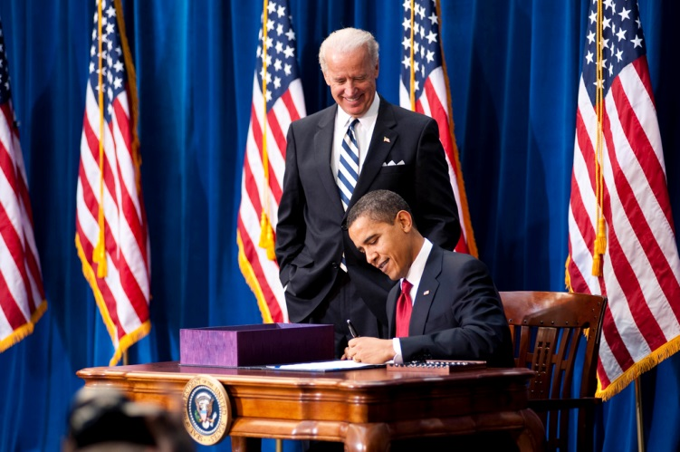
American Recovery and Reinvestment Act of 2009 – economic stimulus package intended to create jobs, promote investment, and increase consumer spending during the recession by giving checks to American households. a $787 billion economic stimulus package aimed at helping the economy recover from the deepening worldwide recession.

Slide 9
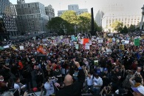
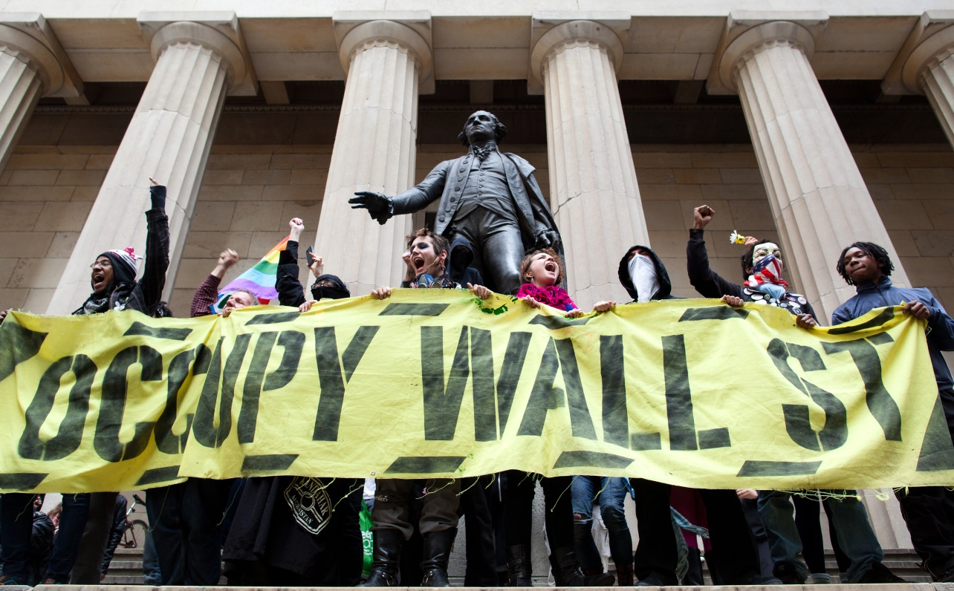
Occupy Wall Street - is the name given to a protest movement that began on September 17, 2011 in New York City's Wall Street financial district.

Slide 10
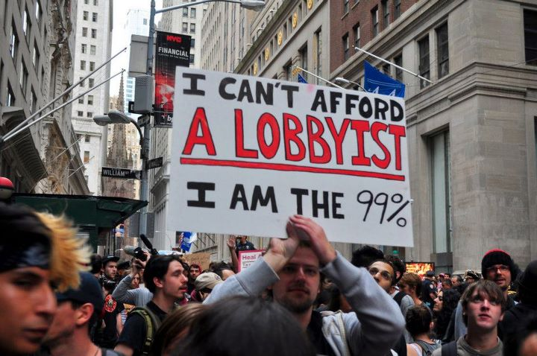
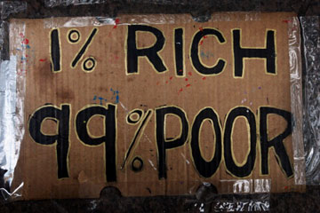
The main issues raised by Occupy Wall Street were social and economic inequality, greed, corruption and the perceived undue influence of corporations on government—particularly from the financial services sector. The OWS slogan, We are the 99%, refers to income inequality and wealth distribution in the U.S. between the wealthiest 1% and the rest of the population. To achieve their goals, protesters acted on consensus-based decisions made in general assemblies which emphasized direct action over petitioning authorities for redress.

Slide 11
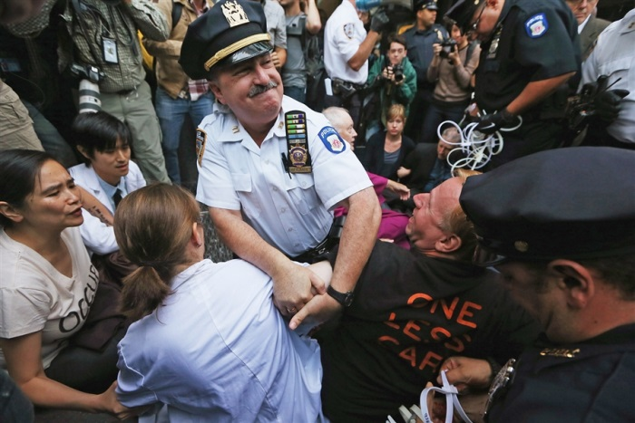
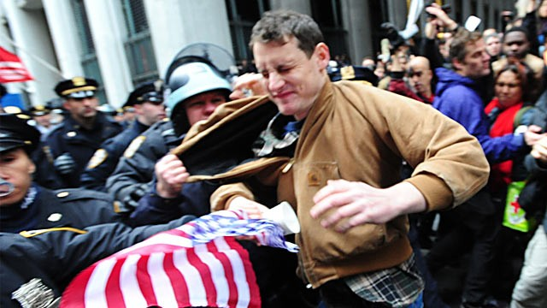
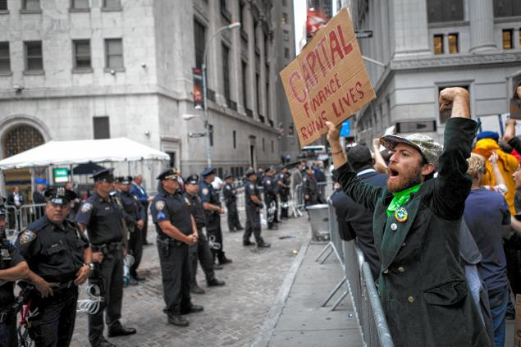
On December 29, 2012, Naomi Wolf of The Guardian newspaper provided U.S. government documents which revealed that the FBI and DHS had monitored Occupy Wall Street through its Joint Terrorism Task Force, despite labelling it a peaceful movement.

Slide 12
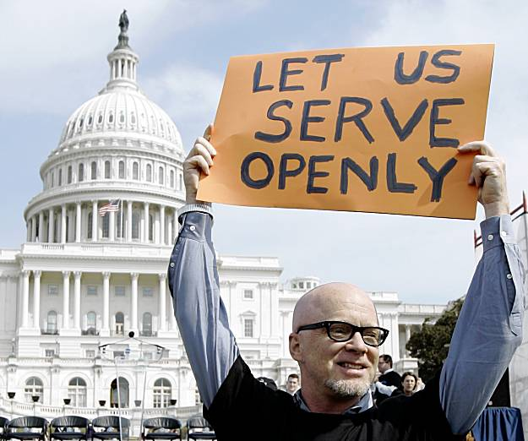
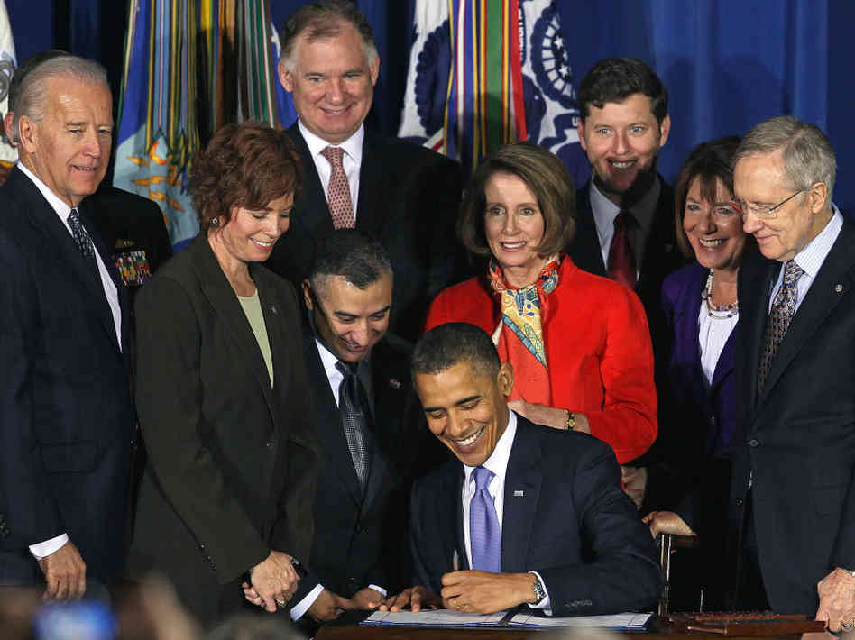
Don't Ask, Don't Tell Repeal Act of 2010 - is a landmark federal statute enacted in December 2010 that established a process for ending the Don't Ask, Don't Tell (DADT) policy, thus allowing gays, lesbians, and bisexuals to serve openly in the United States Armed Forces. It ended the policy in place since 1993 that allowed them to serve only if they kept their sexual orientation secret and the military did not learn of their sexual orientation.

Slide 13
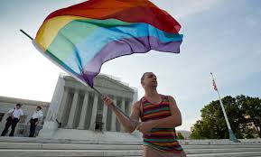
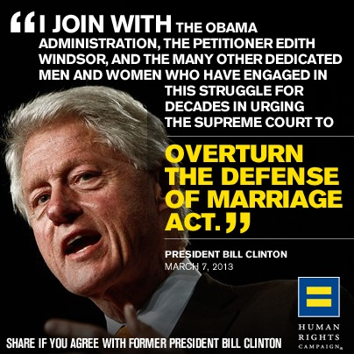
DOMA Struck Down - The Obama administration filed briefs which urged the Supreme Court to strike down the Defense of Marriage Act of 1996 and California's Proposition 8 as unconstitutional on June 26, 2013. This cause many states to change state law regarding marriage. Now 16 states out of 50 have same-sex marriage.

Slide 14
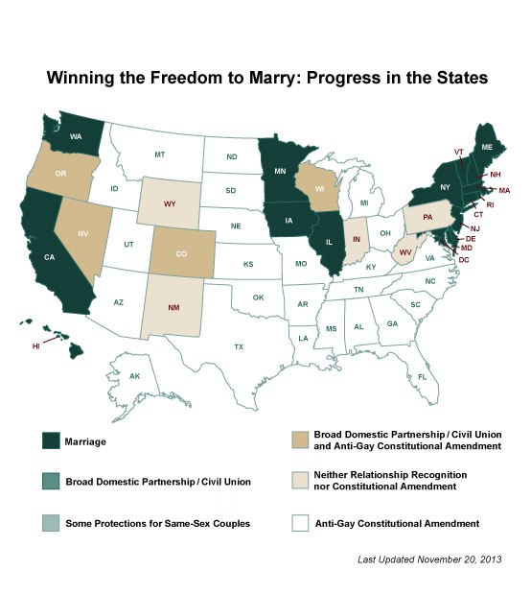

Slide 15
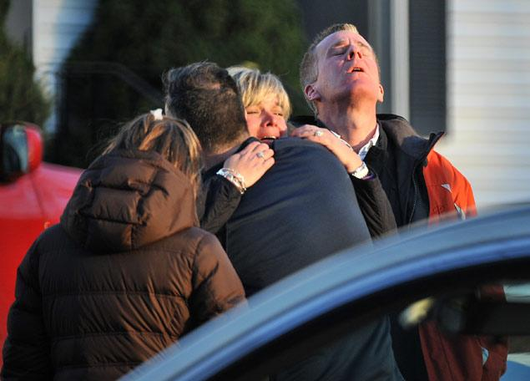
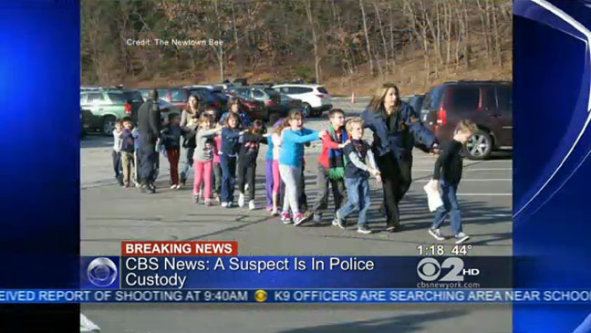
Sandy Hook Elementary School Shooting - On December 14, 2012, a 20-year-old fatally shot twenty children and six adult staff members in a mass murder at Sandy Hook Elementary School in the village of Sandy Hook in Newtown, Connecticut.

Slide 16
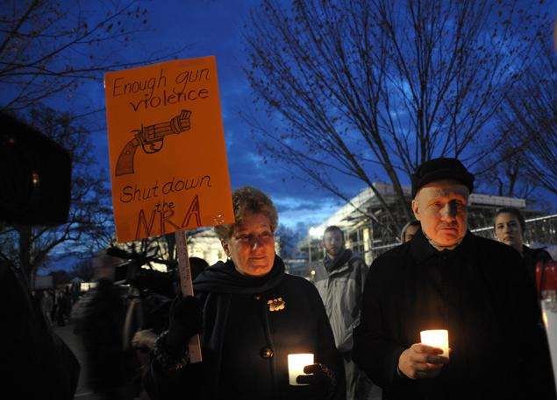
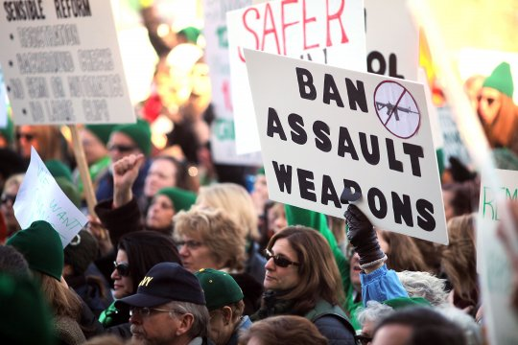
The shootings prompted renewed debate about gun control in the United States, and a proposal for new legislation banning the sale and manufacture of certain types of semi-automatic firearms and magazines with more than ten rounds of ammunition.

Slide 17
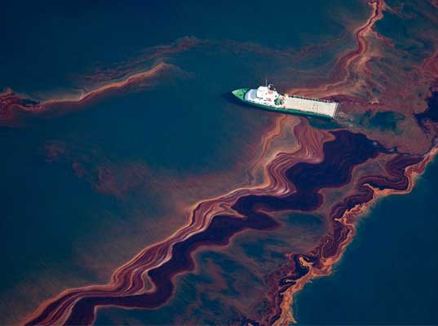
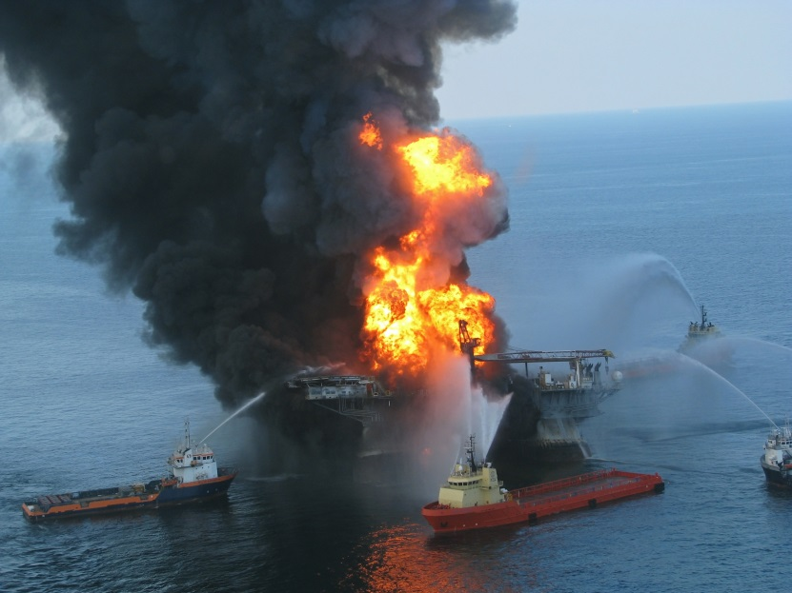
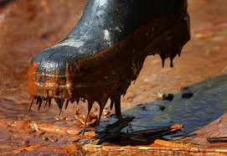
Gulf of Mexico Oil Spill - On April 20, 2010, an explosion destroyed an offshore drilling rig in the Gulf of Mexico, causing a major sustained oil leak. The well's operator, BP, initiated a containment and cleanup plan, and began drilling two relief wells intended to stop the flow. Obama visited the Gulf on May 2 among visits by members of his cabinet, and again on May 28 and June 4. On May 22, he announced a federal investigation and formed a bipartisan commission to recommend new safety standards, after a review by Secretary of the Interior Ken Salazar and concurrent Congressional hearings. On May 27, he announced a six-month moratorium on new deep-water drilling permits and leases, pending regulatory review. As multiple efforts by BP failed, some in the media and public expressed confusion and criticism over various aspects of the incident, and stated a desire for more involvement by Obama and the federal government.

Slide 18
Health care reform - Obama called for Congress to pass legislation reforming health care in the United States, a key campaign promise and a top legislative goal. He proposed an expansion of health insurance coverage to cover the uninsured, to cap premium increases, and to allow people to retain their coverage when they leave or change jobs. His proposal was to spend $900 billion over 10 years and include a government insurance plan, also known as the public option, to compete with the corporate insurance sector as a main component to lowering costs and improving quality of health care. It would also make it illegal for insurers to drop sick people or deny them coverage for pre-existing conditions, and require every American to carry health coverage. The plan also includes medical spending cuts and taxes on insurance companies that offer expensive plans.

Slide 19
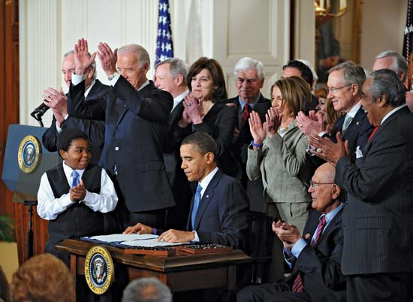
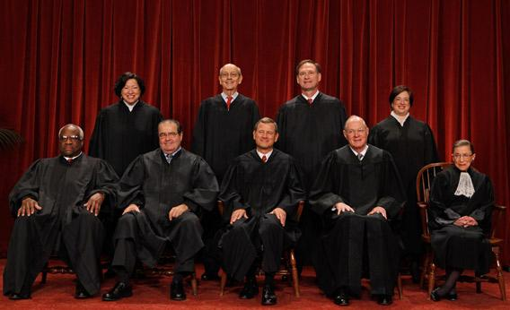
Obama signed the bill into law on March 23, 2010
The law faced several legal challenges, primarily based on the argument that an individual mandate requiring Americans to buy health insurance was unconstitutional. On June 28, 2012, the Supreme Court ruled by a 5–4 vote in National Federation of Independent Business v. Sebelius that the Commerce Clause does not allow the government to require people to buy health insurance, but the mandate was constitutional under the US Congress's taxing authority.

Slide 20
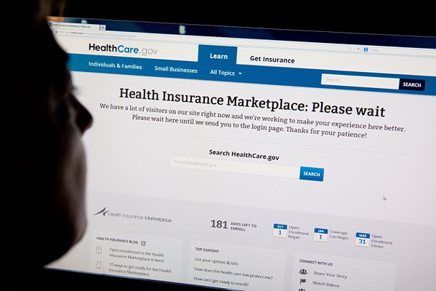
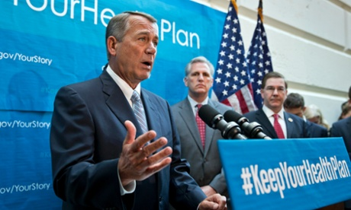
The rollout of the Healthcare Marketplace has been an issue has the federal website was not ready for the heavy traffic it began receiving in October of 2013. This has given opponents of the bill more fuel for their disagreement with the bill.

Slide 21
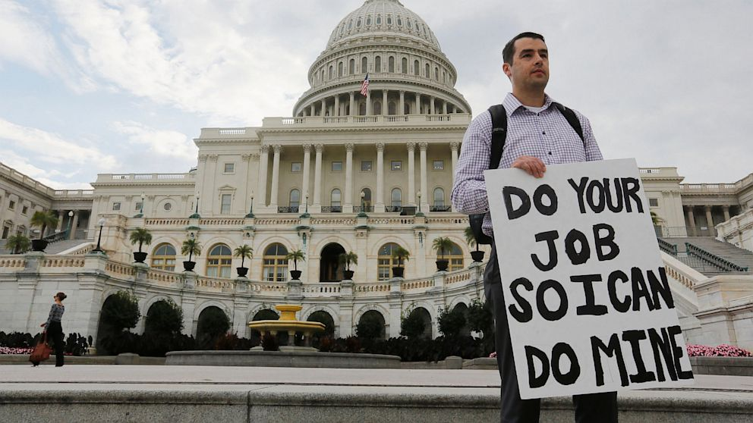
United States Federal Government Shutdown of 2013 - From October 1 through 16, 2013, the United States federal government entered a shutdown and curtailed most routine operations after Congress failed to enact legislation appropriating funds for fiscal year 2014, or a continuing resolution for the interim authorization of appropriations for fiscal year 2014. Regular government operations resumed October 17 after an interim appropriations bill was signed into law.

Slide 22
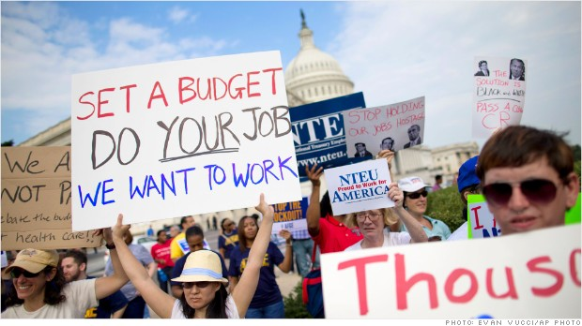
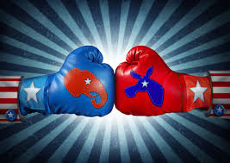
A "funding gap" was created when the two chambers of Congress failed to agree to an appropriations continuing resolution. The Republican-led House of Representatives, in part pressured by conservative senators such as Ted Cruz and conservative groups such as Heritage Action, offered several continuing resolutions with language delaying or defunding the Patient Protection and Affordable Care Act (commonly known as "Obamacare"). The Democratic-led Senate passed several amended continuing resolutions for maintaining funding at then-current sequestration levels with no additional conditions. Political fights over this and other issues between the House on one side and President Barack Obama and the Senate on the other led to a budget impasse which threatened massive disruption.

Slide 23
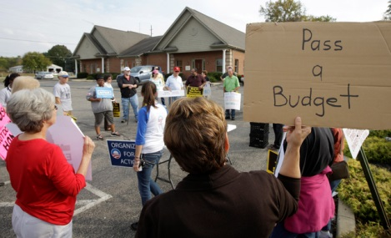
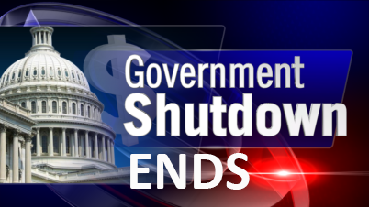
Late in the evening of October 16, 2013, Congress passed the Continuing Appropriations Act, 2014, and the President signed it shortly after midnight on October 17, ending the government shutdown and suspending the debt limit until February 7, 2014.

Slide 24
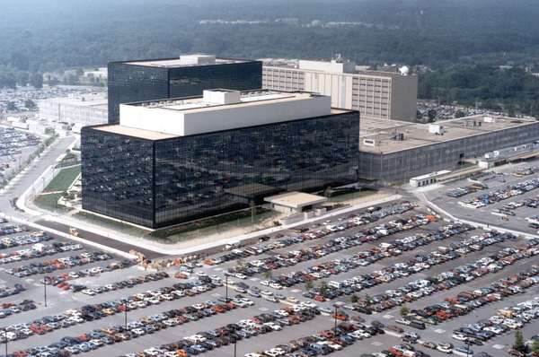
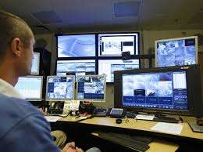
Issues in the N.S.A. - The National Security Agency (NSA), formed in1952, is the main producer and manager of signals intelligence for the United States. Estimated to be one of the largest of U.S. intelligence organizations in terms of personnel and budget, the NSA operates under the jurisdiction of the Department of Defense and reports to the Director of National Intelligence.

Slide 25
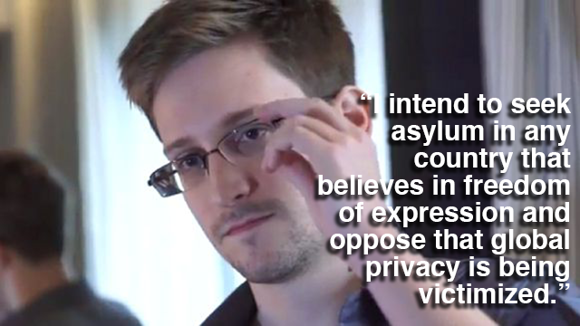
The massive extent of the NSA's spying, both foreign and domestic, was revealed to the public in a series of detailed disclosures of internal NSA documents beginning in June 2013. Most of these were leaked by an ex-contractor, Edward Snowden.

Slide 26
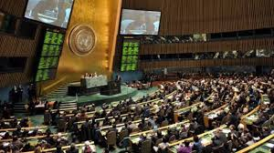
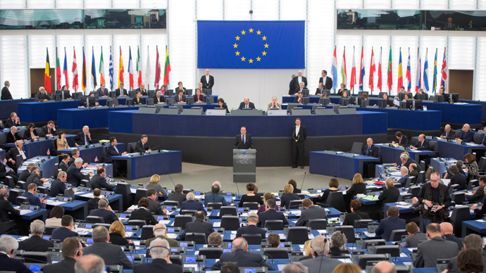
It was revealed that the NSA intercepts telephone and internet communications of over a billion people worldwide, seeking information on terrorism as well as foreign politics, economics and "commercial secrets". The NSA has also spied extensively on the European Union, the United Nations and numerous governments including allies and trading partners in Europe, South America and Asia. This has recently put a strain on our relationship with our allies.
United Nations
European Union

Slide 27
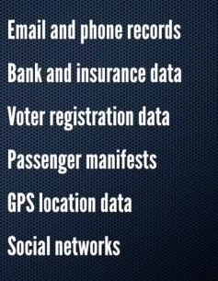
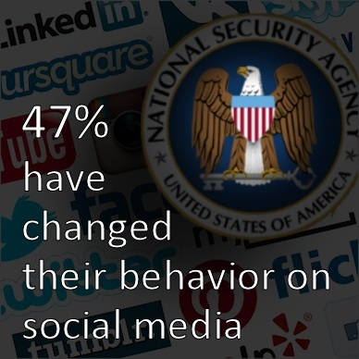
The NSA reportedly has access to all communications made via Google, Microsoft, Facebook, Yahoo, YouTube, AOL, Skype, Apple and Paltalk, and collects hundreds of millions of contact lists from personal email and instant messaging accounts each year. It has also managed to weaken much of the encryption used on the Internet (by collaborating with, coercing or otherwise infiltrating numerous technology companies), so that the majority of Internet privacy is now vulnerable to the NSA and other attackers.

Slide 28
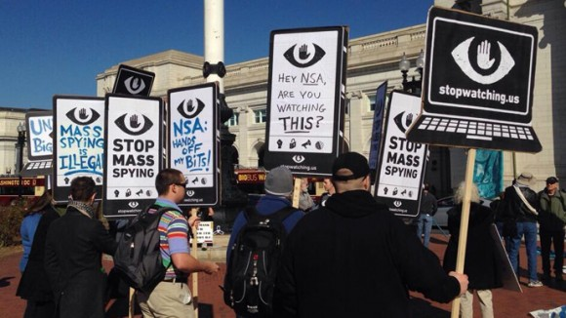
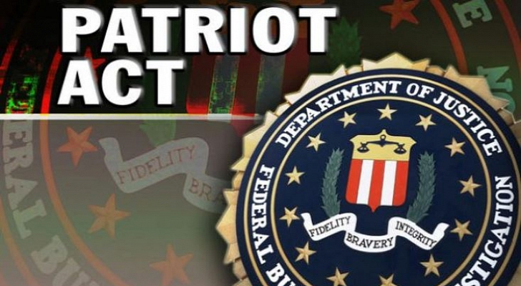
Domestically, the NSA collects metadata of the phone calls of over 120 million US Verizon subscribers as well as internet communications, relying on a secret interpretation of the USA PATRIOT ACT whereby the entirety of US communications may be considered "relevant" to a terrorism investigation if it is expected that even a tiny minority may relate to terrorism.

Slide 29




Oklahoma Marathon Bombing – During the Boston Marathon on April 15, 2013, two pressure cooker bombs exploded at2:49 pm killing 3 people and injuring an estimated 264 others. According to FBI interrogators, Dzhokhar and his brother were motivated by extremist Islamic beliefs and where from Chechnya.

