Slide 1
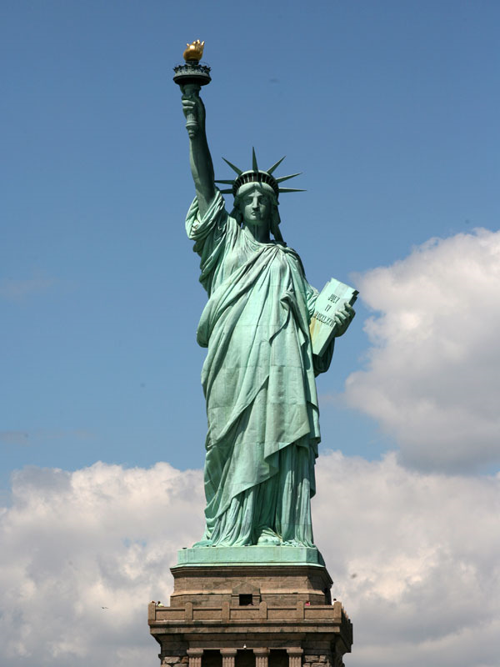
Immigrant Experience- Notes
Opener left side:
When you see a picture of the Statue of Liberty, what does she represent to you?

Slide 2
"Give me your tired, your poor,
Your huddled masses yearning to breathe free,
The wretched refuse of your teeming shore.
Send these, the homeless, tempest-tost to me,
I lift my lamp beside the golden door!"
  Emma Lazarus’ Poem inscribed at the foot of the Statue of Liberty

Slide 3
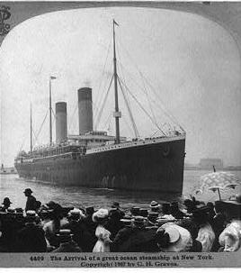
Difficult Journey
1870s all immigrants traveled by steamship
Traveling across the Atlantic Ocean from Europe took 1 week
Crossing the Pacific from Asia took nearly 3 weeks

Slide 4
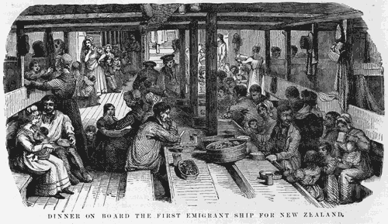
Steerage
The cheapest accommodations- ship’s cargo holds.
  Rarely allowed on deck, immigrants were crowded, unable to exercise or get fresh air
Often slept in lice-infested bunks, shared toilets with others, and disease spread quickly
Many died before reaching America.

Slide 5
“America!...We were so near it seemed too much to believe. Everyone stood silent-like a prayer… Then we were entering the harbor. The land came so near we could almost reach out and touch it… Everyone was holding their breath. Me too… Some boats had bands playing on their decks and all of them were tooting their horns to us and leaving white trails in the water behind them.”
- Rosa: The Life of an Italian Immigrant

Slide 6
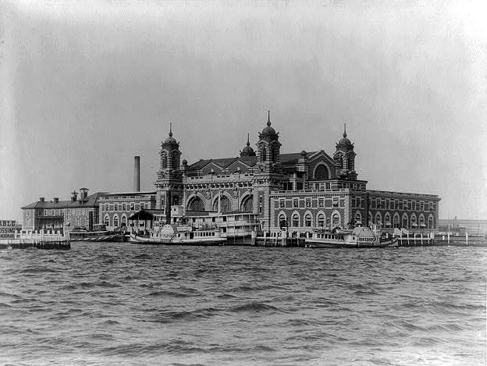
Major locations:
*East Coast:
Ellis Island, New Jersey; Baltimore, Maryland; Philadelphia, Pennsylvania Providence, Boston
*West Coast: Angel Island- SF

Slide 7
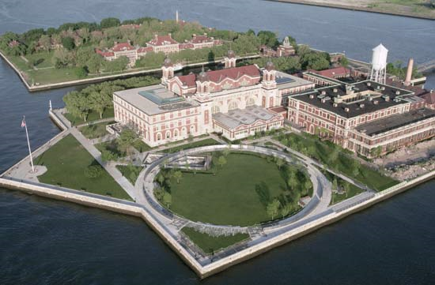
Ellis Island:
Immigrants had to pass through inspection
Operated from 1892-1954
More than 1 million people came through Ellis Island

Slide 8
Arrival
Immigrants joyful to end their long journey faced:
  Pushy officers herding the passengers “as though they were animals”
  First and second class passengers were processed first while third class passengers remained on the ship
    1st and 2nd class did not have to go through the waiting period or examination and were allowed to go into New York City ($, better health or just visiting)

Slide 9
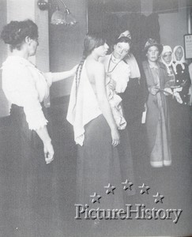
Medical Examination
Immigrants had to wait to be medically examined
Doctors would place a chalk mark if they found something wrong
  B for Back
  C for Conjunctivitis
  Ct for trachoma
  E for Eyes
  F for Face
  Ft for Feet
  G for Goiter
  H for heart
  K for hernia
  L for lameness
  N for Neck
  P for Physical and lungs
  Pg for pregnancy
  Sc for Scalp
  S for Senility
  X for Mental retardation
  K for Insanity

Slide 10
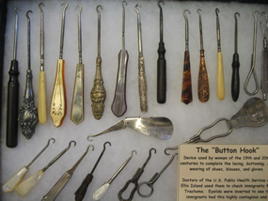
Eye Examination
The most dreaded part of the physical
Doctors flipped up the eyelids with a buttonhook, a hairpin, or their fingers searching for a common eye disease (trachoma)
The disease was contagious and could lead to blindness if untreated

Slide 11
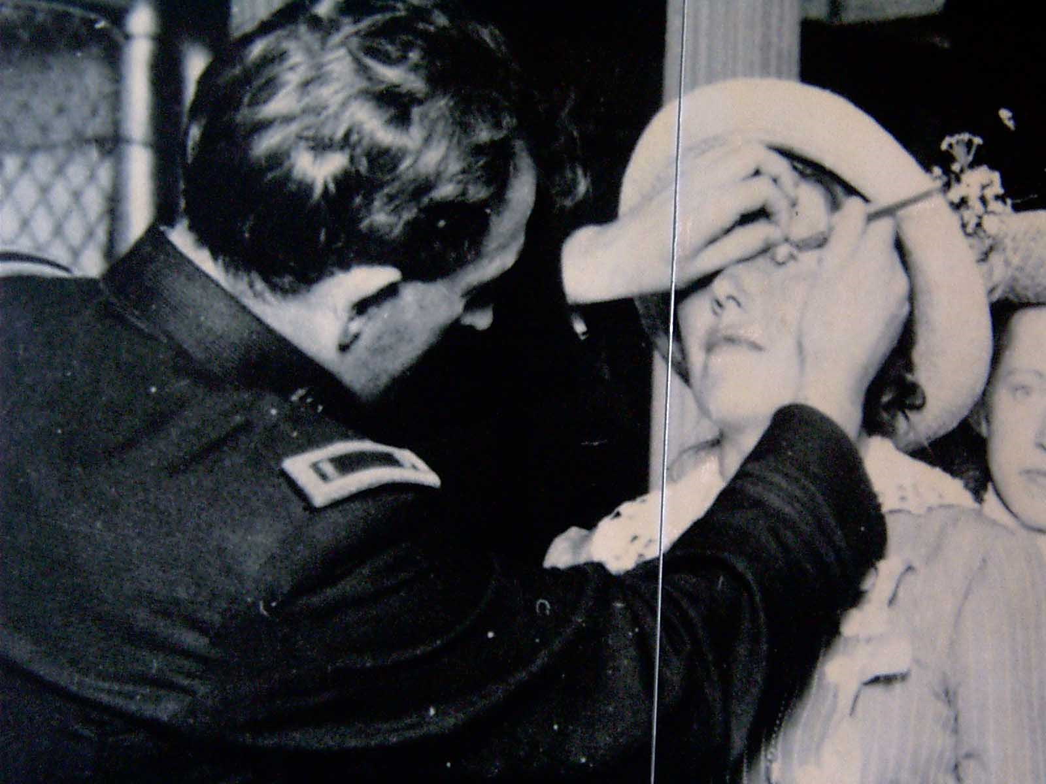

Slide 12
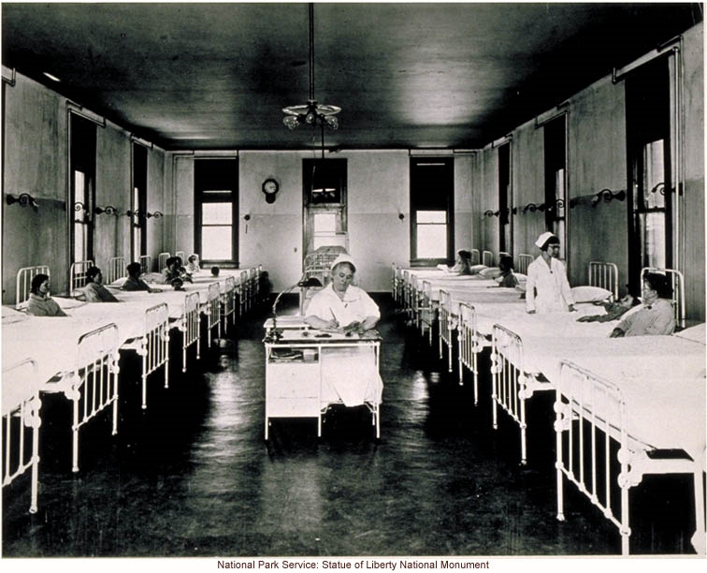
Hospitalization
If cleared and registered, immigrants were free to enter the New World and start their new lives.
If they were sick, they spent days, weeks, months even, in a warren of rooms.

Slide 13
Immigrants Deported
After a long, grueling journey many immigrants were sent back to their countries due to:
  Contagious diseases
  Chinese
  Mentally disabled,
  Paupers
  Potential threat to the public
  Convicts
  Anarchists
  * More than 120,000 immigrants were sent back to their countries of origin, and during the island's half-century of operation more than 3,500 immigrants died there.

Slide 14
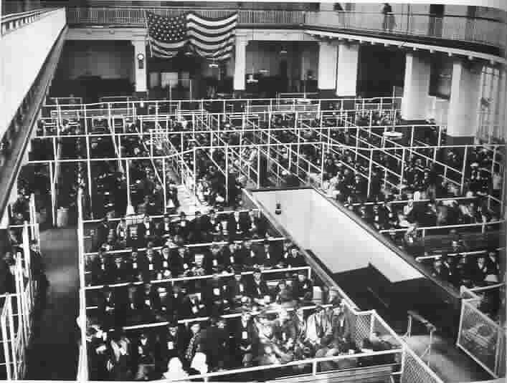
Registry Room
After passing the medical examination, immigrants waited in the Registry Room to be summoned to an inspector’s desk for the legal inspection.

Slide 15
Q & A
Immigrants had to answer a list of questions-
  Name
  Age
  Sex
  Martial status
  Occupation
  Literacy
  Nationality
  Last residence
  Final destination
  How the journey was financed
  How much money they had
  If they were being met by a relative
  If they had been to the U.S. before
  Been to prison
  Been to an almshouse
  Being supported by charity
  If they were a polygamist
  Deformed or crippled
  Doing contract labor in the U.S.

Slide 16
Identity
Often much confusion through the question and answer sessions, especially over names
The government did provide interpreters but many names ended up changing
“They spoke very badly, were very nervous. The inspector would say, “Where do you come from?” And they would say, “Berlin.” The inspector would put the name down ‘Berliner.’ The name was not Berliner. That’s no name.”

Slide 17
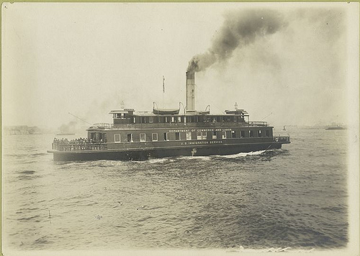
Finally through Inspection
Passengers boarded ferryboats to New York City where their future awaited them…

Slide 18
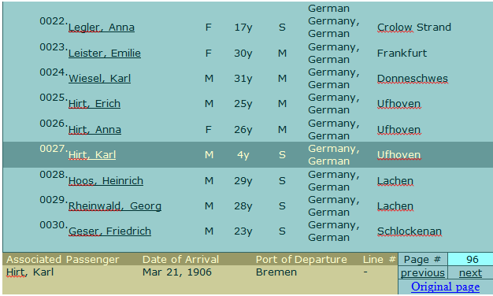

Slide 19
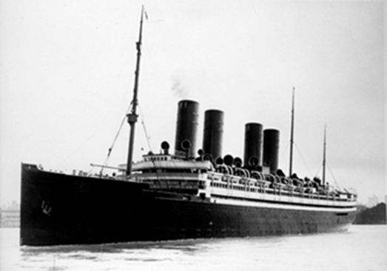
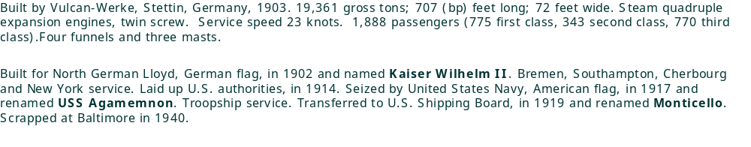

Slide 20
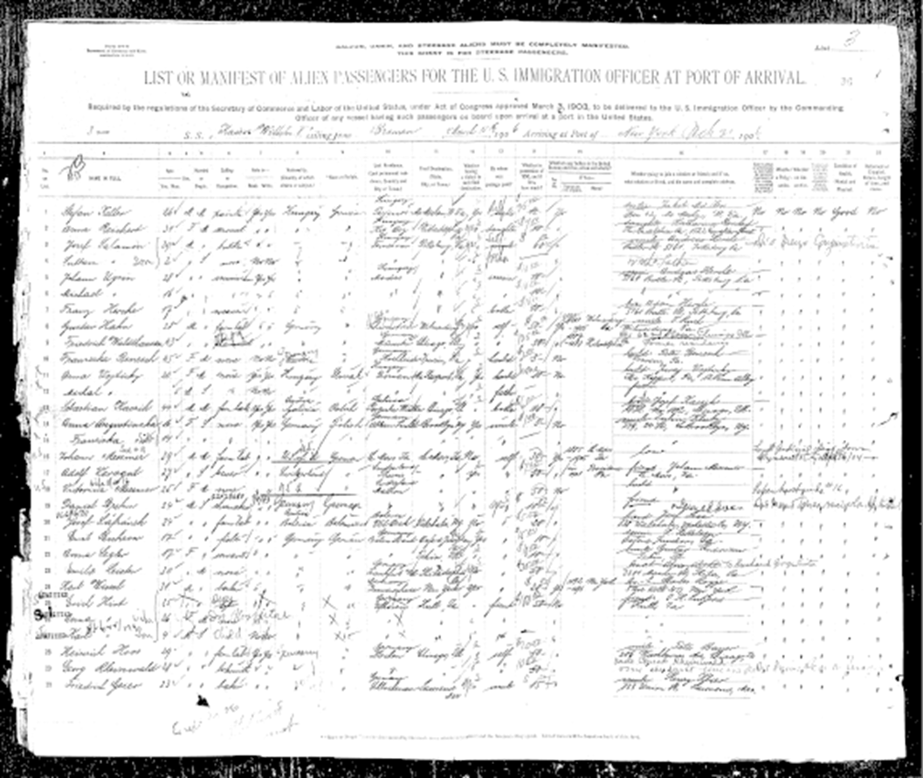

Slide 21
Immigrant Journal Write
(left student side or new page)
*Using the notes from today, write a 1 page journal entry as an immigrant coming to Ellis Island
*Describe: why you’re coming to America, the journey on the ship, what your goals and dreams are for your new life in America

