Slide 1
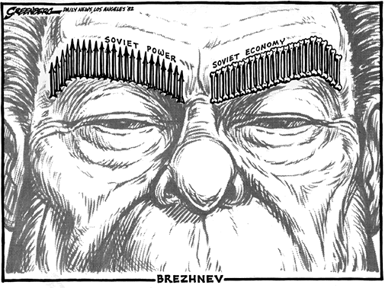
Outside Knowledge:
In attempt to keep up with the arms race, Brezhnev allowed for 25% of the GDP to be spent on military programs. Insistent to be on equal footing with the US, the metal eaters put great pressure on Brezhnev to produce more and better arms.
Despite the increasing amounts of money dedicated to military, the economy itself was withering. This was due to the industrial wastage and inefficiency. For example, 50% of potatoes went to waste and 20% of produce went bad in storage. As a result, the growth rate declined from 5% in the 50s to 0% in the 80s.
Interpretation: There are as many arrows as there are bones, representing that the buildup of arms was at the expense of the economy. Soviets are unable to keep up with the arms race.

Slide 2
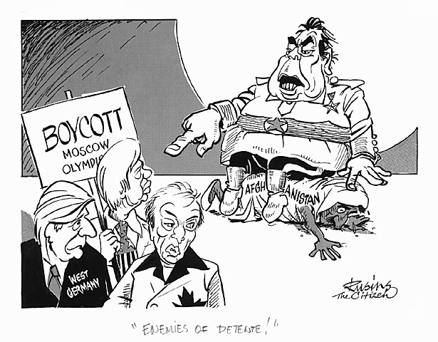
Interpretation: As a response to the Soviet invasion of Afghanistan in 1979, Schmidt of West Germany, Trudeau of Canada, and President Carter the US boycott the 1980 Olympics to be held in Moscow. The Soviets are seen as enemies of détente in that they invaded Afghanistan to ensure the pro-Marxist leaders remain intact.
Outside Knowledge:
In April 1978, the Afghan army seized power and executed Lieutenant General Sardar Muhammad Daud Khan. He was replaced by Nur Muhammad Taraki, who led the People’s Democratic Party of Afghanistan. Afghanistan became increasingly reliant on the Soviets, as seen in the bilateral agreement on December 1978, which led to the opposition of the Mujahideen, an alliance of rebels. Because of the number of Soviet officials killed, the Soviet army invaded on March 1979 with justification given by the Brezhnev Doctrine. In September 1979, Taraki was overthrown by Amin, but was eventually assassinated by the soviets and replaced with Karmal. This invasion had international condemnation, including the decision of the US to limit grain sales and boycott the 1980 summer Olympics in Moscow. Furthermore, The US supported the rebels by allowing the CIA to conduct covert operations in Afghanistan.

Slide 3
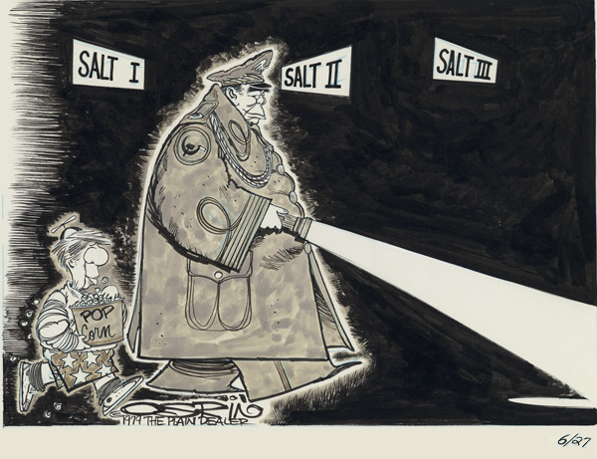
Brezhnev is leading Jimmy Carter through the dark about the SALT treaties. He is showing Carter only what he wants Carter to know about the Soviets and is leading the negotiations.
Outside Knowledge:
Ever since the US creation of the Atomic bomb in Alamogordo, New Mexico in July 1945, pressure has been put on the soviets by metal eaters to reach military equivalence with the US. As a result, much of Soviet economy was dedicated to the buildup– as much as 25% of the GDP. Eventually, realizing that his country could no longer handle such high military spending, he willingly accepts limitations military buildups.

Slide 4
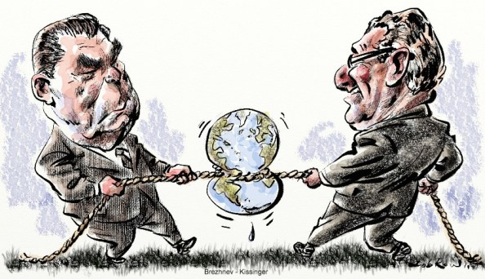
Brezhnev and Kissinger are arguing, or playing “tug-o-war” over other colonies. They argued over geopolitics continuously. This later comes into play when they argue over Afghanistan, or other parts of the Middle East or Africa. Being a realpolitik, Kissinger supported monarchies in foreign countries as to stop Brezhnev’s control. As Brezhnev issued the Brezhnev Doctrine in 1968, he fully believed that he could intervene in any USSR colony, as it would benefit socialism as a whole.

Slide 5
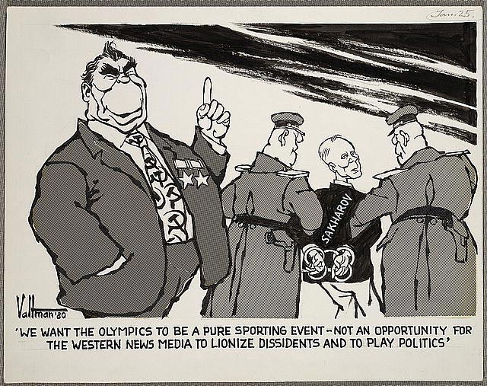
The US boycotted the 1980 Moscow Olympics, which is when this photo was published. The man pointing is obviously Brezhnev as his tie represents the Soviet Union with its use of the sickle and hammer. Despite saying he does not want the Olympics to be about politics, he is arresting Sakharov, who is known for speaking openly against the Russian government.

Slide 6
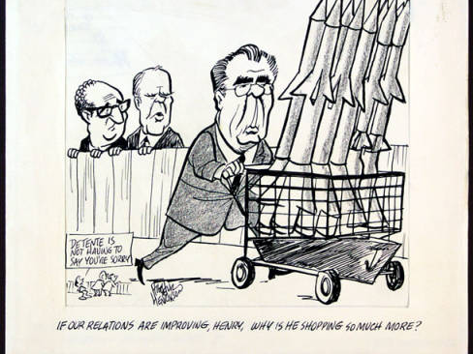
Despite the fact that the US and the USSR are supposed to be in détente, Brezhnev seems to building up his arms. Thus, the two men in the back are Gerald Ford and Henry Kissinger, which is referenced in the captions. They are mocking the idea of détente altogether, which is evident through the caption – “détente is not having to say you’re sorry.” Brezhnev was building up arms to wage wars in his colonies.

Slide 7
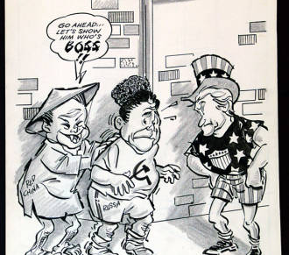
Mao Zedong is depicted as the child with “Red China” written on him, is encouraging the Soviet Union, with “Russia” and the “Sickle and Hammer” emblem on his shirt, to show Uncle Sam “who’s boss”. China was encouraging the USSR, under Brezhnev, to fight back against the US.

Slide 8
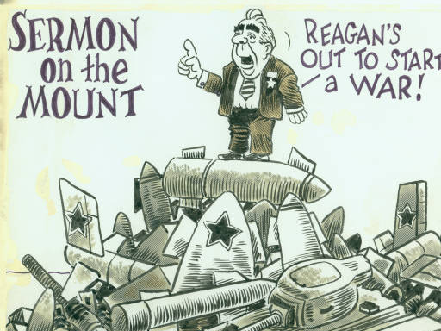
Brezhnev is standing on missiles, and while Brezhnev did leave a legacy of détente, Reagan did not. However, despite Brezhnev’s appearance to support détente, he was building up arms. He also fought to keep control over the Soviet-controlled areas.

Slide 9
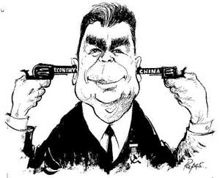
Cerca 1964
Brezhnev holding two pistols to his head about to shoot himself
Shows the extent of Soviet problems that he had to deal with
1963 crop harvest was extrmely bad
Not enough fodder for cattle so they were slaughtered
Sino-Soviet split beginning to take place
Mao renounces the USSR as having become capitalist
http://arts.guardian.co.uk/pictures/image/0,8543,-10204834581,00.html

Slide 10
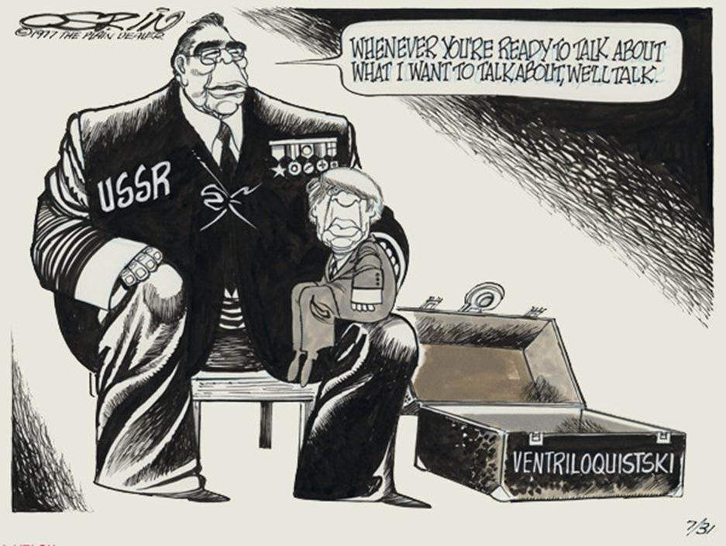
By Ray Orsin
31 July 1977
Carter on the lap of Brezhnev with “ventriloquist” on case
Brezhnev was in control of SALT II negotiations
Soviet economy welcomed the cut in nuclear missile spending
http://images.ulib.csuohio.edu/cdm4/item_viewer.php?CISOROOT=/cartoons&CISOPTR=690&CISOBOX=1&REC=5

Slide 11
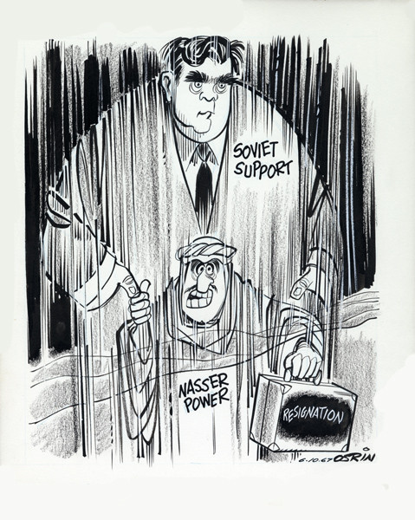
“How was I supposed to know it was only a mirage?”
Brezhnev is supporting Nasser of the Egyptian government in his military exploits between the Arabs and the Israelis. However, this is only an illusion as Brezhnev only cares to keep socialism in place in the area. After the Six days war between Arabs and Israel, the Soviets sought to prevent Nasser from invading Syria. When Nasser sought to resign after the war, he thought that the Soviets had supported him in remaining leader of the Arabs.

Slide 12
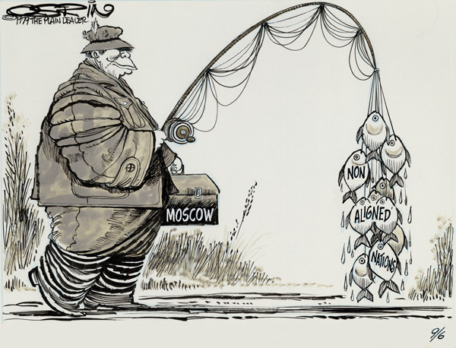
Even though the countries are “non-aligned,” Brezhnev is still exerting its influence on them, wringing them in like fish.
Outside Knowledge:
Because of the devastating results of World War I & II, the Soviets developed a fear of further invasions, especially from Germany. As a result, they sought to create a buffer zone using other nations to protect themselves. In WWII, as they liberated nations that were previously under German countrol, they stationed their own soldiers in these nations in order to exert Communistic influences.

Slide 13
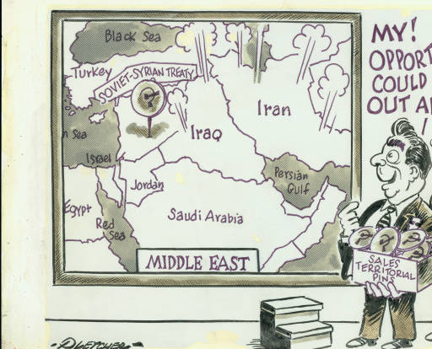
My! Opportunities could be bustin’ out all over (1966-1982)
Leonoid Brezhnev and another man stand looking at a large map of the Middle East. A large push pin with a hammer and sickle symbol on it is stuck in Syria and above this, is “Soviet-Syria treaty.” Brezhnev is holding a box labeled “Sales territorial pins” with more push pins. A small step stool is in front of the map. Lines and shapes suggesting explosions are scattered over Iraq and Iran. Brezhnev sees all the opportunities of countries that he can take over.

Slide 14
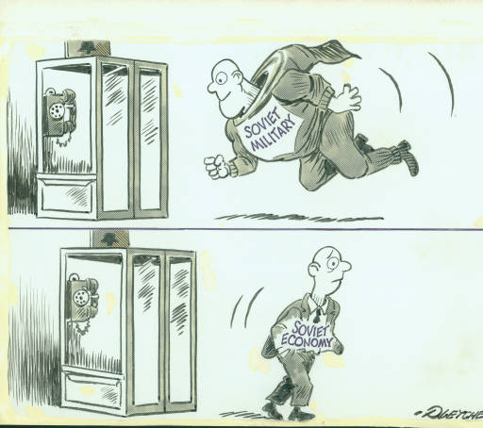
Soviet Military and Soviet Economy
A man dressed in an oversized superhero costume labeled “Soviet military” flies down toward a telephone booth in the upper half o the cartoon. In the lower half, the man walks away from the booth dressed in a business suit labeled “Soviet economy.” This shows that the Soviets like to boast their military because it is strong and the Soviet economy is weak.

Slide 15
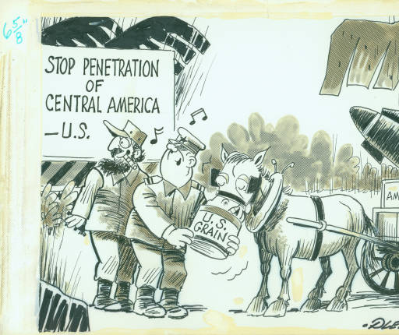
Stop penetration of Central America
A Soviet military officer is holding a pail, labeled “U.S. grain” for a horse to eat. The horse is hitched to a cart that holds a large box labeled “Ammunition” and a missile. Behind the officer is Fidel Castro, and both of them are looking over their shoulders at the sign that reads, “Stop penetration of Central America- US”. This shows that the Soviets are helping the Cubans and are supplying them with ammunition to fight the US, while the US is feeding them with grain.

Slide 16
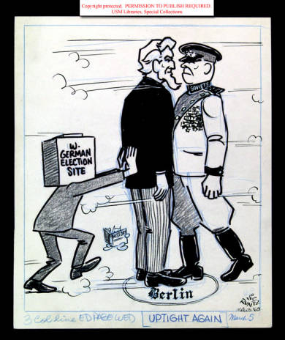
Uptight again
A man with a box on his head labeled “W. German election site” pushes Uncle Sam into a small circle labeled “Berlin” that is drawn on the ground or on the floor. In the circle, Uncle Sam stands face to face and chest to chest with a Soviet military officer of high rank. The Soviet officer is in the act of stepping in to the circle. Lines and puffs radiating from Uncle Sam and the Soviet officer indicate haste. Runtz’s signature cat is in the background reading a book labeled “History”. This shows that the West Germans are pushing for elections and are getting help from the Americans.

Slide 17
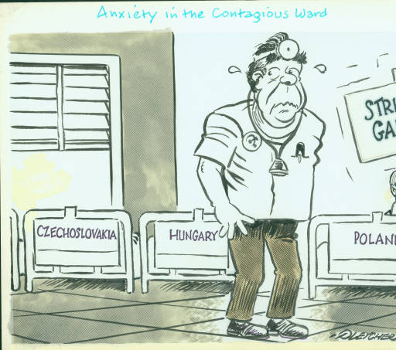
Anxiety in the contagious ward
Leonoid Brezhnev is dressed as a doctor and has a small badge with hammer and sickle on his shirt. He is in a hospital ward with three beds labeled “Czechoslovakia, Hungary, and Poland. Two beds are empty, but a man is in the Poland bed. He is holding up a large sign that reads, “Strike gains.” The doctor is nervously looking over his shoulder at the empty beds. This shows that the Soviets are trying to help the other countries, but cannot actually help them and two of the countries have already left. These are the countries that are behind the “iron curtain”.

Slide 18
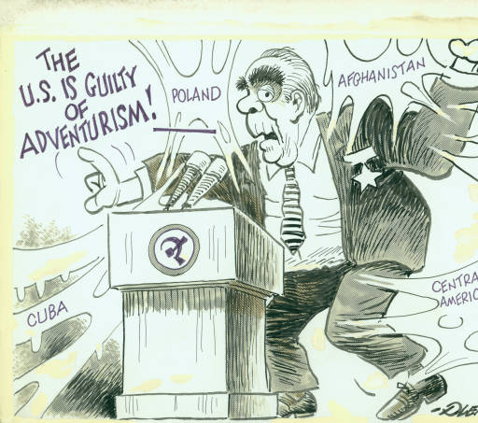
US is guilty of Adventurism
Leonoid Brezhnev is behind a podium that has a hammer and sickle symbol on it, yelling “The US is guilty of adventurism!” He is waving his arms, and around him are jagged shapes of labeled Cuba, Poland Afghanistan, and Central America. This shows that Brezhnev is trying to show the world that the US is invading and is attacking.

Slide 19
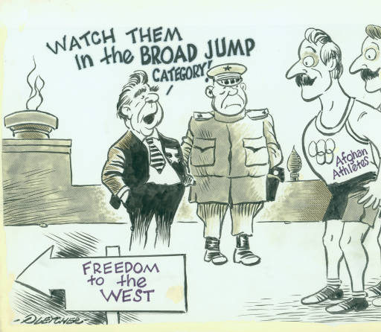
Watch them in the broad jump category!
Leonoid Brezhnev talks with a Soviet general in Moscow, the site of the 1980 Summer Olympics. The Olympic flame and an onion dome are in the background. Two men labeled “Afghan athletes” are in the foreground, and there is a directional sign labeled “Freedom to the west” This was when the Soviets invaded Afghanistan and the US backed up Afghanistan. The Afghans are trying to flee from Soviet control to the West.

Slide 20

If our relations are improving, Henry, why is he shopping so much more?
Secretary of State Henry Kissinger and President Gerald Ford look over a fence while the Soviet Union’s Leonoid Brezhnev pushes a shopping cart full of missiles along a sidewalk. Ford asks Kissinger, “If our relations are improving, Henry, why is he shopping so much?” A vignette in the lower left corner of the cartoon portrays someone behind Ford and Kissinger saying to them, “Détente is not having to say you’re sorry.” This shows how the idea of détente has slowed come to an end under Ford. The US is still under the idea that the Soviets want détente, but they are actually arming up for war.

Slide 21
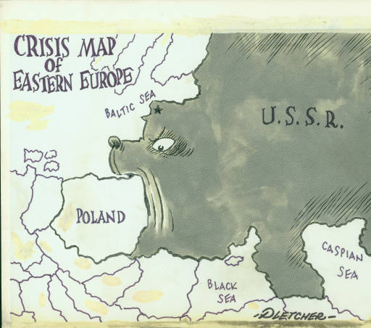
Crisis map of Eastern Europe
On a map of Eastern Europe, the Soviet Union is shaped like a bear. Its mouth is open and beginning to eat Poland. A Soviet star is placed in the bear’s forehead. This shows that the Soviet Union is trying to consume Poland behind the Iron Curtain. The USSR is displayed as the bear which is the normal depiction of the USSR.

Slide 22
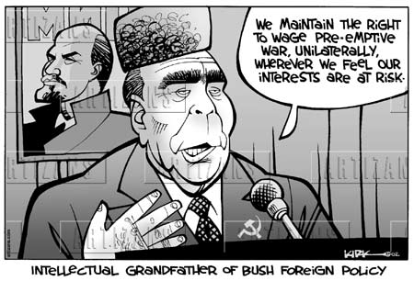
The Brezhnev Doctrine was announced to justify the soviet invasion of Czechoslovakia in August 1968. It put an end to liberalization efforts and uprisings that compromised the Soviet rule in the eastern bloc. It limited the independence of communist party and no country was allowed to leave the Warsaw pact, disturb the communist party’s power or compromise the eastern bloc. It even justified the invasion of Afghanistan in 1979.

Slide 23
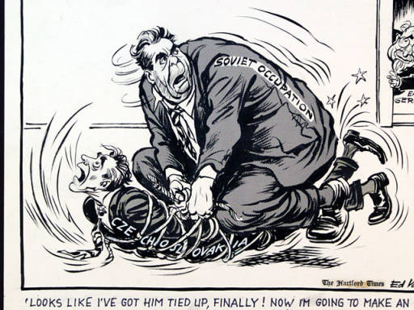
Students and writers began complaining about a lack of freedom and poor performance of the Czechoslovak economy and President Antonin Novotny asked the Soviet leader Brezhnev to support him, but Brezhnev refused. Dubcek later took control for the Communist party. For four months, Prague Spring, there was freedom in Czechoslovakia but went out of control. Dubeck’s government announced that he was still committed to democratic communism but other political parties were set up. Because of the Brezhnev Doctrine, 500,000 Warsaw pact troops invaded Czechoslovakia and Dubcek and other leaders were arrested. Brezhnev placed Husak, supporter of the USSR leader of the KSC.

Slide 24
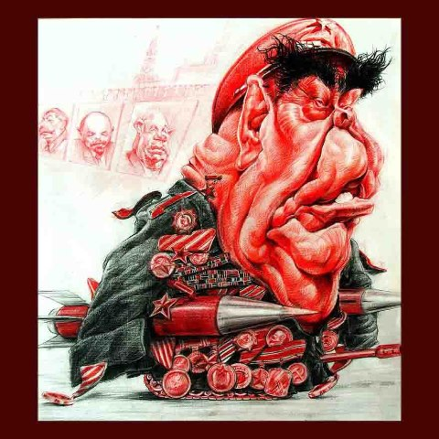
First off the fact that Brezhnev is red shows that he is communist. The portraits of the leaders behind him show that he is following in the footsteps of former Soviet leaders such as Stalin, and ignoring détente in search of more aggressive approaches to foreign policy. The missiles under Brezhnev’s arms show that he is not willing to follow the policies of disarming the missiles and would rather keep them. He is seen as an aggressor rather than someone looking for peace.

Slide 25
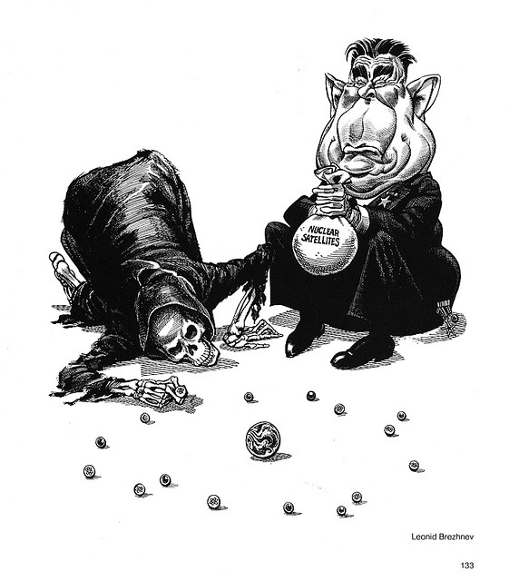
This cartoon involves Brezhnev wanting to arm the USSR’s satellite nations. The bag is representative of all the satellites he can set up and the giant marble is the middle is earth. Essentially what this portrays is that by attempting to arm all these satellite nations, Brezhnev is playing with death, as seen literally in the cartoon. The more nations he attempts to arm, the higher the chance is that death will strike the world, meaning that there will be a higher chance of a nuclear war which will lead to the destruction of mankind.

Slide 26
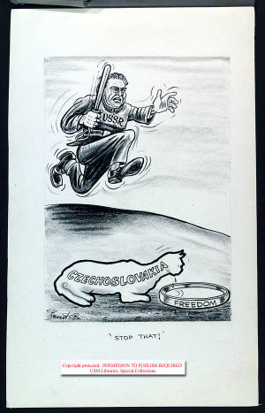
This picture is set in1968, in which the Soviets invaded Czechoslovakia in August 1968. The cat is a representation of Czechoslovakia’s country. During this year, a reform-minded new leader, Alexander Dubcek came to power and implanted measures to form a democratic socialism with freedom of press, and democratization in certain areas of the political system. This “Prague Spring” was stopped by a sudden military invasion by the Kremlin. Effects of the invasion included the canceled trip of Lyndon Johnson to Moscow, disapproval of many Eastern communist countries and further Sino-Soviet tensions. China feared the Soviet Union for the action it took against a communist country.

Slide 27
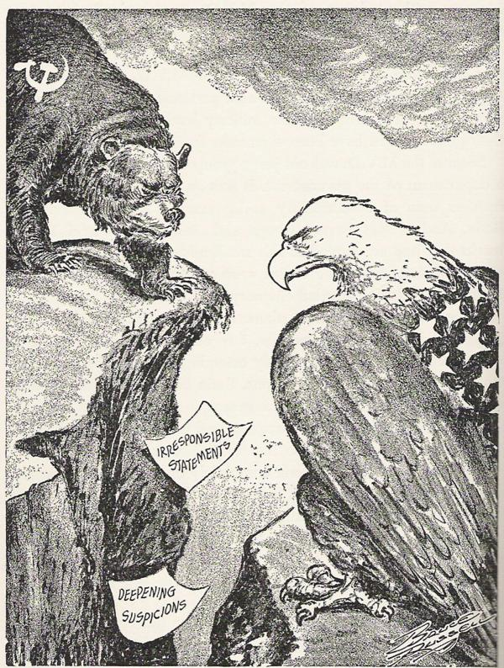
In this picture, the eagle is depicted as the U.S.A staring down the bear (Soviet Union). The two documents that have caused a bridge between the two are the Truman Doctrine and Brezhnev Doctrine. The Truman Doctrine of 1947 set in forth the policy of containment to support Greece and Turkey with economic aid to prevent them from falling into the Soviet sphere. The Brezhnev Doctrine of 1968 called for the use of the Warsaw Pact forces to intervene in communist affairs. The Brezhnev Doctrine affirmed that each Communist party is responsible not only to its own people, but also to all the socialist countries, to the entire Communist movement.
More info: The Brezhnev Doctrine is one of the major reasons why the Soviet Union is stuck in the quagmire in Afghanistan, by taking responsibility of communist affairs, withdrawal was not seen as an option. The Truman Doctrine also bridged tensions between the U.S and The S.U, as the U.S was seen to be in direct opposition.

Slide 28
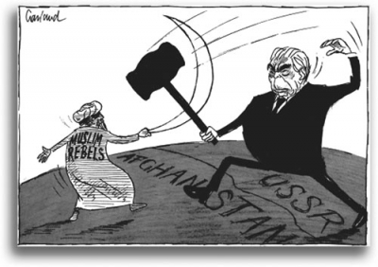
This is the Soviet intervention in Afghanistan. The message of the picture is that the Soviet invasion, under the pretext established in the Brezhnev Doctrine, met opposition by the Muslim rebels, the Mujahidin. What this picture does not show is that the Soviets had a standing condition of intervention in Afghanistan since the Czarist reign of the late 19th century. Also, the goal of the invasion was dubious; the military officials wanted a full scale invasion to overthrow Amin and the KGB wanted a limited intervention to stop the revolt from spilling into neighboring countries.

Slide 29
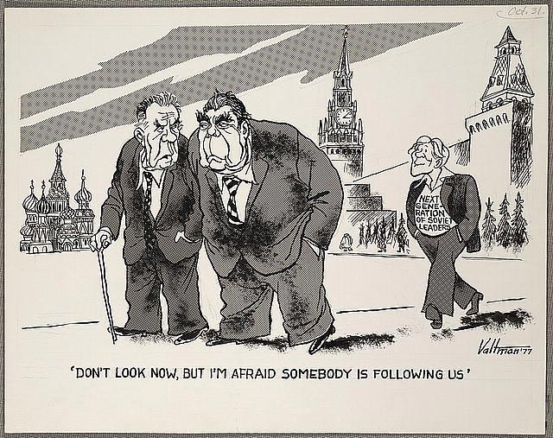
The message of this cartoon is to display the the “Old Regime” of the Soviet Union. The leader, Brezhnev, gave a speech called the “stability of Cadres” speech, which asserted that all the elderly members of the politburo would remain. This effectively kept the Brezhnev era policies alive until 1985, with the death of Cherenko. At the time (1976-1985) the average age of a politburo member was 72 years old. In the back is then new generation of Soviet officials that would bring about drastic openness in the Soviet system.

