Slide 1
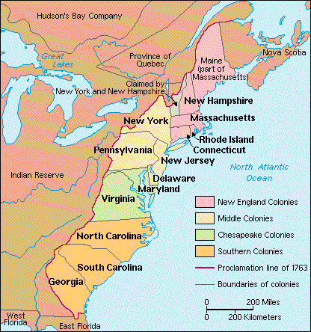
The Colonies

Slide 2
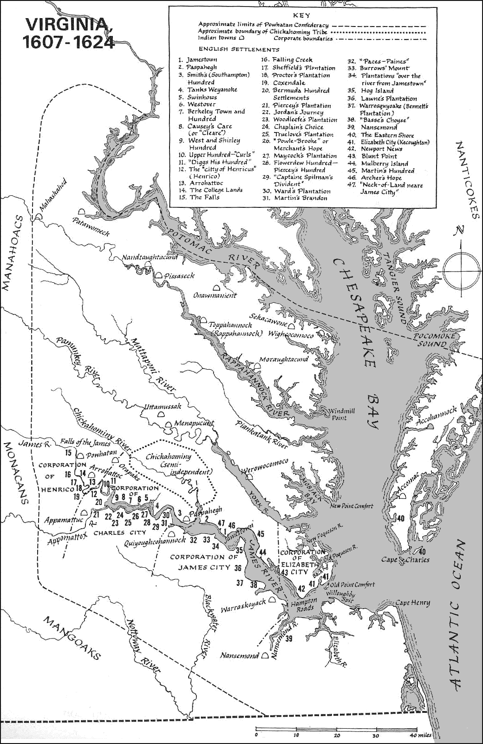
Virginia

Slide 3
Virginia
Most populous colony in the new world
Tobacco becomes major cash crop
  More than a million pounds per decade shipped to England
Brutal living
  Disease, famine, poor weather
  Indentured servitude

Slide 4
Indentured Servants
Thousands of landless bachelors
  ¾ of immigrants were indentured servants
Bacon’s Rebellion-1676
  Landless are disenfranchised (no vote)
  Nathaniel Bacon leads attacks on natives
  Torch Jamestown
Fear of uprisings lead planters to look for new labor
  Turn to Africa

Slide 5
Slavery
About 400,000 slaves in North America at peak
  Almost all after 1700
Primarily from West Africa
1 in 5 dies during the trip across the middle passage
Slave codes written
  Difference between slaves and indentured servants

Slide 6
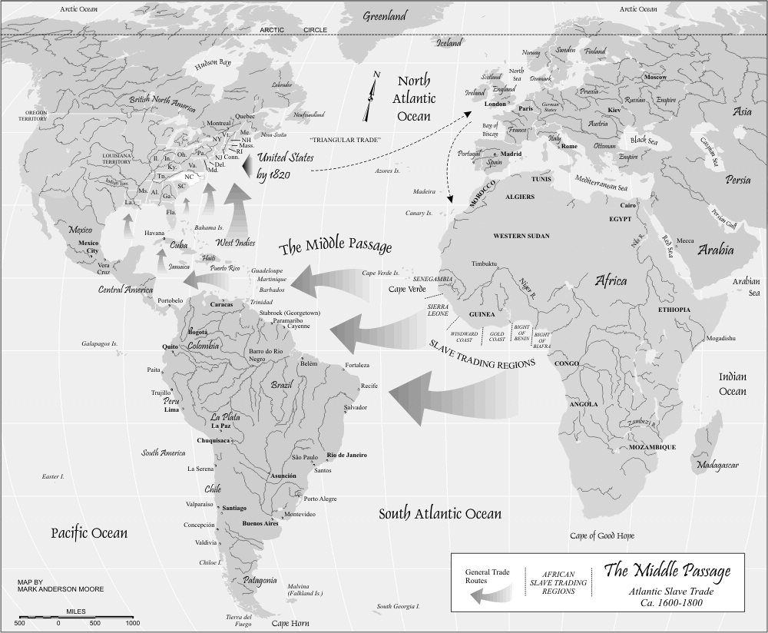
Slavery

Slide 7
African life
Brutal labor and conditions
  Especially in deep south
Families began to form
  Slave population increase through reproduction
Slave society perpetuates itself
  Children of slaves are property of slave owners

Slide 8
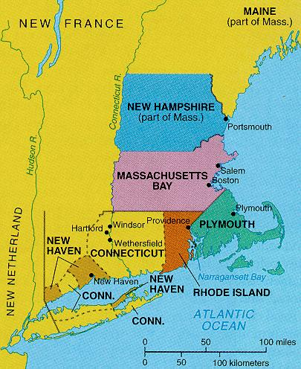
New England

Slide 9
New England
Much better living than the Southern colonies
  Less disease, safer weather, clean water
Strong, stable families
  Lots of kids, very low teen pregnancy, long life spans
Unlike the South, women couldn’t own property
Tight-knit, strict communities emerge
  Laws decided by the townspeople

Slide 10


Slide 11
Economics
South: Agrarian (planting crops)
New England: Bad soil, cold winters
  Farming proved difficult
  Turn to the water
    Commercial fishing, shipping, etc.
Northern society remains lily white
  No need for slaves
  Puritan hatred of slavery

Slide 12
