Slide 1
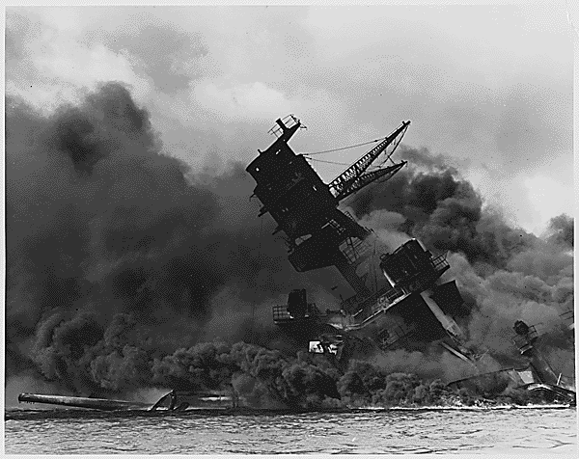
Opener:
Imagine- how would you feel if you encountered a Japanese American walking past you on the sidewalk the day after Pearl Harbor?
Imagine- how would you feel if you were a Japanese American the day after Pearl Harbor?
How would the fears be similar or different from #1 and 2?
Akiko K. was 16 years old when the Japanese bombed Pearl Harbor. In this video clip she recalls her family's reaction and her own response.
http://www.densho.org/assets/sharedpages/primarysource/primarysource.asp?id=117&display_format=4&section=causes&text=1&mediaType=video

Slide 2
Learning Objectives:
Students will be able to:
Explain why there was anti-Japanese hysteria after the Pearl Harbor attack.
Explain how the media and government added to the hysteria and relate to modern examples of racial hysteria.
Describe what life was like for Japanese-Americans in the internment camps.

Slide 3
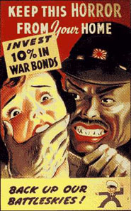

Slide 4
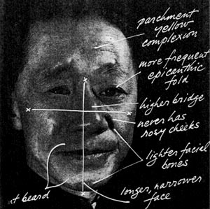

Slide 5
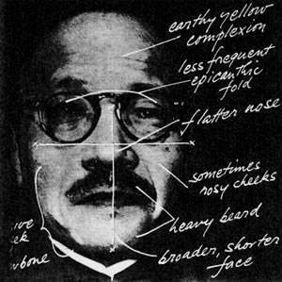

Slide 6
1)How did propaganda like the posters you just saw, change or manipulate American perspectives of Japanese-Americans?

Slide 7
http://www.densho.org/assets/sharedpages/primarysource/primarysource.asp?id=123&display_format=4&section=causes&text=1&mediaType=video 2) How did the military use the fear of Japanese to their advantage? Answer!

Slide 8
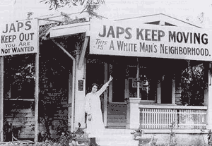

Slide 9
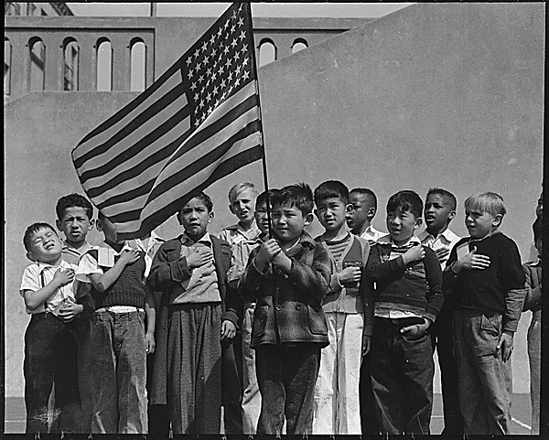

Slide 10
http://www.densho.org/assets/sharedpages/primarysource/primarysource.asp?id=125&display_format=4&section=causes&text=1&mediaType=video
3) Why didn’t any Japanese American’s try to refute the statements against them?
Answer!
http://www.densho.org/assets/sharedpages/primarysource/primarysource.asp?id=127&display_format=4&section=causes&text=1&mediaType=video
4) How did the media distort even a simple image of Japanese-American children playing?
Answer!

Slide 11
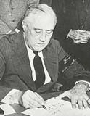
Certain principles and freedoms are guaranteed by our Constitution. Yet, without enforcement, the Constitution is just a piece of paper. Where does one turn if national leaders fail to uphold these fundamental rights?
President Roosevelt ignored reports from Naval Intelligence, the FBI and other official sources that there was no need for either mass removal or incarceration of people of Japanese ancestry.
According to then FBI Director J. Edgar Hoover, " ... the decision to evacuate was ... based primarily on public and political pressures rather than factual data."
Perhaps Roosevelt was influenced by anti-Japanese sentiments or misled by key advisors.
Perhaps it was because there was no strong opposition to the incarceration on the West Coast.
In any case, President Roosevelt encountered little resistance when he chose to violate the civil rights of a small, easily identifiable and politically powerless minority group rather than go against the rising tide of hostility.
The U.S. Supreme Court upheld Roosevelt's decision.
In sharp contrast to the mainland, the military leadership in Hawaii discouraged public hysteria and there was no mass incarceration on the islands.

Slide 12
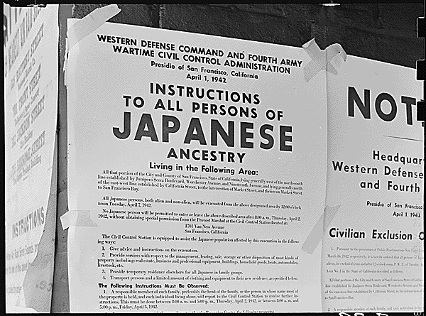

Slide 13
Document Analysis:
Group 1: Executive Order 9066: What does Roosevelt mean, “Whereas the successful prosecution of the war requires every possible protection against espionage and against sabotage to national-defense material, national-defense premises, and national-defense utilities?”
Group 2: Instructions to all persons of Japanese Ancestry: What do instructions state that all Japanese must do? What are they allowed to bring?

Slide 14
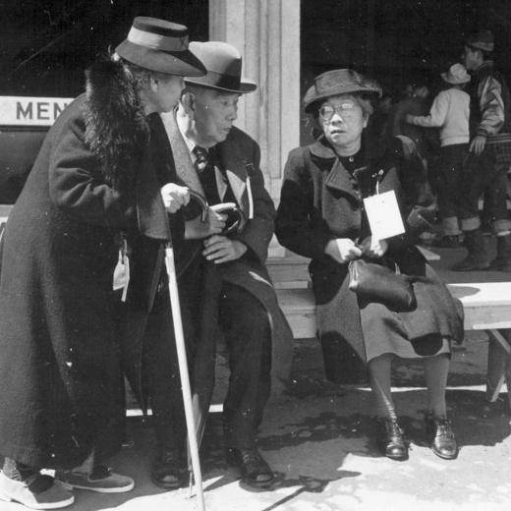
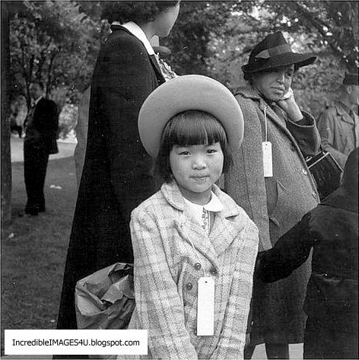
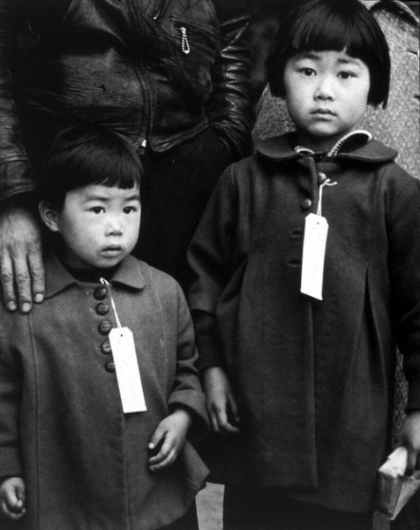
*Open to yesterday’s page- #8 U.S.A. Paranoia
Opener (left side): You have just picked up an identification tag- Write down who you are and what your bio says.

Slide 15
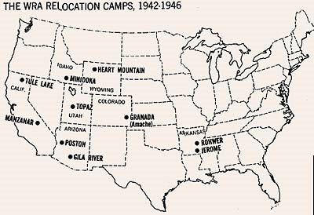
http://www.densho.org/sitesofshame/map.html
Which camp looks like it was the most appropriate location for any San Diego Japanese Americans to be sent to?

Slide 16
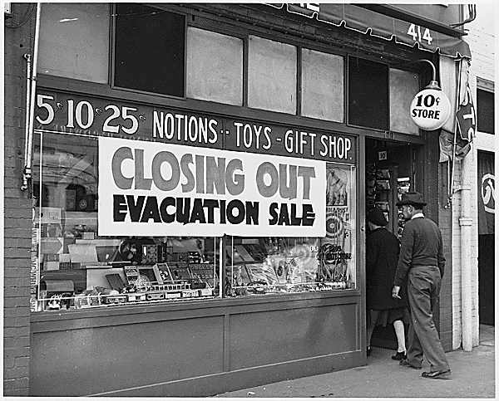

Slide 17
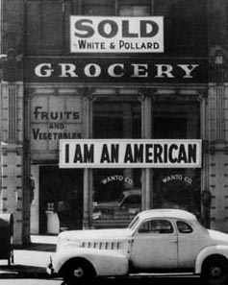

Slide 18
Government Newsreel, Japanese Relocation http://www.densho.org/assets/sharedpages/primarysource/primarysource.asp?id=115&display_format=4&section=causes&text=1&mediaType=video
E:\lessons\video\newsreel.mov

Slide 19
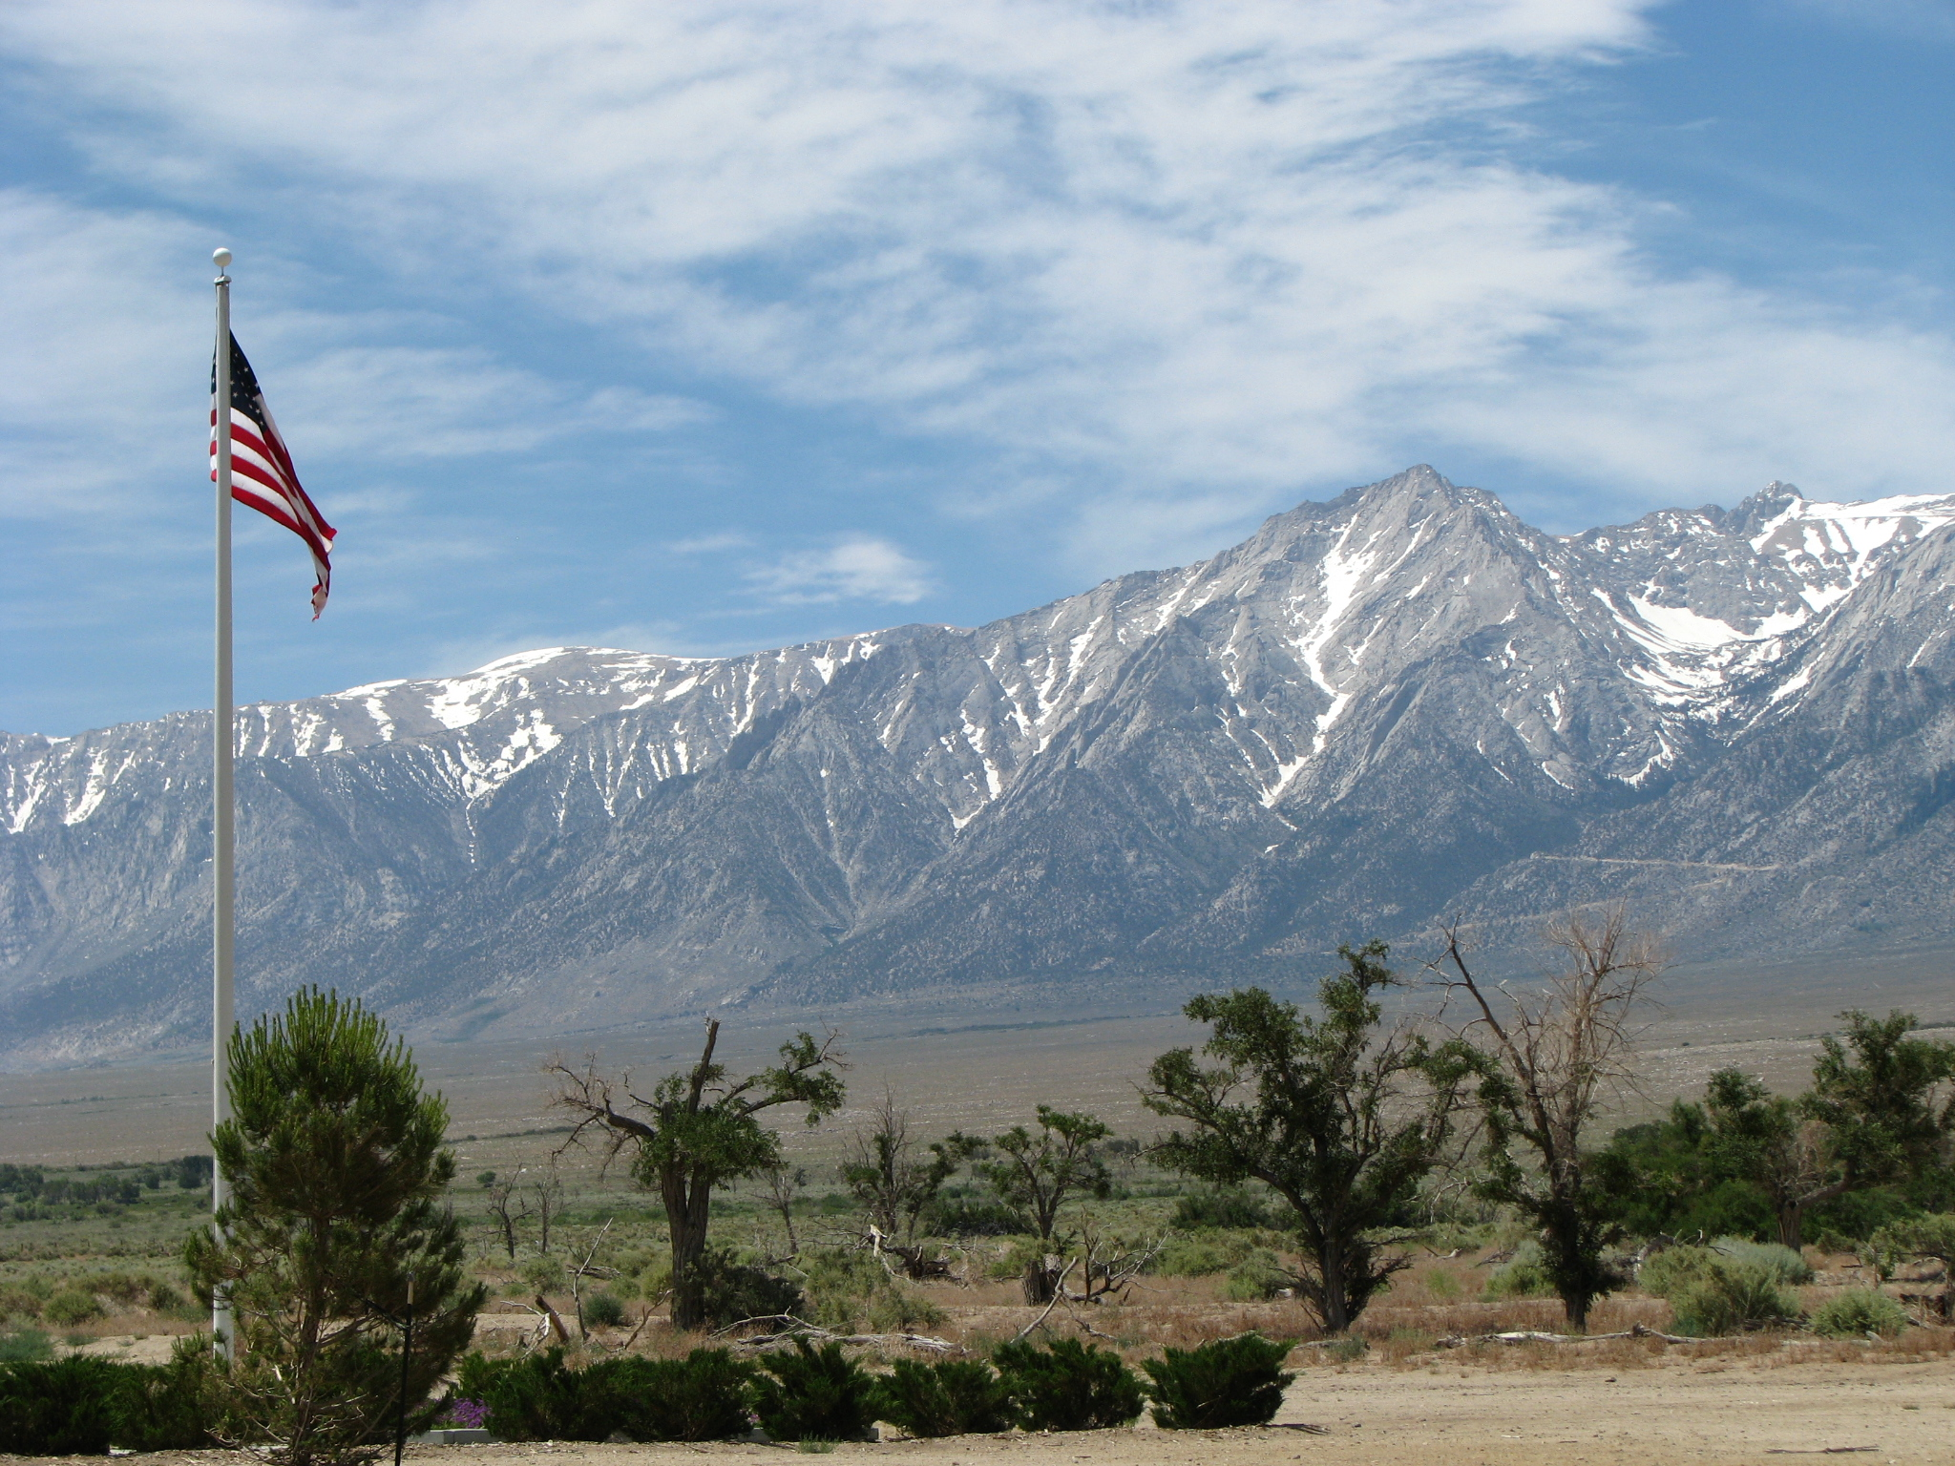
Camp Manzanar
Photos taken by Mrs. Janiak
June 2011

Slide 20
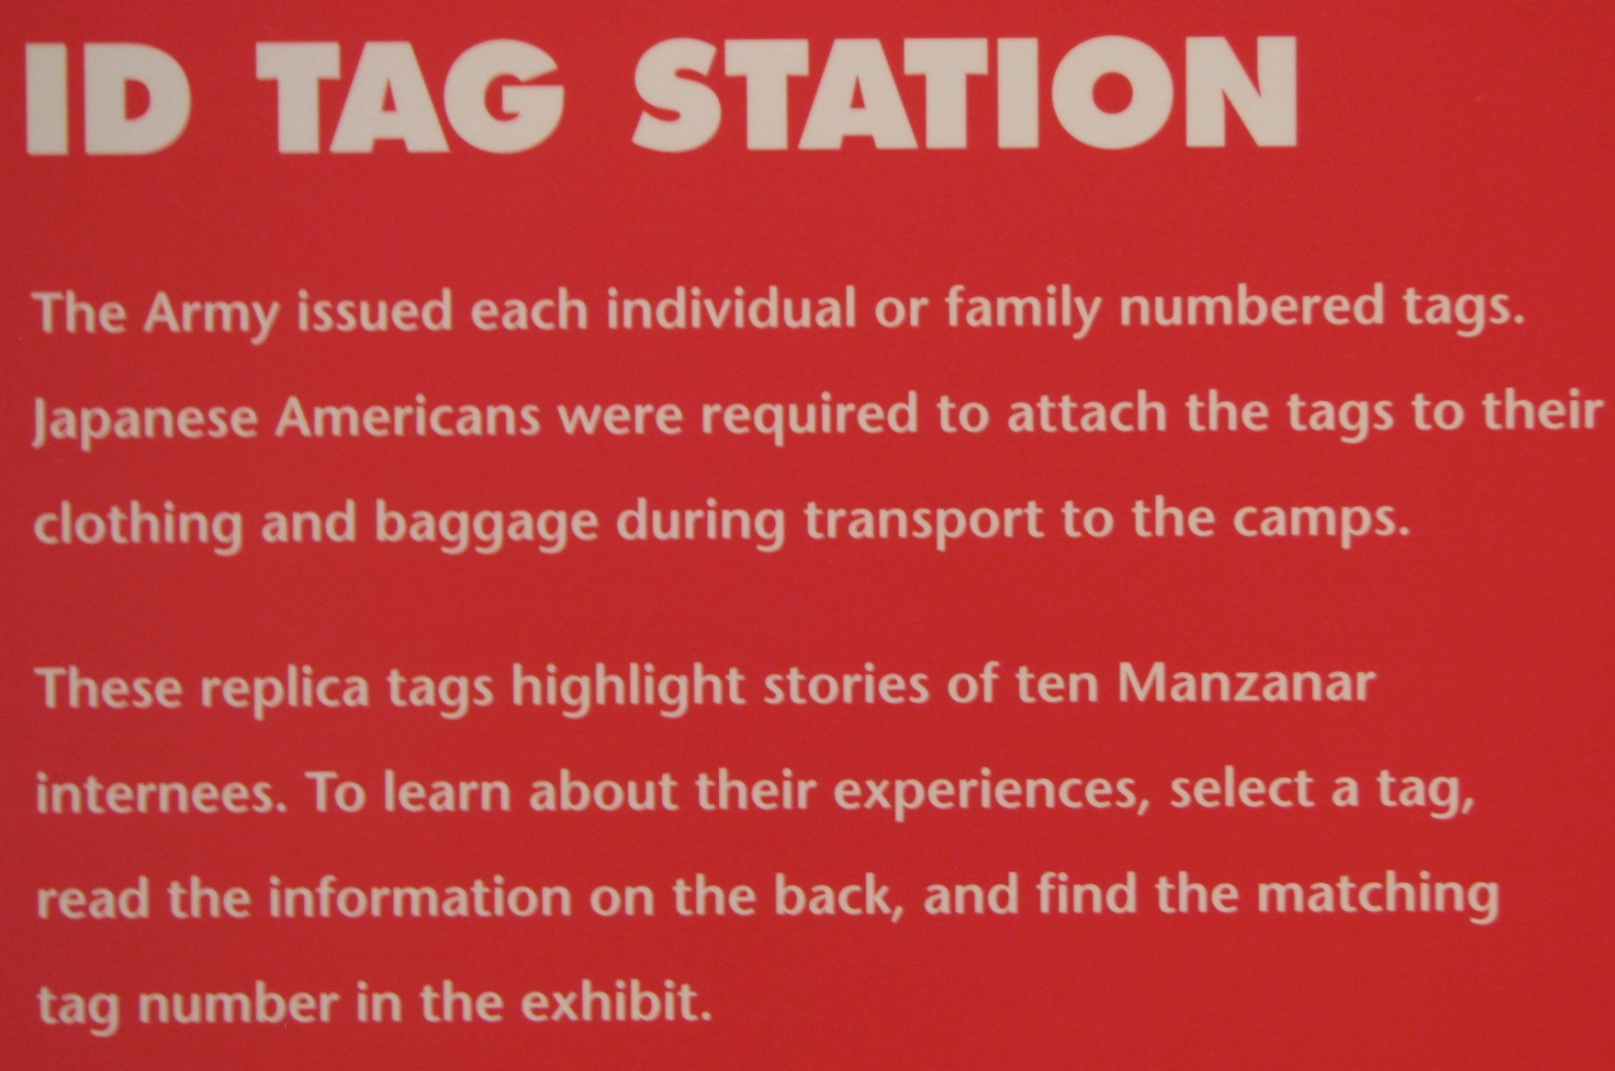
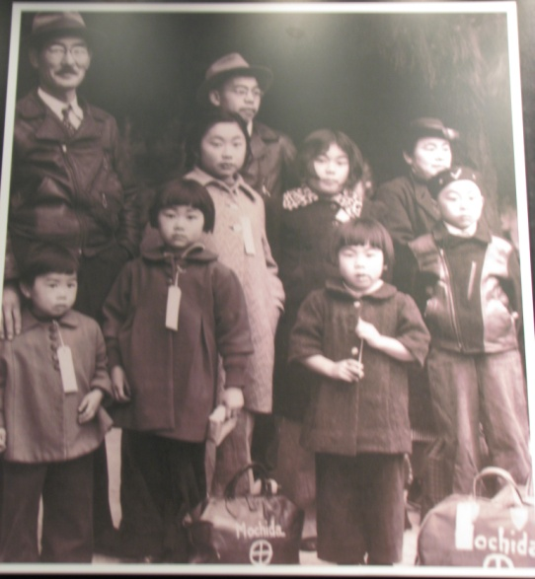
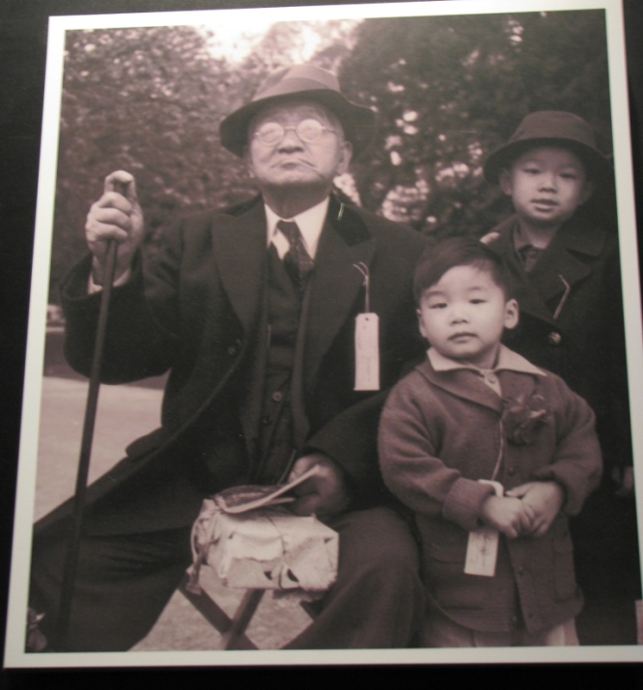
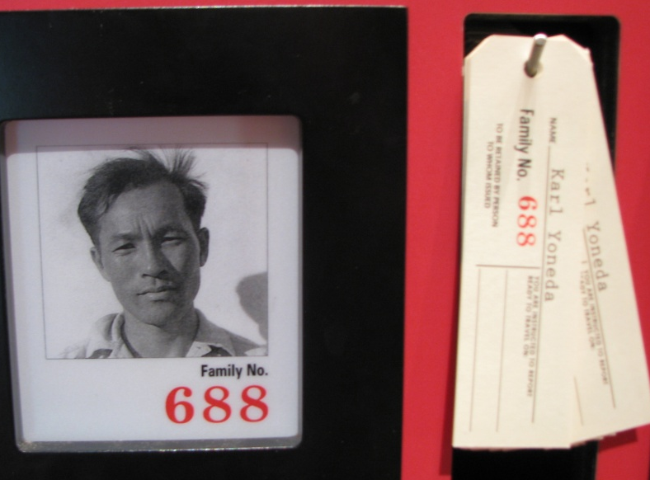

Slide 21
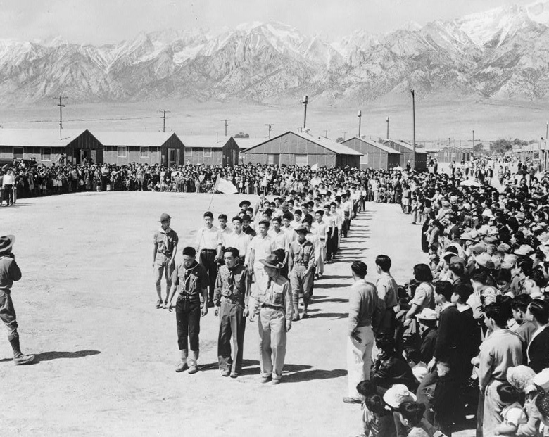

Slide 22
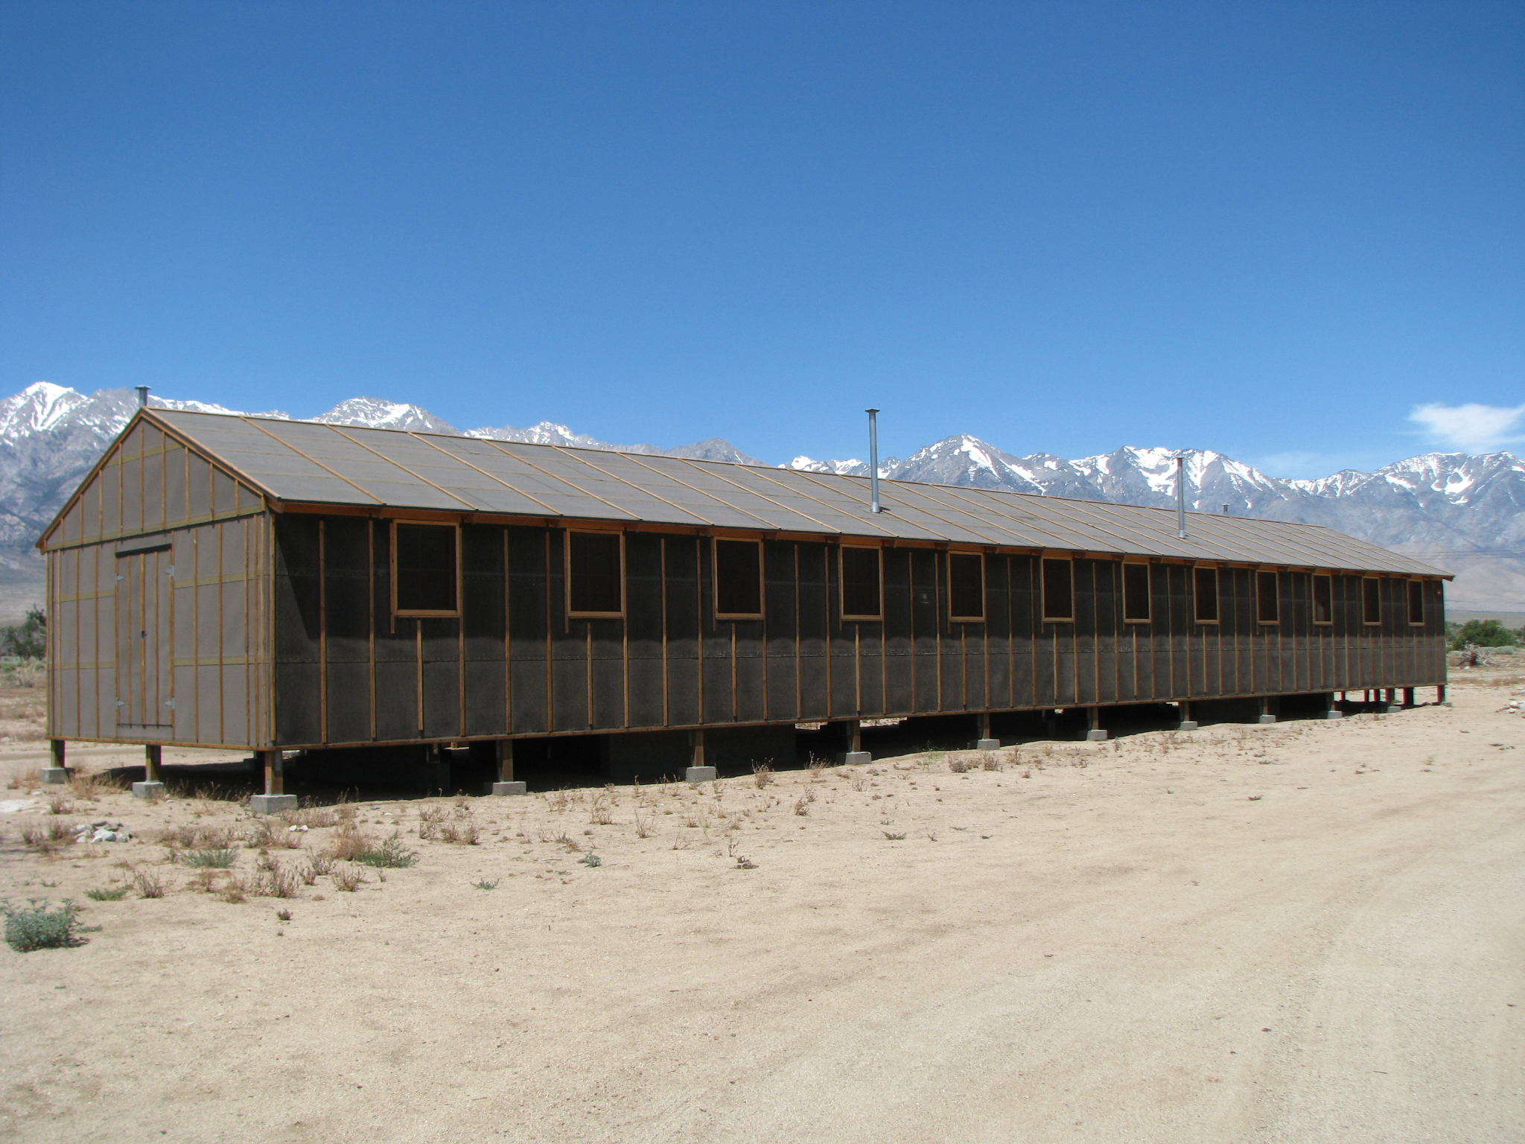
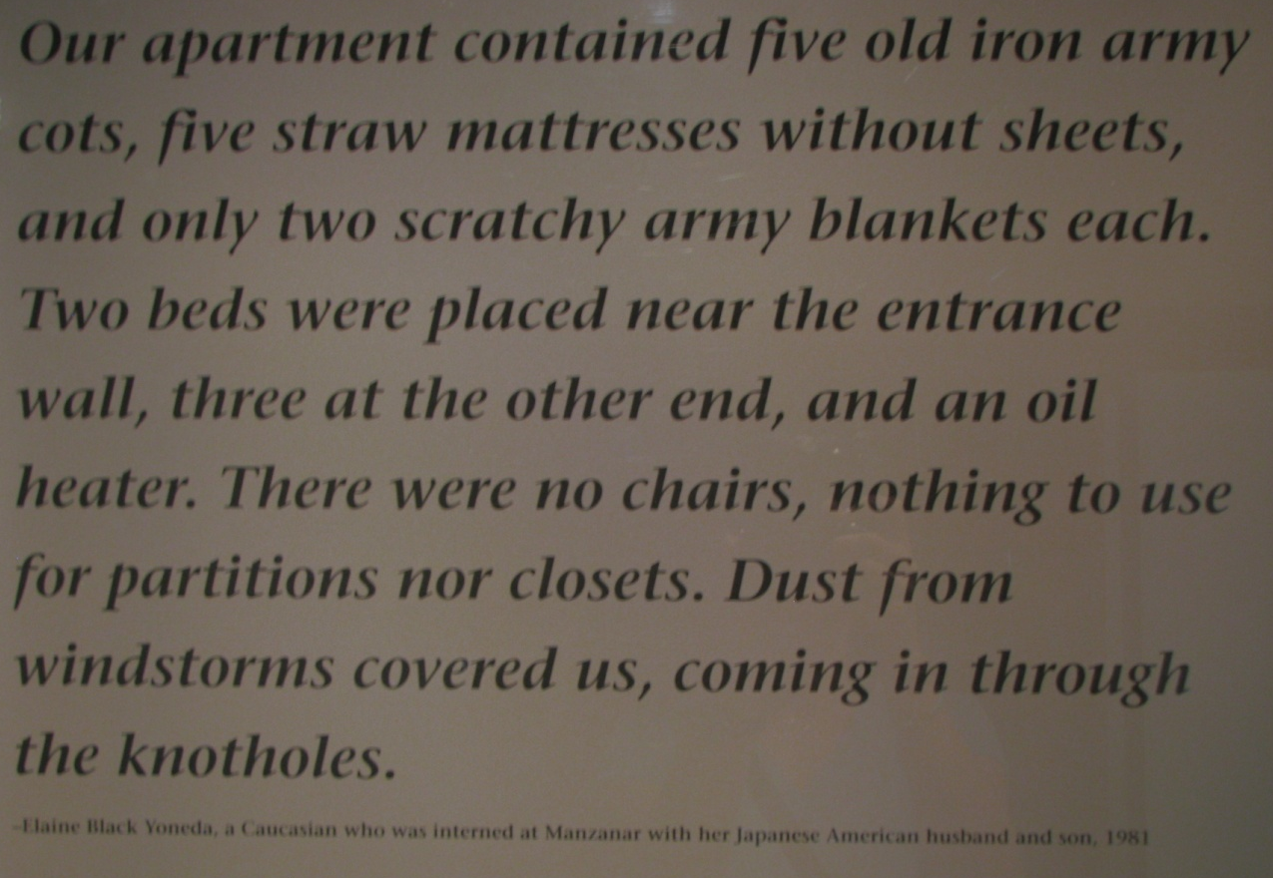
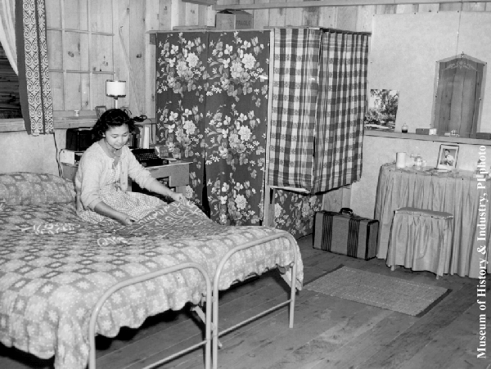
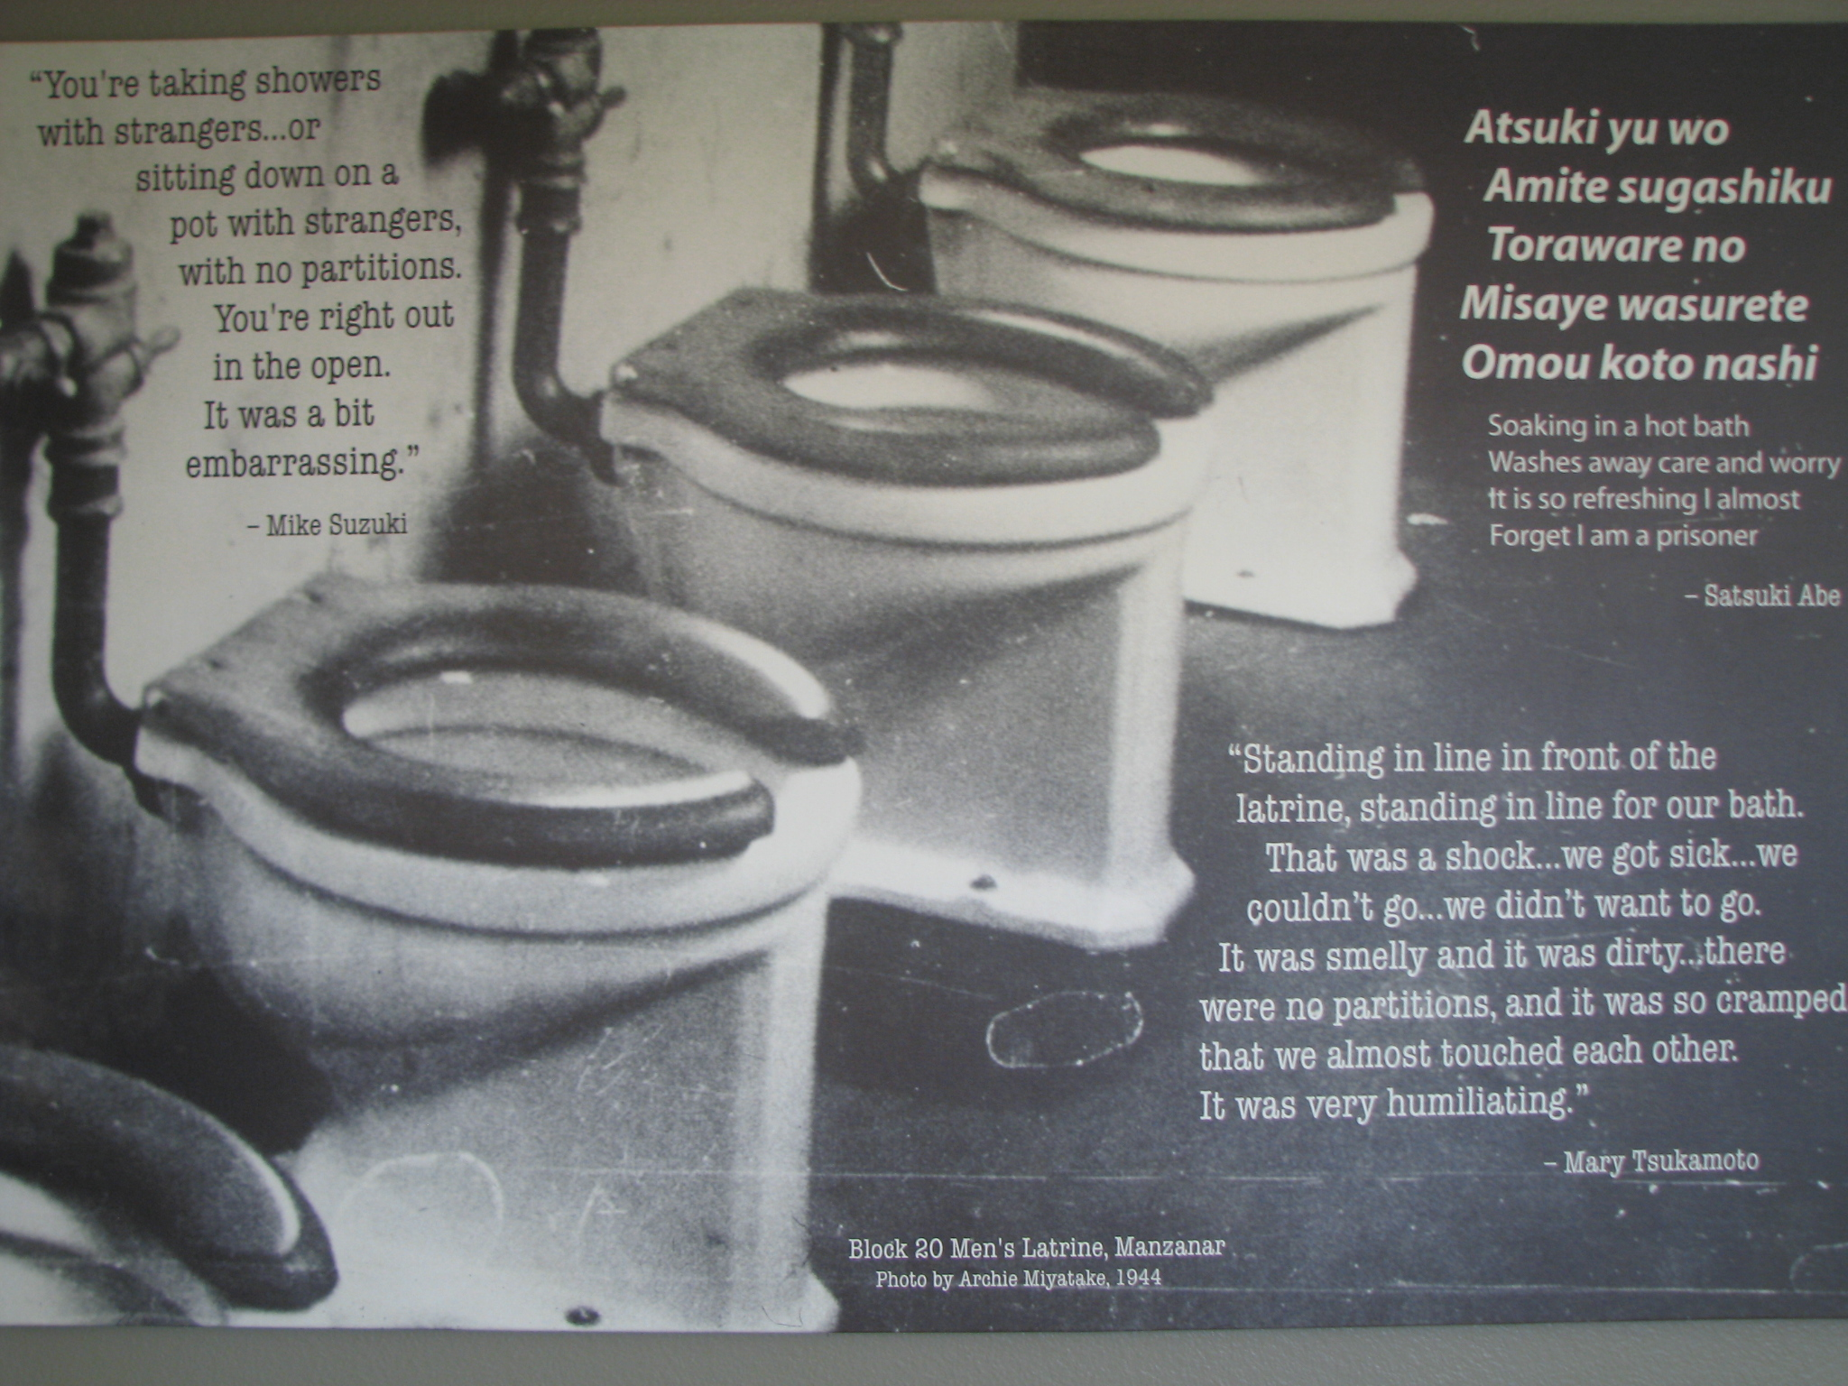
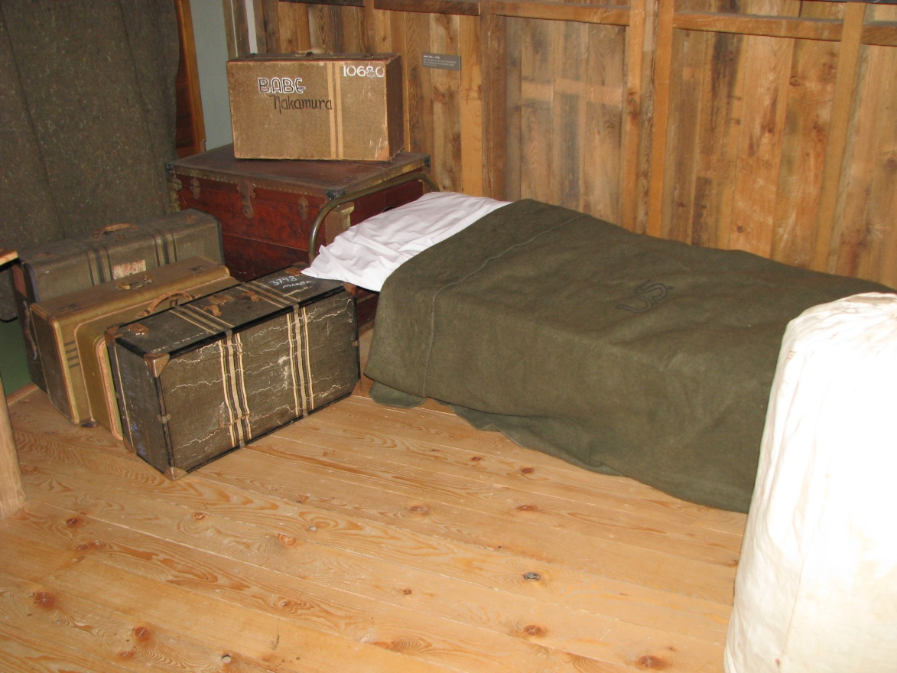

Slide 23
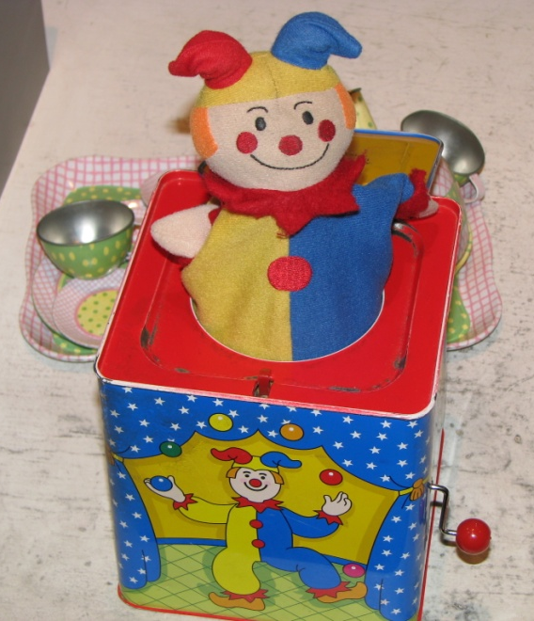
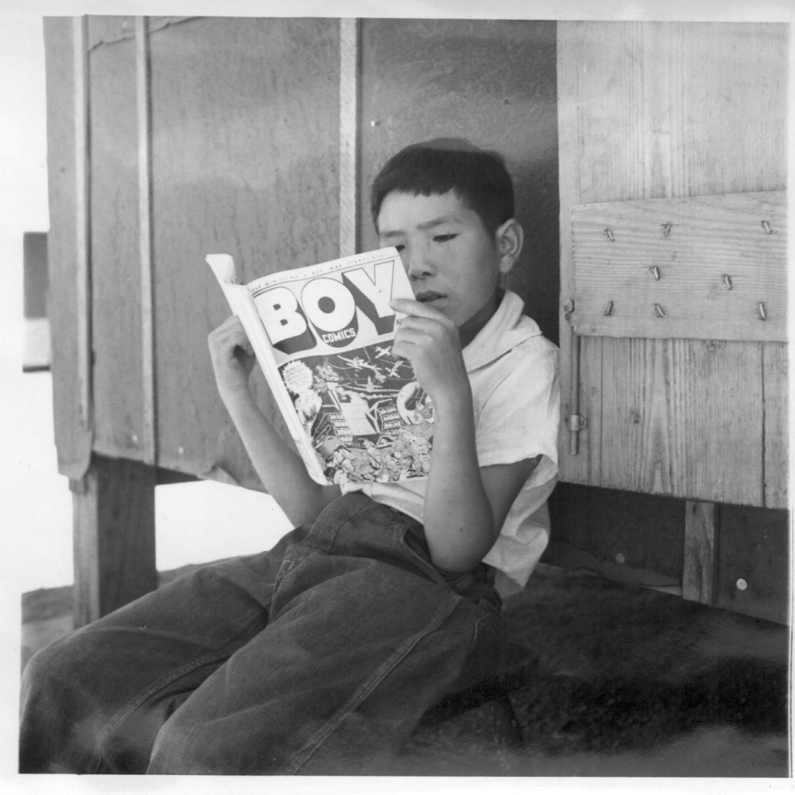
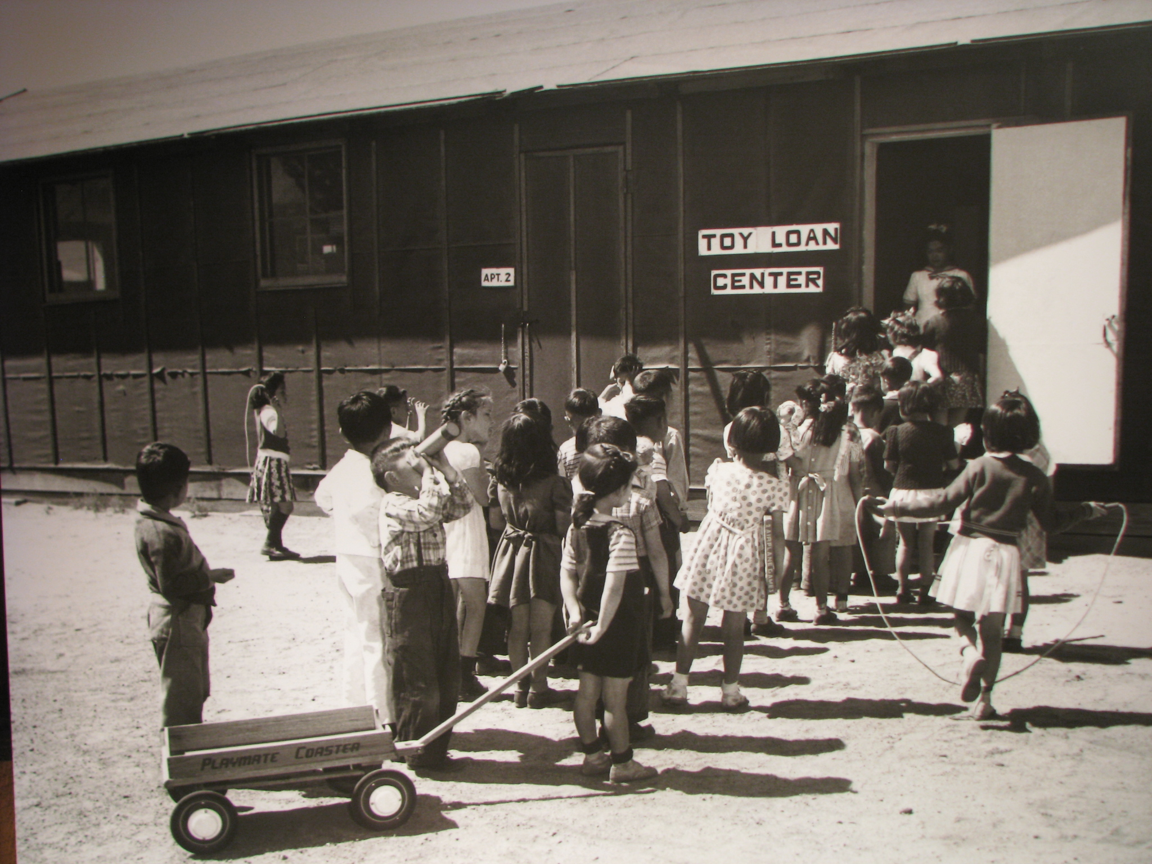
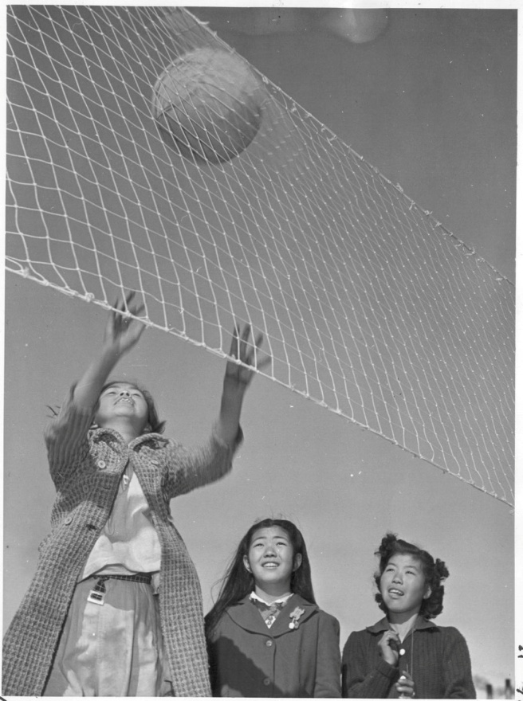
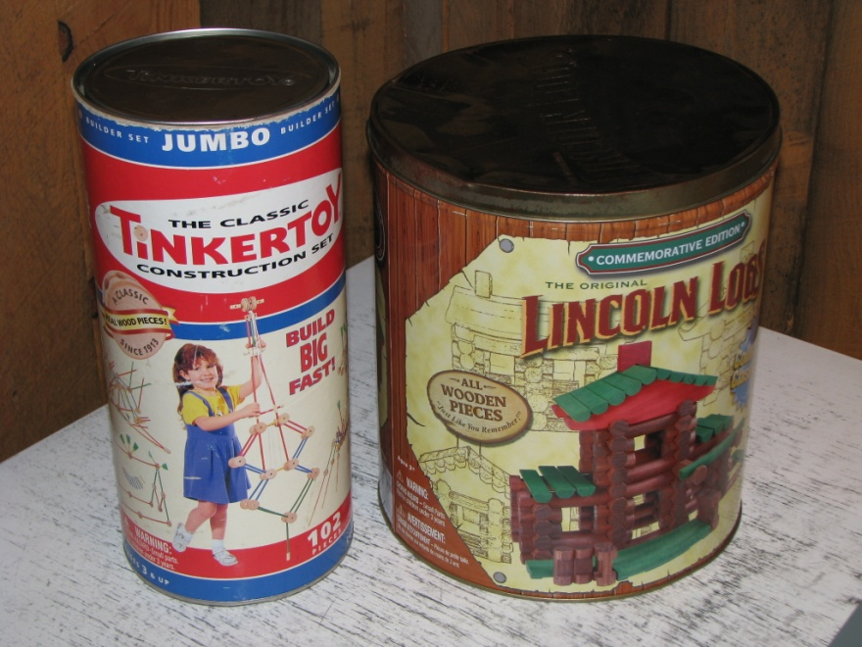

Slide 24
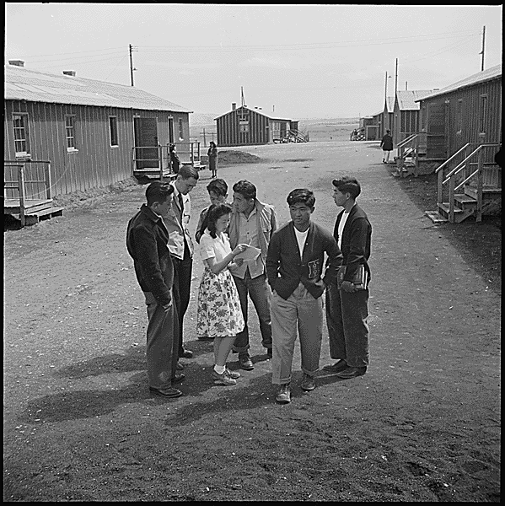
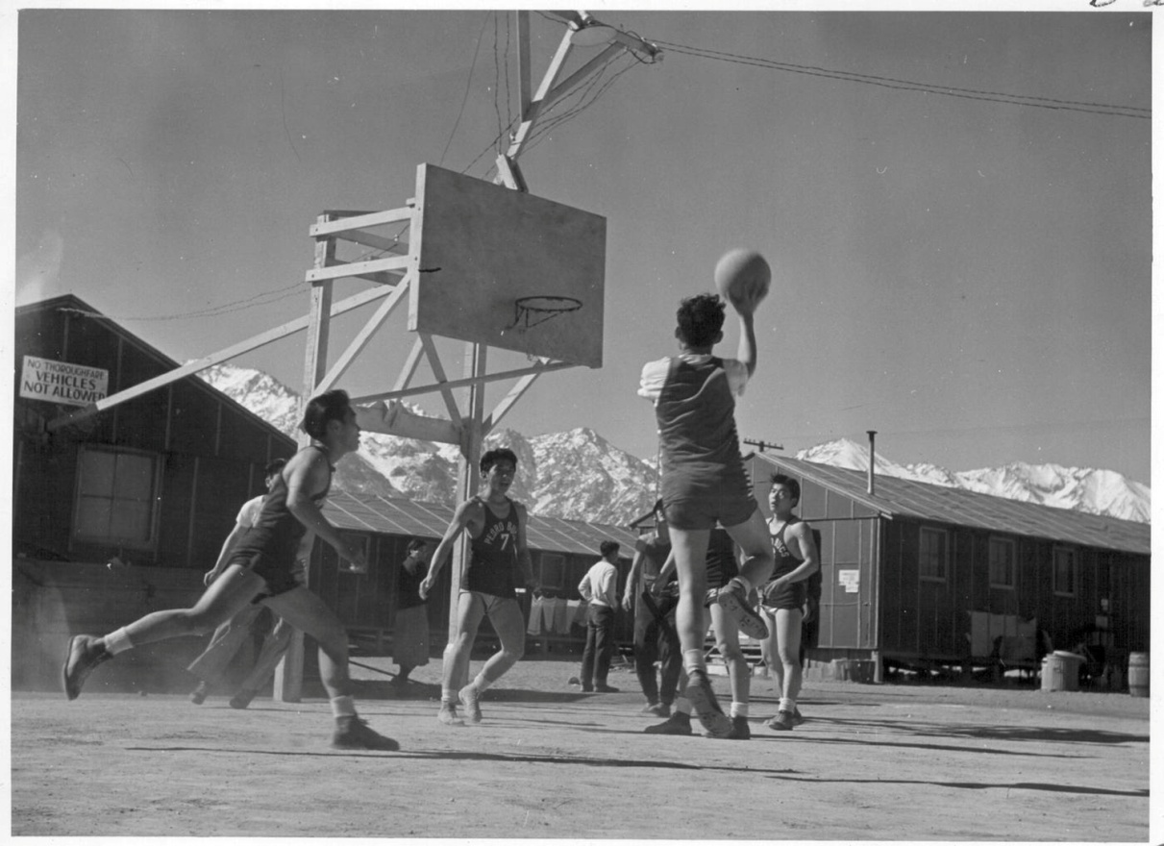
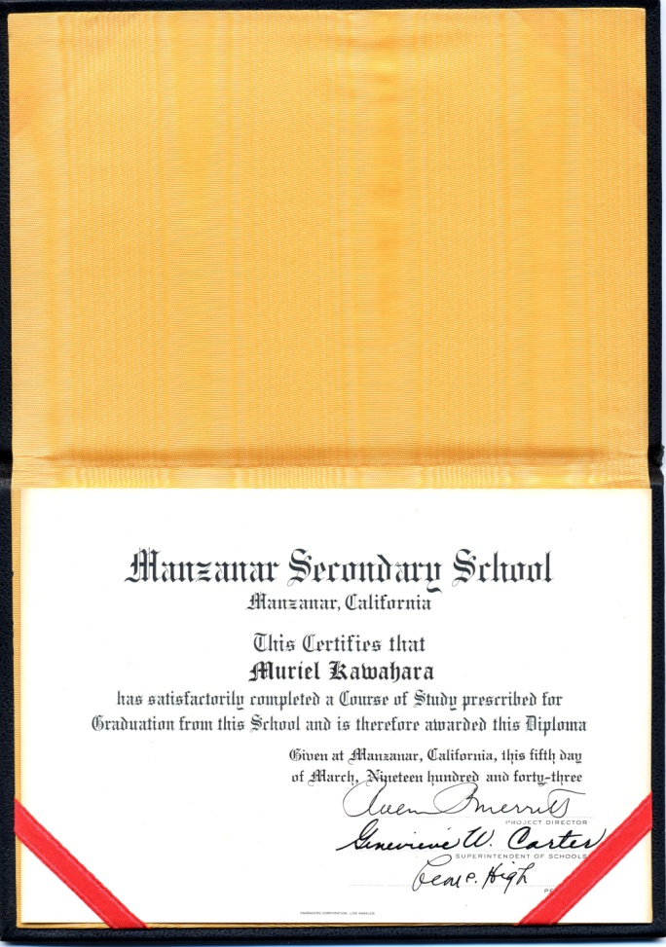
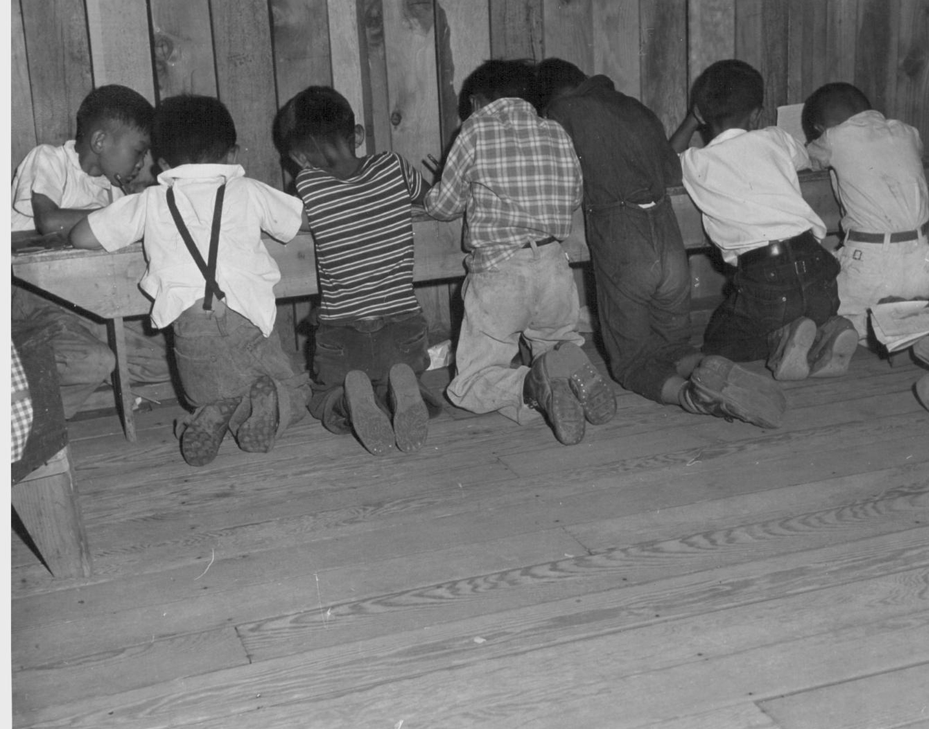
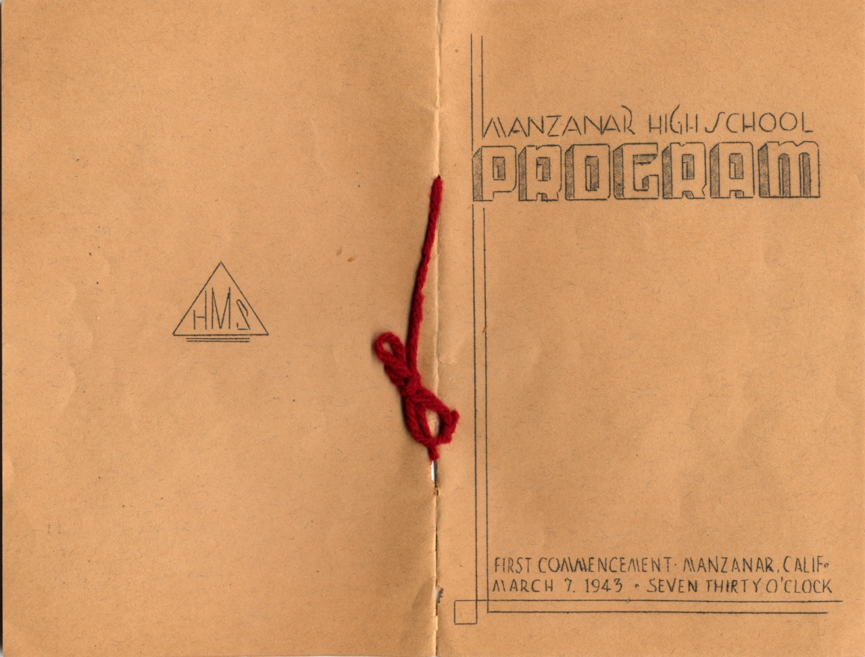

Slide 25
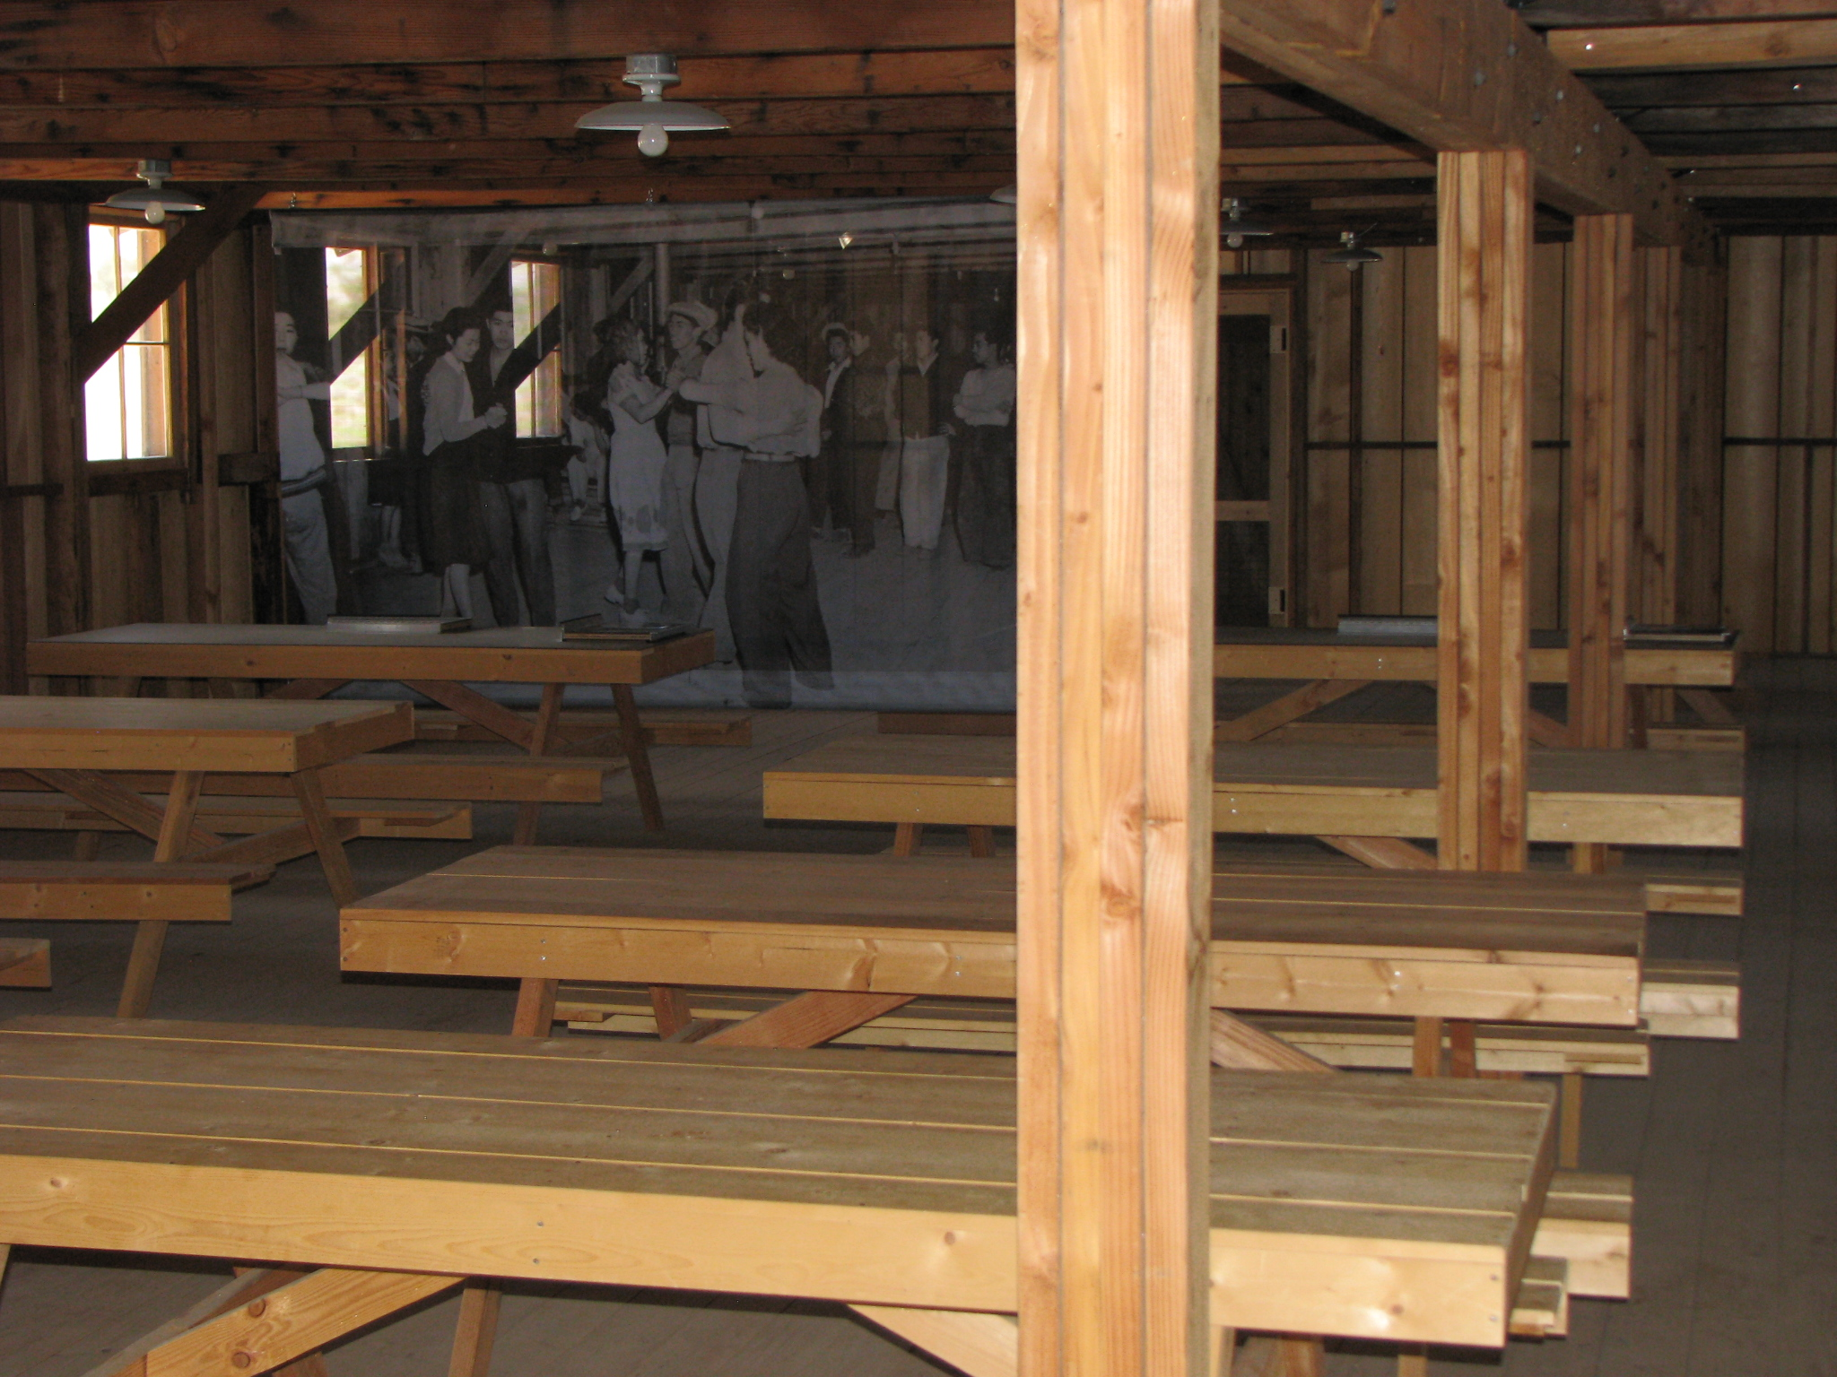
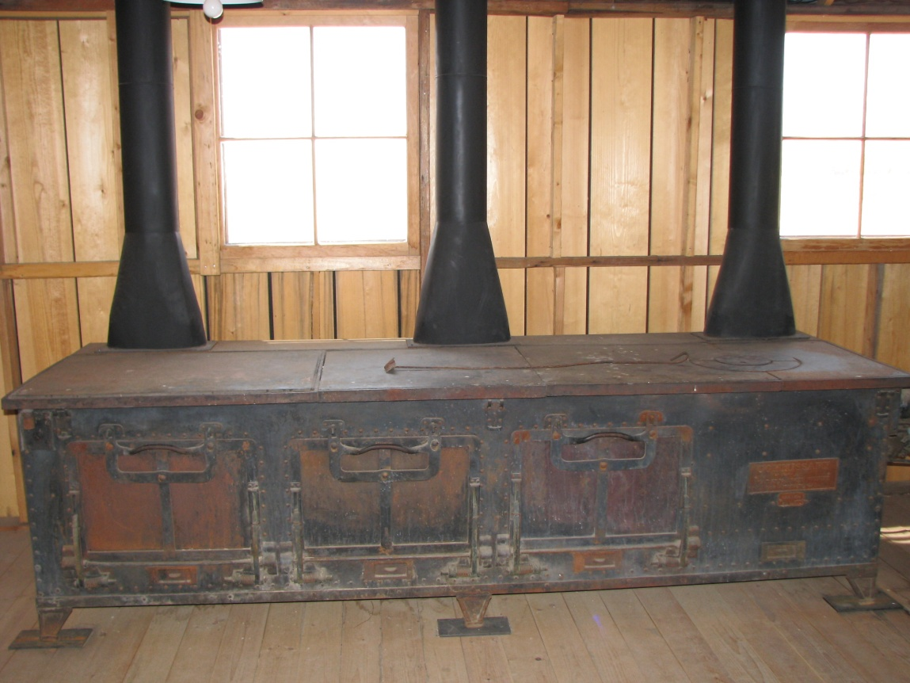
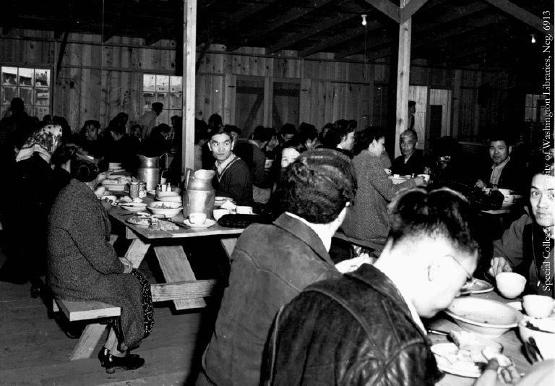
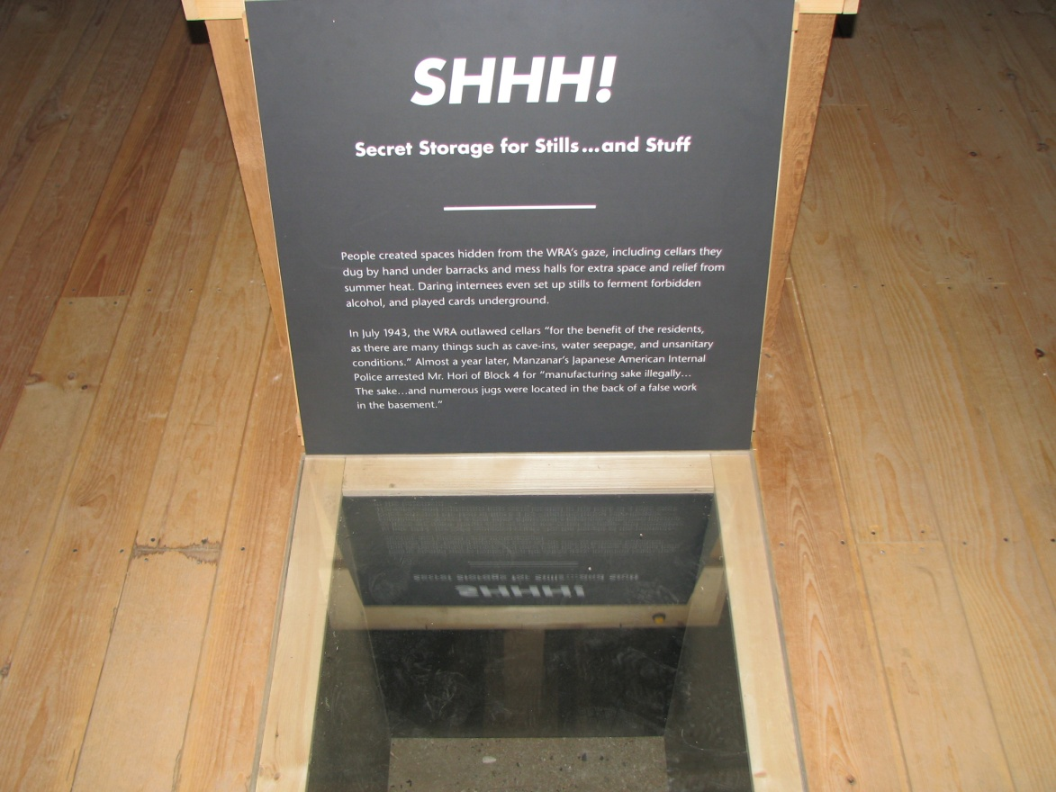

Slide 26
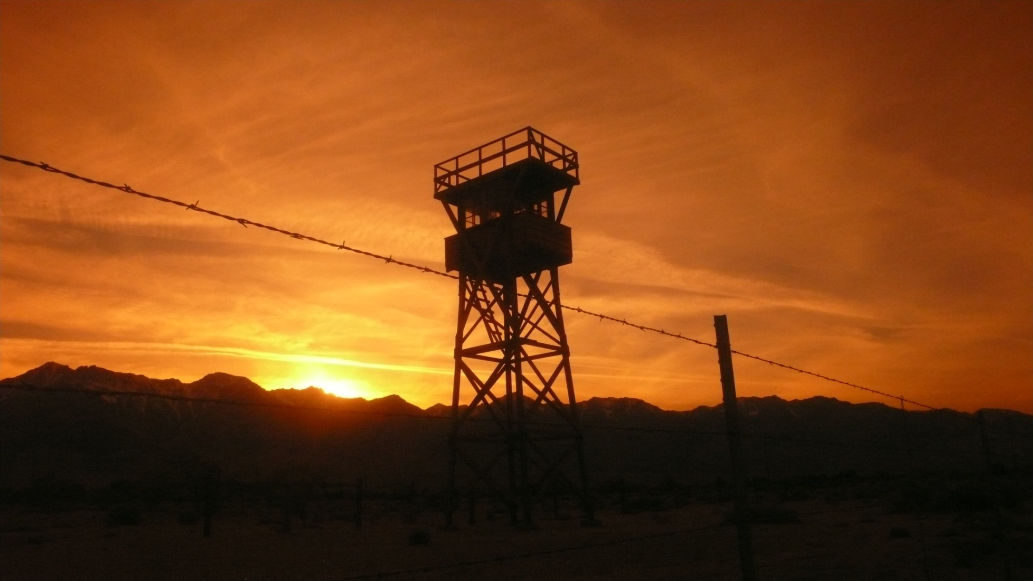
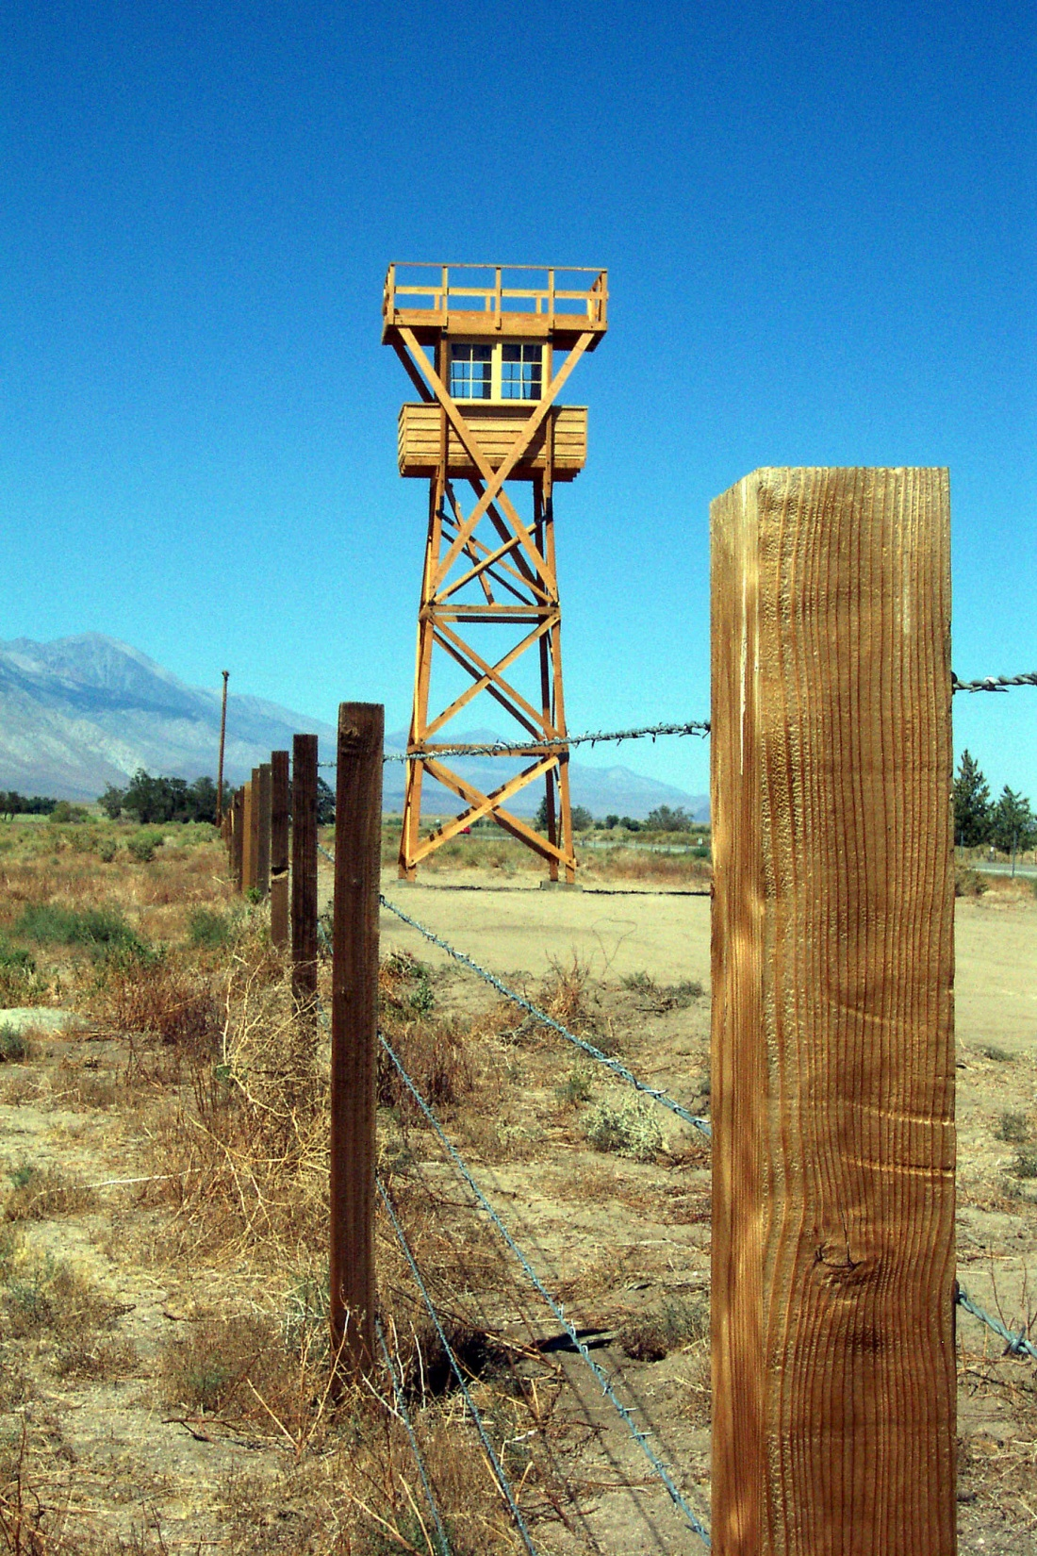

Slide 27
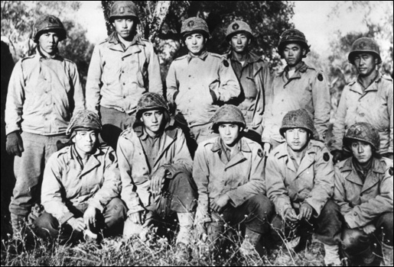
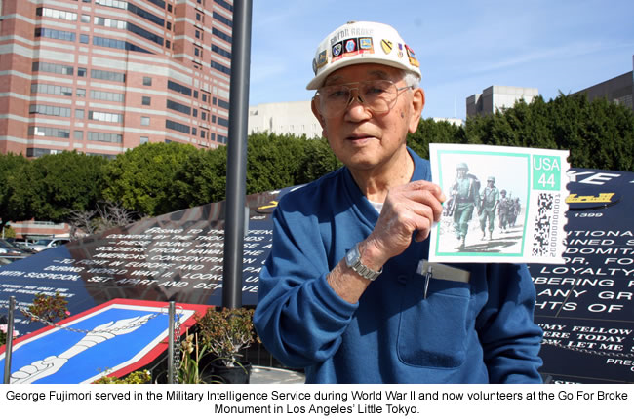

Slide 28
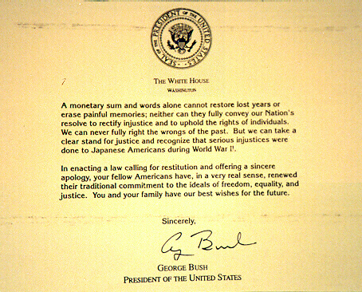
President Reagan signed a bill providing $20,000 to each Japanese American sent to a relocation camp

Slide 29
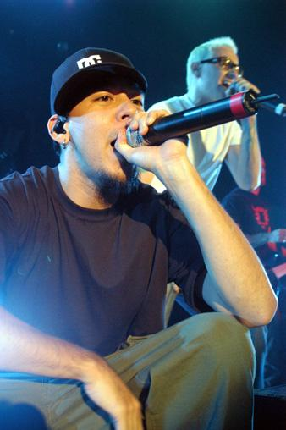
Kenji - Manzanar
This is a video to the song "Kenji" by Fort Minor, or Mike Shinoda of Linkin Park. It describes his family's life in the time of World War II and how they were put in a Japanese Internment Camp. Effects used in this make it seem as though the video was actually from 1942.

Slide 30
Wrap-up: Choose 1 of the following to explain in detail in your notebook-
1)Explain why there was anti-Japanese hysteria after the Pearl Harbor attack.
2) Explain how the media and government added to the hysteria and relate to modern examples of racial hysteria.
3) Explain how the U.S. government should have reacted to the anti-Japanese hysteria and what should have been instead.

