Slide 1
Chapter 26 – The Great West & the Agricultural Revolution, 1865-1896
APUSH

Slide 2
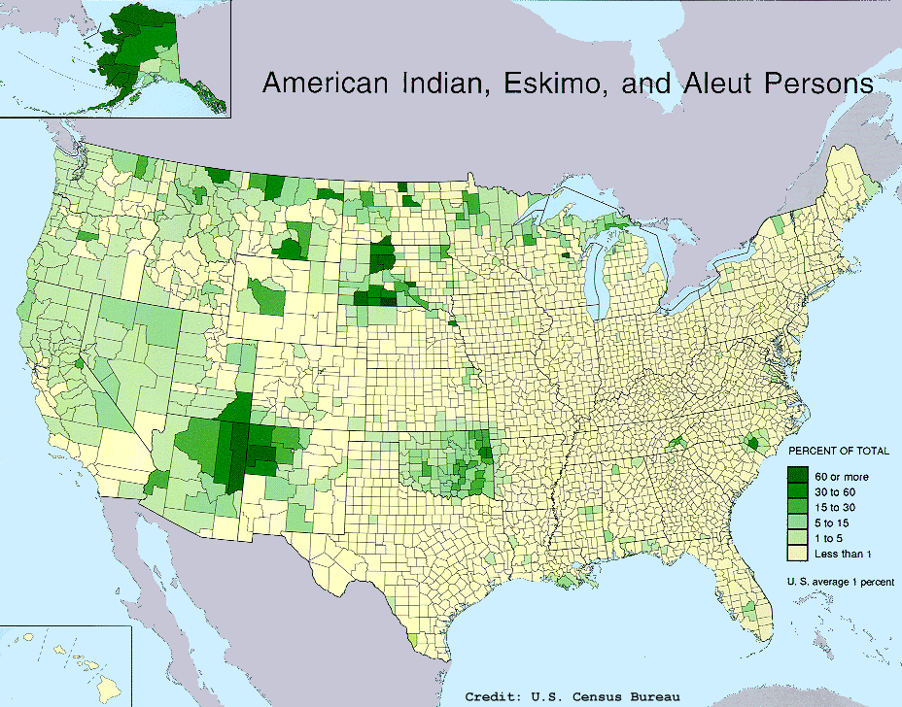
Native American Populations in U.S.

Slide 3
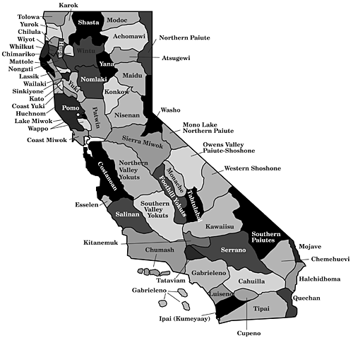
Tribes in California

Slide 4
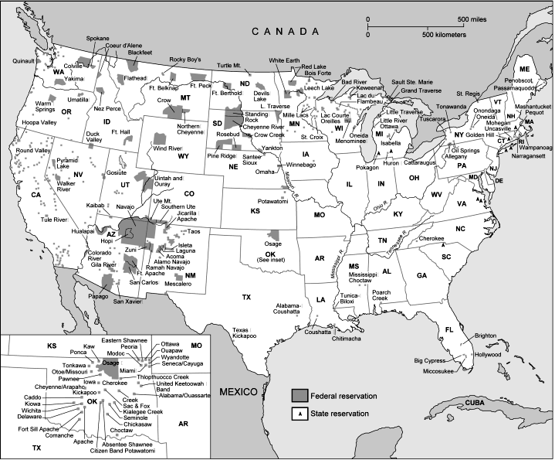
Current Native American Reservations -2% of American Land

Slide 5
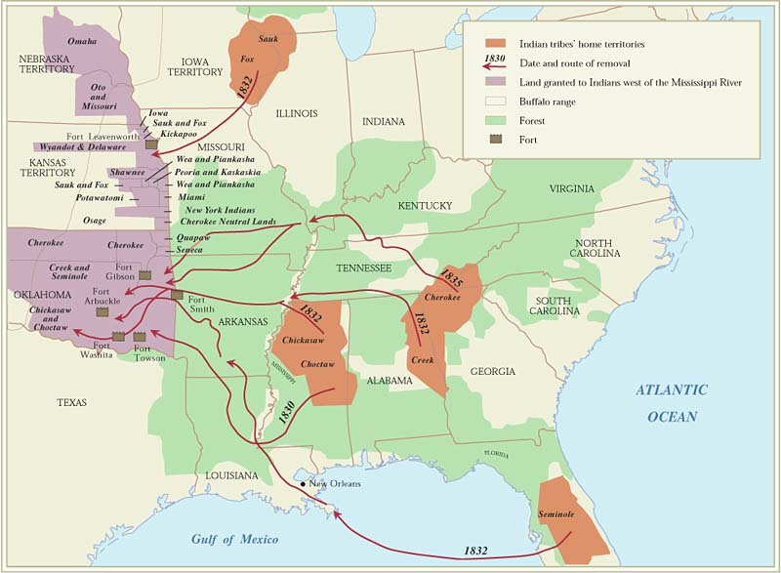
Indian Removal Act, 1830
Forced resettlement of Native Americans
living in Southern states
to…Oklahoma & Kansas
Trail of Tears, 1838

Slide 6
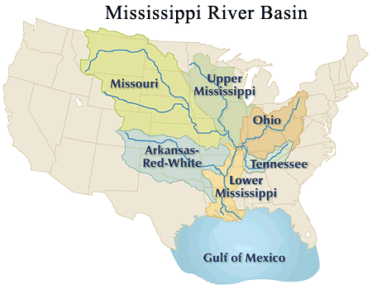
By 1850, Nearly all Native Americans
Lived WEST Of Mississippi River
400,000 by 1865
Still true , Present day

Slide 7
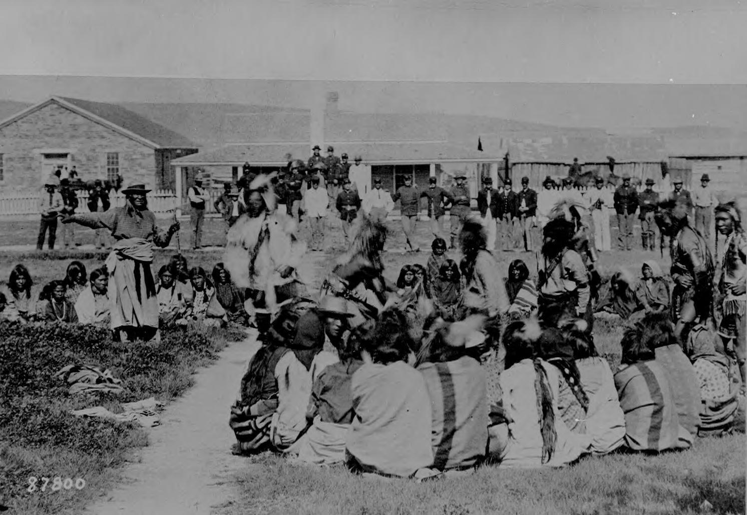
Oklahoma =
“Indian Territory”
Over 67 tribes represented
Various cultures, languages
Forced relocation Detrimental to cultural identity, preservation of languages

Slide 8
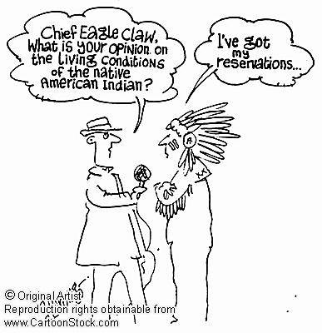
A “Reservation” is…
Land set aside
For “ownership” + use of Native American Tribes
Remote areas
Undesirable to white settlers

Slide 9
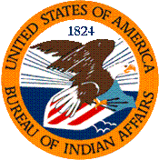
Bureau of Indian Affairs
“Indians who resist confinement on reservations will be dealt with by force”

Slide 10
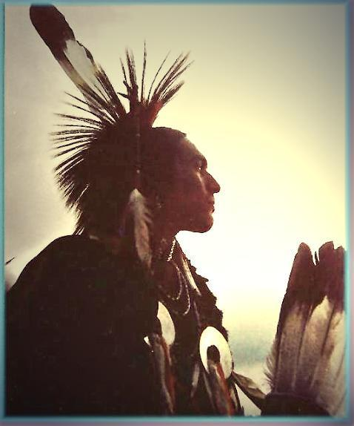
“Indian Wars”
End of Civil War to 1890
Constant warfare over territory + Broken promises

Slide 11
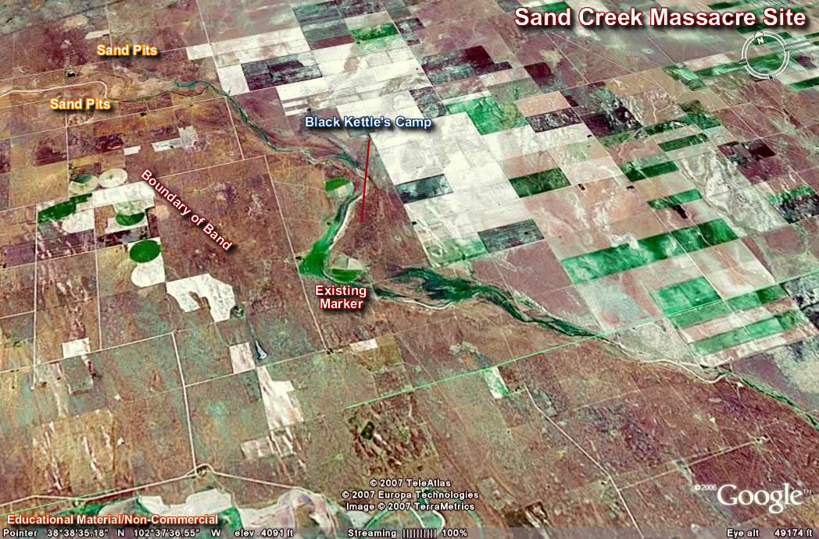
Sand Creek Massacre
Colorado, 1864
Cheyenne + Arapaho Indian camp
Chief Black Kettle thought he had Established peace

Slide 12
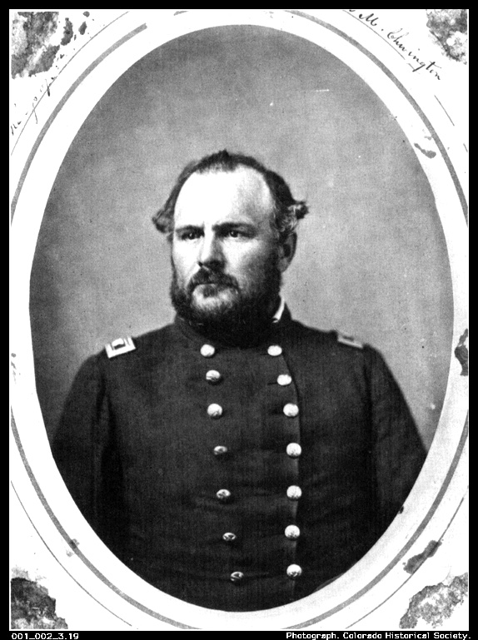
Col. John Chivington + 700 American Soldiers
Attacked Native American camp
While men were away hunting
For no reason…

Slide 13
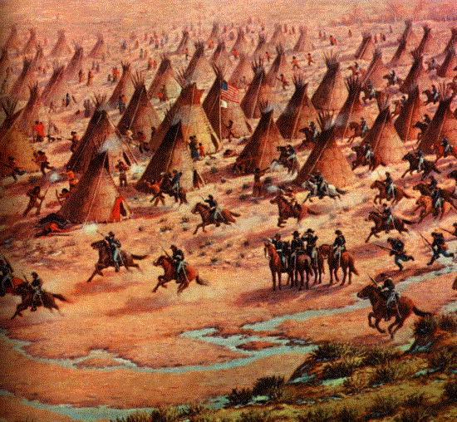
Sand Creek Massacre
200-400 of the camp’s Women, children, and elderly Attacked

Slide 14
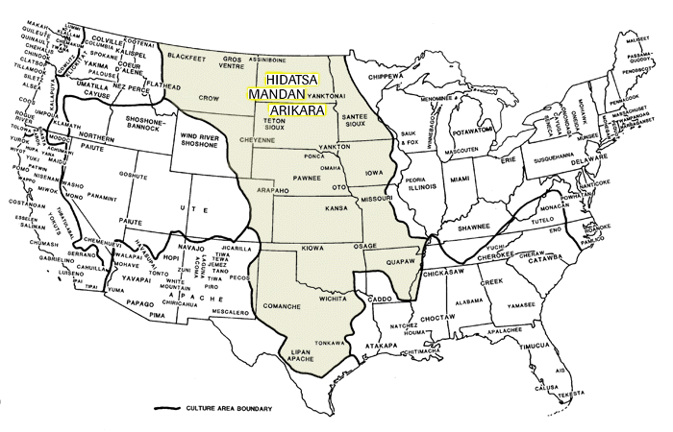
Plains Indians
Note: To print the map, set your browser's print settings to "landscape."

Slide 15
1866 Fetterman Massacre
Sioux blocked the construction of Bozeman Trail
Attacked civilians and soldiers
Including Captain William J. Fetterman

Slide 16
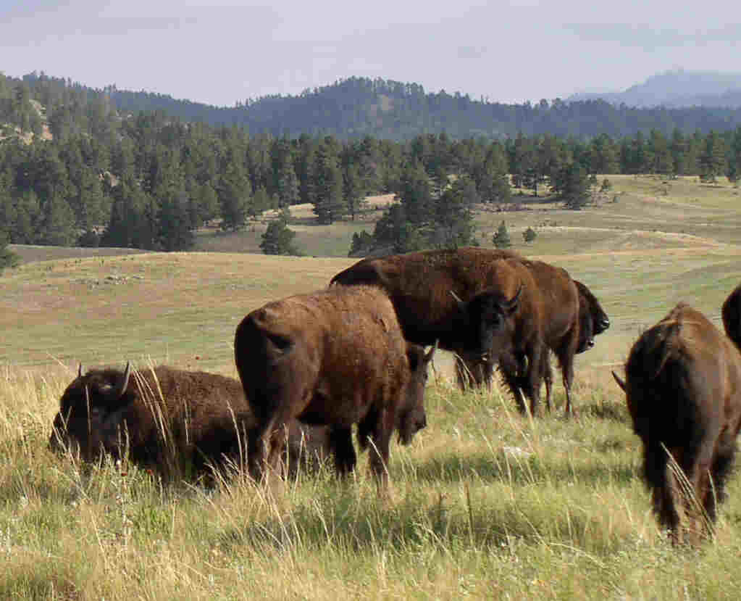
2nd Treaty of Fort Laramie
1868
Sioux agreed to move
To reservation
in Black Hills South Dakota/ Wyoming

Slide 17
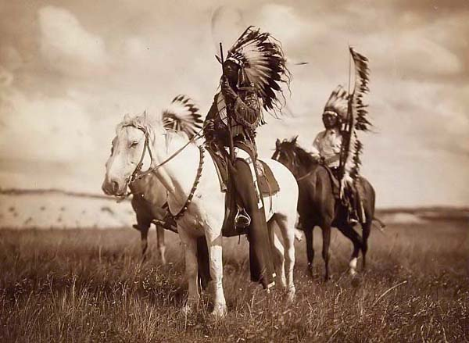
Sioux Betrayed
Gold found in Black Hills 1874
Govt. ordered Sioux to move ( again!)
1875 U.S. army arrived

Slide 18
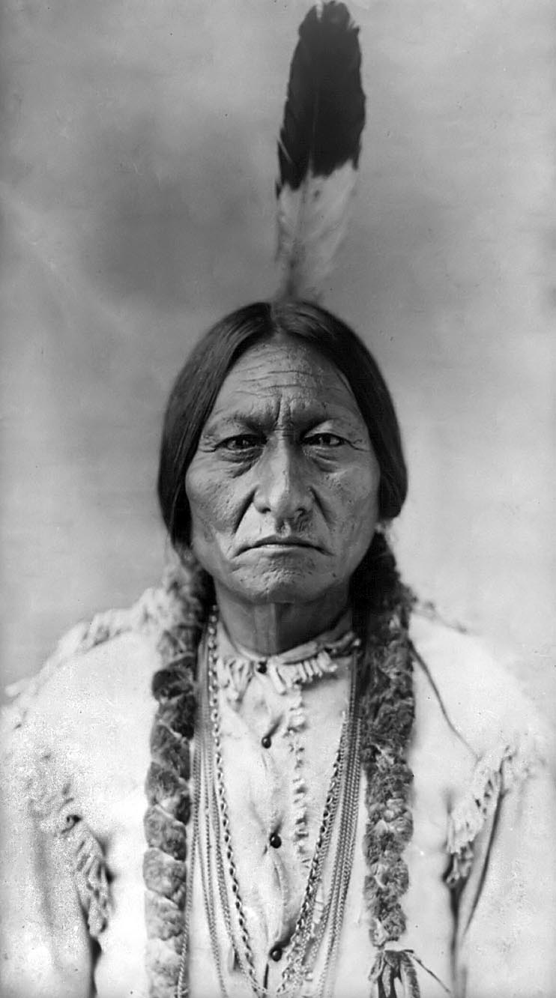
Chief Sitting Bull
Urged Sioux
To fight back & Resist order to move

Slide 19
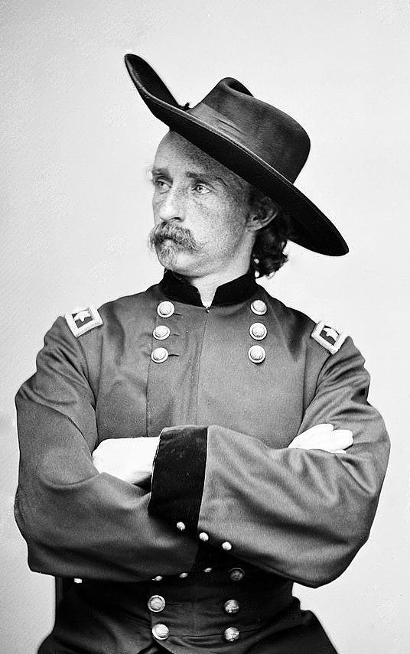
Gen. George Custer
Civil War Veteran
Image: “protecting white settlers from savages”

Slide 20
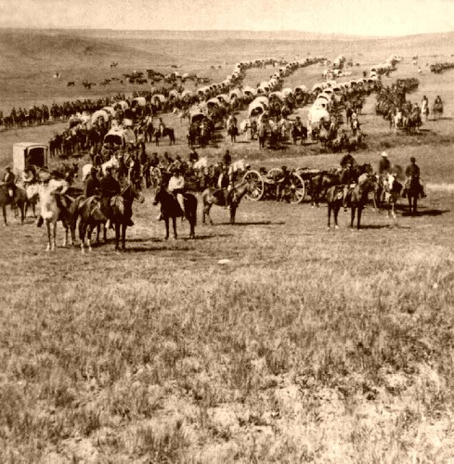
Battle of Little Bighorn, 1876
Native Americans win
Also known as “Custer’s last stand”
“worst American military disaster”

Slide 21
What Does This Statement Imply?
“ When whites wiped out Indians, the engagement (in American history books) was usually a ‘battle’ . When Indians wiped out whites, it was a ‘massacre’ .”
-pg.598

Slide 22
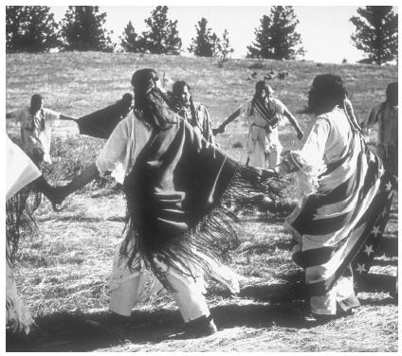
“Ghost Dance” Movement
Wovoka – founder
Taught:
“..that to bring about a renewal in their lives, culture and lands, they must change themselves inwardly by having only good thoughts about all men and at a deeper level about themselves “

Slide 23
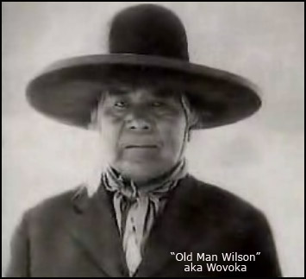
Wovoka’s Prophesy
White settlers would vanish
& Traditional ways of life would return

Slide 24
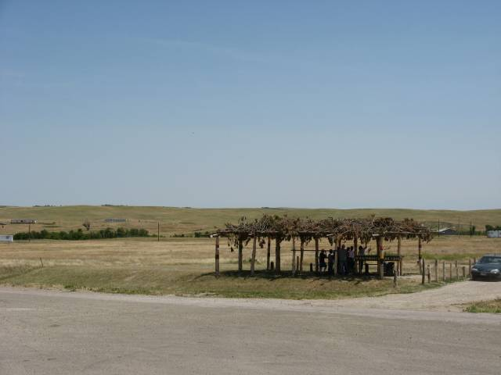
Wounded Knee, 1890
Govt. Interprets “Ghost Dance” as “resistance”
Troops sent to stop ritual
300 Native Americans die, 30 U.S. Soldiers

Slide 25
Destruction of Native American Culture
1. Dawes Act (1887) :
stripped tribes of official recognition & land rights
Lose land & tribal organization

Slide 26
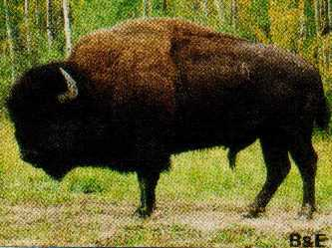
Destruction of Native American Culture
2. Killing of Buffalos
“every buffalo dead is an Indian gone”

Slide 27
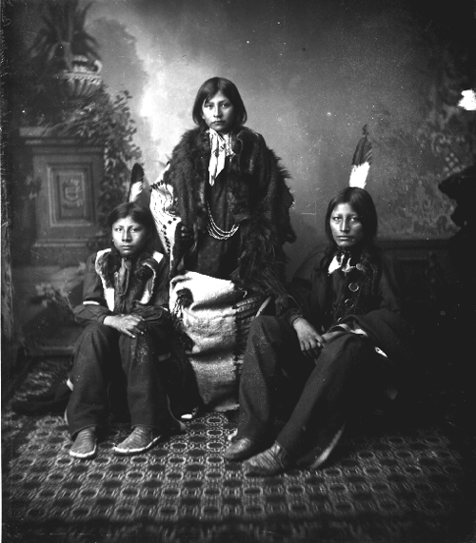
Destruction of Native American Culture
3. Assimilation -Govt. urged Native Americans to:
become farmers
Abandon culture
Look “American”

Slide 28
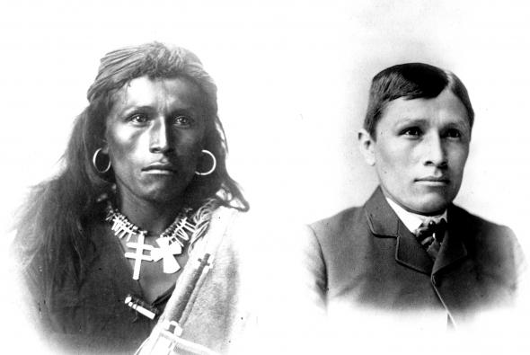
Stripped of land, Identity, & Culture
Carlisle Indian School
1.Forced to speak English
2. Adopt “American” names
3. Give up tribal ownership of land

Slide 29
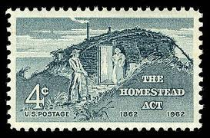
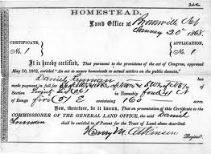
The Homestead Act , 1862
160 acres of land
Live & work land for 5 years
$10 filing fee
Myth- “abundance of free land for anyone willing to cultivate it”

Slide 30
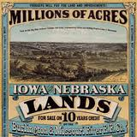
Railroad Companies
Needed people to develop settlements along railways
(Pacific Railway Act, 1862)
(Trans-continental Railroad ,1869)

Slide 31
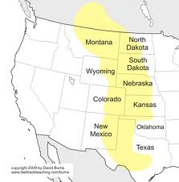
Westward Settlement
1865-1890’s Families moved to the Great Plains
West of Mississippi
From: Illinois, Iowa, Missouri
Also, European Immigrants

Slide 32
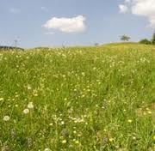
Realities of Settlement
Great Plains lack rainfall = dry, tough sod & treeless plains
Tough soil conditions /rough terrain
Iron plow pulled by oxen “ the plow that broke the plains”

Slide 33
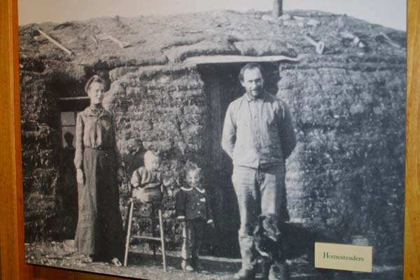
Realities of Settlement
“sodbusters”
Built sod (mud)homes – no trees!! Had to work within the confines of their new environment
Backbreaking work!
Tilling soil, planting crops, digging wells,

Slide 34
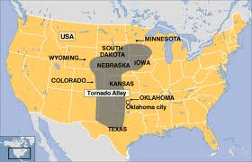
Realities of Settlement
Drought, hot summers, prairie fires,
Thunder storms , Tornados (Kansas/Nebraska)
Insect plagues: grasshoppers, Locust plague in 1874 devoured everything in its path!!
bedbugs, fleas, snakes!

Slide 35
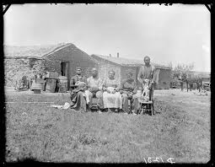
Realities of Settlement
1892 ½ of the homesteaders in Nebraska had given up and gone back east.
By 1900, 2/3rds of homesteads had failed

Slide 36
Future Consequences
Soil depletion
Excessive plowing, combined with heavy winds, contributed to the Dust bowl 1930’s

Slide 37
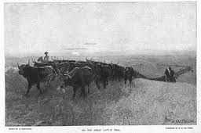
The Cattleman’s West, 1860-1890
Open Range cattle ranching
Cattle raised in Texas
shipped off to eastern markets in railcars
Big Business! Cattle ranchers bought cattle for $9 in Texas, sold them for $28 a head!

Slide 38
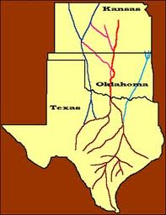
Overland Cattle Drives
The emergence of the “cowboy”
Job: to herd cattle from Texas to Northern Railroad
Pay $30 a month
Had to deal with cattle thieves, uncooperative weather, accidents on the job

Slide 39
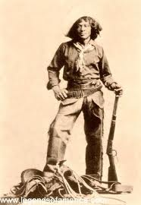
“Cowboy “ in Popular Culture
Cowboys romanticized in film
1/5 African American or Mexican
Dangerous job, didn’t pay well, but the freedom!!!
Nat Love – felt “wild, reckless, free… and afraid of nothing” ->

Slide 40
Turning Point
Early 1800’ s extreme cold weather followed by droughts
“Texas Fever” (disease spread by ticks) killed up to 90% of the cattle
Cattle ranchers went into debt, in some cases bankruptcy
The introduction of barbed wire/fencing interrupted cattle trails

Slide 41
Legacies
1. The Romanticized view of the West, Cowboy
2. The emergence of Cattle towns Abilene Kansas where cattle were shipped

Slide 42
Mining
  * Gold Rush 1849- California
  Colorado, Nevada, Montana, Idaho, Wyoming, South Dakota
  Alaska 1869
  “Mining towns” emerged- hastily built
  Young male population
  Diversity! Mining camps ethnic melting pots

Slide 43
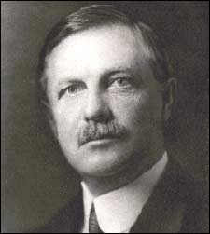
Frederick Jackson Turner
“Frontier Thesis”
Three Western Frontiers: Mining, Cattle, Farming
a crucial aspect of American identity & development
The frontier “transformed” individuals from European immigrants to “Americans”
Closing of “frontier” era: 1893

