Slide 1
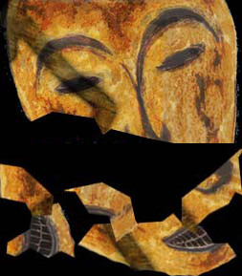
Things Fall Apart
By Chinua Achebe

Slide 2
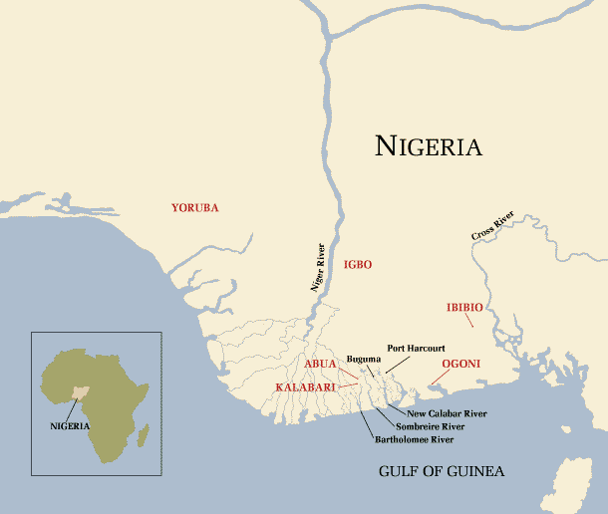
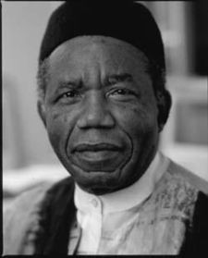
Chinua Achebe (Born in 1930)

Slide 3
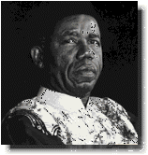
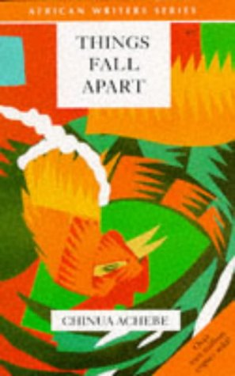
Chinua Achebe
A poet and novelist, one of the most important living African writers. The father of modern African literature.
Born in the Igbo (spelled Ibo) town of Ogidi in eastern Nigeria in 1930, the son of a missionary teacher who raised him as a Christian. Birth name—Albert Chinualumogu (short for Chinua) Achebe.
Thus, he received early education in English but grew up and surrounded by the complex blend of Igbo traditions & the colonial legacy.

Slide 4
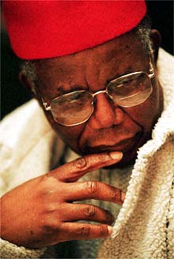
Chinua Achebe
At the university Achebe rejected his British name and took his indigenous name Chinua.
Achebe left his career in radio in 1966 as a result of the political conflicts which would lead to Nigerian civil war, Biafran War, in 1967.
A paraplegic from the waist down in a 1990 automobile accident, Achebe has lived in the United States since, teaching at Bard College.

Slide 5
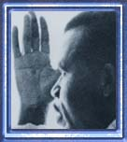
Style of Chinua Achebe
Achebe sought to convey a fuller understanding of one African culture and give voice to an under-represented and exploited colonial subject. (See Achebe's "An Image of Africa: Racism in Conrad's Heart of Darkness")
Mold the English language to the rhythm and lyrical quality of the Nigerian language: This style, and the incorporation of the proverbs and idioms of African culture, combine to mark his stories as uniquely African.
Achebe sees his role as a writer as one of social responsibility, since he believes that all good stories should have a purpose.

Slide 6
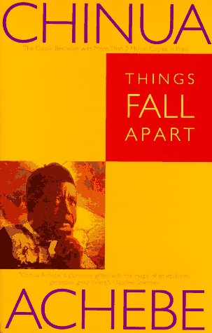
Works by Chinua Achebe
Things Fall Apart (1958)
No Longer at Ease (1960) describes poignantly the effects of European colonialism on Igbo society, Nigeria, and newly independent African nations.
Arrow of God (1964)
A Man of the People (1966)
Beware, Soul Brother (1971)
Chick and River (1966)
Morning Yet on Creation Day: Essays (1975)
The Trouble with Nigeria (1984)
Hopes and Impediments (1988)
Home and Exile (2000)

Slide 7
Achievements of Chinua Achebe
Awards & Honors:
Margaret Wrong Memorial Prize, 1959, for Things Fall Apart
Nigerian National Trophy, 1961, for No Longer at Ease
Jock Campbell/ New Statesman Award, 1965, for Arrow of God
Commonwealth Poetry Prize, 1972, for Beware, Soul Brother
Nigerian National Merit Award, 1979
Named to the Order of the Federal Republic of Nigeria, 1979

Slide 8
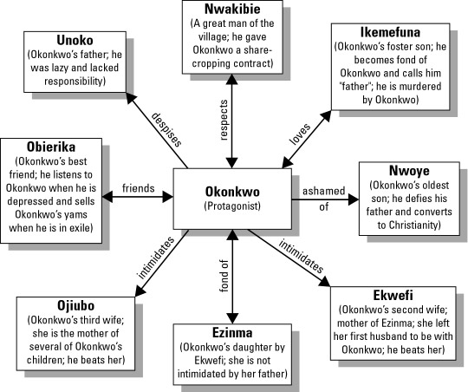
Introduction of Characters
source

Slide 9

Nwoye (Nuh-woh-yeh) Okonkwo’s oldest son, age twelve at the book’s beginning. He is innately a sensitive young man.
Ikemefuna (Ee-keh-meh-foo-nah) A boy of fourteen who is given to Umuofia, a neighboring village, to avoid war. He is a clever, resourceful young man.
Ezinma (Eh-zeen-mah) Daughter of Ekwefi and Okonkwo; Ekwefi’s only surviving child.

Slide 10
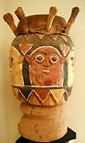
Obierika (Oh-bee-air-ee-kah) Okonkwo’s best friend, who often represents the voice of reason.
Mr. Brown The first white Christian missionary in Umuofia and Mbanta. An understanding and accommodating man, he is inclined to listen to the Igbos.
The Reverend James Smith A strict, stereotypical white Christian missionary, who takes over the church after Mr. Brown’s departure.

Slide 11
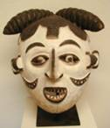
Okonkwo
(Oh-kawn-kwoh)
The central character of Things Fall Apart. A young leader of the African Igbo community of Umuofia (Oo-moo-oh-fee-ah); he is known as a fierce warrior as well as a successful farmer. He is determined to overcome the stigma left by his father’s laziness and wastefulness.

Slide 12

Theme
Turning and turning in the widening gyre
The falcon cannot hear the falconer;
Things fall apart; the center cannot hold;
Mere anarchy is loosed upon the world.
  -- W.B. Yeats: “The Second Coming”

Slide 13

Theme
“Achebe’s Things Fall apart, written with an insider’s understanding of the African world and its history, depicts the destruction of an individual, a family, and a culture at the
moment of colonial incursion.”
(Norton p.2616, line 8 from the bottom)

Slide 14
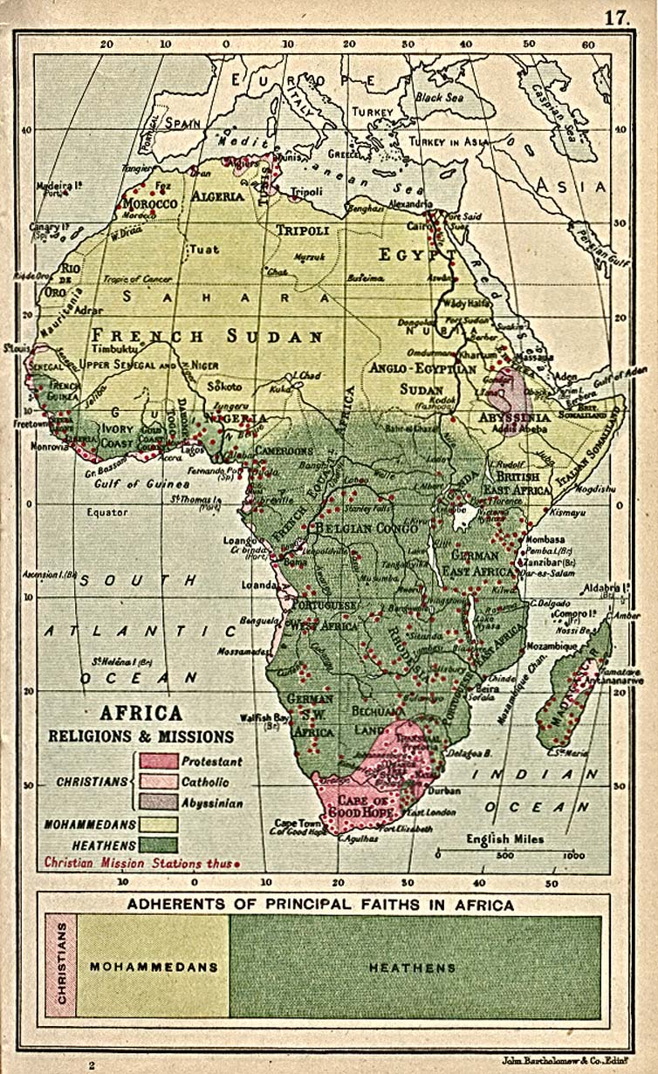
Theme
~ Understanding of the African
language of Igbo and many
traditional customs
~ A downfall of Okonkwo
- masculine

Slide 15
Theme
~The collapse of Okonkwo’s family
- Unoka, Okonkwo & his offspring
~The struggle between transition & tradition
-The tribesmen are caught between resisting
and embracing change and they face the
dilemma of trying to determine how best to
adapt to the reality of change.

Slide 16
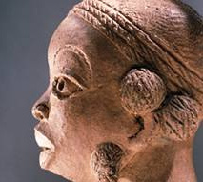
Short Summary
The bulk of the novel takes place in Umuofia, a cluster of nine villages on the lower Niger. Umuofia is a powerful clan, skilled in war and with a great population.
Nok (central Nigerian) terra-cotta head.
Source

Slide 17
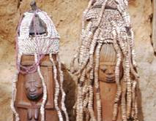
One day, a neighboring clan commits an offense against Umuofia. To avoid war, the offending clan gives Umuofia one virgin and one young boy. The boy, whose name is Ikemefuna, is to be sacrificed, but not immediately. He lives in Umuofia for three years, and he becomes like a part of Okonkwo's family. But eventually the Oracle calls for the boy's death, and a group of men take Ikemefuna away to kill him in the forest.
Source
Yoruban (southwestern Nigerian)
beaded crowns.

Slide 18
Later, during a funeral for one of the great men of the clan, Okonkwo's gun explodes, killing a boy.
In accordance with Umuofia's law, Okonkwo and his family must be exiled for seven years. Okonkwo flees with his family to Mbanto, his mother's homeland. There they are received by his mother's family, who treat them generously.
During Okonkwo's exile, the white man comes to both Umuofia and Mbanto. The missionaries arrive first, preaching a religion that seems mad to the Igbo people. However, with time, the new religion gains momentum.

Slide 19
Okonkwo returns to Umuofia to find the clan sadly changed. Worse, the white man's government has come to Umuofia. The clan is no longer free to judge its own; a District Commissioner judges cases in ignorance.
During a religious gathering, a convert unmasks one of the clan spirits. The offense is grave, and in response the clan decides that the church will no longer be allowed in Umuofia.
Soon afterward, the District Commissioner asks the leaders of the clan, Okonkwo among them, to come to him for a peaceful meeting. The leaders arrive, and are quickly seized, until the clan pays a heavy fine.

Slide 20
After a release of the men, the clan calls a meeting to decide whether they will fight or try to live peacefully with the whites.
During the meeting, court messengers come to order the men to break up their gathering. Enraged, Okonkwo kills the court messenger. The other court messengers escape, and because the other people of his clan did not seize them, Okonkwo knows his act of resistance will not be followed by others.
Embittered and grieving for the destruction of his people's independence, and fearing the humiliation of dying under white law, Okonkwo returns home and hangs himself.

Slide 21
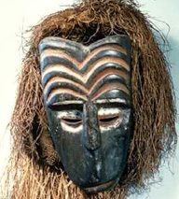
Igbo Customs in Things Fall Apart
Week of Peace: In Umuofia, a sacred week in which violence is prohibited.
Bride-price: money and property given to a prospective bride’s family by the prospective groom and his family.
Ikenga-- a carved wooden figure kept by every man in his shrine to symbolize the strength of a man’s right hand.
Polygamy: a man can marry more than one wife.
Nigerian yam-cult dance mask
Source

Slide 22
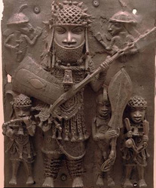
The Igbo week has four days: Eke, Oye, Afo, and Nkwo.
Osu: a class of people in Igbo culture considered outcasts, not fit to associate with free-born members of the clan.
Eating habits: The man of the house eats separately in his central hut; Yam is Igbo’s staple food.
Bronze plaque of Nigerian military figures.
Source

Slide 23
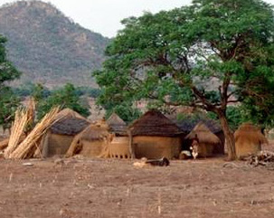
A Nigerian farm, possibly similar to that of Okonkwo.
Source: http://www.stfrancis.edu/en/student/achebe/chinua/igbo.htm

Slide 24
Study Questions
What's the purpose of using "The Second Coming" in Things Fall Apart?
Why did Okonkwo hang himself at the end of Things Fall Apart?
What makes Umuofia, the village, change during the seven years while Okonkwo has been in exile?
What’s Achebe’s purpose in using the traditional Igbo/African elements in the novel?
Do you consider Okonkwo a tragic hero? Please explain your argument.
Why couldn’t Okonkwo accept those white men and Christian? Please explain.

Slide 25
Works Cited and Consulted
“About the Novel: Introduction”. Cliffsnotes.com: Things Fall Apart by Chinua Achebe. 2000~2006. <http://www.cliffsnotes.com/WileyCDA/LitNote/id-133,pageNum-2.html>.
“Achebe”. Learnessays.com. 2003~2006. <http://www.learnessays.com/show_essay/126873.html>.
“Achebe, Chinua”. Encyclopedia.com. 6th ed. 2006. <http://www.encyclopedia.com/html/A/Achebe-C.asp>.
Achebe, Chinua. Things Fall Apart. The Norton Anthology of English Literature. Ed. M.H. Abrams, et al. 7th ed. Vol. 2. New York: Norton, 2000. 2617-2706.
“An Aspect of Chinua Achebe's Life”. Ian's Chinua Achebe Page: Links. <http://www.angelfire.com/ia/nmay/achebescholar.html>.
“Biography of Chinua Achebe (1930-)”. GradeSave.com. 1999~2006. 20 Apr. 2006 <http://www.gradesaver.com/classicnotes/authors/about_chinua_achebe.html>.
Brians, Paul. “William Butler Yeats: ‘The Second Coming’ (1921).” Chinua Achebe: Things Fall Apart Study Guide. 13 Dec. 2005. 20 Apr. 2006 <http://www.wsu.edu:8080/%7Ebrians/anglophone/achebe.html>.

Slide 26
“Chinua Achebe”. Wikipedia, The Free Encyclopedia. 11 Apr. 2006. <http://en.wikipedia.org/wiki/Chinua_Achebe>.
“Chinua Achebe (1930-) - in full Albert Chinualumogu Achebe”. Pegasos: Authors' Calenda Kirjailijakalenteri. 2000. 20 Apr. 2006 <http://www.kirjasto.sci.fi/achebe.htm>.
“Chinua Achebe's Biography and Style”. Melissa Culross add. Postcolonial and Postimperial Authors: Chinua Achebe: Biography. 5 Feb. 2002. 20 Apr. 2006 <http://www.thecore.nus.edu.sg/post/achebe/achebebio.html>.
“GradeSaver: ClassicNote: Things Fall Apart - Short Summary.” 12 Apr. 2006 <http://www.gradesaver.com/classicnotes/titles/things/shortsumm.html>
“Hidden Spaces, Silenced Practices and the Concept of IGBA N'RIRA.” 12 Apr. 2006 <http://www.westafricareview.com/vol3.2/nzegwu.html>
“Image: ChinuaAchebe.BC.jpg.” Wikipedia, The Free Encyclopedia. 26 Oct. 2005. 12 Apr. 2006 <http://en.wikipedia.org/wiki/Image:ChinuaAchebe.BC.jpg>.

Slide 27
Medan, Purwarno UISU. “Narrative Technique in Chinua Achebe's ‘Things Fall Apart’". Bookrags.com. 2000~2005. 20 Apr. 2006 <http://www.bookrags.com/essays/story/2005/11/30/213554/49>.
“Nigeria”. American Museum of Natural History. 1998. 12 Apr. 2006 <http://www.amnh.org/exhibitions/sokari/images/map1.gif>.
Nwangwu, Chido. “Achebe: Why I'm rejecting Nigeria's 2004 national honors from Obasanjo's government”. Usafricaonline.com. 16 Oct. 2004. 22 Apr. 2006 <http://www.usafricaonline.com/achebe.obasanjono.chido.html>
“Study Questions.” 2005 New Student Reading Project. Sep. 2005. 22 Apr. 2006 <http://www.westafricareview.com/vol3.2/nzegwu.html>.
“Term Paper on The Second Coming Vs, Things Fall Apart”. Term Papers Lab. 2006. 22 Apr. 2006 <http://www.termpaperslab.com/term-papers/22929.html>.
“Things Fall Apart Book Notes by Chinua Achebe: Author/Context”. Bookrags.com. 2000~2006. 22 Apr. 2006 <http://www.bookrags.com/notes/tfa/BIO.htm>.
“Things Fall Apart by Chinua Achebe: Context”. SparkNotes.com. 22 Apr. 2006 <http://www.sparknotes.com/lit/things/>.
“Who are the Igbo people?” 22 Apr. 2006
<http://www.stfrancis.edu/en/student/achebe/chinua/igbo.htm>.

