Slide 1
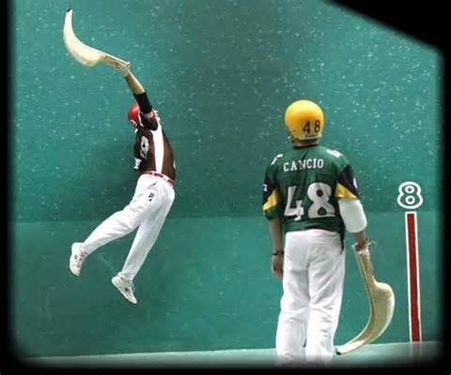
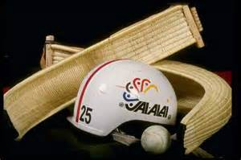
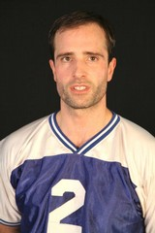
My favorite sport, Jai alai
I play jai alai. I play jai alai on a court. I play jai alai every Saturday. I play with my team from school. The equipment that I use is a basket, a helmet, a ball and a uniform.
My favorite player is Egi from Spain.
the court
the basket
the helmet
no padding
the ball

