Slide 1
Warm-up #7
Under the Articles of Confederation, how were taxes handled?
Why did this upset citizens?

Slide 2
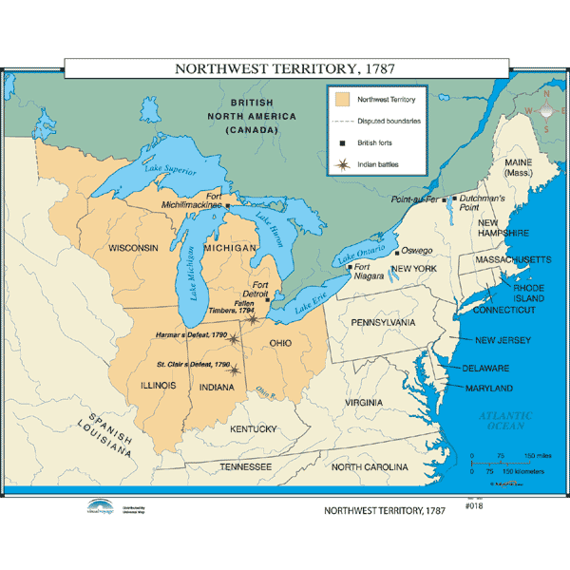

Slide 3

How was land divided after the establishment of the United States?

Slide 4
Academic Vocabulary Concept Maps
Land Ordinance of 1785– Divided the Northwest Territory into six by six mile townships with one square mile section reserved for schools. This was better then the old system of using natural barriers to determine where cities started and ended.
Northwest Ordinance 1787- Describes how the Northwest Territory was to be governed. When each territory had 60,000 white men living there, it could apply to become a state. Also made conditions for settlement 1) slavery outlawed but slaves already living there were not freed. 2) fugitives were to be returned. 3) rivers were open to navigation to all people. 4) freedom of religion and trial by jury were guaranteed.

Slide 5

Northwest Ordinance of 1787
Made the rules for becoming a state.
Ruled by federally appointed governor.
60,000 people = apply for statehood, and write constitution.
Becomes equal to the original 13 states.
Created five new states.
A success of the Continental Congress (government created by the Articles of Confederation)

Slide 6
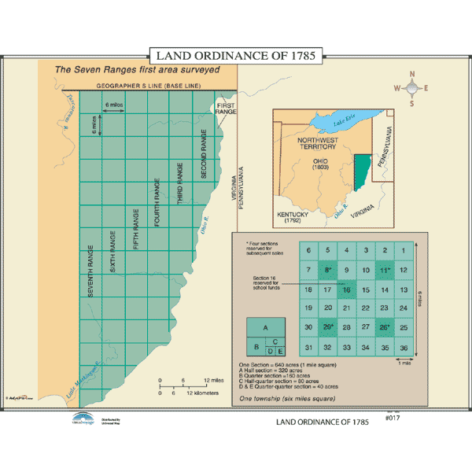

Slide 7

Homework
Revolution Title Page
Prep for notebook check

