Slide 1
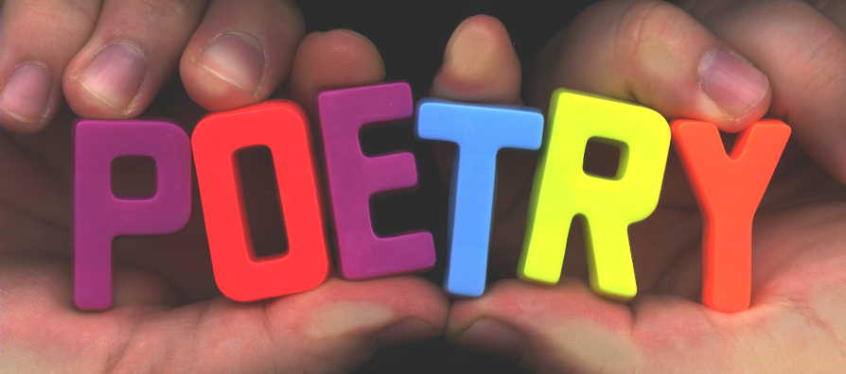
Poetry Terms
Time to test your knowledge

Slide 2
Poetry Forms Terms
Term | Definition
1. ballad | A. A poem of mourning or melancholy
2. sonnet | B. A long narrative poem, usually in praise of a hero
3. elegy | C. A song-like poem that typically includes a refrain
4. ode | D. A poem with either an octave/sestet or 3 quatrains and a couplet
5.epic | E. A poem in praise of an object

Slide 3
Poetry Forms: Answers
Term | Definition
1. ballad | C. A song-like poem that typically includes a refrain
2. sonnet | D. A poem with either an octave/sestet (Petrarchan) or 3 quatrains and a couplet (Shakespearean)
3. elegy | A. A poem of mourning or melancholy
4. ode | E. A poem in praise of an object
5.epic | B. A long narrative poem, usually in praise of a hero

Slide 4
Figurative Devices
Terms | Definitions
1. paradox | A. A poem addressed to a person who is not present
2. hyperbole | B. Human characteristics attributed to non-human things
3. metaphor | C. Seemingly contradictory statement that is nevertheless true
4. simile | D. Comparison of two seemingly unlike things for dramatic effect
5. allusion | E. Exaggeration for effect; overstatement
6. personification | F. Substitution of the part for the whole
7. synecdoche | G. Reference to well-known literature or history
8. apostrophe | H. Comparison using like or as

Slide 5
Figurative Devices: Answers
Terms | Definitions
1. paradox | C. Seemingly contradictory statement that is nevertheless true
2. hyperbole | E. Exaggeration for effect; overstatement
3. metaphor | D. Comparison of two seemingly unlike things for dramatic effect
4. simile | H. Comparison using like or as
5. allusion | G. Reference to well-known literature or history
6. personification | B. Human characteristics attributed to non-human things
7. synecdoche | F. Substitution of the part for the whole (“steel” instead of “sword”)
8. apostrophe | A. A poem addressed to a person who is not present

Slide 6
Poetic Elements
Terms | Definitions
1. meter | A. A 2-syllable foot (stress/unstress: never, happy, cranky)
2. iamb | B. A 3-syllable foot with the stress on the first syllable: happiness
3. trochee | C. A 2-syllable foot with stresses on both syllables: childhood
4. anapest | D. A line of poetry with 5 feet (10 syllables)
5. dactyl | E. A 2-syllable foot (unstress/stress: below, amuse, delight)
6. spondee | F. A line of poetry with 4 feet (8 syllables)
7. tetrameter | G. A pattern of stressed and unstressed syllables in a poem
8. pentameter | H. A 3 syllable foot with the stress on the last syllable: Cavalier

Slide 7
Poetic Elements: Answers
Terms | Definitions
1. meter | G. A pattern of stressed and unstressed syllables in a poem
2. iamb | E. A 2-syllable foot (unstress/stress: below, amuse, delight)
3. trochee | A. A 2-syllable foot (stress/unstress: never, happy, cranky)
4. anapest | H. A 3 syllable foot with the stress on the last syllable: Cavalier
5. dactyl | B. A 3-syllable foot with the stress on the first syllable: happiness
6. spondee | C. A 2-syllable foot with stresses on both syllables: childhood
7. tetrameter | F. A line of poetry with 4 feet (8 syllables)
8. pentameter | D. A line of poetry with 5 feet (10 syllables)

Slide 8
Devices of Sound
Terms | Definitions
1. end rhyme | A. Repetition of initial consonant sounds
2. internal rhyme | B. Repetition of vowel sounds
3. alliteration | C. Similarity of sound occurring in the same line of verse
4. assonance | D. The use of a word to imitate a sound
5. onomatopoeia | E. Repetition of consonant sounds within a line of verse
6. consonance | F. Similarity occurring at the end of two or more lines of verse
7. refrain | G. Repetition of one or more phrases or lines at intervals in a poem

Slide 9
Devices of Sound: Answers
Terms | Definitions
1. end rhyme | F. Similarity occurring at the end of two or more lines of verse: This walking around/Without touching the ground
2. internal rhyme | C. Similarity of sound occurring in the same line of verse: Once upon a midnight dreary, while I pondered weak and weary
3. alliteration | A. Repetition of initial consonant sounds: Five miles meandering in a mazy motion
4. assonance | B. Repetition of vowel sounds: Hear the mellow wedding bells
5. onomatopoeia | D. The use of a word to imitate a sound: sizzle, crunch, fizz
6. consonance | E. Repetition of consonant sounds within a line of verse: He struck a streak of bad luck
7. refrain | G. Repetition of one or more phrases or lines at intervals in a poem

Slide 10
Reading poetry on the AP Test
Read the poem freely, calmly, and correctly – read the SENTENCES, not the lines
Read it a second time, paraphrasing as you go
Read it a third time, noting:
Any figurative devices
Diction that seems important or suggestive
Images that create a particular mood or feeling
Any repetition of words or phrases
Purpose/theme – state the main idea/theme in a phrase or sentence

Slide 11
Reading Poetry: SO WHAT?
4. It’s not enough to note the devices; in fact, it’s VERY BORING!
A. How do figurative devices work? How do they relate to the poem and its theme?
B. What is suggested by the diction?
C. What is the effect of the images? How do they relate to the poem and its theme?
D. Why are the words/phrases repeated? Effect? Purpose?
E. After carefully thinking about A-D: Does your theme still hold? Remember: themes are complex and multi-dimensional. They are NOT simple morals or judgments

Slide 12
Writing Tips
Avoid wasting words. Focus on your essential discoveries in your intro.
Do NOT cherry pick! Look at the poem as a whole. Look for possible IRONY.
Quote, but avoid lengthy quotes. Use parts that capture the essence of the poet’s voice to help prove your points.
DO NOT paraphrase or summarize unless absolutely necessary. Focus on effects, intents, and meaning (the how and why more than the what!)
Rhyme scheme is NOT usually something worth writing about!

