Slide 1
Video #1 Notes:
Bureau of Indian Affairs:

Slide 2
Video Notes:
Why did the Natives fight back?
What were some of the results of natives resisting and fighting U.S. government policies?

Slide 3
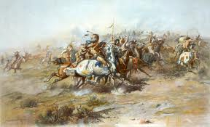
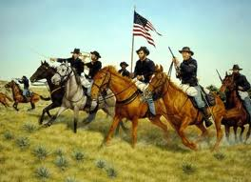
The Battle of Little Bighorn
Focus Question: Who was responsible for the Battle of Little Bighorn?

Slide 4
Introduction Notes:
In the decades following the Civil War, the United States engaged in a number of conflicts with Native American tribes living west of the Mississippi. Some historians refer to these conflicts as “The Indian Wars.”
The primary issue of the Indian Wars was land. The United States government made several treaties with Native American tribes to define Indian lands. However, as ever increasing numbers of Americans moved through, and sometimes settled on, Native American territory, these treaties were often ignored or broken by the government.

Slide 5
Native Americans fought the United States for decades. They were ultimately overwhelmed by the superior numbers and weapons technology of the United States Army. Though on several occasions Native Americans defeated American troops in individual battles. One of the most famous of those Native American victories occurred at the Battle of Little Bighorn in Montana.

Slide 6
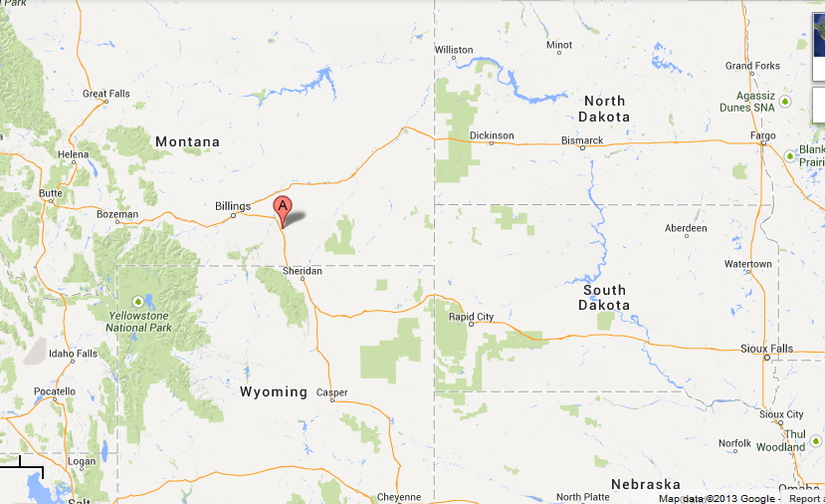

Slide 7
Today we are going to look at three different documents related to the Battle of the Little Bighorn: a textbook version of the battle; a letter to the President from the Secretary of War a month after the battle; and the recollections of a Native American woman about the battle from 1922.
Our job is to analyze these sources and draw evidence from them in order to answer the question:
Who was responsible for the Battle of the Little Bighorn?

Slide 8
Document 1: Textbook excerpt
Directions:
  Read and highlight main information
  Answer the guiding questions

Slide 9
Documents 2 and 3: Cameron Report and Kate Bighead Interview
Directions:
  Read
  Answer the questions

