Slide 1
Directions
Write down the homework in your planner
Check your STAR paper with your reading log, make sure the levels match
Have a pen/pencil ready

Slide 2
Plot Posters
Must have the basic shape of the plot diagram
Must label the 5 steps of plot
Must describe each step of plot in complete sentences
You may use the definitions, or tell me about your favorite movie, book, or show using the plot. You may also use the Little Red story as your example.
Other:
Must be colorful (or extremely detailed if it is black and white)
Must be neat, quality work
Due Tuesday at the end of class.

Slide 3
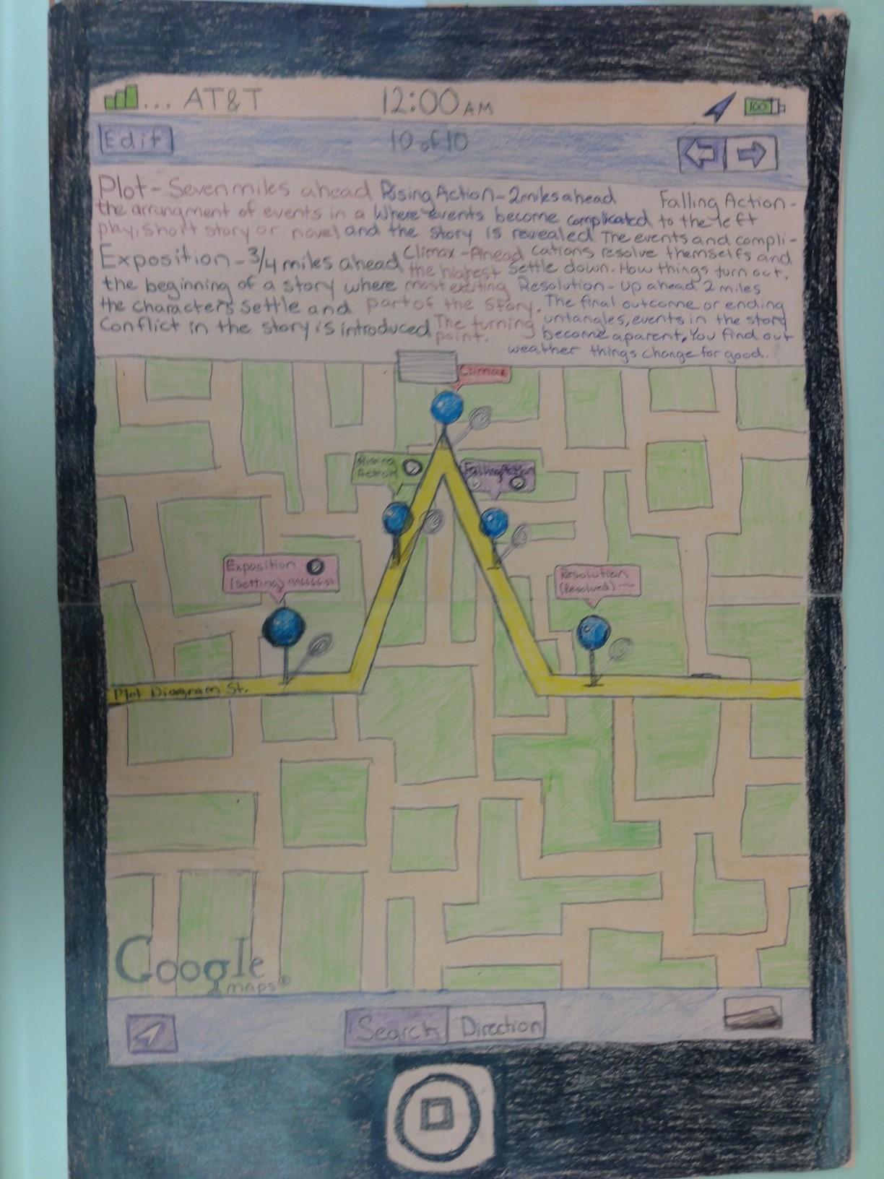

Slide 4
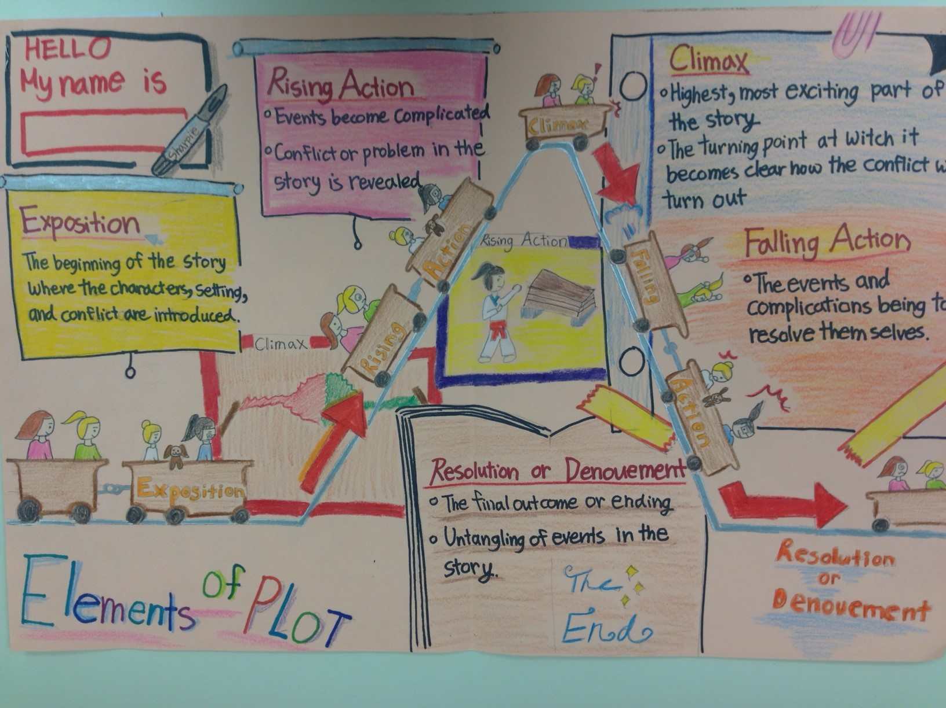

Slide 5
