Slide 1
Protein Synthesis: Translation and Transcription
EQ: What is the Central Dogma and what processes does it involve?
Describe processes

Slide 2
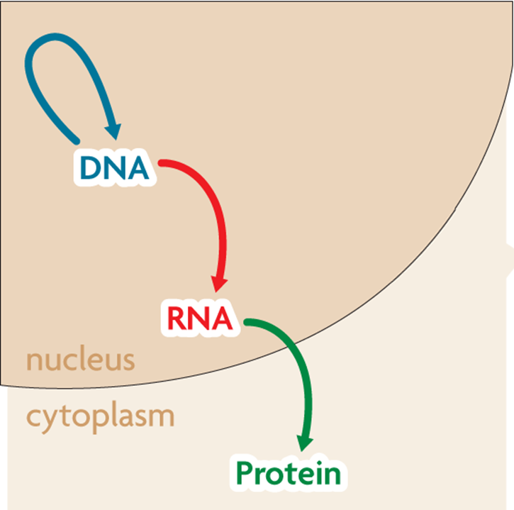
Central Dogma
Transcription converts a gene into a single-stranded RNA molecule
RNA carries DNA’s instructions out of the nucleus
The central Dogma states that information flows in one direction from:
DNA RNA Protein

Slide 3
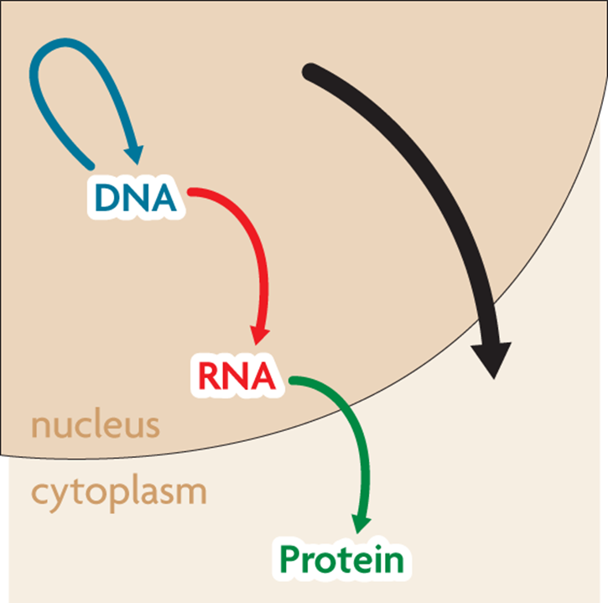



Central Dogma
The central dogma includes three processes:
Replication
Transcription
Translation
RNA is a link between DNA and proteins

Slide 4
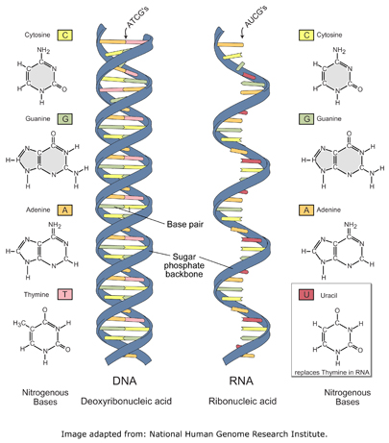
RNA
RNA differs from DNA in three major ways.
RNA has a ribose sugar while DNA has Deoxyribose
RNA has uracil instead of thymine found in DNA
RNA is single stranded while DNA is double stranded

Slide 5
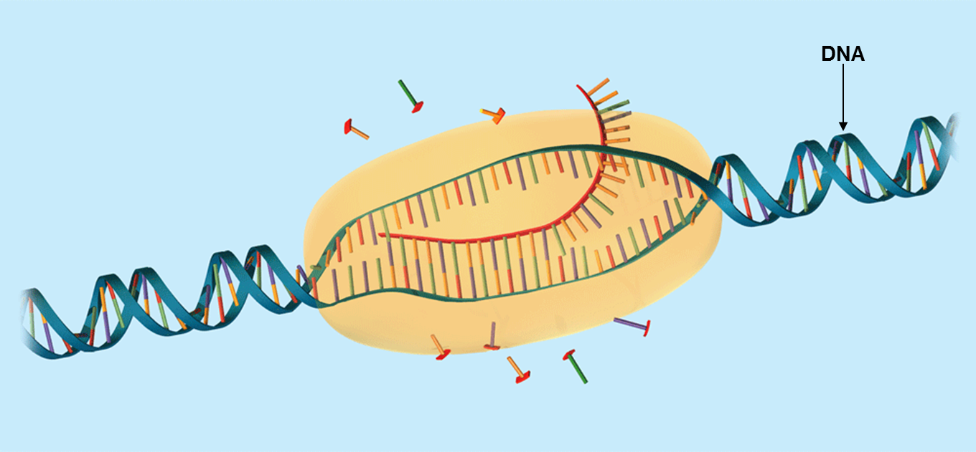
Transcription
Transcription copies DNA to make a strand of RNA
RNA being transcribed

Slide 6
Transcription
Transcription makes three types of RNA
Messanger RNA (mRNA) carries the message that will be translated to form a protein
Ribosomal RNA (rRNA) forms part of ribosomes where proteins are made
Transfer RNA (tRNA) brings amino acids from the cytoplasm to a ribosome.

Slide 7
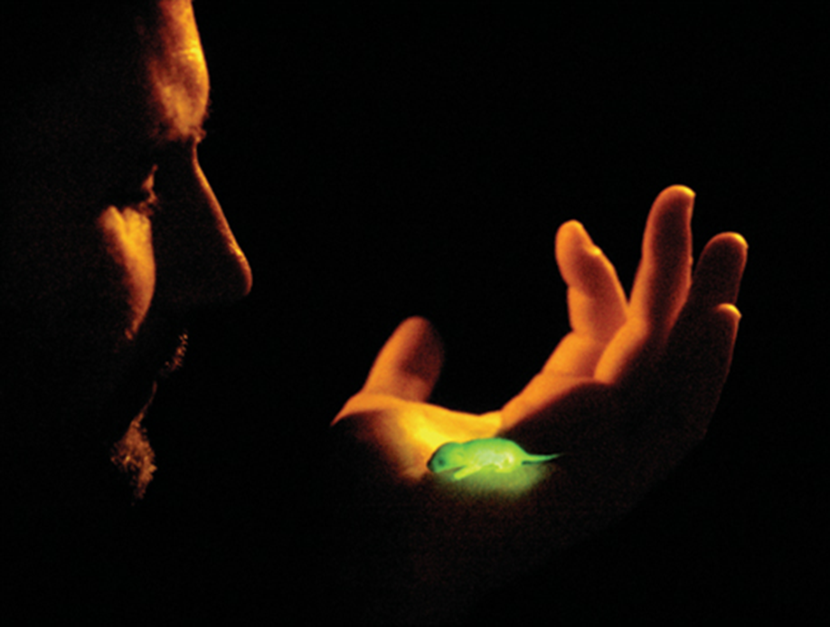
Translation
Translation coverts an mRNA message into a protein

Slide 8
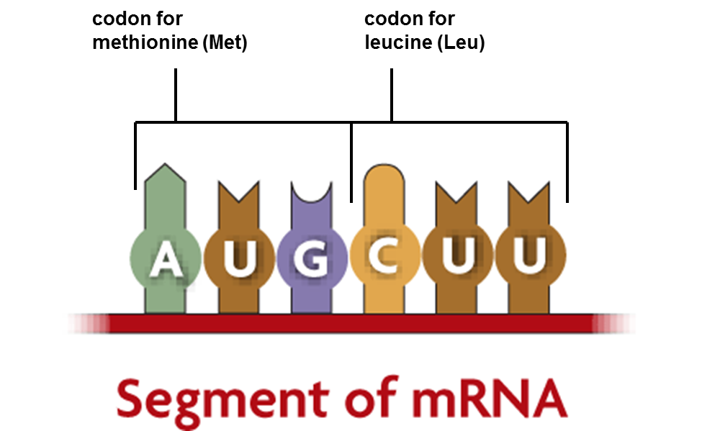
Translation
Amino acids are coded by mRNA base sequences
Translation converts mRNA messages into proteins
A codon is a sequence of 3 nucleotides that code for an amino acid

Slide 9
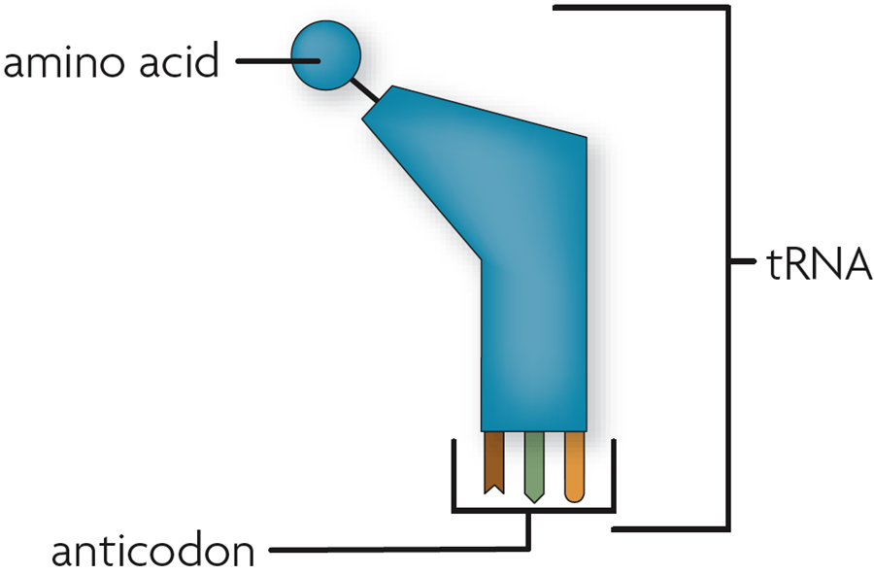
Translation
Amino acids are linked to become a protein
An anticodon is a set of three nucleotides that is complementary to an mRNA codon.
An anticodon is carried by a tRNA

Slide 10
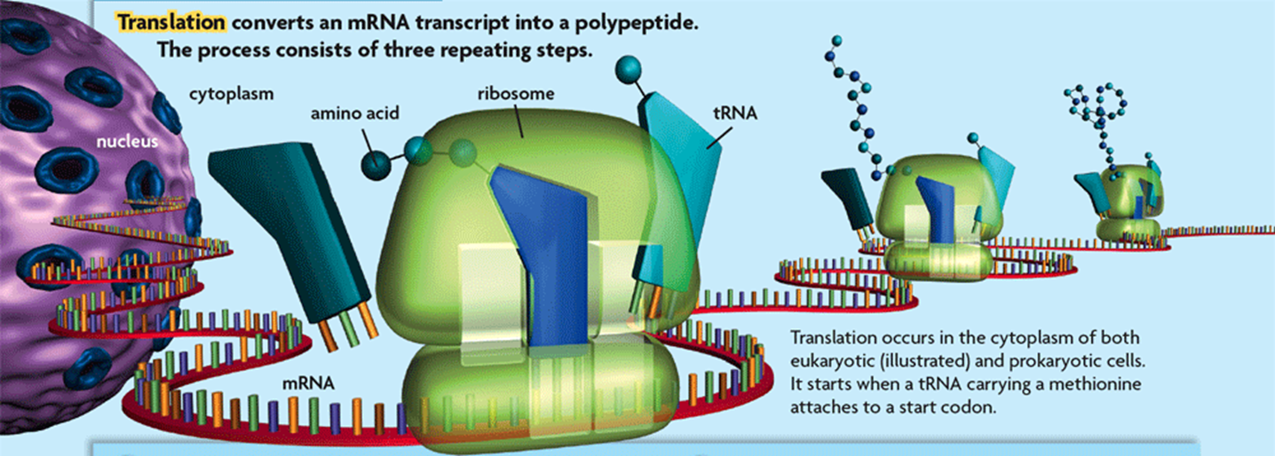
Translation
Translation occurs at the ribosome
For translation to begin, tRNA must bind to a corresponding codon. Ex. tRNA anticodon – UAC binds with mRNA codon AUG
Then attaches amino-acid to form a protein

Slide 11
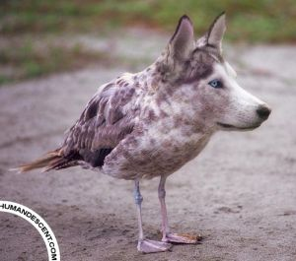
Mutation
Mutations are changes in DNA that may or may not affect an organisms traits and expression of genes

Slide 12
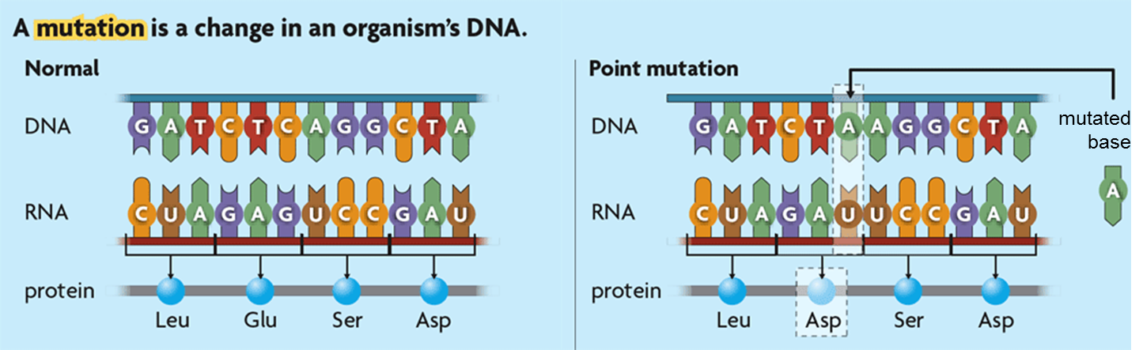
Mutations
Some mutations affect a single gene, while others affect an entire chromosome
A mutation is a change in an organism’s DNA
Many kinds of mutations can occur, especially during replication
A point mutation substitutes on nucleotide for another

Slide 13
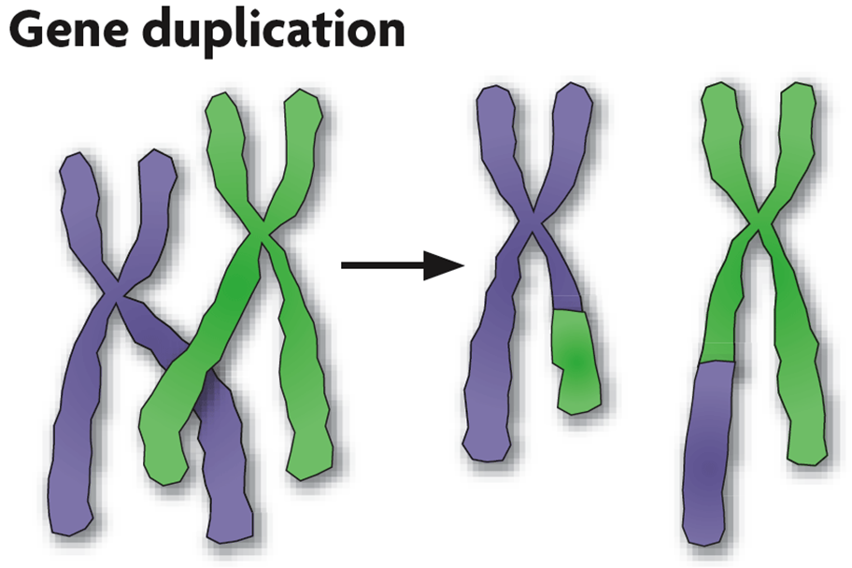
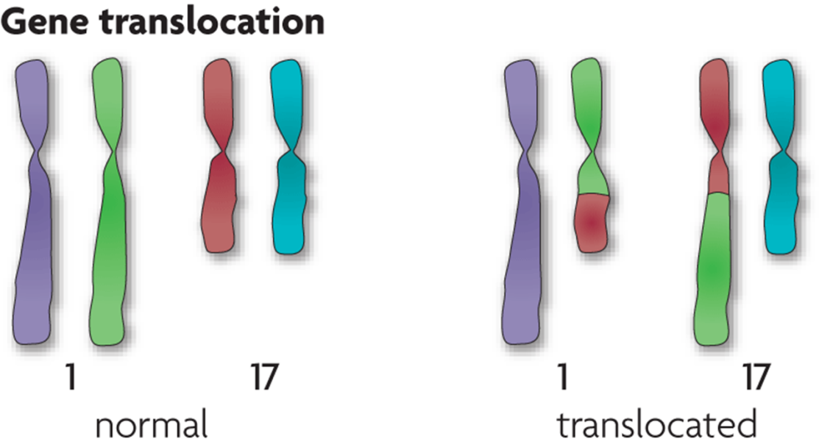
Mutations
Chromosomal mutations affect many genes
Chromosomal mutations may occur during meiosis

Slide 14
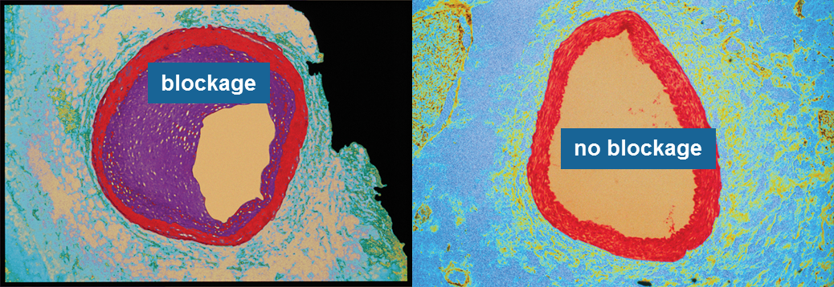
Mutations
Mutations may or may not affect expression of genes
Chromosomal mutations tend to have a big effect
Some gene mutations change gene expression
A mutation may change protein shape
Some gene mutations do not affect gene expression

Slide 15
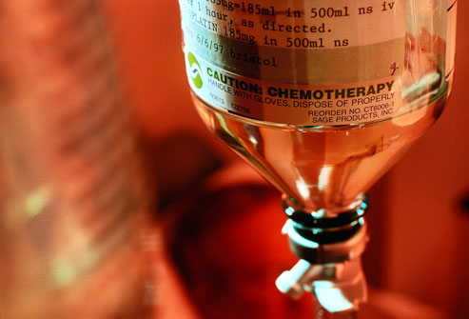

Mutations
Mutations can be caused by several factors
Replication errors can cause mutations
UV rays and chemicals can cause mutations
Some cancer drugs use these properties to kill cancer cells.
e.g. radiation treatment or chemotherapy

