Slide 1
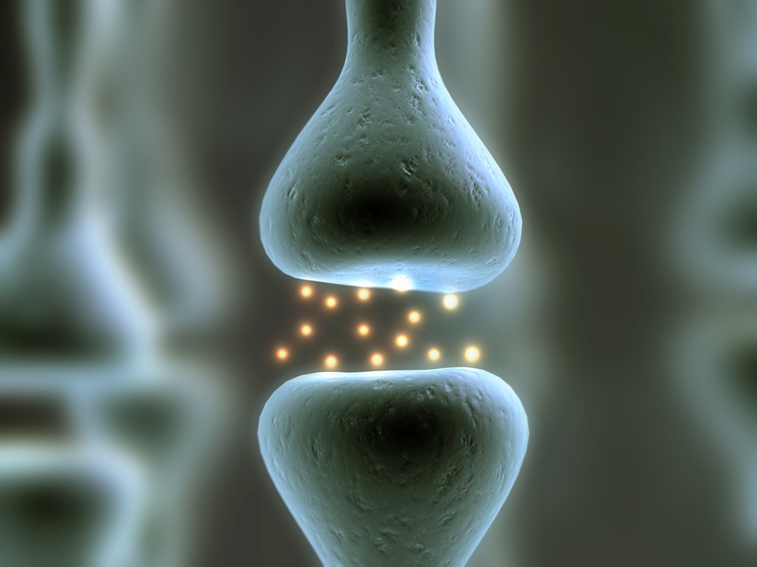
Nervous System
CORE 6.5.1-6.5.6, OPTION E1, E2, E4

Slide 2
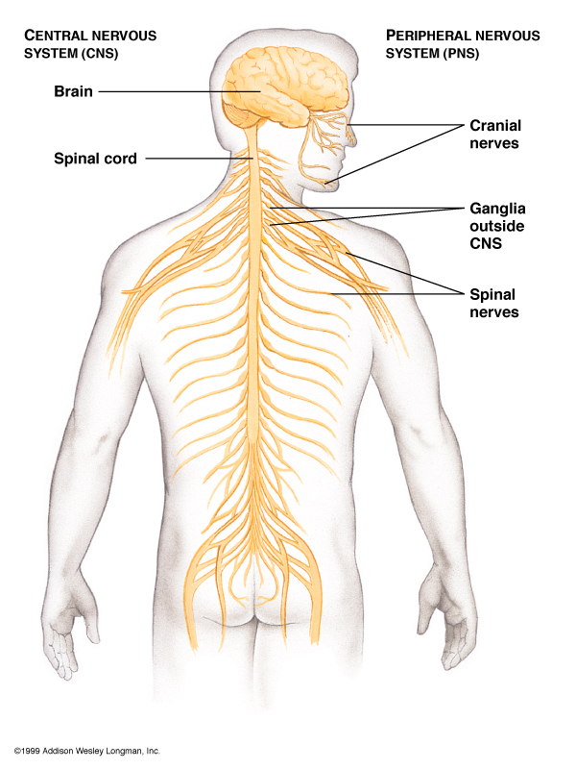
6.5.1 State that the nervous system consists of the central nervous system (CNS) and peripheral nerves, and is composed of cells called neurons that can carry rapid electrical impulses.
The Nervous System allows organisms to
It consists of:
Brain and spinal cord –
Sensory Receptors & Peripheral Nerves –
– functional unit of the nervous system; specialized cells for transmitting electrical and chemical signals

Slide 3
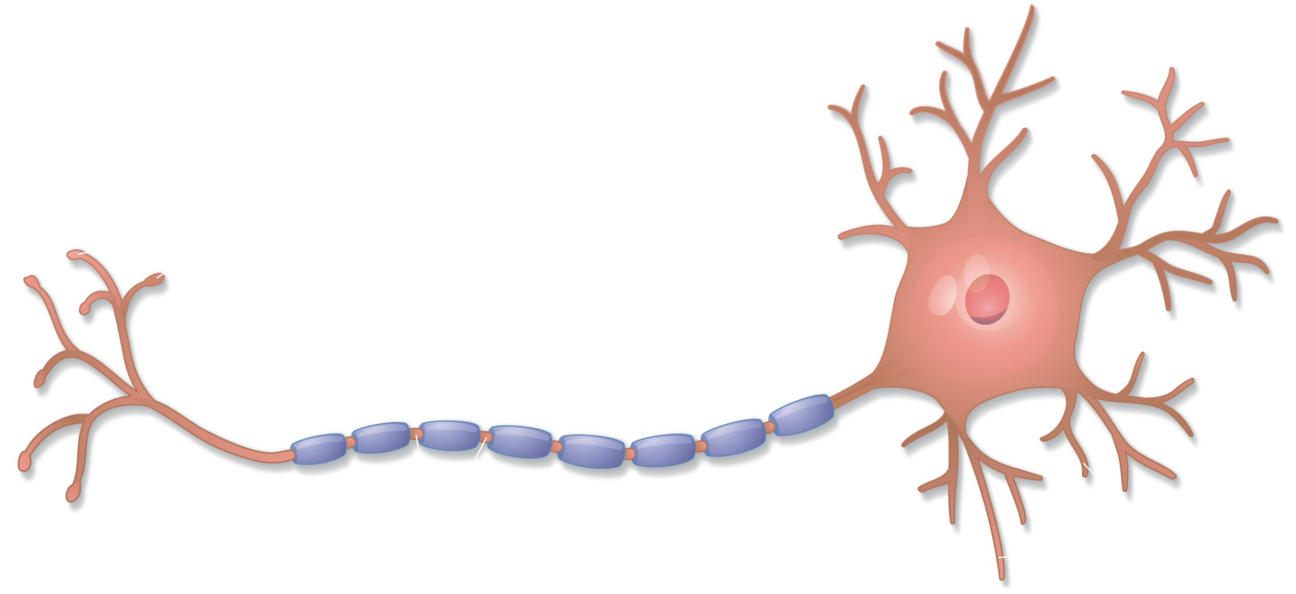
Anatomy of a Nerve Cell:
Cell body –
Dendrites and axon extend from the cell body
Dendrites – short and highly branched
Dendrites
Cell body

Slide 4
Anatomy of a Nerve Cell:
Axon –
Microscopic in diameter but may extend a meter or more in length
May divide forming branches –
Divides at the end to form – in motor neurons these are called and send messages to muscles
Synaptic terminals release (chemicals) (gap between neurons)

Slide 5
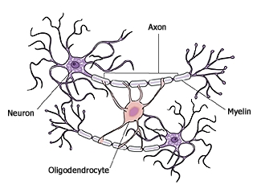
6.5.1 State that the nervous system consists of the central nervous system (CNS) and peripheral nerves, and is composed of cells called neurons that can carry rapid electrical impulses.
Myelin Sheath –
Composed of Schwann cells that form insulation
– gaps between Schwann cells
Oligodendrocyte is a neuroglia cell in CNS

Slide 6
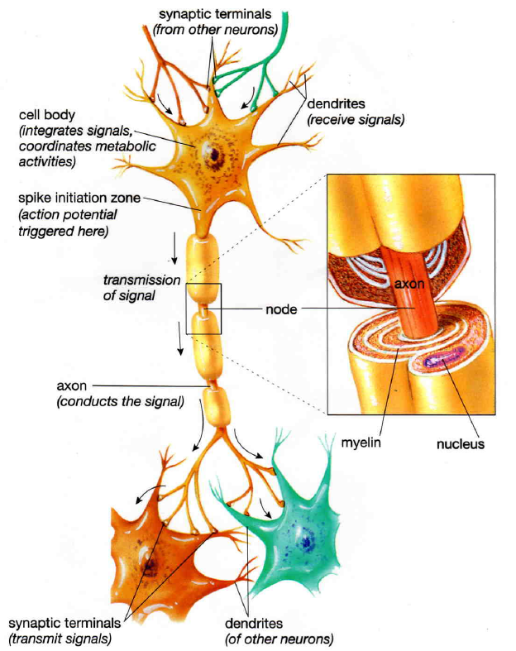
6.5.2 Draw and label a diagram of the structure of a motor neuron
In Motor neurons these are called motor end plates
Notes:
Include dendrites, cell body with nucleus, axon, myelin sheath, nodes of Ranvier and motor end plates

Slide 7
Outside the CNS:
Nerves consist of
Cell bodies are usually grouped together in masses called
In the CNS:
Bundles of axons are called instead of nerves
Collection of cell bodies are called

Slide 8
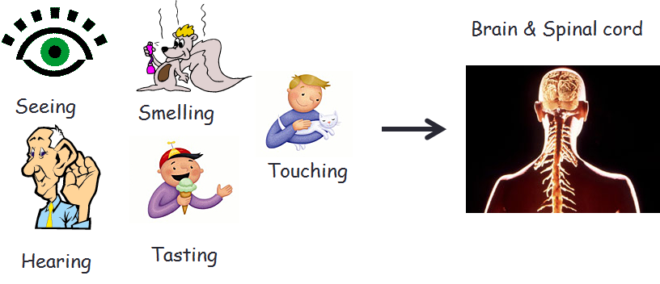
6.5.3 State that nerve impulses are conducted from receptors to the CNS by sensory neurons, within the CNS by relay neurons, and from the CNS to effectors by motor neurons.
Types of Neurons:
– conduct impulses into CNS from the periphery (sensory impulses)
Pick up stimulus from sensory receptors – mechanoreceptors, chemoreceptors, thermoreceptors, photoreceptors

Slide 9
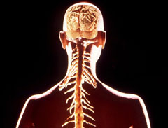
6.5.3 State that nerve impulses are conducted from receptors to the CNS by sensory neurons, within the CNS by relay neurons, and from the CNS to effectors by motor neurons.
– afferent neurons usually transmit impulses to interneurons
Located within
Neurons that integrate input and output
Integration involves
Forms connecting lines between sensory and motor neurons
Brain & Spinal cord

Slide 10
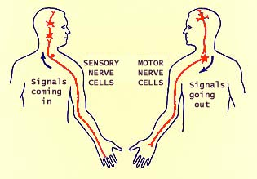
6.5.3 State that nerve impulses are conducted from receptors to the CNS by sensory neurons, within the CNS by relay neurons, and from the CNS to effectors by motor neurons.
– transmit messages from CNS to effectors (muscle or gland)
Sensory receptors, afferent and efferent neurons are part of the
Afferent
Efferent
http://www.siumed.edu/~dking2/ssb/neuron.htm#4b

Slide 11
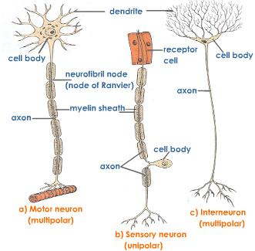
Multipolar = many extensions that branch into dendrites
Unipolar = one extension
http://www.tutorvista.com/content/biology/biology-iv/nervous-coordination/neurons-types.php

Slide 12
Organization of the Nervous System

Slide 13
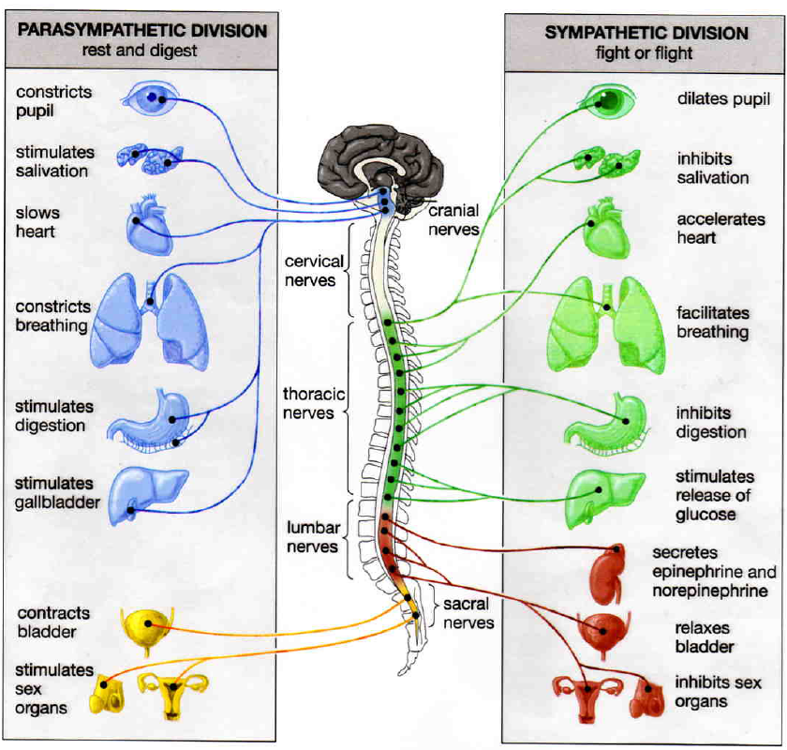
PNS
Motor Division
Autonomic NS
Sypathetic & Parasympathetic Divsions:

Slide 14
6.5.4 Define resting potential and action potential (depolarization and repolarization).
Membrane potential is the
Resting potential is the .
Slight excess of positive ions outside the membrane and slight excess of negative ions inside the membrane
Resting potential is normally about (mV)
Membrane of neuron is due to unequal distribution of ions – as a result, the cell can produce an action potential (impulse)

Slide 15
6.5.4 Define resting potential and action potential (depolarization and repolarization).
Depolarization is
Action potential is the .
Repolarization is .

Slide 16
6.5.5 Explain how a nerve impulse passes along a non-myelinated neuron.
Na+ concentration is the cell and K+ concentration is
Ion pumps, ion channels and gates cause a specific distribution of ions across the cell membrane
Sodium-potassium pumps in the membrane
K+ tends to through ion channels causing further negative charge inside as compared to outside of cell
Ion channels that allow the passage of Na+ are closed at resting potential
Notes:
Include the movement of Na+ and K+ ions to create a resting potential and an action potential

Slide 17
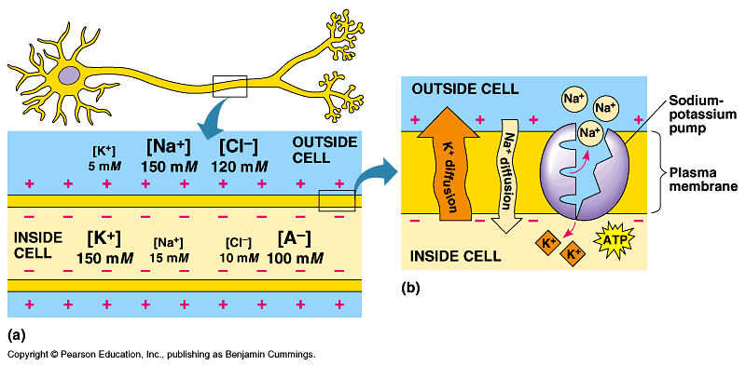

Slide 18
6.5.5 Explain how a nerve impulse passes along a non-myelinated neuron.
Stimulation –
– minimum amount needed for depolarization to occur
Causes
Disturbs adjacent areas –
Polarity across membrane is momentarily
K+ channels also open but more slowly allowing
Notes:
Include the movement of Na+ and K+ ions to create a resting potential and an action potential

Slide 19
Notes:
Include the movement of Na+ and K+ ions to create a resting potential and an action potential

Slide 20
Notes:
Include the movement of Na+ and K+ ions to create a resting potential and an action potential

Slide 21
6.5.5 Explain how a nerve impulse passes along a non-myelinated neuron.
Repolarization – after action potential passes, membrane begins to repolarize
Na+ channels
Open K+ channels
Impulse is actually a series of depolarization and repolarization waves sweeping down the axon (takes place in )
Then K+ channels close and
Notes:
Include the movement of Na+ and K+ ions to create a resting potential and an action potential

Slide 22
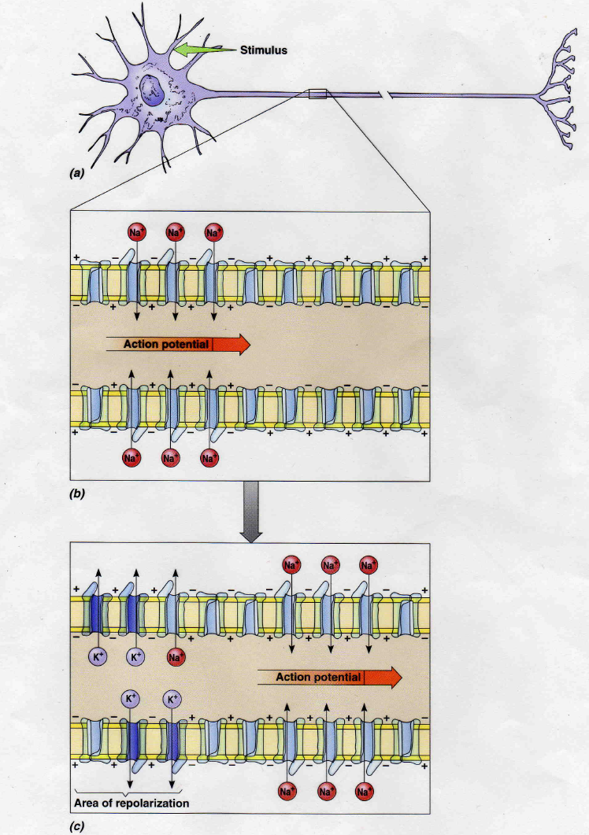

Slide 23
6.5.5 Explain how a nerve impulse passes along a non-myelinated neuron.
Impulse conduction video
Notes:
Include the movement of Na+ and K+ ions to create a resting potential and an action potential

Slide 24
Myelinated vs. Non-myelinated
Impulse conduction is
Here there is continuous conduction, the
Vertebrate neurons are
Depolarization occurs only at the – Action Potential “jumps” from one node to the next →
Diameter of axon affects speed of transmission
Notes:
Include the movement of Na+ and K+ ions to create a resting potential and an action potential

Slide 25
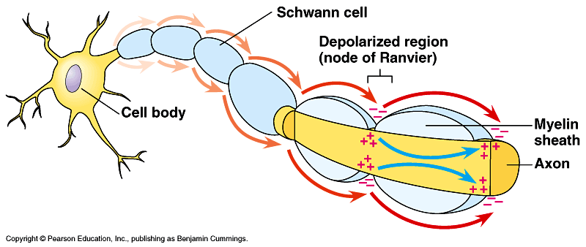
Notes:
Include the movement of Na+ and K+ ions to create a resting potential and an action potential

Slide 26
6.5.6 Explain the principles of synaptic transmission.
Synapse –
Synapse between neuron and muscle cell is called a
Notes:
Include the movement of Na+ and K+ ions to create a resting potential and an action potential

Slide 27
6.5.6 Explain the principles of synaptic transmission.
Neurotransmitters act as chemical messengers to conduct the signal across the synapse
contain neurotransmitter
When action potential reaches axon terminal, calcium ions begin to diffuse in →
and neurotransmitter diffuses across synapse
Notes:
Include the release, diffusion and binding of the neurotransmitter, initiation of an action potential in the post-synaptic membrane, and subsequent removal of the neurotransmitter.

Slide 28
6.5.6 Explain the principles of synaptic transmission.
Neurotransmitters (specific to the type of neurotransmitter) –
to free up receptor sites for next impulse and the (reuptake)
Notes:
Include the release, diffusion and binding of the neurotransmitter, initiation of an action potential in the post-synaptic membrane, and subsequent removal of the neurotransmitter.

Slide 29
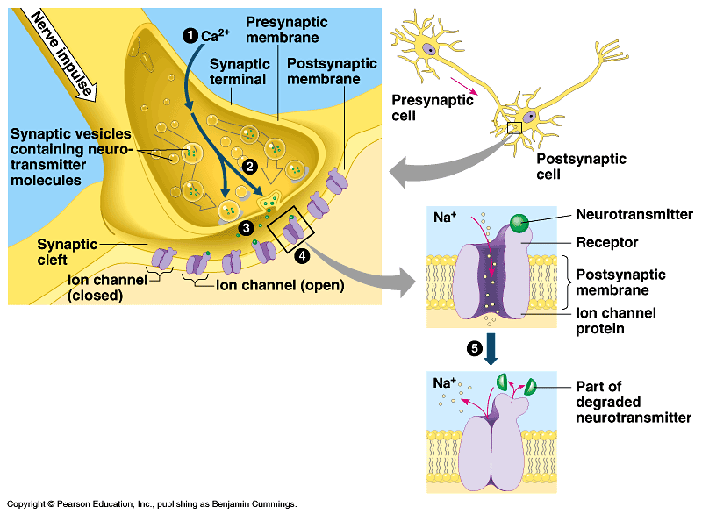
Notes:
Include the release, diffusion and binding of the neurotransmitter, initiation of an action potential in the post-synaptic membrane, and subsequent removal of the neurotransmitter.

Slide 30
E.4.1 State that some presynaptic neurons excite postsynaptic transmission and others inhibit postsynaptic transmission.
Neurotransmitters each have a different function:
Excitatory –
(stimulate muscle contraction)
(affect mood)
Inhibitory –
– inhibits neurons in brain and spinal cord; results in a calming effect; may be used to treat anxiety

Slide 31
E.4.2 Explain how decision-making in the CNS can result from the interaction between the activities of excitatory and inhibitory presynaptic neurons at synapses.
Excitatory Postsynaptic Potential (EPSP) – if a
Causes partial depolarization bringing neuron closer to firing
One EPSP is probably too week to trigger an action potential –

Slide 32
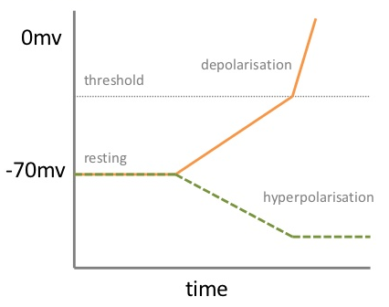
E.4.2 Explain how decision-making in the CNS can result from the interaction between the activities of excitatory and inhibitory presynaptic neurons at synapses.
Inhibitory Postsynaptic Potential (IPSP) – occur when neurotransmitter – brings membrane potential and a

Slide 33
E.4.2 Explain how decision-making in the CNS can result from the interaction between the activities of excitatory and inhibitory presynaptic neurons at synapses.
How are decisions made in the CNS?
Different areas of the brain carry out different functions
Impulses are received in the brain and integration takes place –
There is
There are different types of connection pathways between the neurons

Slide 34
Important “classical” neurotransmitters that have been recognized for many years:
Acetylcholine
Secreted at
Neurons that release acetylcholine are called cholinergic neurons
( )
May be

Slide 35
Noradrenaline (also called Norepinephrine)
Secreted by
Chemically very similar to the hormone adrenaline (also called epinephrine)
Prepares body

Slide 36
Dopamine
Secreted by
Thought to
May be involved in causing
in a specific brain region causes
Characterized by difficulty in initiating conscious movements, uncontrolled tremors, shuffling gait, and muscle weakness
Without dopamine,
The drug can be used by unharmed neurons in the brain to synthesize dopamine – reduces symptoms

Slide 37
Classifying synapses in the peripheral nervous system:
Cholinergic synapses use
Most synapses in the
are cholinergic
Adrenergic synapses use
Most synapses of
Central nervous system uses a much wider range of neurotransmitters

